Slide 1
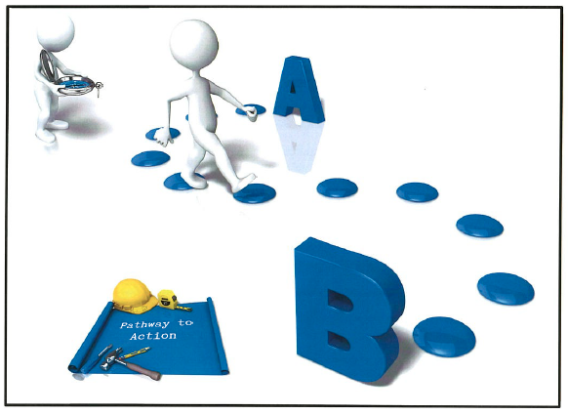
Design Pathways to Action
Principal Leadership Seminar
November 30, 2023

Slide 2
Facilitative leaders set their teams up for success by describing the “big picture” and providing a framework for planning and problem solving.
Where We are Now
How Do We Get From Here to There
Where We Want to Be

Slide 3
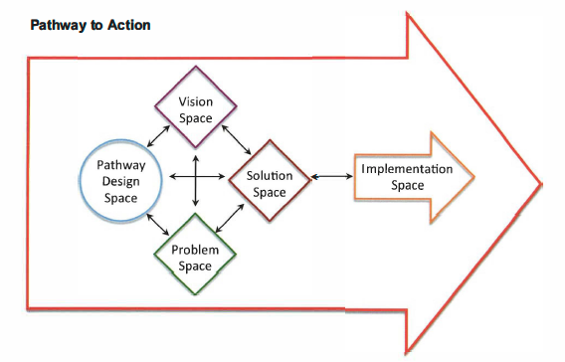
Designing a Pathway to Action
What it is: a planning tool to plan out work in a way that encourages collaboration and maximum appropriate involvement.
It is also: an assessment tool for determining at any time in a project or work session: (1) Where the team’s attention is currently focused, and (2) What the team should focus on next.
How it works: The pathway to action organizes the collaborative planning process into five stages or spaces. In each space team members reach specific understanding and agreement. With each new agreement, the team moves closer to its goals.

Slide 4
Pathway to Action Information Guide
Vision Space: Agreement on an image of the ideal future state
Solution Space: Agreement on a solution(s) that everyone is willing to support
Implementation Space: Agreement on an action plan for implementing the decision. Also includes carrying out the action plan.
Pathway Design Space: Agreement on the pathway and process for moving through the spaces
Problem Space: Agreement on what the problem is and why it exists

Slide 5
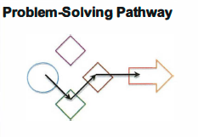
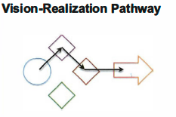
Sample Pathways

Slide 6
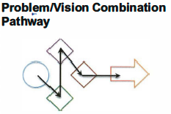
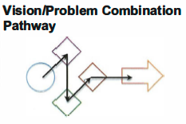
Sample Pathways

Slide 7
Exercise: Designing a Pathway to Action

Slide 8
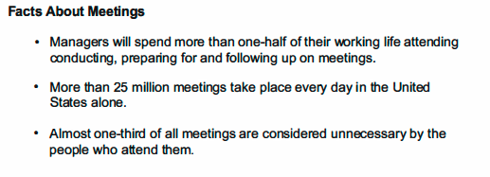
Bonus Slide: Meetings are Milestone Along the Pathway to Action

