Slide 1
MAP Growth
Proctor Slide Deck

Slide 2
Welcome Proctors!
These slides will help you:
create test day slides
anticipate and answer student questions
help students log in to the test
find solutions to common technical issues

Slide 3
How to use this deck
Review the full slide deck
Fill out the slide templates, and delete the slides you don’t need
Use these slides to guide your students on test days

Slide 4
Proctoring Resources

Slide 5
Proctoring Resources
Remote Testing Support
Help Center: Proctor Quick Start
Remote Testing—Explained and Demonstrated for Teacher and Student (covers session creation and student login)
Remote Testing: Common Challenges and Situations During Testing (troubleshooting advice)
Proctor Troubleshooting Guide

Slide 6
How should I prepare for testing?
Work through our Proctor Pre-Test Checklist to be sure you and your students are prepared on test day.

Slide 7
Where can I get help?
Contact our Partner Support team.
Search the Help Center.

Slide 8
Test Day Slides

Slide 9
Test introduction
Welcome students!
Today we are taking MAP Growth. This helps me know what you’re ready to learn next.
It’s OK and expected not to know all the answers. Some questions will be easy, and others more difficult.
Give this your best effort, and take your time.

Slide 10
How long is the test?
There are [#] questions.
The test will take about [#] minutes, but it’s OK if the test takes longer.
Proctor: Fill out slides based on Test Type.

Slide 11
Can I take breaks?
If you need a break, [directions here].
Proctor: Provide directions to students about what to do if they need a break; otherwise, delete this slide.

Slide 12
Can I use a calculator?
On some questions, a calculator will appear. Only use a calculator on the test if one is provided in the testing application.
Proctor: Delete this slide if students are taking the K–2 test, or are not taking the math test.

Slide 13
What if I don’t know the answer?
It’s OK and expected that you won’t know all the answers. Just try your best, and select your best guess.
Proctor: Adjust the directions based on your policies.

Slide 14
Can I change my answer to a previous question?
No, after clicking the arrow button, your answer is final, and you can’t go back to make changes.
Your test is always changing and updating based on how you answer each question. Each new question depends on how you answered the one before it. This is why you can’t go back.

Slide 15
How will I know when I’m done?
You will see a “Congratulations” message.
Let me know when you are done [or provide alternative directions].
Proctor: Adjust the directions based on your policies.

Slide 16
What else do I need during the test?
Scratch paper
Pen or pencil
Device charger
Headphones [if K–2 or using Text-to-Speech]
Proctor: Edit this slide based on your policies.

Slide 17
Should I keep [meeting or chat channel] open during testing?
Keep the communication channel open so that you can contact me if there are any issues [or provide alternative directions].
Proctor: Provide directions based on your preferences.

Slide 18
What should I do if I have a problem?
Let me know, and we will troubleshoot the problem together [or provide alternative directions].
Proctor: Provide directions based on your preferences.

Slide 19
Do I need my parent/caregiver during testing?
No, after you have logged in successfully, parents/caregivers won’t be needed.
Proctor: Provide directions based on your policies.

Slide 20
Student Login Steps

Slide 21
Student login
Open a browser
Go to test.mapnwea.org

Slide 22
Student login: if taking K–2 test on iPad
Open the testing app.
Proctor:
Students will need a second device in order to communicate with you during the test.

Slide 23
Now, students should enter:
Session Name: [enter here]
Session Password: [enter here]
Proctor:
The Session Name and Password are available on your Proctor console.

Slide 24
Complete login
Select your name.
If it’s correct, select “Yes.”
Then, I will confirm you to begin.
Proctor:
Once you select “Confirm,” the student will be able to start their test.

Slide 25
Common issues during login
“Oops! Where’s my test window?”
Workstation readiness check
Session login information is not working
Student needs to disable pop-up blocking
Directions by device
Screen resolution error
Chromebook: Ctrl+Shift+0, then refresh browser
Windows: Ctrl+0, then refresh browser
Make sure students are on test.mapnwea.org and not the practice test login

Slide 26
Good luck, you’ll do great! We will stop at [time].

Slide 27
Troubleshooting Tips

Slide 28
“Oops! Where’s my test window?” error
If a student sees this and not the login page, they likely need to disable pop-up blocking.
Directions by device.

Slide 29
Workstation Readiness Check error
Screen Resolution error:
Chromebooks: Ctrl+Shift+0, then refresh browser
Windows: Ctrl+0, then refresh browser
Other errors may require an update to the operating system or browser. See our System Requirements.

Slide 30
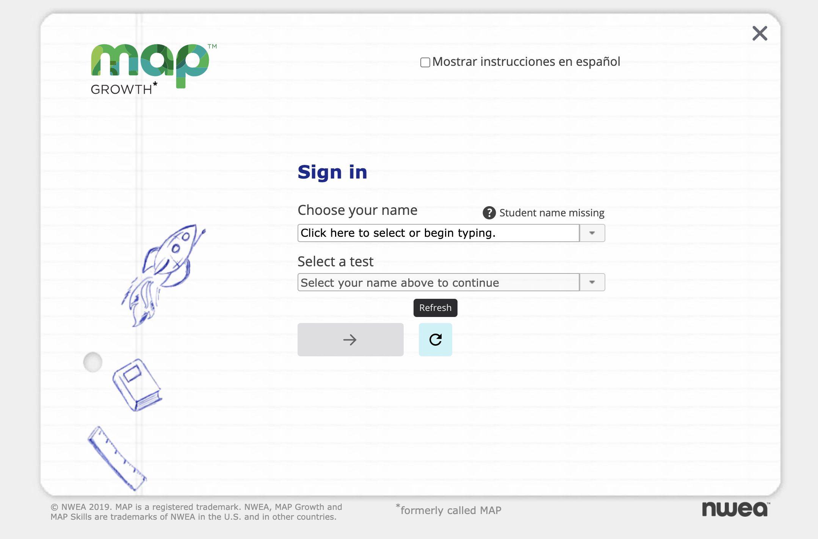
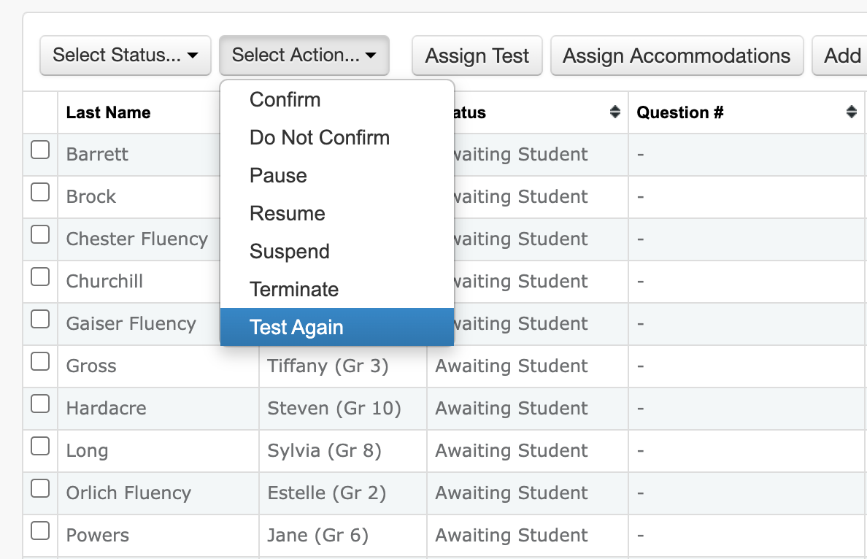
Student can’t find name when signing in
On the proctor console, find the student’s test status. Then follow the directions below to get them back into “Awaiting Student” status.
Suspended, Completed, or Terminated status:
Select student
Select Action: Test Again
Refresh the student’s screen
Paused or Testing status:
Select student
Select Action: Suspend
Select student
Select Action: Test Again
Refresh the student’s screen
Confirmed or To Be Confirmed status:
Select student
Select Action: Do Not Confirm
Refresh the student’s screen

Slide 31
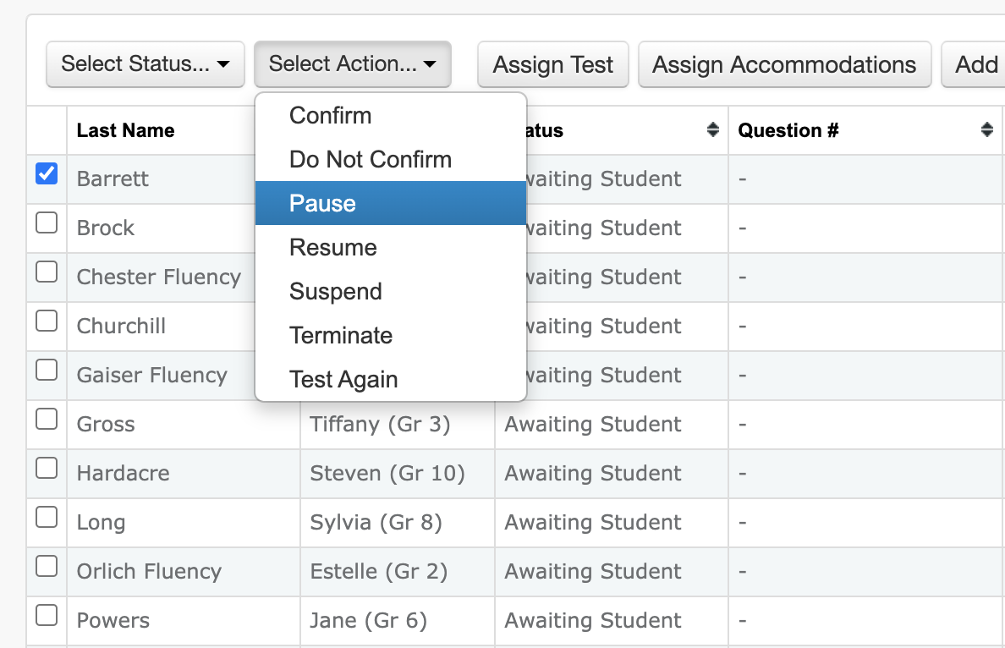
Glossary for “Select Action” dropdown
Confirm / Do Not Confirm
Confirms the student to start their test. Clicking “Do Not Confirm” will put students back at the login page.
Pause / Resume
Used for breaks up to 25 minutes. If resumed within 25 minutes, can resume without re-logging in. After 25 minutes, will need to log in again.
Suspend
Pauses the test and logs students out.
Terminate
Discards student progress on the test.
Test Again
Puts the student back into “Awaiting Student” status. Can be logged into same or different test.

Slide 32
How do I pause a student’s test?
Select the student.
Choose “Select Action: Pause”.
Proctor:
Students paused longer than 25 minutes will need to log back in to keep testing.

Slide 33
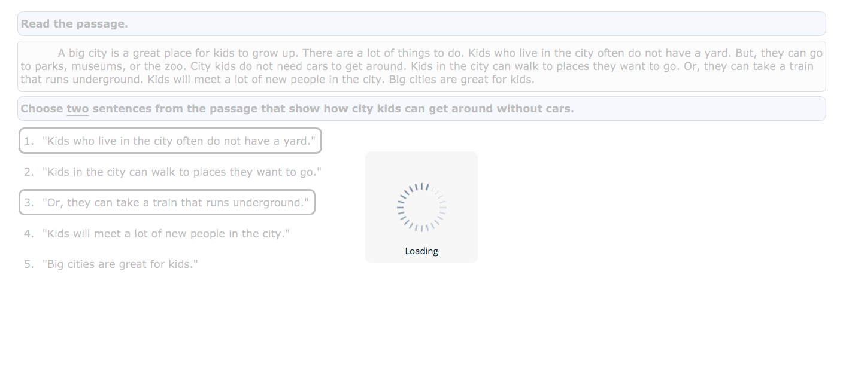
Test question isn’t appearing or is taking a while to load
On your proctor console, choose:
Student
Select Action: Suspend
Student
Select Action: Test Again
Restart testing browser on student device

Slide 34
What happens when I end the test session?
Students’ tests will be paused, and students will be logged out. Students can resume their tests from where they left off the next time you open the test session.
Before ending, “Download Session Progress” to retain a copy of the students’ testing progress.

