Slide 1
Images © Alamy www.alamy.com
Images used in PowerPoint presentation are part of the presentation and not to be used out of context of the presentation, may not be used as stand-alone images unless to promote the presentation/event, and may not be resold in singular form or as part of an image library. Images are © Alamy and presentation templates and content therein are © MISDA, any other usage requires written permission from both parties.

Slide 2
Scripture quotations used in Balanced Living PowerPoints are taken from Bibles in the Public Domain which have no USA copyright restrictions. We have indicated which version each quotation is taken from as follows:
KJV - King James Version
BBE - Bible in Basic English
WEB - World English Bible
DBY - Darby's Translation
Any scriptures not otherwise noted are the author's paraphrase of one of these versions.

Slide 3
Notes:
Presenter: Please read and study the tract that accompanies this PowerPoint to prepare for this presentation.
Out topic today is how to: Read slide.
The dictionary defines mindset as “the established set of attitudes held by a person.”
Your mindset is a particular way of thinking that affects your outlook in life.

Slide 4
Notes:
Read slide.
Have you ever heard a parent tell their teenager they need an “attitude adjustment”?
I think we have all felt that need at one time or another.
Our basic outlook in life can take us to new levels of happiness, success, and well-being or trap us in a pit of discouragement, defeat, and discontent.
Life anything else, attitudes can become habits—so maybe we all could use an attitude adjustment for a better life!

Slide 5
Notes:
Read slide.
Foods rich in plant nutrition such as vegetables, fruits, beans, whole grains; daily exercise, rest, and trust in God—these are just a few of the important tools for improving thinking, mood, attitude, and behavior.
Have you experienced some of these lifestyle benefits on mental health and mood? (Wait for response)

Slide 6
Notes:
Read slide.
The mindset we carry influences our thoughts, words, actions—and health—both physical and mental.
It has been said that as the mind thinks, the mouth speaks, and the man moves!

Slide 7
Notes:
Dr. John Ratey, a psychiatrist and author from Harvard University says this: Read slide.

Slide 8
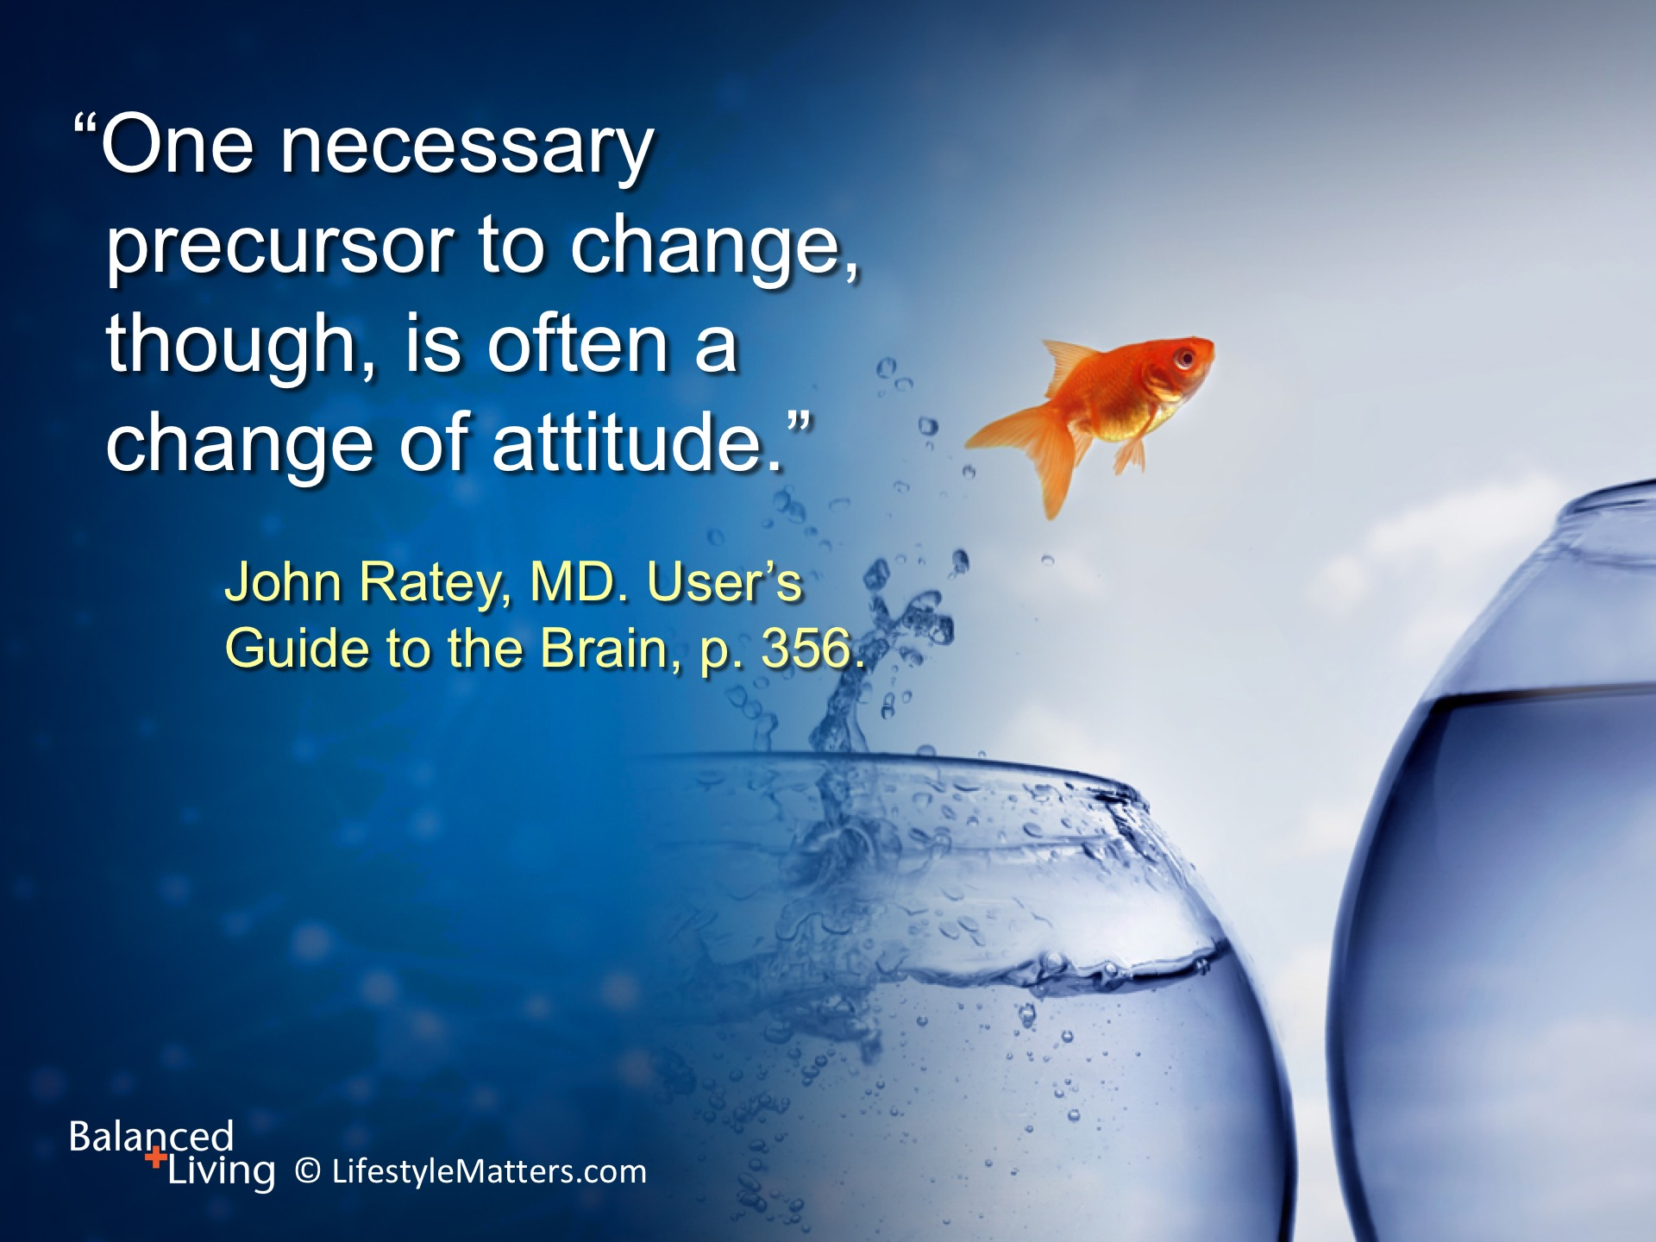
Notes:
Read slide.
Mindset affects our thoughts; the thoughts we choose affect our mindset; and both affect our health!
Notice this famous quote from the book Ministry of Healing:
“The relation that exists between the mind and the body is very intimate. The condition of the mind affects the health to a far greater degree than many realize…Grief, anxiety, discontent, remorse, guilt, distrust, all tend to break down the life forces and to invite decay and death...
“Courage, hope, faith, sympathy, love, promote health and [tend to] prolong life.” p. 241.
Even mental depression can be increased or reduced by our mindset or thoughts.

Slide 9
Notes:
Read slide.
Have you noticed that when you purchase a new car, all of a sudden you see the same make and model wherever you go?
We notice what occupies our thoughts. This is known as “selection bias.”
Selection bias also occurs in our thinking. Notice this quote from Ellen White in 1859:
When a person “dwells too much upon the rough pathway [in life], he makes it much harder than it really is. If he dwells upon the bright spots in the way and is grateful for every ray of light…instead of gloom, mourning, and complaints, he will bear a cheerful countenance” and God will bless him with “gladness of heart.” Review and Herald, 1859.

Slide 10
Notes:
Read slide.
Carol Dweck is a social scientist and the author of a book entitled Mindset.
In her research she identifies and discusses two mindsets which she terms “fixed” or “growth”.
The “fixed” or “growth” mindset manifests in all ages and all life settings such as work, school, and relationships.

Slide 11
Notes:
Read slide.
Fixed mindsets believe that if they have to “work” at improving it means they are lacking in basic intelligence or ability.
For the fixed mindset, every situation calls for a confirmation of their intelligence, personality, or character.
Every situation is evaluated: Will I succeed or fail? Will I look smart or dumb? Will I be accepted or rejected? Will I feel like a winner or a loser?

Slide 12
Notes:
Read slide.
The fixed mindset has no strategy for growth—no recipe for healing; mistakes and flaws are too threatening to acknowledge.
The first failure in a diet; the first bad grade on a test; the first argument in a marriage spells disaster.
After all, if it was “meant to be”, it would be easy!

Slide 13
Notes:
Sociologist Benjamin Barber, quoted in Mindset, said: Read slide.

Slide 14
Notes:
Read slide.
Are you a learner or a non-learner? A learner outlook is another way of describing the “growth” mindset.
Can you identify some “fixed” mindset thinking in some areas of your life?
Here are some other clues:
Fixed mindsets avoid challenges and tend to give up easily when confronted with problems.
They tend to ignore criticism and find other people’s success threatening.
They tend to be negative, anxious, and unforgiving of themselves and others when mistakes are made.
The first task for a fixed mindset is to accept the great news that attitude is more important to success than aptitude…and that we can all learn and change!
Do you believe you can learn and change?

Slide 15
Notes:
Read slide.
A growth mindset is concerned with improving. The fixed mindset is concerned with being judged.
Do you want to have a growth mindset?
Do you want to continually be improving and enjoy the journey?

Slide 16
Notes:
Read slide.
Children with this mindset chose hard puzzles. They liked the challenge and were not so concerned with failure.
A growth mindset allows you to thrive during challenging times in your life.
It allows you to learn in school, relationships, work, and personal growth.
“Learner” individuals have a “growth” outlook instead of a “prove myself” orientation to life.

Slide 17
Notes:
Read slide.

Slide 18
Notes:
Read slide.

Slide 19
Notes:
Read slide.
Growth mindsets tend to be more positive. They focus on solutions rather than problems.
They are more trusting, resilient in hard times, and are more forgiving of themselves and others when mistakes occur.
These traits carry people through hard times.

Slide 20
Notes:
Would you like to transition from a “fixed” mindset to a “growth” orientation to life? Read slide.
No one needs to stay “stuck” in a fixed, fragile, fatalistic way of thinking.

Slide 21
Notes:
Dr. John Ratey states: Read slide.
Learning is a big part of what makes life interesting.
God designed human beings with a marvelous capacity to learn, grow, and improve in every area of life—including the inner life of the mind.
With His help you can control your thoughts, emotions, and mood.
You can learn to persist in challenging areas of your life.

Slide 22
Notes:
Awareness is a great beginning. Here are a few key helps: Read slide.
We all can find areas where our thinking can be improved.
In the beginning, it was not so: “Man was originally endowed with a noble character and a well-balanced mind.” Steps to Christ, p. 17.
Over time, heredity, circumstances, and evil angels have worked to defeat and discourage us in every way possible.
But Christ our Redeemer came and died on the cross to restore all that sin has broken and taken away!

Slide 23
Notes:
Receiving Christ means receiving a new life, new outlook, and new purpose in life! Read slide.
The helpless become hopeful; the brokenhearted are healed; new motives inspire the heart.
This is a powerful, life-changing step of faith!
You can make this decision right now – to receive Christ as Lord and Savior—to become a “new creation” – to think new thoughts – to have new motives – to live free.
If you haven’t taken this step, will you consider it now?

Slide 24
Notes:
The promise is: Read slide.
Now the learning begins! No more “stuck in a rut” of negativity and failure! You can live free and full of hope!
God will plant deep within you a willingness and desire to improve the way you think, speak, and live.
This will increase your joy, peace, and strength. You become a child of God and a witness to His restoring power.
Do you choose to become a learner and allow God to work His healing plan in your life?

Slide 25
Notes:
Read slide.
God embodies all that is good, powerful, and right. He says His Word is “living”. It is the life-giving Seed of His own character that takes root in the heart, mind, and affections.
God says His thoughts are not our thoughts, and His ways are not our ways. They are higher than the heavens are to the earth—and so is His plan for you. Isaiah 55:8-9.
Spending daily time with God in His Word, conversing with Him in prayer, and meditating on what He says “re-seeds” our thoughts, words, and actions over time—and all for the better!
“By beholding we become changed.” We learn truth and learn to separate truth from faulty thinking.
You learn to ask yourself, “Is what I am thinking according to what God says?”
As you learn God’s Word, you are able think in a more truthful way.

Slide 26
Notes:
Our words have a powerful effect on our own thoughts, mood, and emotions, as well as on others. Read slide.
As you learn God’s words, you will speak them more often and more naturally.
Words have power. The Bible compares the tongue to a tiny bit in a horse’s mouth that controls and guides a 2,000 pound animal.
It compares the tongue to a small rudder that can steer a huge ship through stormy seas. James 3:3-4.
Our words influence our whole nature, character, and how successfully we navigate through life’s stormy trials.
“No man can tame the tongue.” James 3: 8. But thankfully God’s power in you can tame the tongue!

Slide 27
Notes:
What we choose to dwell on and talk about habitually affects physical and mental health. Read slide.
That doesn’t mean we don’t have problems to deal with, think about, and discuss. We need to talk about life and interact with others during good times and bad!
But even the way we talk about our problems can help or hurt us and others.
For instance, I can get up in the morning and say: “I dread this day—I can’t see anything good that will come of it!” (speaking just from feelings)
Or, I can say: “God, Thank you this day of life. Thank you that you will give me the strength and wisdom to meet the challenges that I face today.” (recognizing feelings but choosing to speak God’s truth)

Slide 28
Notes:
Words are powerful! Read slide.
Have you ever heard someone say, “You are going to eat your words!”
It is true. What we say and how we say it affects others, but it also reacts upon ourselves.
When we understand the power of words to hurt or heal, our lives can be transformed.

Slide 29
Notes:
Read slide.
The mouth repeats what the mind thinks. We can choose our thoughts.
Our words influence our thoughts in a powerful way! We can choose our words.
Even in a world of trouble, we can have thoughts of gladness – of thankfulness.
A thankful heart – or thankful mindset heart affects how we think and speak.

Slide 30
Notes:
Read slide.
You may have a dark past but you can have a bright future. It all depends on attitude.
Real change begins when we face the truth and refuse to make excuses for wrong behavior.
Self-pity and bitterness are the enemies of peace, joy, and progress.
Forgiveness is the gift of God to free us from the bondage of our guilty past and the sins others have committed against us.

Slide 31
Notes:
Read slide.
Self-pity and bitterness are the enemies of peace, joy, and progress.
Forgiveness is the gift of God to free us from the bondage of our guilty past and the sins others have committed against us.
Recognizing and changing thinking habits is a learned process.
Thinking habits change over time.
Ask yourself, is God’s truth? If not, change your thoughts and words to match His!

Slide 32
Notes:
Read slide.
God wants to do a “new thing in you—He wants you to have joy and strength, even when you are facing trials and tunneling through trouble.
The Scriptures tell us: “In everything give thanks: for this is the will of God in Christ Jesus concerning you.” 1 Thessalonians 5:18.
“This command is an assurance that even the things which appear to be against us will work for our good. God would not bid us be thankful for that which would do us harm.” Ministry of Healing, p. 255.
God can bring blessings out of bad things. Strength, power, and compassion are often born in adversity. This is real cause for joy.

Slide 33
Notes:
Read slide.

Slide 34
Notes:
Read slide.
It takes time, practice, and God’s Word planted deep within to tame and train our thoughts and words and mindset.
Day by day you will become happier, stronger, and bring glory to God. It is His plan to renew you in His own image.
Never give up!

Slide 35
Notes:
Read slide.
This is a promise of hope. God will give you rest.
Is your heart aching under a load of care? Have you been searching for peace and power in the wrong places?
Have you tried to change for the better and failed time and time again?
Worry is blind and cannot see the future—but God sees and knows everything about you: your circumstances, where you have been, and where you are headed. He wants to guide you, comfort you, and teach you His ways.

Slide 36
Notes:
Read slide.
What a wonderful invitation!
Christ has made every provision. He died to set you free and fill you with a new heart and a new mindset of hope, perseverance, and victory.
He is the best teacher! Would you like to ask Him for this gift? (Raise your hand to help others raise theirs.)
Christ will renew you and help you grow and change.

