Slide 1
Images © Alamy www.alamy.com
®
Images used in PowerPoint presentation are part of the presentation and not to be used out of context of the presentation, may not be used as stand-alone images unless to promote the presentation/event, and may not be resold in singular form or as part of an image library. Images are © Alamy and presentation templates and content therein are © MISDA, any other usage requires written permission from both parties.

Slide 2
Scripture quotations used in Balanced Living PowerPoints are taken from Bibles in the Public Domain which have no USA copyright restrictions. We have indicated which version each quotation is taken from as follows:
KJV - King James Version
BBE - Bible in Basic English
WEB - World English Bible
DBY - Darby's Translation
Any scriptures not otherwise noted are the author's paraphrase of one of these versions.

Slide 3
Notes:
Read slide.
These brains of ours…can they change, adapt, and improve all through life?
In this session we are going to see how your brain is designed for renewal, restoration, and repair.

Slide 4
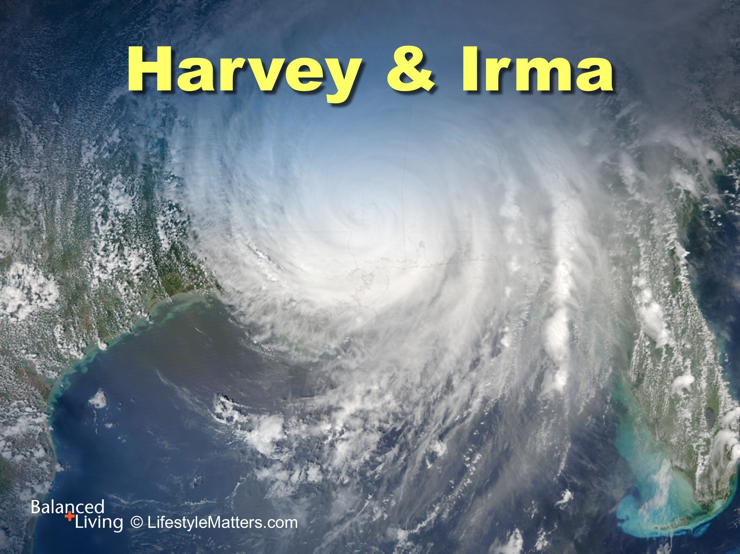
Notes:
Harvey and Irma are a lovely couple who have been married for 75 years.
Harvey and Irma are also two Super Hurricanes we vividly remember, decimating two different parts of the country in September 2017.
Harvey pounded Texas with such violence that it put 2/3 of Houston under water, inflicting so much damage that it could go down in history as one of the costliest natural disasters in America.
Irma followed shortly after, bashing the Caribbean Islands, Florida, and surrounding islands.

Slide 5
Notes:
Read slide.
Such a city has lost its synchrony and vitality.
Its broken communication and transportation systems shut down the city’s normal operations .
With weakened defenses, the city is especially vulnerable to vandalism and violence—it is now in survival mode!

Slide 6
Notes:
God often uses the things we can see to help us understand the things we cannot see.
Notice this vivid comparison of just such a city with mankind in his broken condition:
Read slide.

Slide 7
Notes:
Read slide.
Your brain is capable of physical, mental, and emotional improvement and spiritual renewal.
The great news is that you can move forward and continue forward—whether your brain has been hit by a storm of stress, depression, negativity or bad habits.

Slide 8
Notes:
Notice this statement by Dr. John Ratey, a psychiatrist and author from Harvard University in his book, “User’s Guide to the Brain”:
Read slide.

Slide 9
Notes:
How do you heal a broken brain?
There are at least five key areas to building a better brain, better thinking, better habits, and a better life!
Read slide (Each is briefly summarized on the next slides).

Slide 10
Notes:
Assessment:
Work closely with your physician or healthcare provider.
Lifestyle changes may reduce or eliminate the need for certain medications over time.
3. Use medicine or medical procedures when needed.

Slide 11
Notes:
Lifestyle: Lifestyle choices, nutrition, exercise and sleep, are very powerful for restoring the brain.
Lifestyle choices are the foundation of mental, physical, and spiritual strength.

Slide 12
Notes:
A healthy lifestyle has many components that minister to your mind, body, and spirit.
Read slide.

Slide 13
Notes:
Read slide
Lifestyle choices matter, especially ones that we repeat every day.
Can you think of some other lifestyle factors that might affect the brain-body system? (wait for response)

Slide 14
Notes:
Environment: The internal environment of how you think and the external environment you surround yourself with are critical for achieving and maintaining positive change.

Slide 15
Notes:
Managing Stress: We all need practical strategies to tap into when confronting challenges and stress.

Slide 16
Notes:
God has provided a lifestyle plan that promotes peace.
Lifestyle is one of the major factors determining brain as well as body health.
Read slide.

Slide 17
Notes:
Connections: Your associations and interests have a profound shaping effect on your values and goals.
Knowing that God’s power and guidance are available gives courage and power for the journey.
Social connections provide an opportunity to check in with each other, exchange ideas, and perhaps lend a supportive ear or shoulder.

Slide 18
Notes:
Read slide.
A close relationship with God is not only linked to a healthier immune system with lower blood pressure, inflammation, cholesterol and fasting blood sugar.
A close relationship with God also shows a reduced risk for depression and addictions.

Slide 19
Notes:
Read slide.
“God created man in His own image.” Genesis 1:27
He gave you the intellect to reason about your existence; the capacity to know him; the ability to experience His love and share it with others.

Slide 20
Notes:
Read slide.
Your brain changes with your thoughts and emotions.
Knowing that you are created by God and that God is personally watching over you, helps heal a broken brain.

Slide 21
Notes:
Read slide.
We have been given powerful tools, mental, physical, social, and spiritual, for healing the broken brain.
Would you like to experience these wonderful changes in your life?
If this is your desire and commitment, raise your hand with me—and bring a friend to the next sessions!

