Slide 1
Facilitative Leadership
Module #3: Seek Maximum appropriate involvement

Slide 2




Review Previous Session

Slide 3
Reflect and Share with a partner

Slide 4
Ellen White on Leadership
The Lord saw the danger that would result from one man’s mind and judgment controlling decisions and working out plans, and in His Inspired Word we are commanded to be subject one to another and to esteem others better than ourselves. When plans are to be laid that will affect the cause of God, they should be brought before a council composed of chosen men of experience; for harmony of effort is essential in all these enterprises.” Testimonies for the Church 5:418

Slide 5
Thesis Statement

Slide 7
Resolving the Leader’s Dilemma
Begin By:
Defining which decisions need to be made
Who should participate in making those decisions.

Slide 8
From whom is it appropriate to seek involvement?

Slide 10
Exercise: Coaching Pairs

Slide 11
Decide and Announce

Slide 12
Gather Input from Individuals and Decide

Slide 13
Gather Input from Team and Decide

Slide 14
Consensus

Slide 15
Delegate Decision with Constraints

Slide 16
Connect, Reflect and Summarize

Slide 17
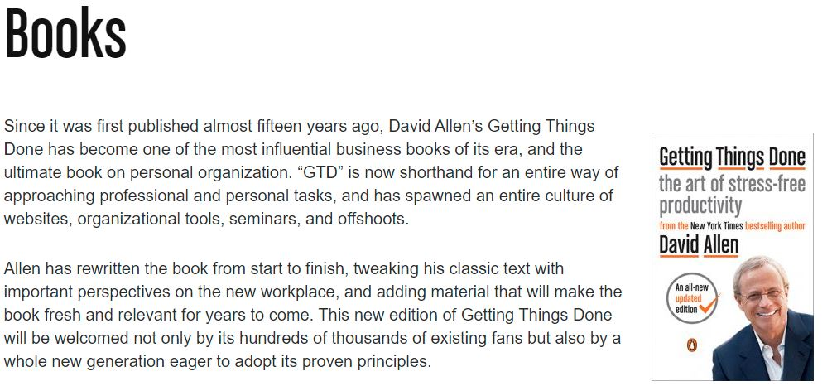
Bonus Slide Book Review

