Slide 1
Meetings: Design and Implementation
Leadership Initiative Training for Educators

Slide 2
Definition: A meeting is . . .
Any time tow or more people work together to:
Give/gather information
Take action (planning, problem-solving, decision-making)

Slide 3
Facts About Meetings
Managers will spend more than half of their working life attending, conducting, preparing for and following up on meetings.
More than 25 million meetings take place every day in the United States alone
Almost one-third of all meetings are considered unnecessary by the people who attend them.

Slide 4
Purpose of the Meeting
Why Meet?

Slide 5
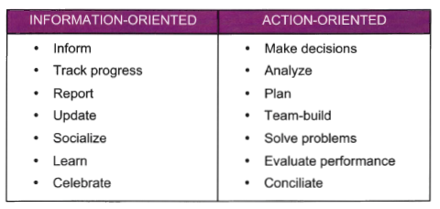
People meet for many reasons:

Slide 6
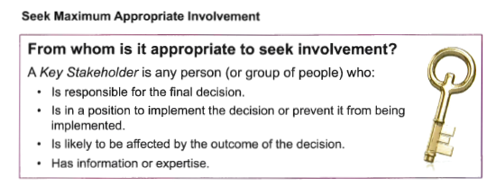
Stakeholder Analysis

Slide 7
The Impact of Planning on the Success of Meetings
Rule of Thumb:
You should spend as much time planning for a meeting as you spend in the meeting

Slide 8
Key Elements for Planning Your Meeting
Desired Outcomes
Decision-making Process
Time
Identify Roles

Slide 9
Desired Outcome Statements
A desired outcome is what your meeting aims to achieve, the expected result. A desired outcome statement answers the question, “What will we know, understand or be able to do by the end of this meeting?”

Slide 10
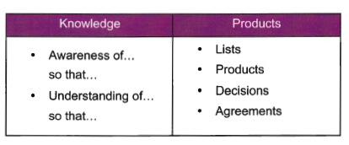
Two Kinds of Outcomes

Slide 11
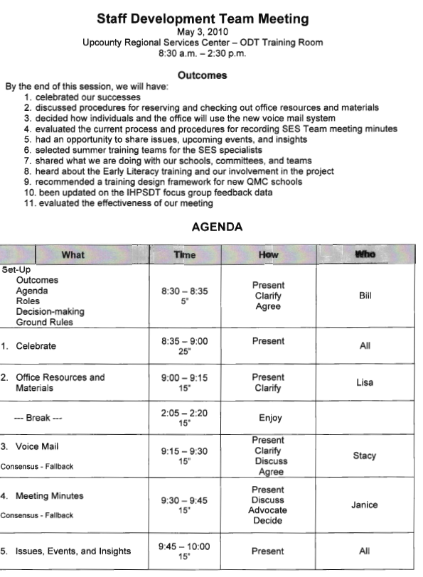
Sample Agendas

Slide 12
Comments or Questions
This Photo by Unknown Author is licensed under CC BY-NC

