Slide 1
REPORT FROM AREA A
3/31/2024 D. Murdock
Notes:
REPORT FROM AREA “A” by D. Murdock, 03-31-2024

Slide 2
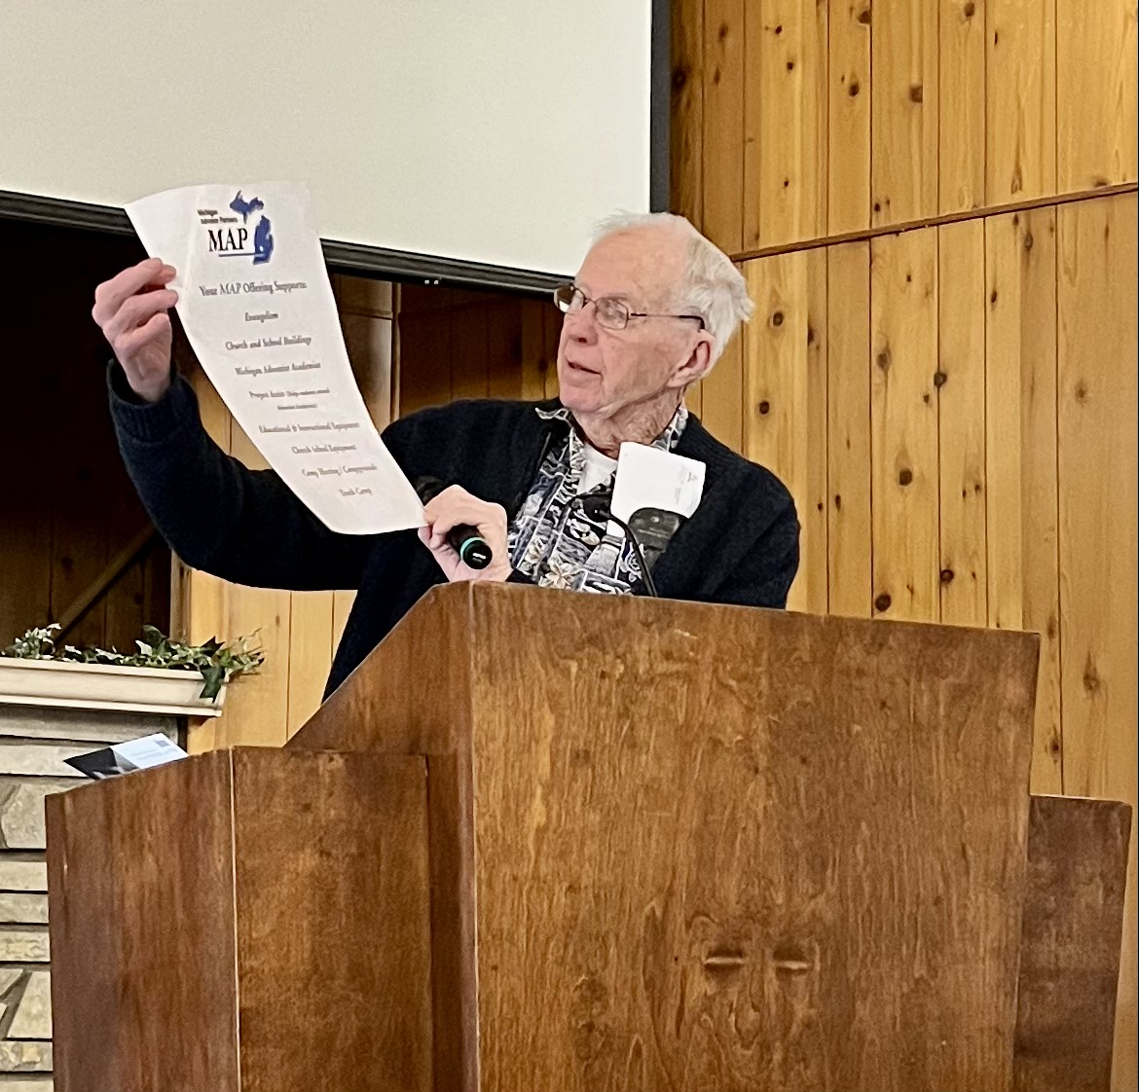
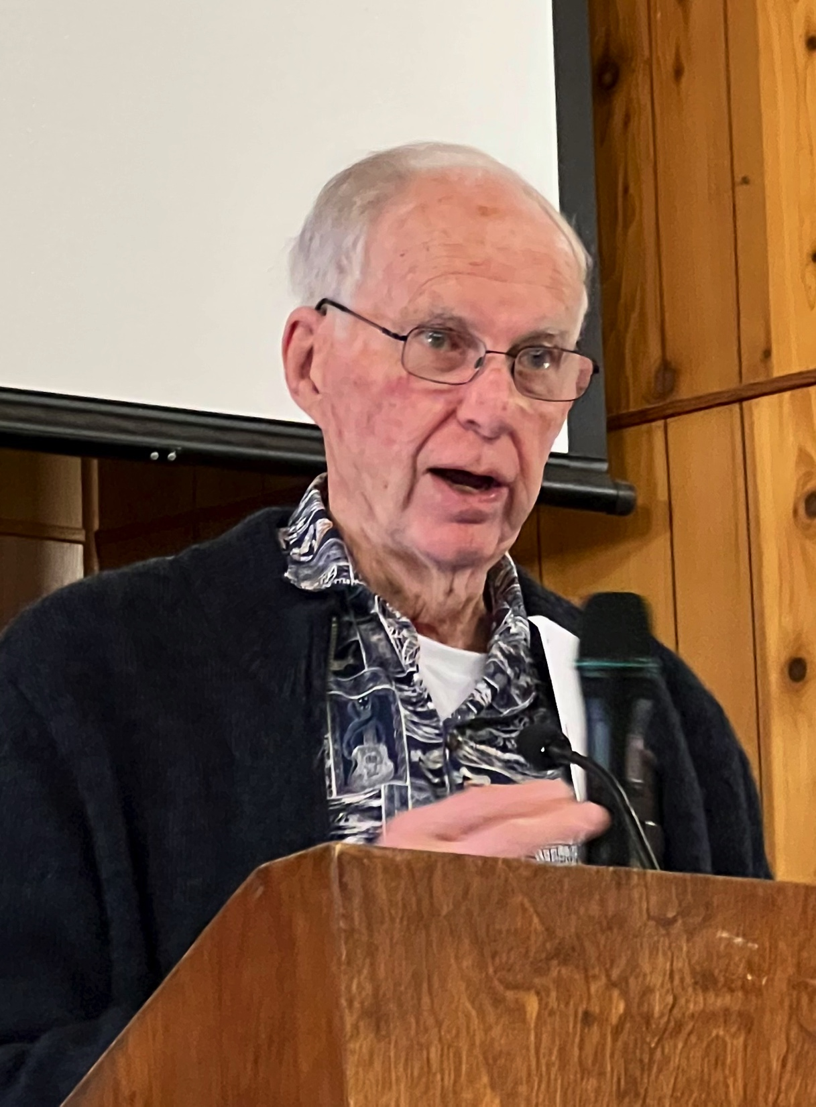
AT KALKASKA SDA CHURCH
2023
January 14
Richard Muskett
USE OF MAP GRANT FUNDS
Notes:
Richard Muskett presented Kalkaska Church with the MAP Grant.

Slide 3
FELLOWSHIP HALL HEATING SYSTEM
OLD FURNACE GAVE OUT
Notes:
The old furnace in the fellowship hall failed in December 2022, leaving them with no heat to keep pipes from freezing, or heat the area for the Youth Sabbath School class or their 2 monthly fellowship meals.

Slide 4
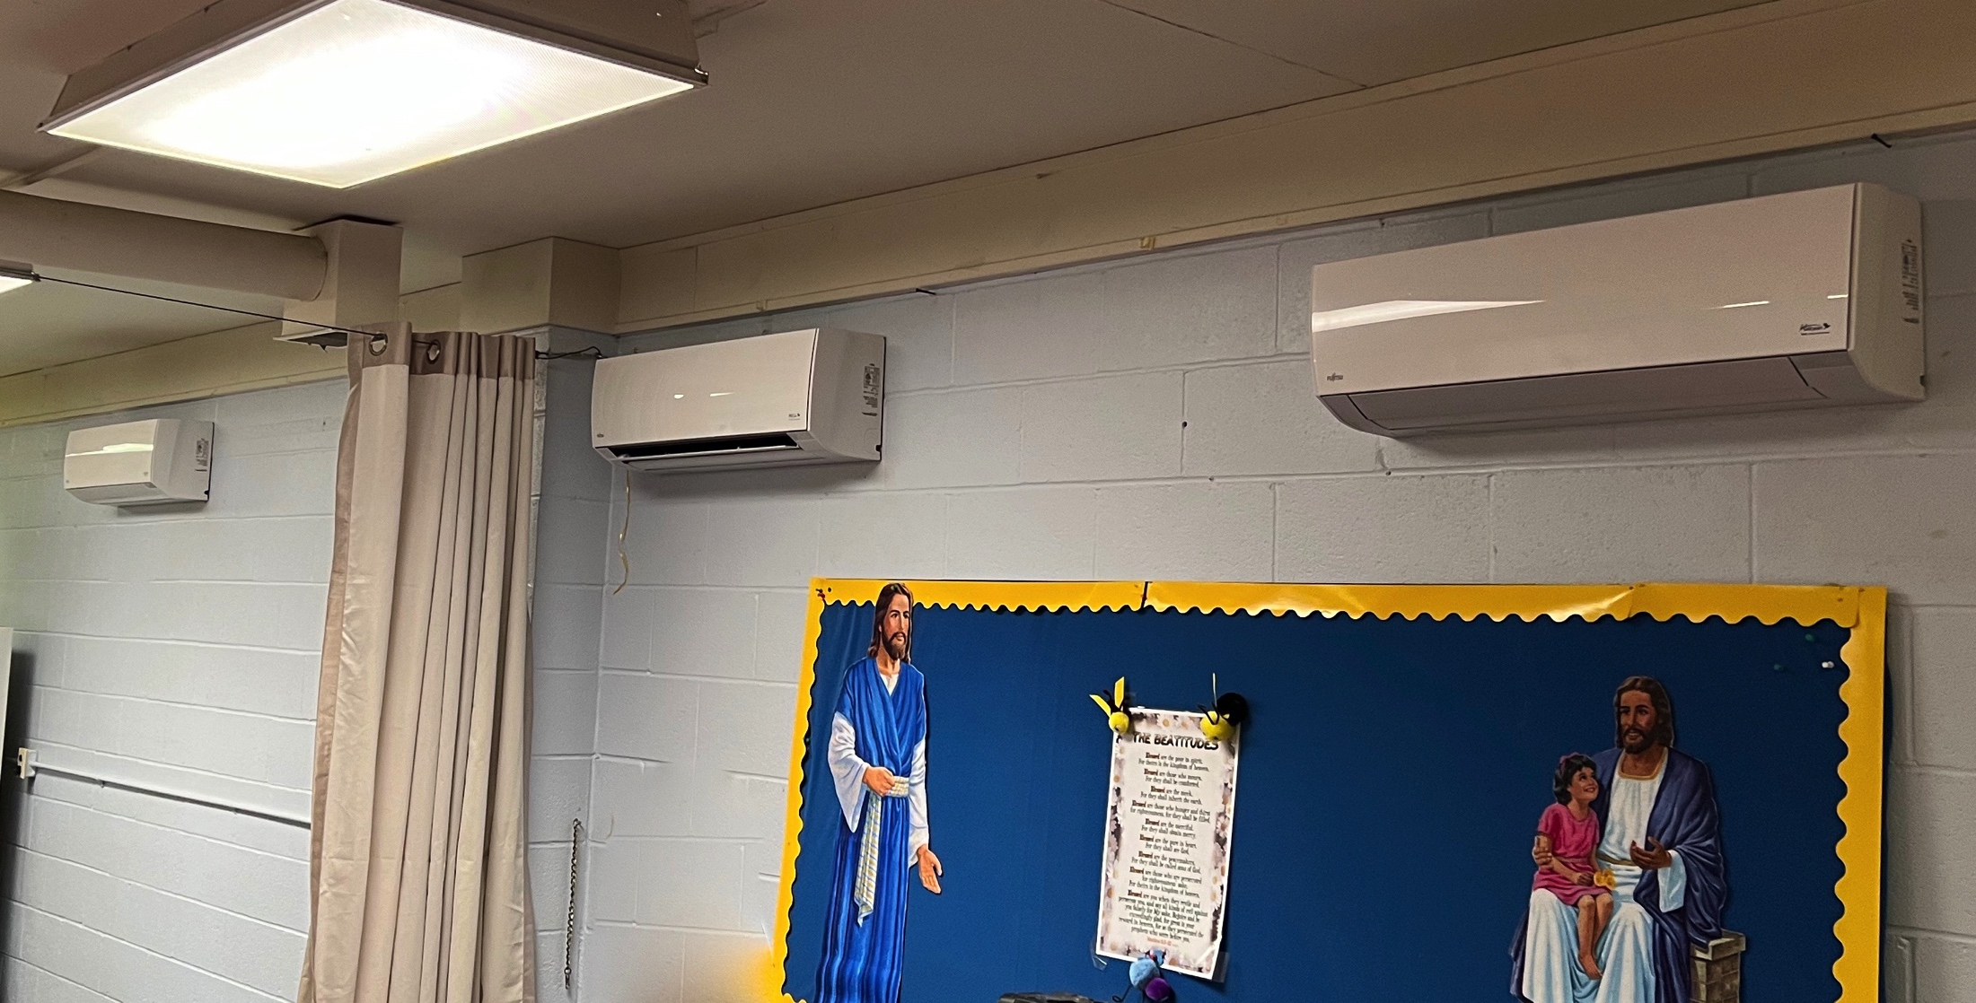
FELLOWSHIP HALL HEATING SYSTEM
NEW SYSTEM INSTALLED
Notes:
Their new, highly efficient heating system was installed early in February, thanks to MAP assistance.

Slide 5
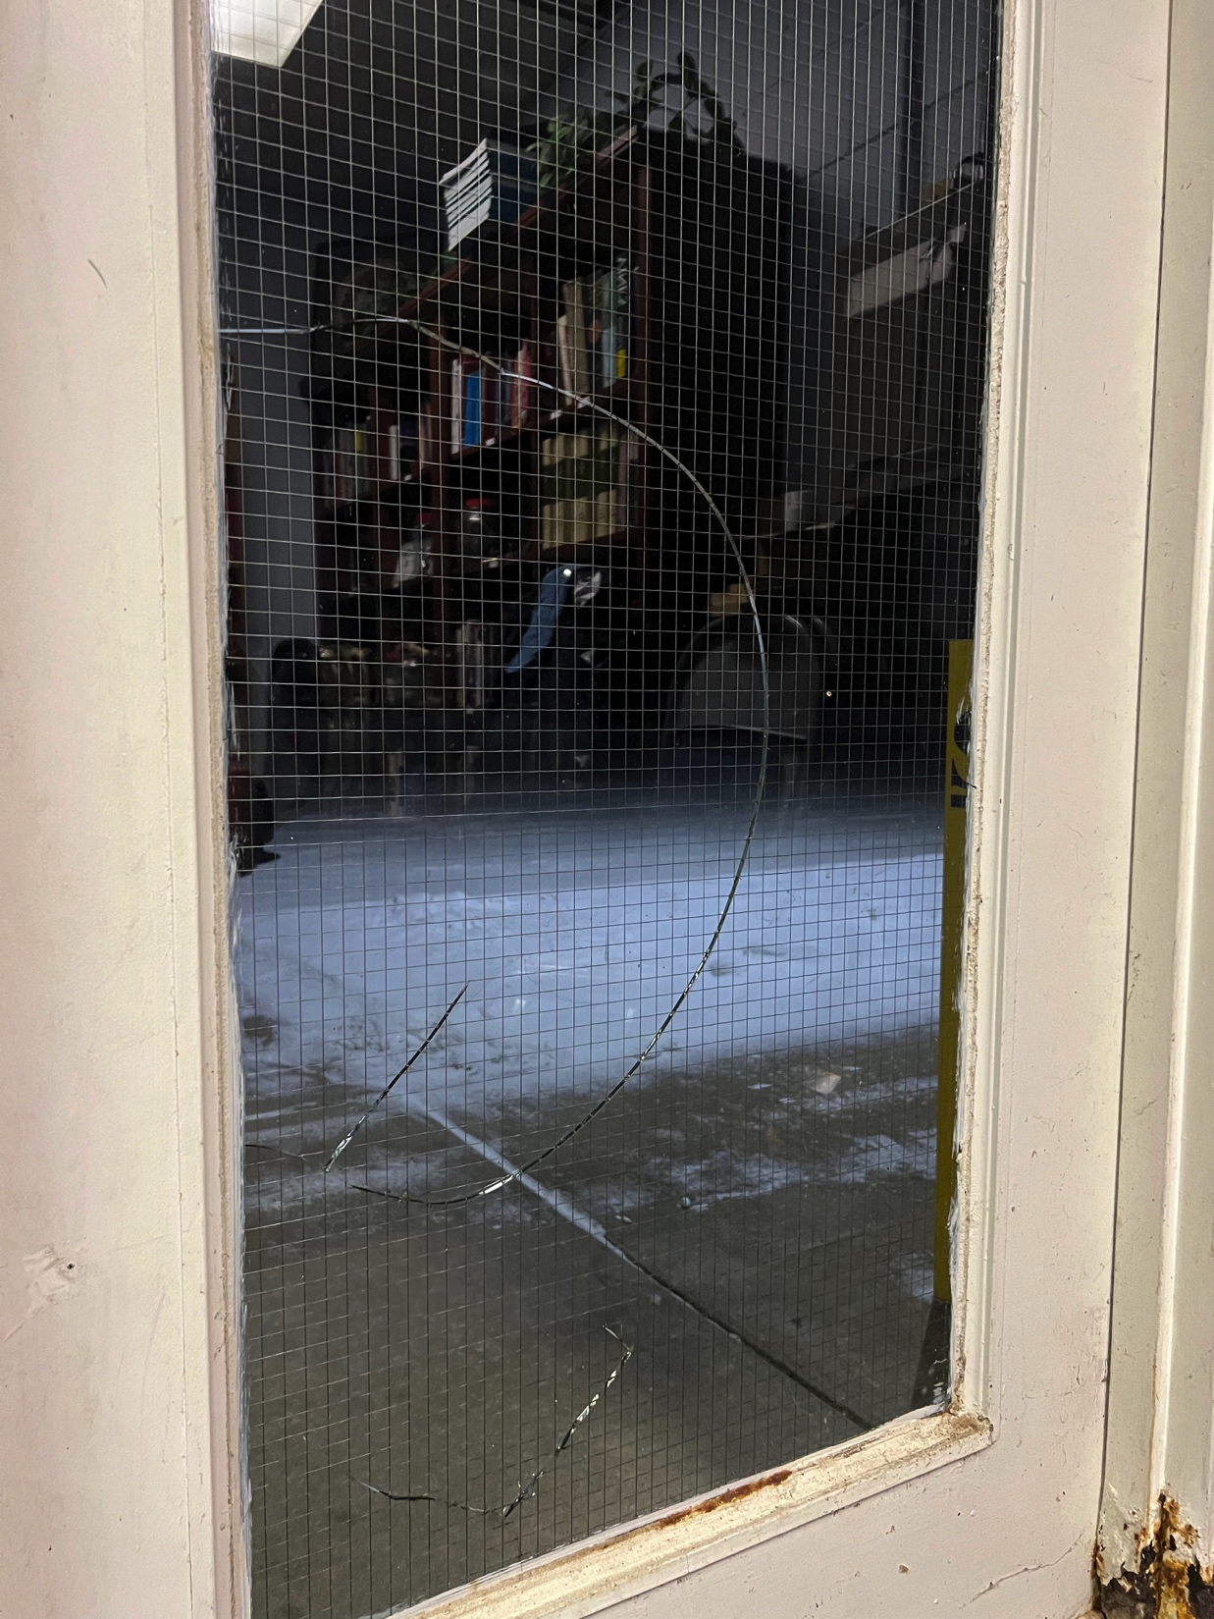
FELLOWSHIP HALL DOORS REPAIRED & PAINTED
BROKEN GLASS
RUSTY METAL
RUSTY METAL
AFTER REPAIRS & RESTORATION
Notes:
This encouraged the members to take a closer look at the building as “community friends” eyes would see things as they came to events held there. What would their FIRST IMPRESSION be?
One of the doors glass was broken
The metal was rusted and breaking
After considerable amounts of elbow grease, metal replacement, and paint, the doors almost looked like new.

Slide 6
CHURCH ELECTRIC UPGRADED
DIG THE TRENCH
LAY THE LINES
Notes:
When the church was built 50 years ago, a 100 AMP service was all that was needed. In 2023, it was being used at full capacity. To add new audio visual equipment, they needed 200 AMP service. With MAP funds in hand...(next)

Slide 7
CHURCH ELECTRIC UPGRADED
PREP FOR NEW METER
NEW METER CONNECTED
Notes:
…the UP-GRADE process began.

Slide 8
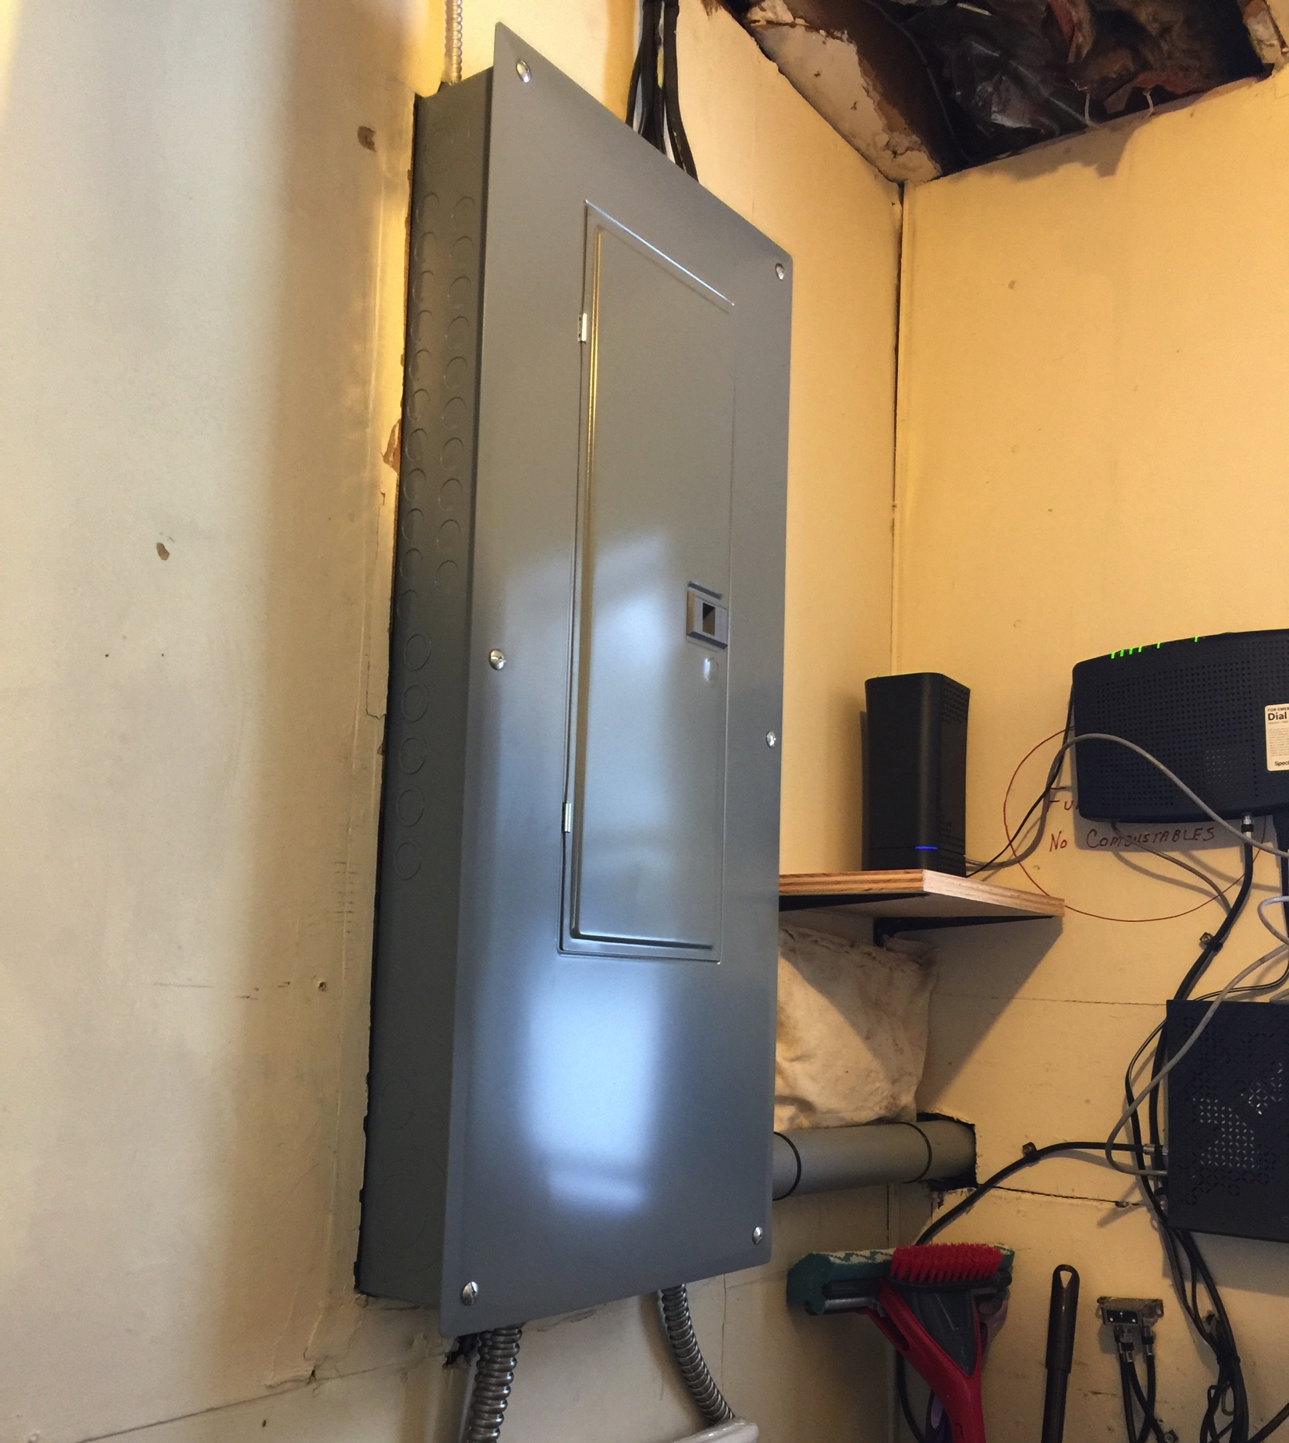
CHURCH ELECTRIC UPGRADED
NEW 200 AMP PANNEL INSTALLED
NEW WIRING RUN
Notes:
and the UP-GRADE process continued with the new box
so the rewiring could begin.

Slide 9
CHURCH ELECTRIC UPGRADED
OUT WITH THE OLD -- -- IN WITH THE NEW
Notes:
Where did you say this wire went?
Do you know what it’s for?
Now the NEW components are in place with LABLES !
AND all wires bundled and in their places. (smile)

Slide 10
NEW LAZER PROJECTOR
MOVED MOUNT FORWARD
ADJUSTED THE ANGLE
Notes:
NOW the new projector they’d already purchased could be installed and put into use. They no longer had to lower the blinds at the windows or dim the sanctuary lights to see presentations clearly on the screen.

Slide 11
NEW LAZER PROJECTOR
MOVED MOUNT FORWARD
ADJUSTED THE ANGLE
Notes:
BUT---At that time, all the A/V components & controls were in the HOT balcony area. (NEXT SLIDE)

Slide 12
MOVED AV COMMAND CENTRAL TO MAIN FLOOR
BEFORE
Notes:
Surely a cooler location would prolong the life of their expensive computer and sound board!
The other components they’d already purchased were waiting to be put into service.

Slide 13
AV SPLITTERS & SWITCHERS
Notes:
SO----Where could they possibly find a space for “Command Central” on the main floor?
Yes! There was a room-- at the back of the sanctuary – the “cry” room. So the conversion process began. (Next Slide)

Slide 14
NEW AV ROOM WIRING
Notes:
They had all the wiring redone – tapping into the new 200 amp service so the rest of the equipment could be installed – like …(next slide)

Slide 15
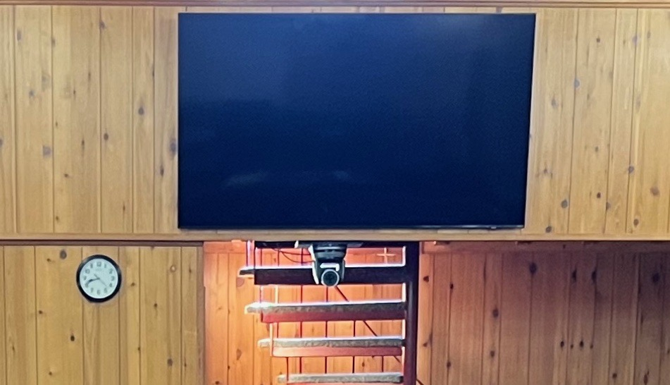
LIVESTREAMING CAMERAS & BACK WALL MONITOR
Notes:
… two cameras for live streaming, AND a large screen monitor for the back of the sanctuary. (No longer necessary to turn around to see what’s on the screen.)

Slide 16
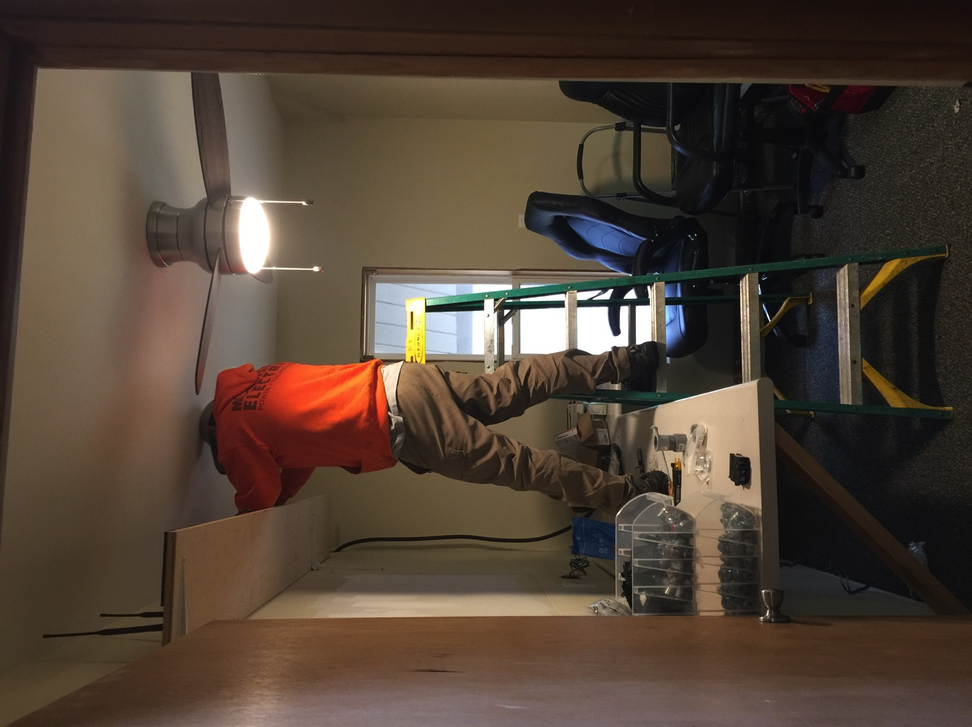
FINISHING TOUCHES
Notes:
After sheetrock, plaster & paint, the countertops, shelving & a new light fixture with a FAN were added.
Then a window opening to the sanctuary was framed in. These were some of the finishing touches.

Slide 17
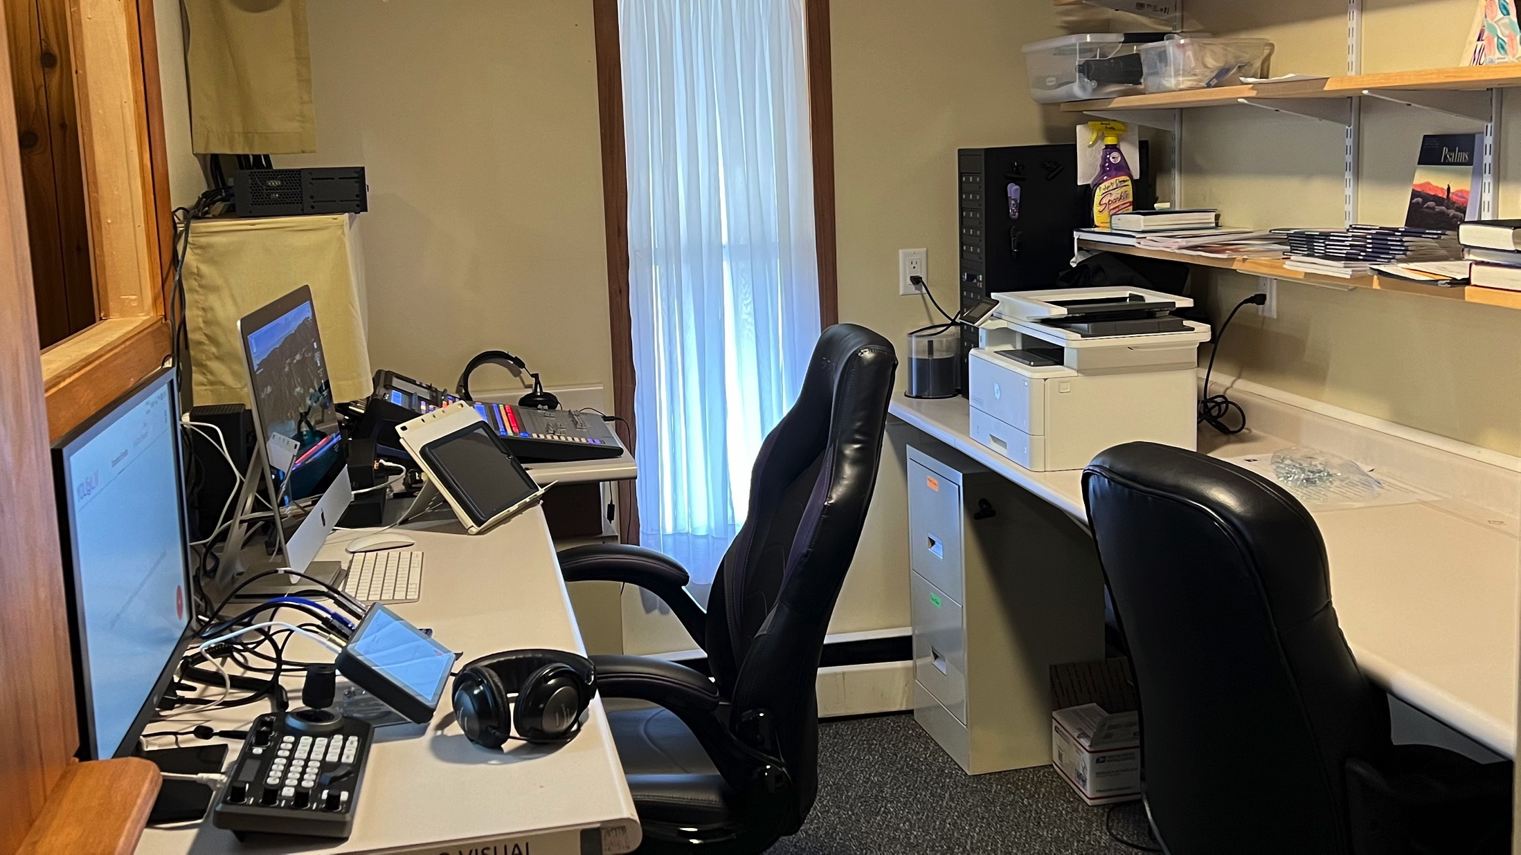
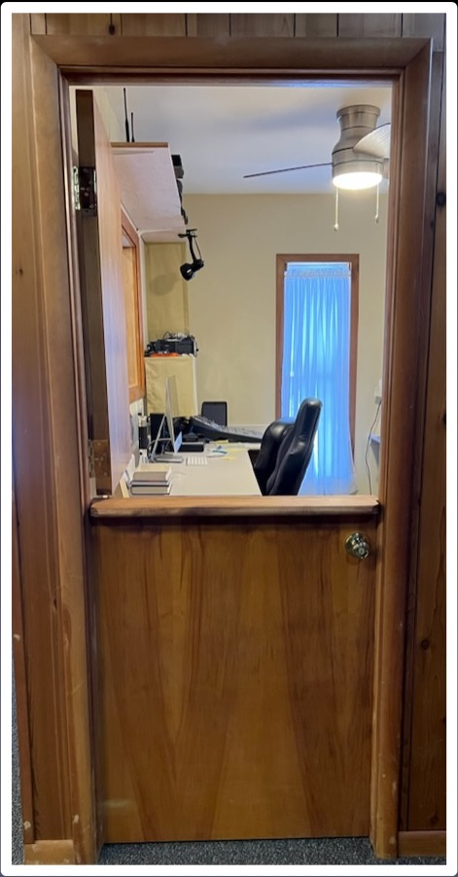
NEW AV ROOM & DUTCH DOOR
Notes:
Neat, orderly, all connected and working well…
Secured by a divided door.

Slide 18
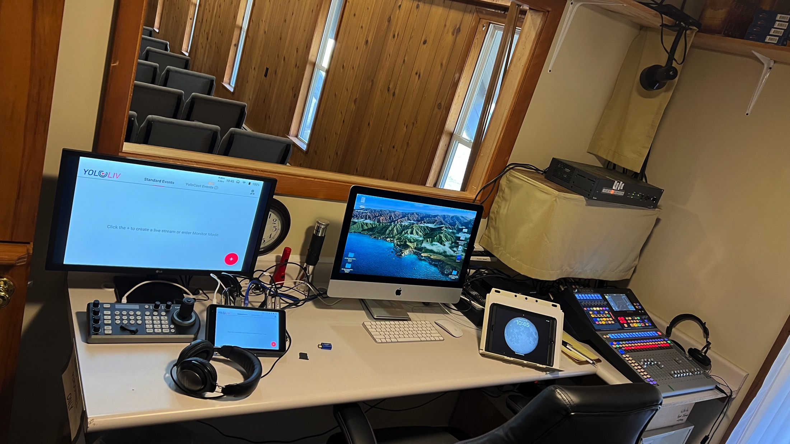
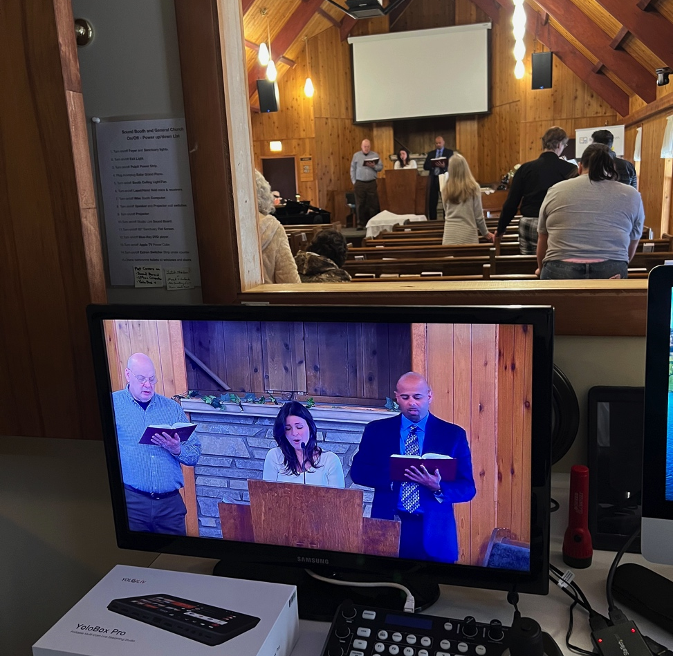
FINISHED AV ROOM
GETTING READY
IN USE
Notes:
TO GOD BE THE GLORY!!
Even the cameras are working (Smile).

Slide 19
SANCTUARY UPDATE
BEFORE
Notes:
BUT… what about the rest of the sanctuary?
The102 years old grand piano wouldn’t stay in tune? Did you see the upholstery on the pews?
(next slide)

Slide 20
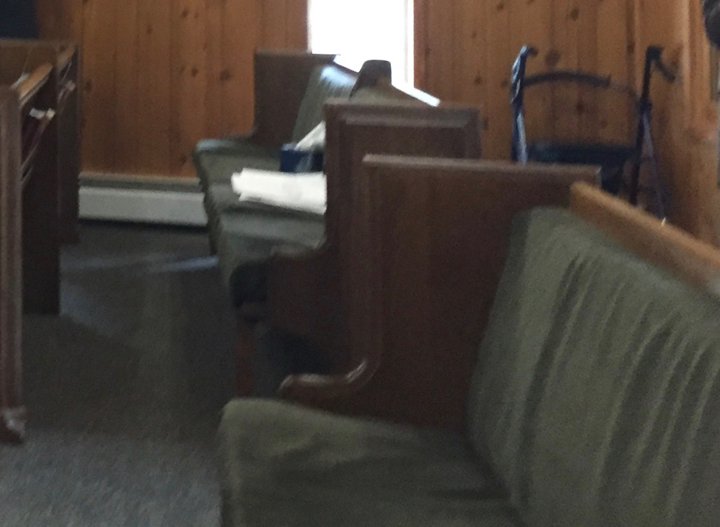
SANCTUARY UPDATE
BEFORE
Notes:
They were quite outdated and worn. Not a good first impression! They wondered what could be done.
With the help of MICHIGAN ADVANCE PARTNERS (MAP) they added…. (next slide)

Slide 21
SANCTUARY UPDATE
NEW PIANO NEW PULPIT
Notes:
... A new piano and pulpit.
They painted the doors and platform wood,
And purchased new chairs. (next slide)

Slide 22
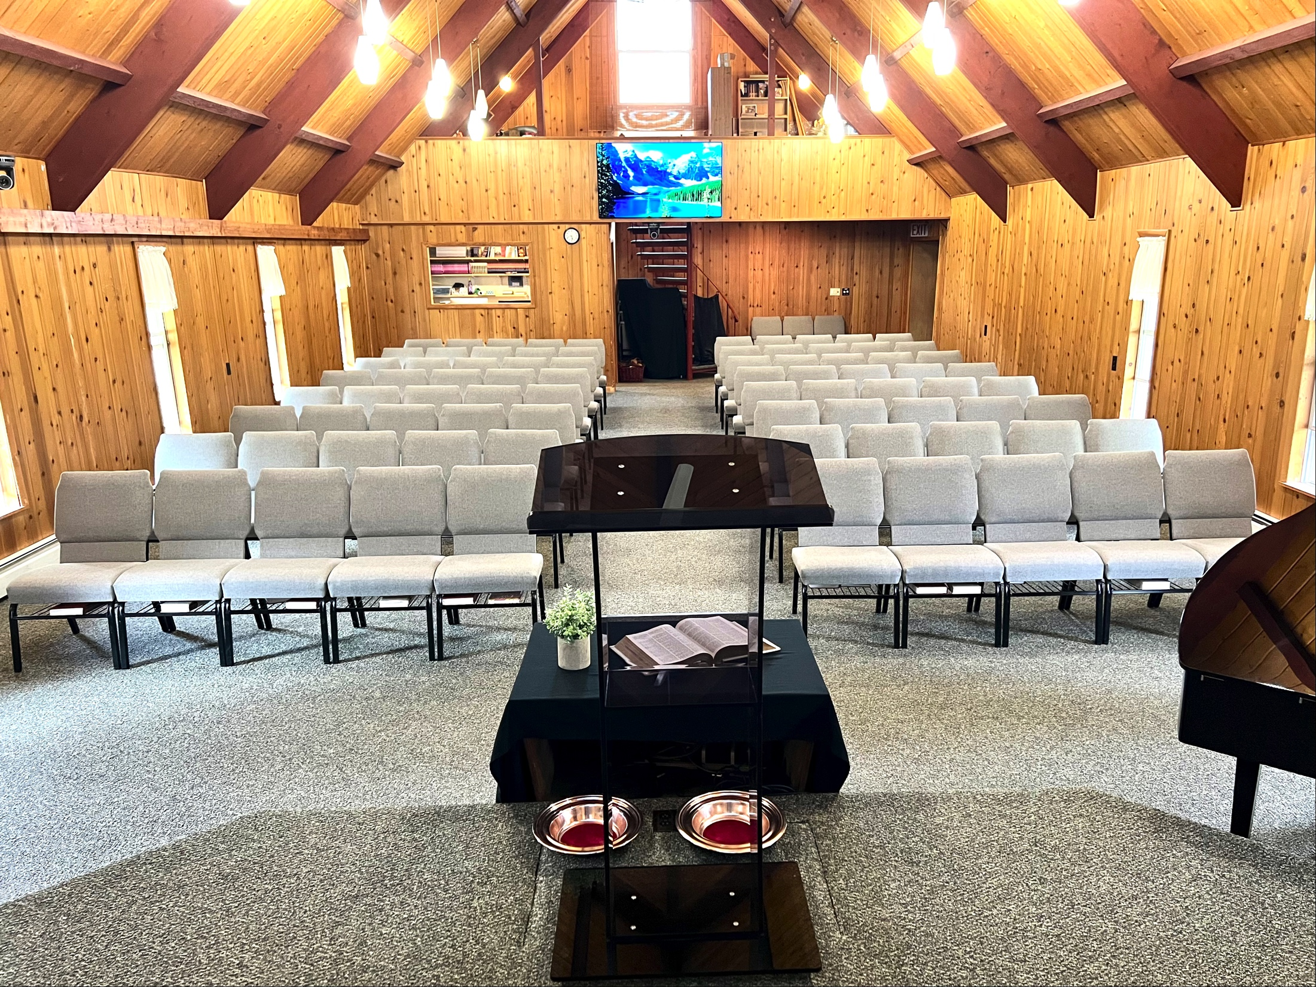
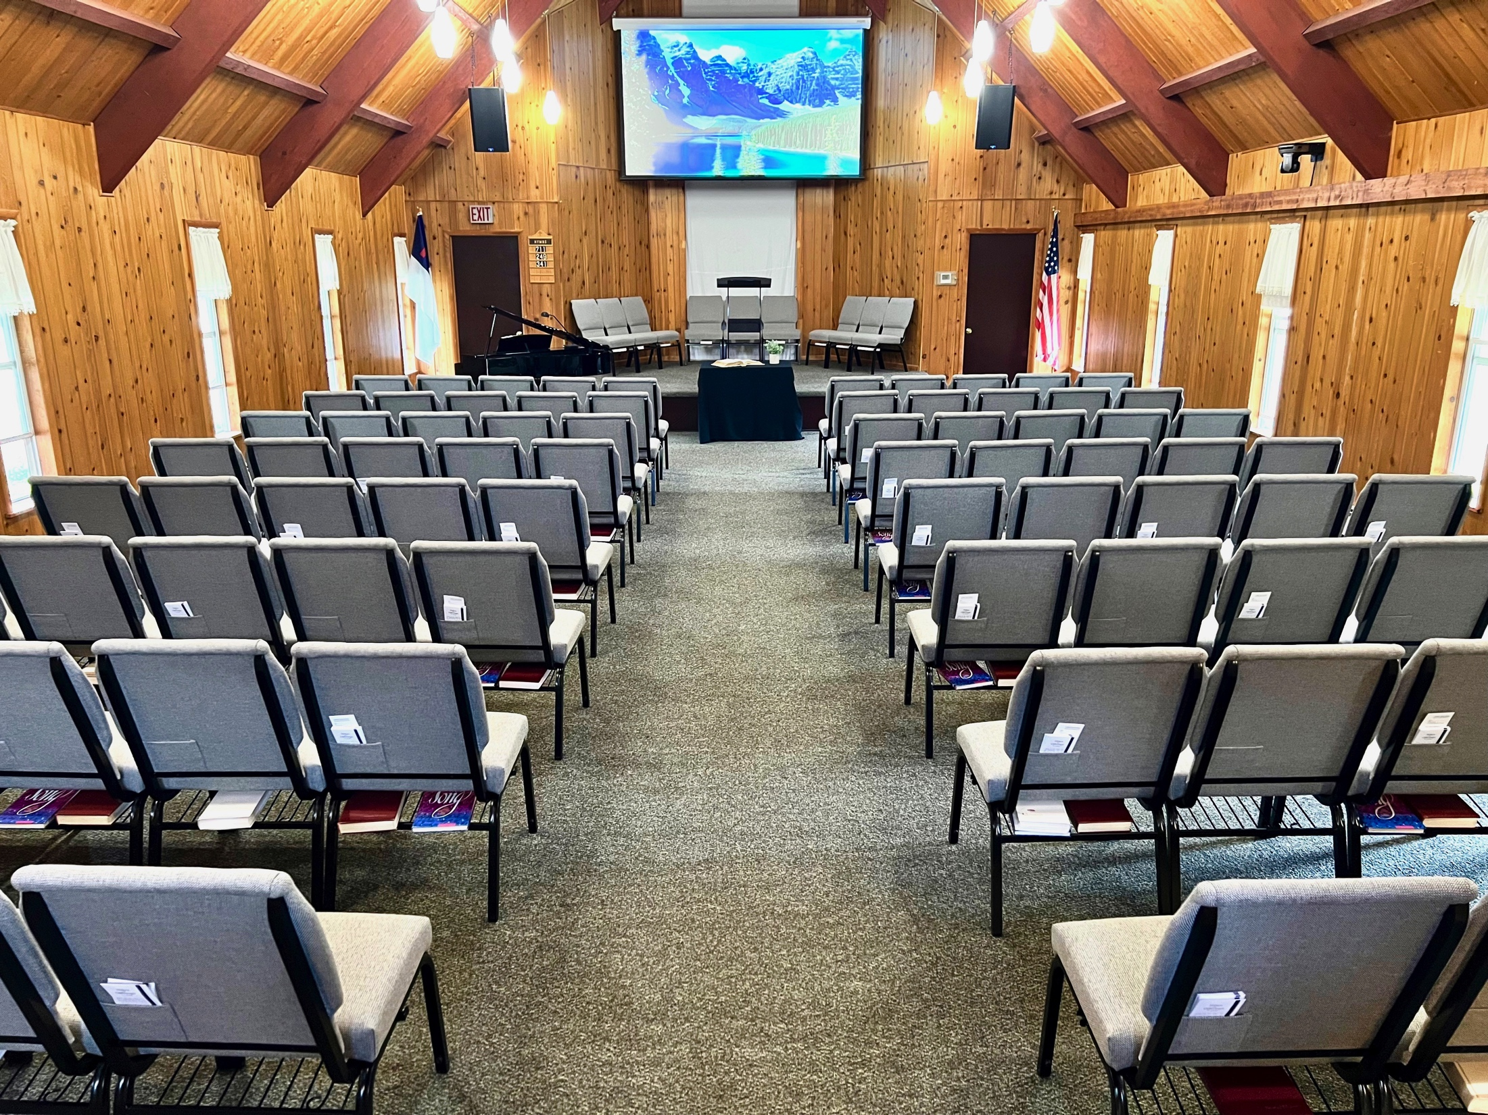
SANCTUARY UPDATED
AFTER
Notes:
The pictures speak for themselves.

Slide 23
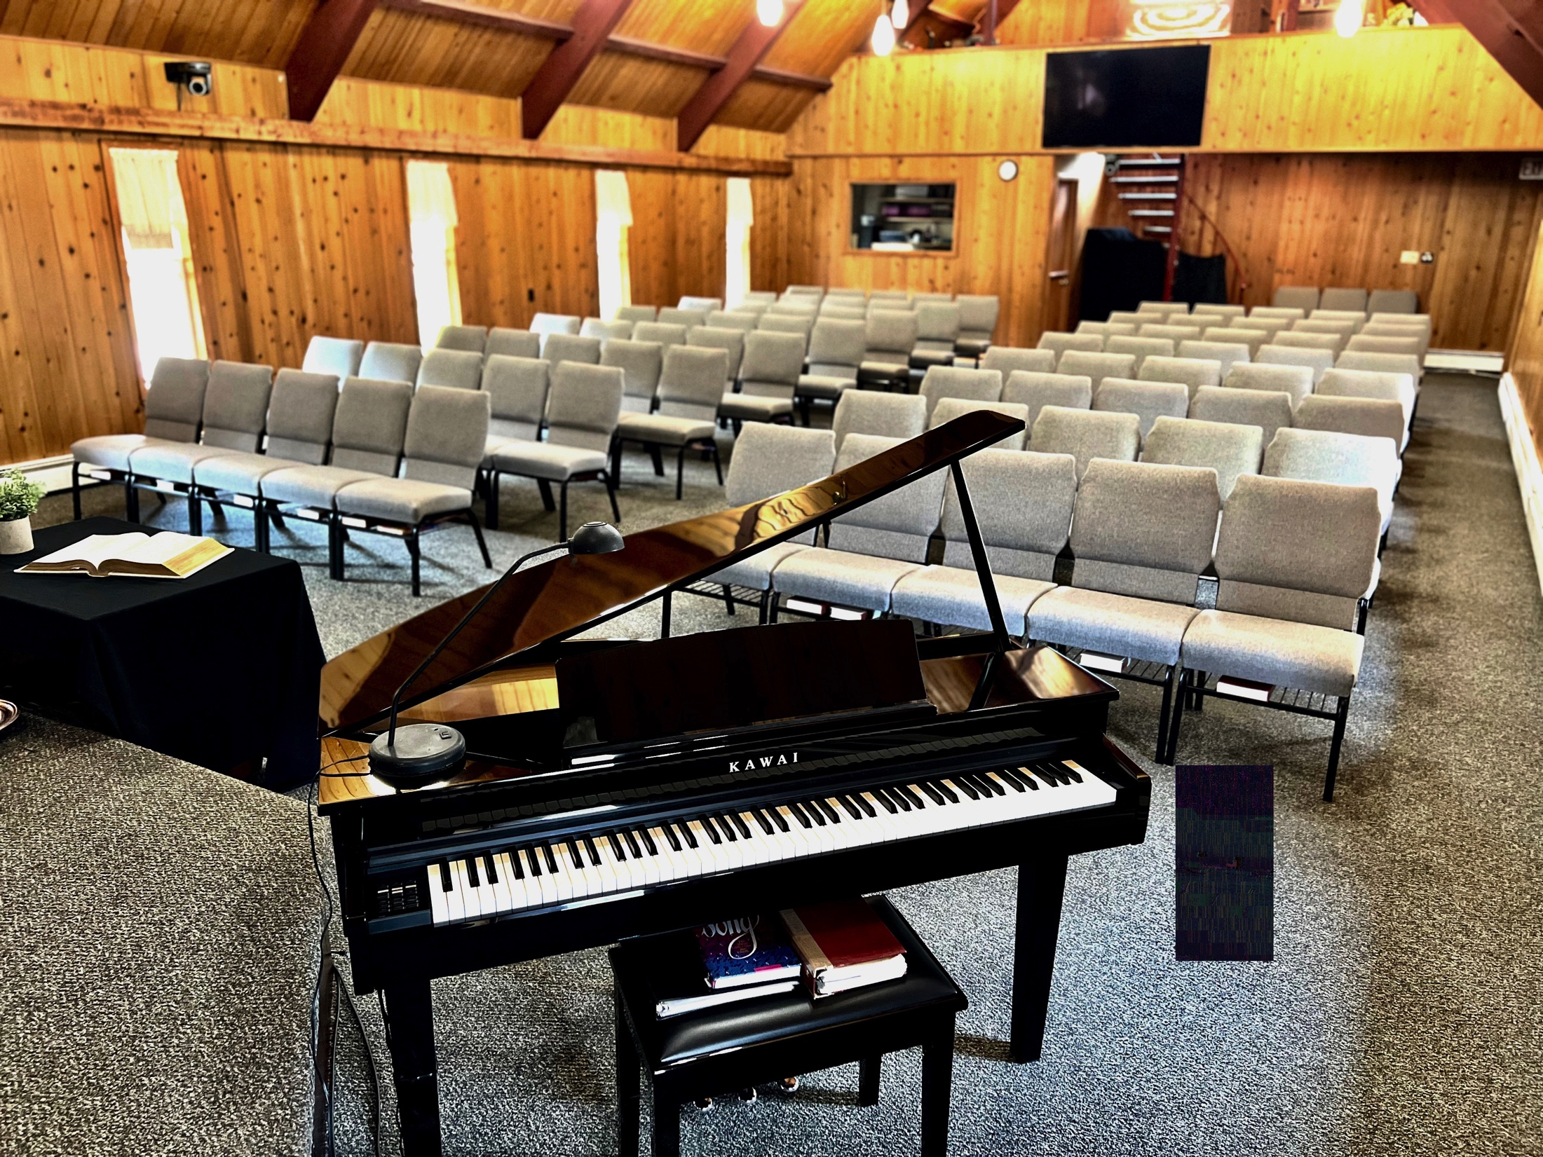
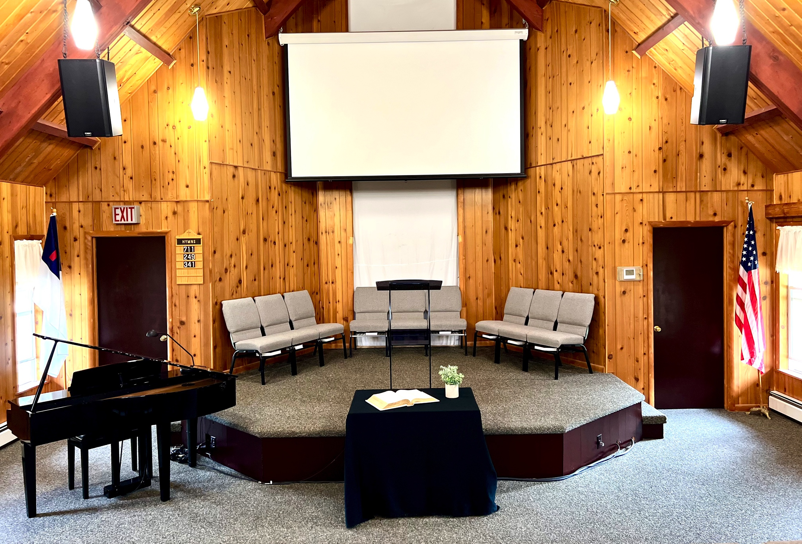
SANCTUARY UPDATED
AFTER
Notes:
What a HUGE difference! (Pause) ---- But what happened
To the baptistery?

Slide 24
OLD BAPTISTRY
BEFORE
STEEP ENTRY
Notes:
The old welded metal tank had served well for 50 years, but it had a history of leaking, and the ascent was like the ladder in Jacob’s vision - going up to Heaven!

Slide 25
OLD BAPTISTRY REMOVED
WALL AND STAIRS REMOVED -
- WIRES & PIPES EVERYWHERE
Notes:
That was quite a process!!
It had been welded together in the space that was available after the church was built. Consequently, it had to be cut apart with a torch so the pieces could be removed!

Slide 26
NEW BAPTISTRY AREA PREPARATION IN PROCESS
COMING SOON
Notes:
MAP Grant funds have been received and set aside
to help purchase the new baptismal tank as soon as the area is prepared.

Slide 27
NEW BAPTISTRY AREA PREPARATION IN PROCESS
COMING SOON
Notes:
With FALL Evangelism preparation in mind, “Community Friends” would see more than the Sanctuary.
They would come through the foyer and the hall.
What would they see there?

Slide 28
FOYER ACCENT WALL PAINTED
Notes:
One Foyer wall was showing the scars of the passing years. It needed “HELP”! They decided to paint it and make it an accent wall to match the stone work already in place.

Slide 29
FOYER BASEBOARD PAINTED
Notes:
NICE!!!,
But those baseboard heating registers needed to
“DISAPPEAR”. So they were painted too. (smile)

Slide 30
FRESH NEW LOOK
Notes:
This was now a “Welcoming Space” for Community Friends.
What about the restrooms?
One had been updated a few years ago.
But the other one definitely showed it’s age. (Next slide)

Slide 31
BATHROOM UPDATE
BEFORE
Notes:
…stained linoleum, outdated wall paper,
No changing table for tiny tots, etc. etc.!!
A volunteer helped with demolition and re-plumbing for the new vanity.

Slide 32
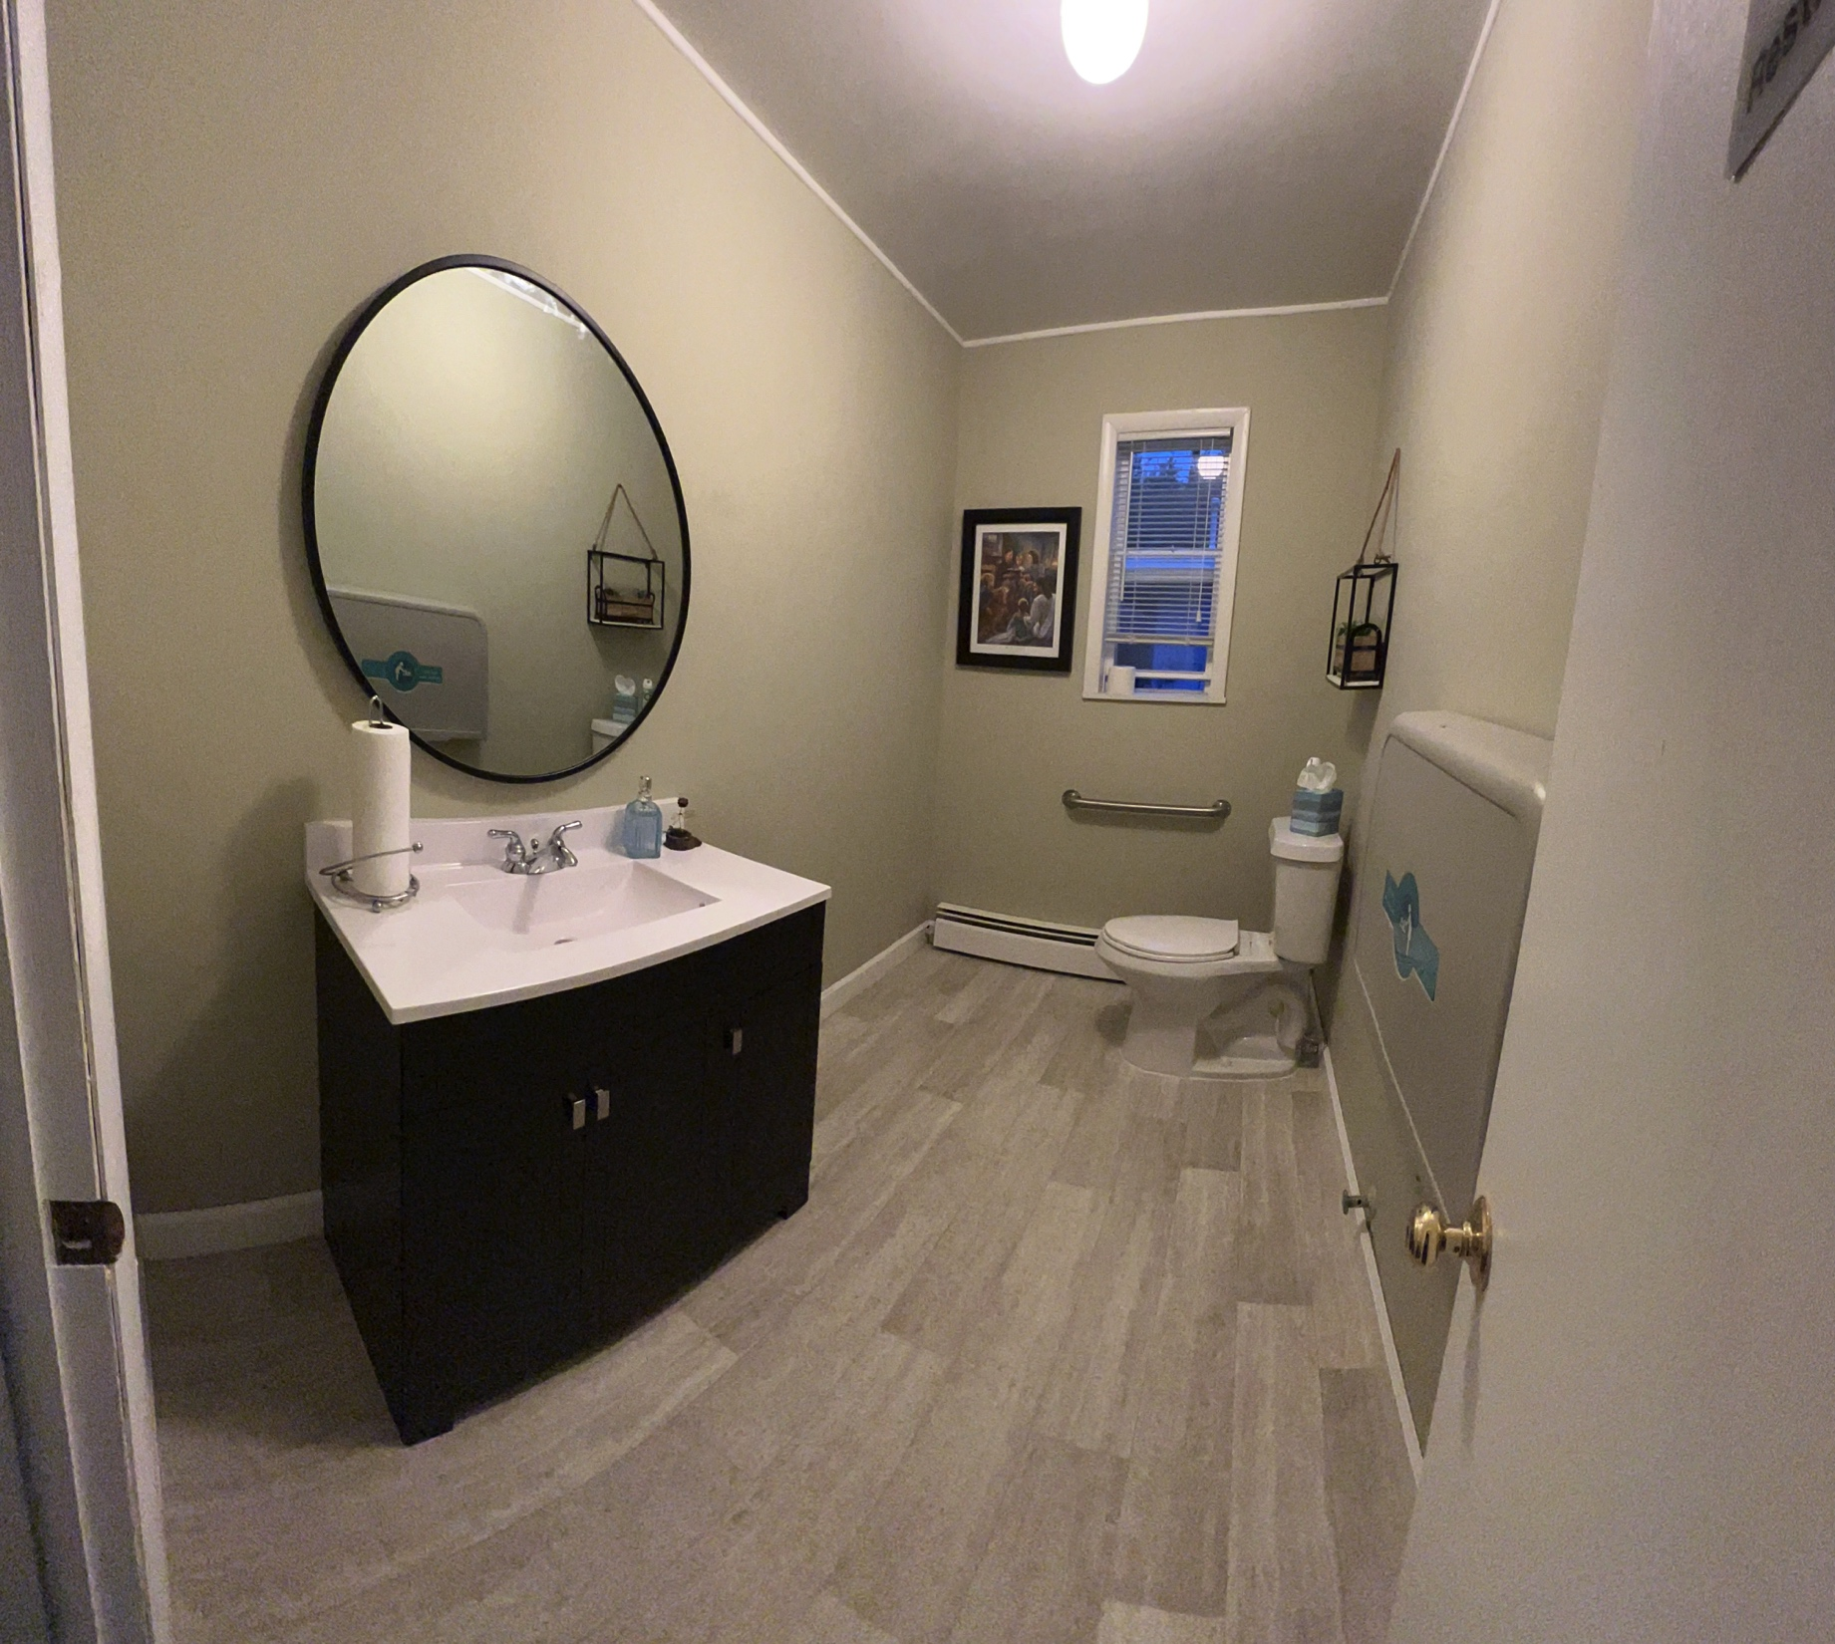
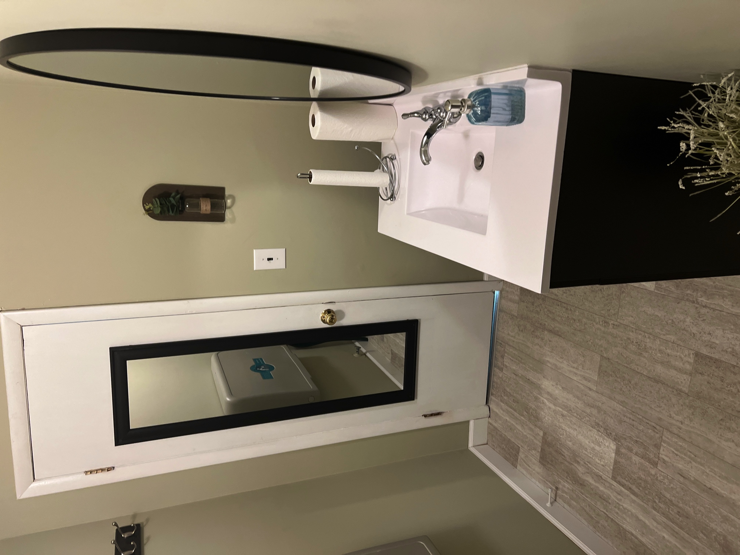
BATHROOM UPDATE
AFTER
Notes:
It’s impossible to describe the feelings that members expressed when they they saw the transformation.
You know, God IS into transformations!

Slide 33
BATHROOM UPDATE
AFTER
Notes:
One member said, “NOW I’m not ashamed to invite someone to our church.”-- -- --
Right next to the bathrooms is the Boiler System Room.
(next slide)

Slide 34
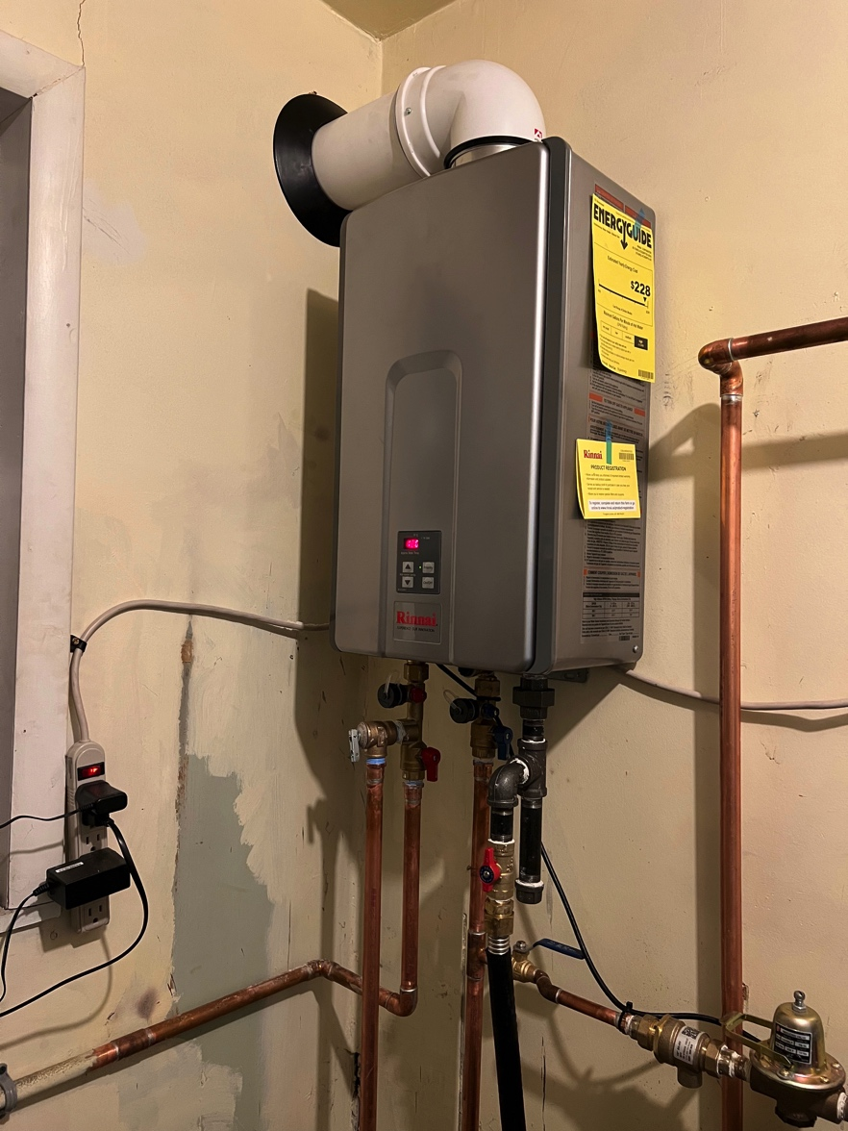
MECHANICAL ROOM
NEW ON-DEMAND WATER HEATER
Notes:
When the old hot water heater gave out in the fall of 2022, MAP funding helped provide an energy efficient
“ON DEMAND” water heater. WHAT A BLESSING!

Slide 35
MECHANICAL ROOM
HEAT VENTED OUT
LOUVERED DOOR ADDED
Notes:
But the heat build-up in that room was stifling. Since this room was right by the back EXIT , the boiler room door was often left standing wide open. So an “over-the-door” vent and louvered door were added. -- -- --
It was not a pretty site inside.(next slide)

Slide 36
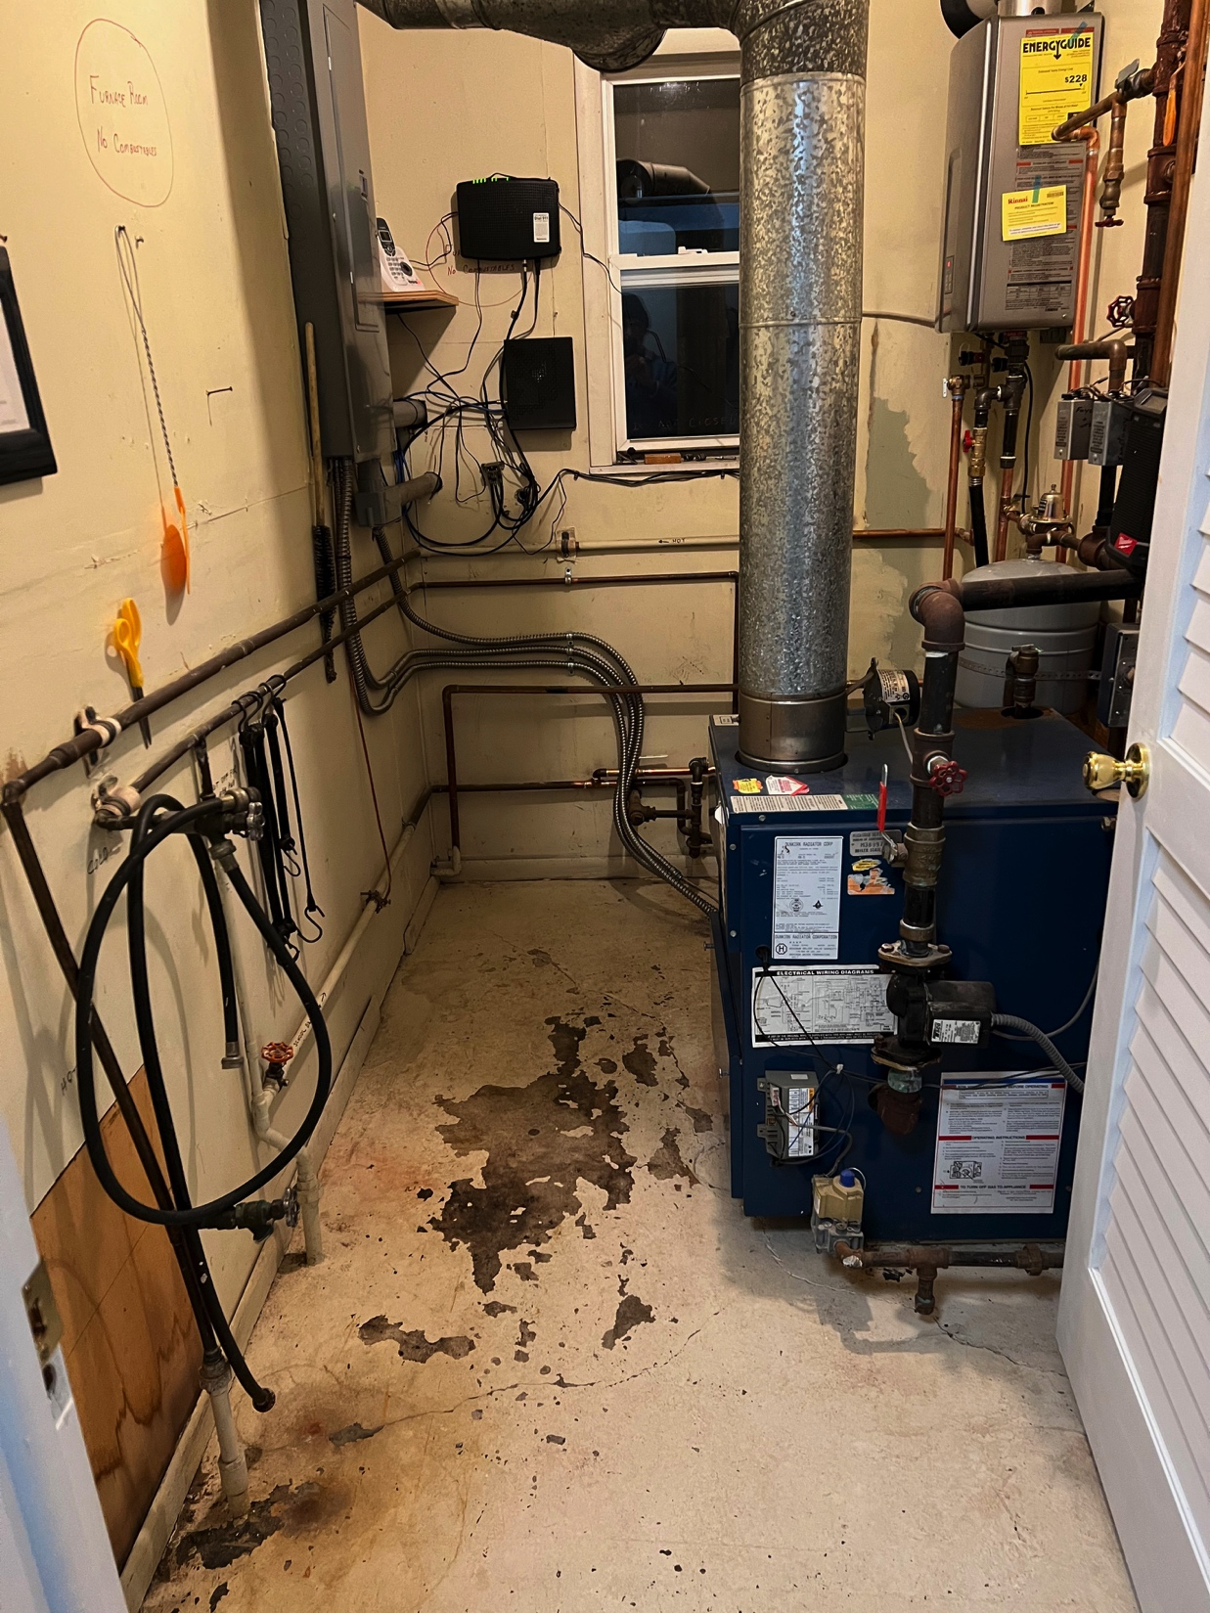
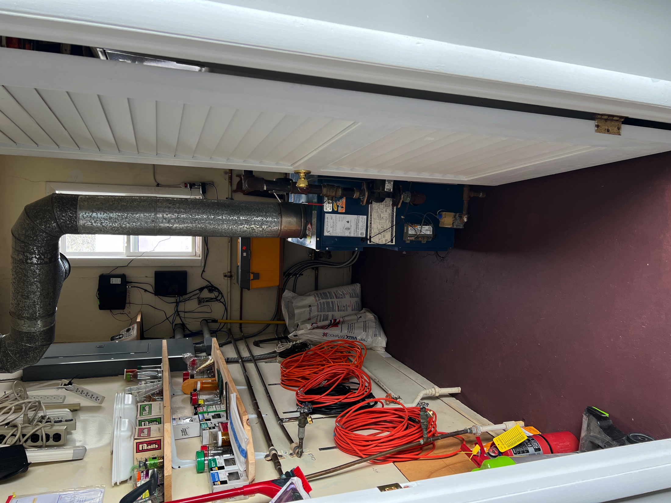
MECHANICAL ROOM
BEFORE PAINTED & ORGANIZED
Notes:
… but someone with a gift for organization and lots of elbow grease put their talents to work and transformed this whole space. (continued on next slide)

Slide 37
MECHANICAL ROOM
BEFORE PAINTED & ORGANIZED
Notes:
Now, if the door happens to be left open, it shows that this room is also a part of God’s House…
kept neatly & in order. -- -- --
The largest upgrade expense was for a new sanctuary roof. (Next Slide)

Slide 38
SANCTUARY ROOF
OFF WITH THE OLD
Notes:
This would have been impossible without MAP assistance. The LORD sent lovely weather so the process moved ahead quickly… And VBS was coming.

Slide 39
SANCTUARY ROOF
ON WITH THE NEW
INSULATION & PLYWOOD
Notes:
Great strides were make every day. (pause)

Slide 40
SANCTUARY ROOF
INSULATION & PLYWOOD
… AND NEW SHINGLES
Notes:
Part of the crew finished the back side while the rest continued steadily on the side toward the road. All who passed by noted that something BIG was happening.

Slide 41
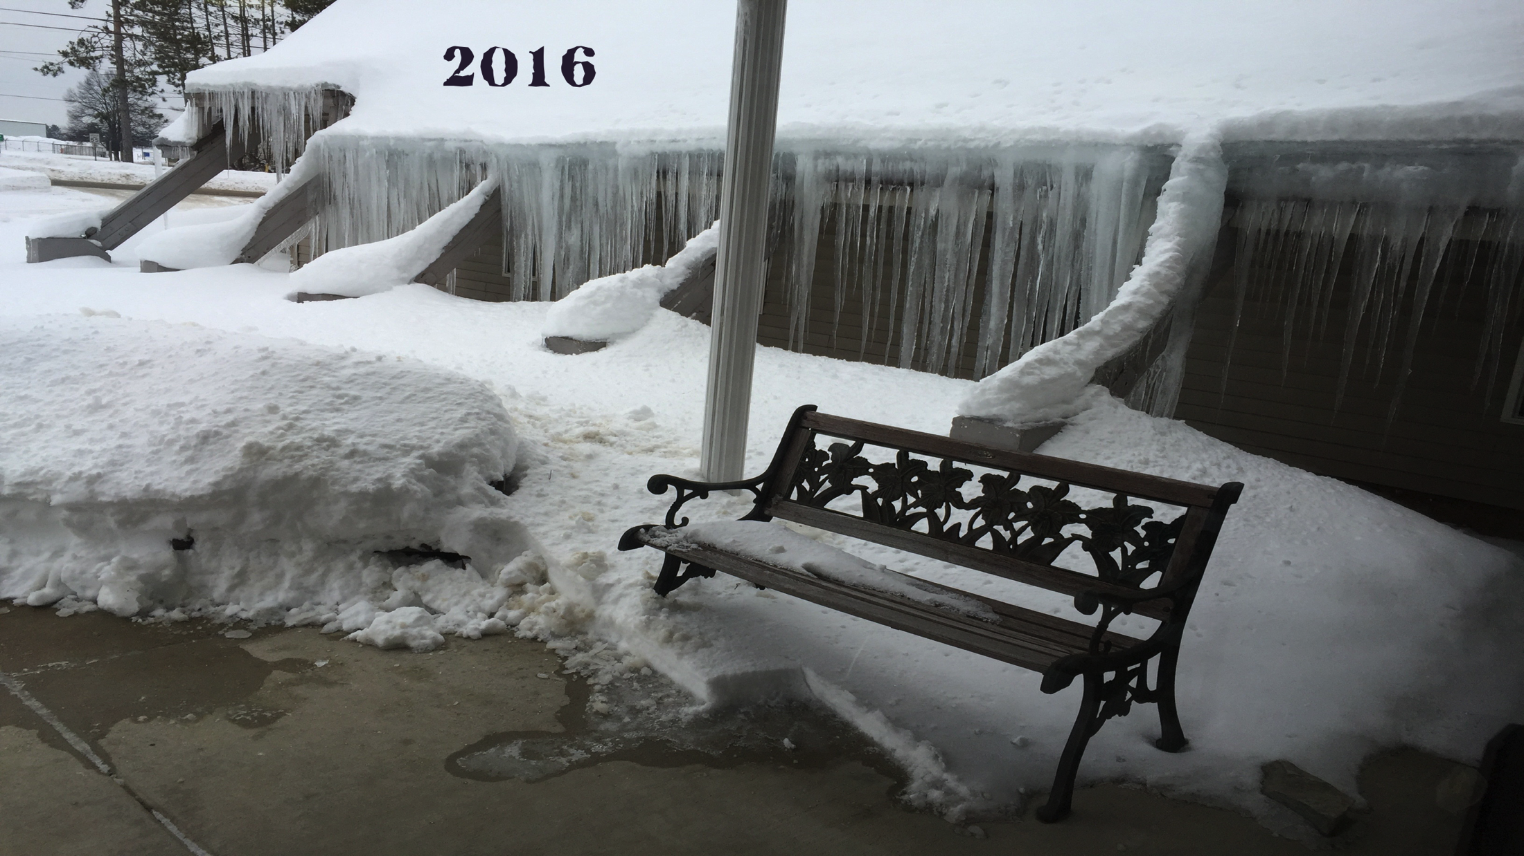
SANCTUARY ROOF
OLD ROOF WITHOUT INSULATION ! !
Notes:
All these years, the heat loss had caused huge ice cycles to form. Of course the children thought they were great!

Slide 42
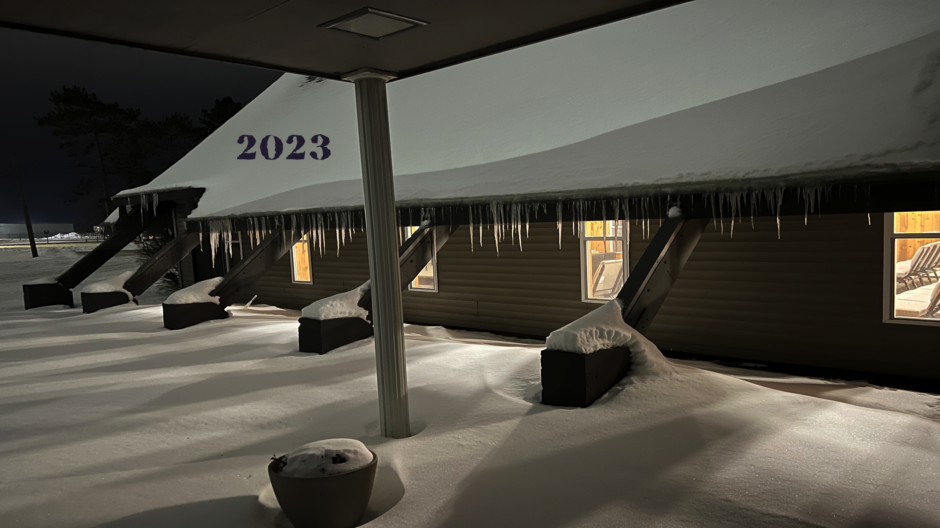
SANCTUARY ROOF
THIS PAST WINTER WITH INSULATION ! !
Notes:
But with new insulation, the heating bills and the ice cycles were both smaller.

Slide 43
EXTERIOR TRIM STRIPPED
BEFORE
AFTER
Notes:
The supporting beams had also deteriorated over time, and were in need of repair. They were power washed, sanded, repaired and…

Slide 44
EXTERIOR TRIM REPAINTED
PRIMED
FINISHED
Notes:
…protective primer, paint & additional metal caps were applied. Even the door was sanded and painted.

Slide 45
PYLONS ALL PAINTED
Notes:
Here’s the finished look, with the CROSS repaired and freshly painted-- by day….
(Next slide)

Slide 46
CROSS LIGHTING REPAIRED
Notes:
…and by night the cross is lit with new LED lights that are regulated by a “dusk to dawn” sensor.

Slide 47
CROSS SHINING BRIGHTLY OPENING NIGHT
Notes:
With all these preparations completed, they were finally ready for OPENING NIGHT - to welcome the community friends God was preparing to send.

Slide 48
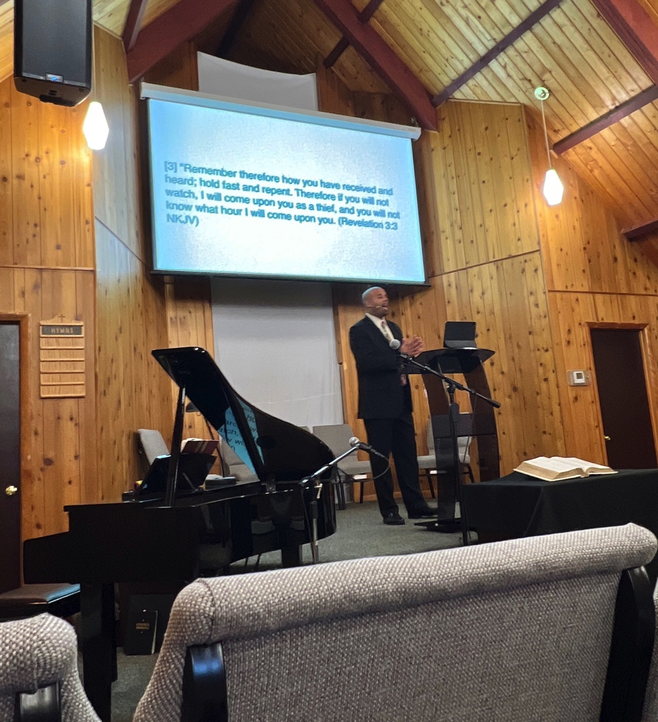
WELCOME TO GOD’S HOUSE IN KALKASKA
THE PLACE TO BE
Notes:
To God be the Glory for the things HE has done in Kalkaska

Slide 49
THANK YOU JESUS
THANK YOU TO ALL MICHIGAN ADVANCE PARTNERS
3/31/2024 D. Murdock
Notes:
AND THANK YOU TO ALL MICHIGAN ADVANCE PARTNERS.

