Slide 1


®
Images © Alamy
www.alamy.com
Images used in PowerPoint presentation are part of the presentation and not to be used out of context of the presentation, may not be used as stand-alone images unless to promote the presentation/event, and may not be resold in singular form or as part of an image library. Images are © Alamy and presentation templates and content therein are © MISDA, any other usage requires written permission from both parties.

Slide 2
®
Scripture quotations used in Balanced Living PowerPoints are taken from Bibles in the Public Domain which have no USA copyright restrictions. We have indicated which version each quotation is taken from as follows:
KJV - King James Version
BBE - Bible in Basic English
WEB - World English Bible
DBY - Darby's Translation
Any scriptures not otherwise noted are the author's paraphrase of one of these versions.

Slide 3
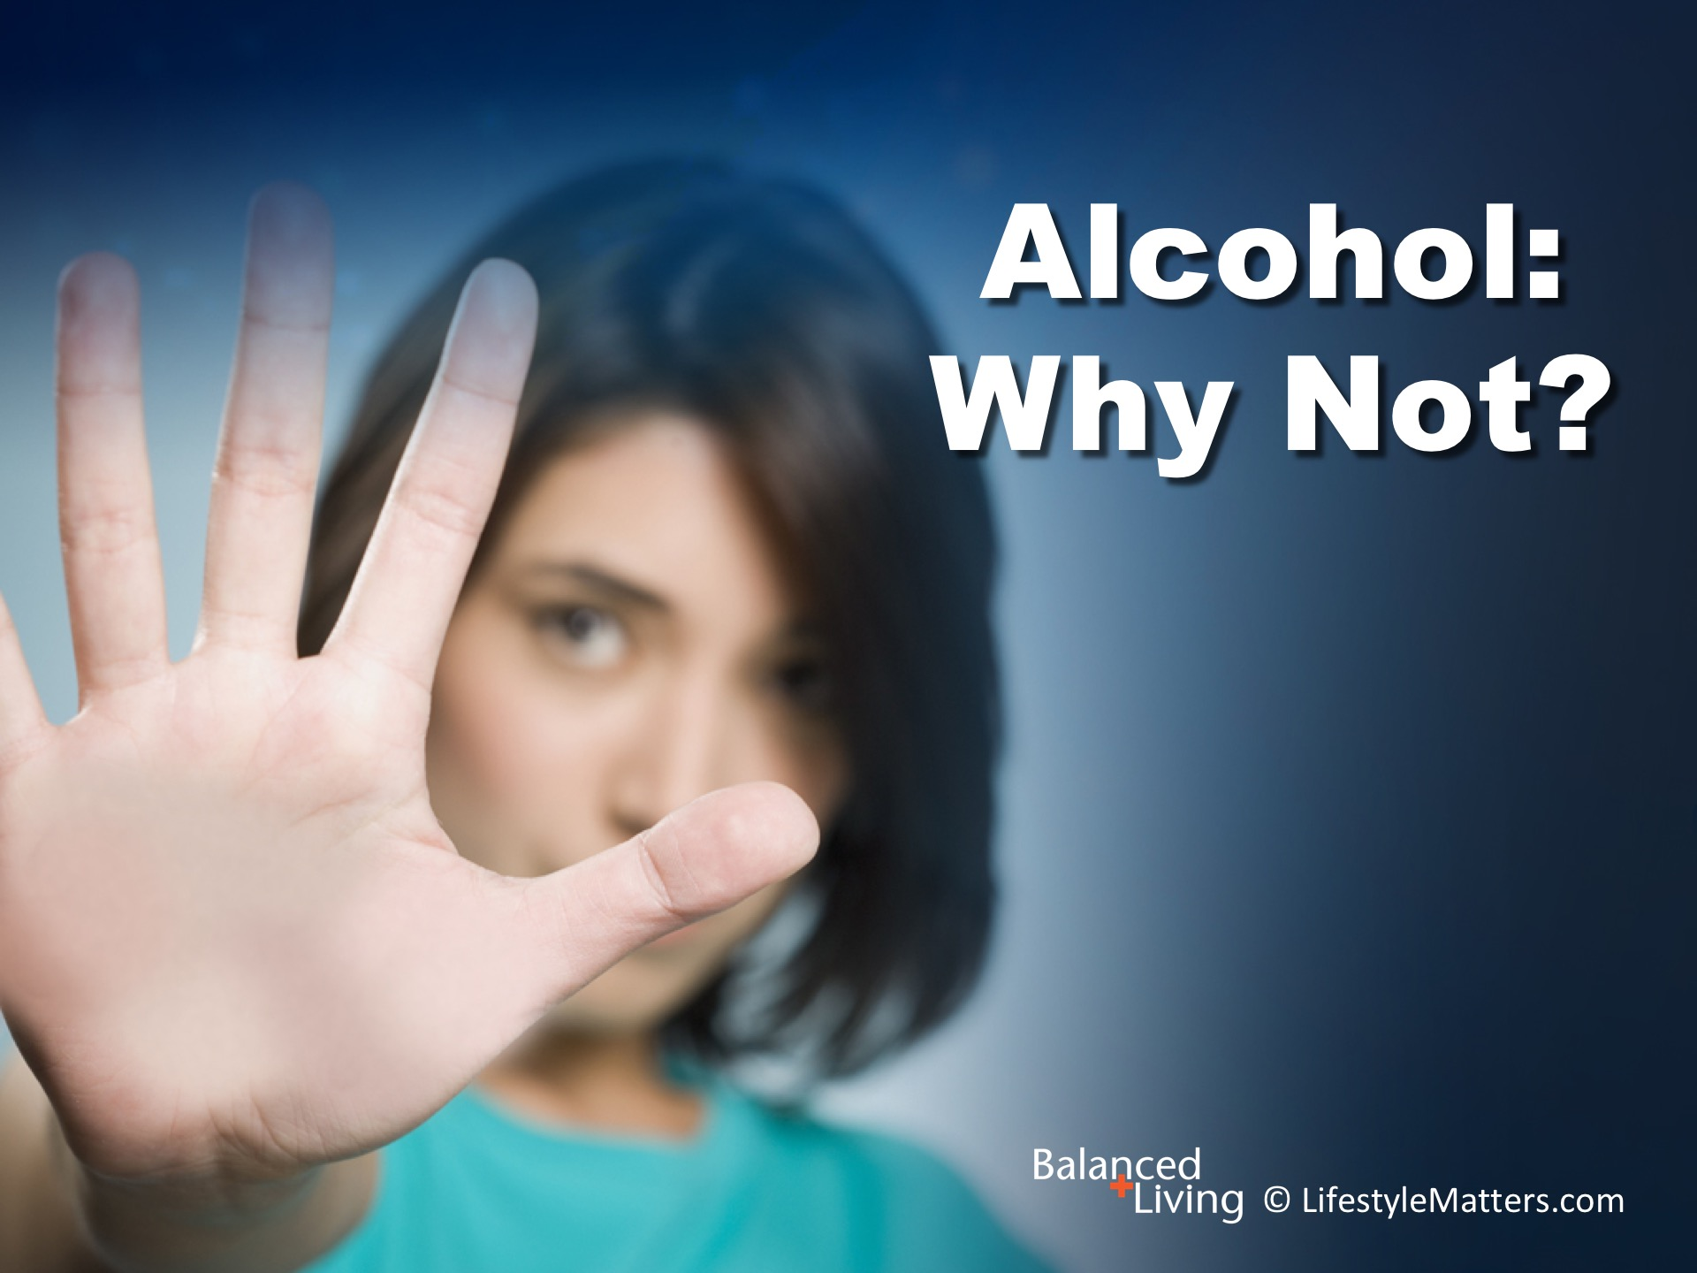
Notes:
Presenter: Please read and study the tract that accompanies this PowerPoint to prepare for this presentation.
In this session we are asking the question: Read slide.

Slide 4
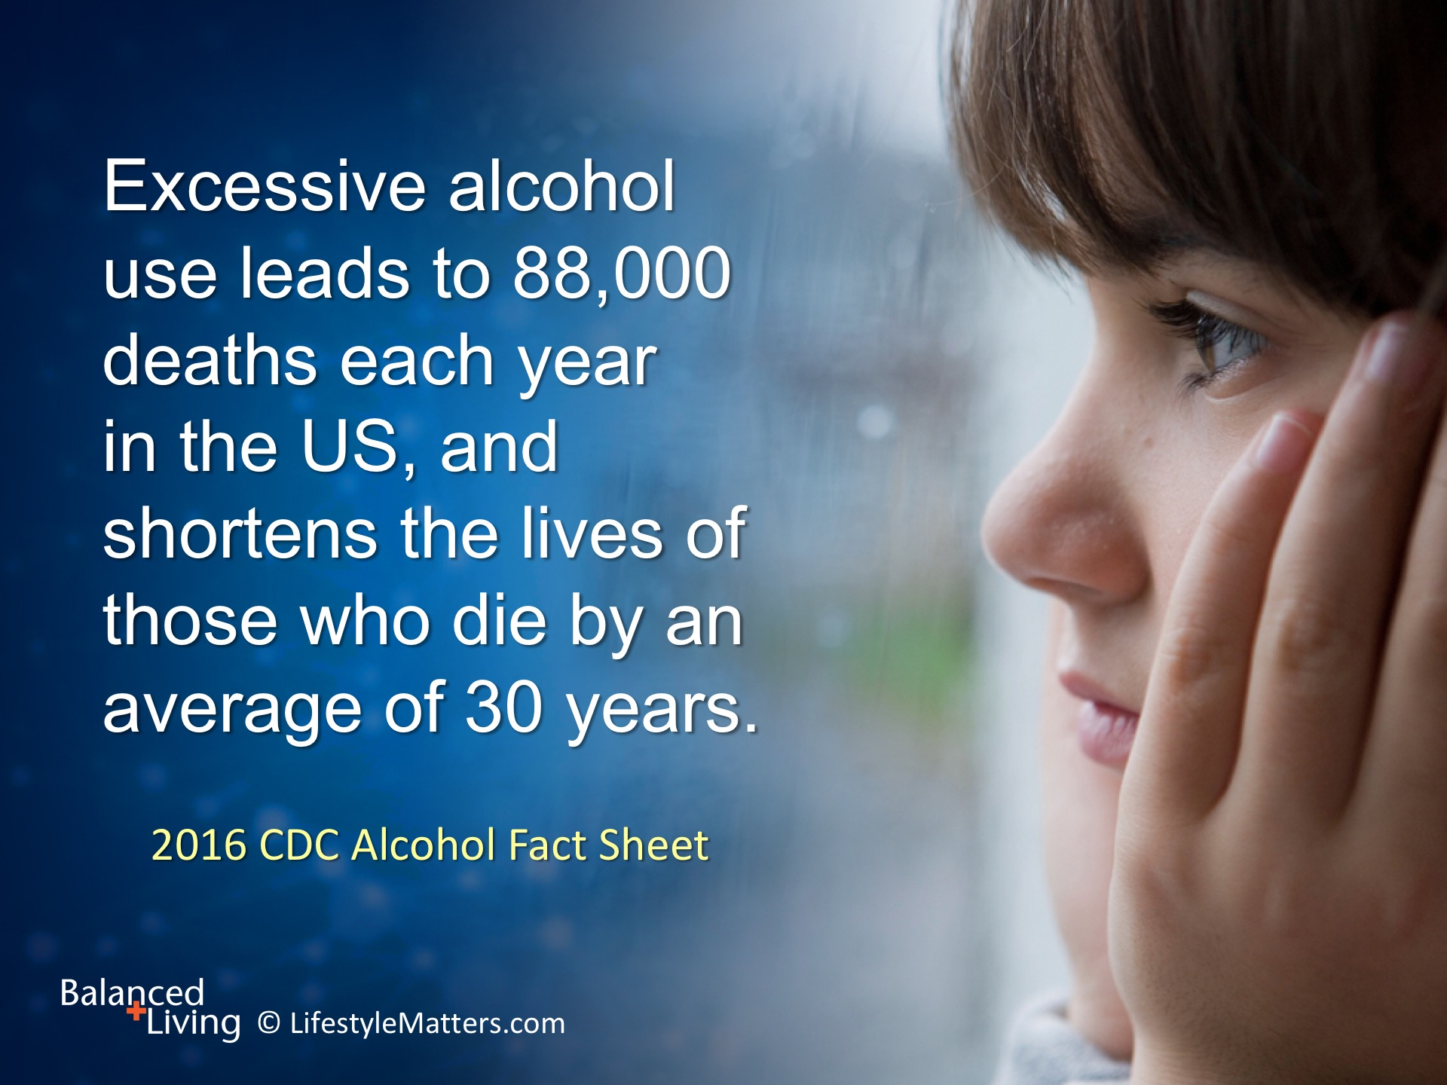
Notes:
Read slide.
Alcohol is legal and socially accepted, but it is not harmless.
England’s government guidelines now state that there is “no safe level” of alcohol consumption, and even small amounts increase the risk of certain cancers. (Source: UK’s Committee on Carcinogenicity on Alcohol and Cancer Risk.)
One out of three people who use alcohol do so excessively. If you had a dog that bit one out of three people, would you keep it?

Slide 5
Notes:
Read slide.
A large-scale study showed that women having just 3 drinks a week significantly increased their risk of breast cancer.
(Sources: CDC Alcohol Fact Sheet, 2016; www.breastcancer.org/risk/factors/alcohol.)

Slide 6
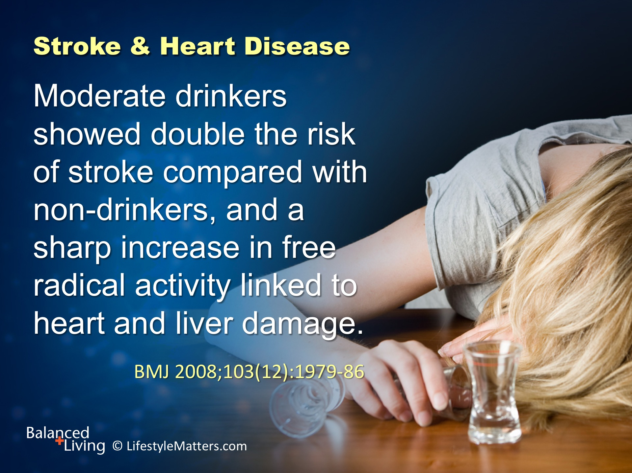
Notes:
In this study from Scotland, Read slide.
Just after drinking, there is a temporary rise in blood pressure and blood platelets become stickier, increasing the immediate risk of heart attacks and strokes. (Source: American Heart Association Report—Poster P158. Elizabeth Mostofsky, Sc.D.)

Slide 7
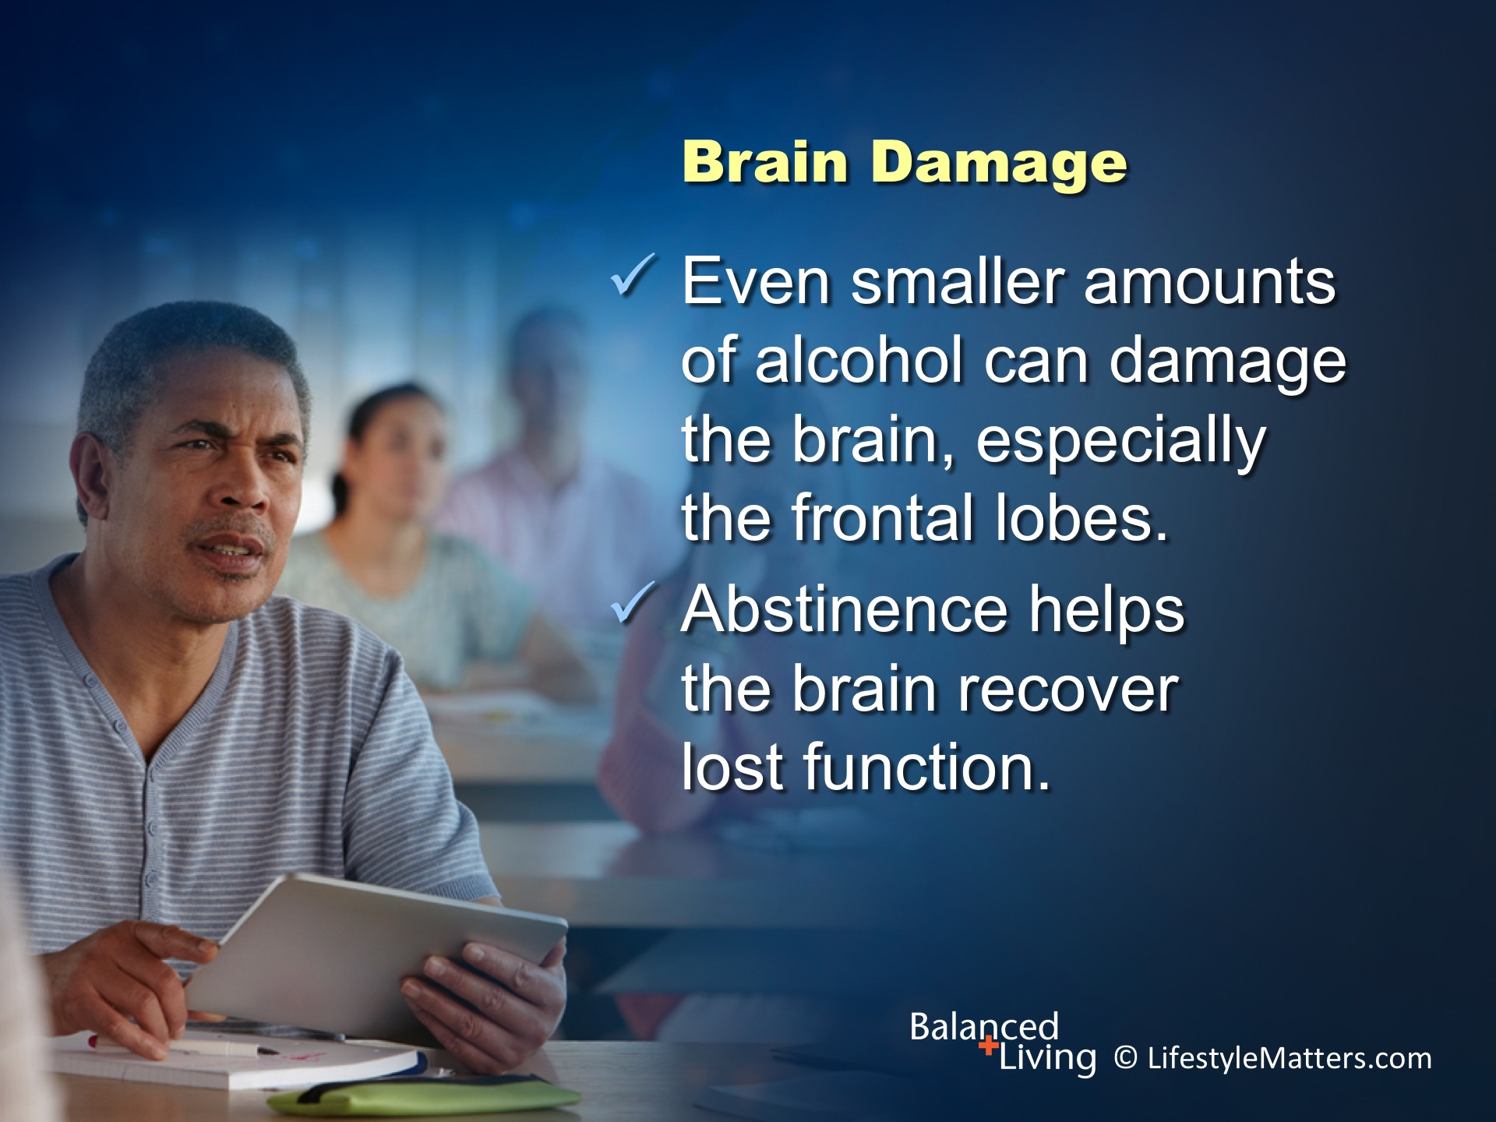
Notes:
Read slide.
Alcohol molecules are tiny, and soluble in both fat and water. They easily permeate almost all parts of the body.
This can affect frontal lobe function, which involves problem solving, memory, judgement, impulse control, and behavior.
(Source: Clinical Psychology Review 2014;(34):531–550; http://www.recoveryanswers.org/blogs/neuroscience-of-recovery-the-brain-in-recovery/)

Slide 8
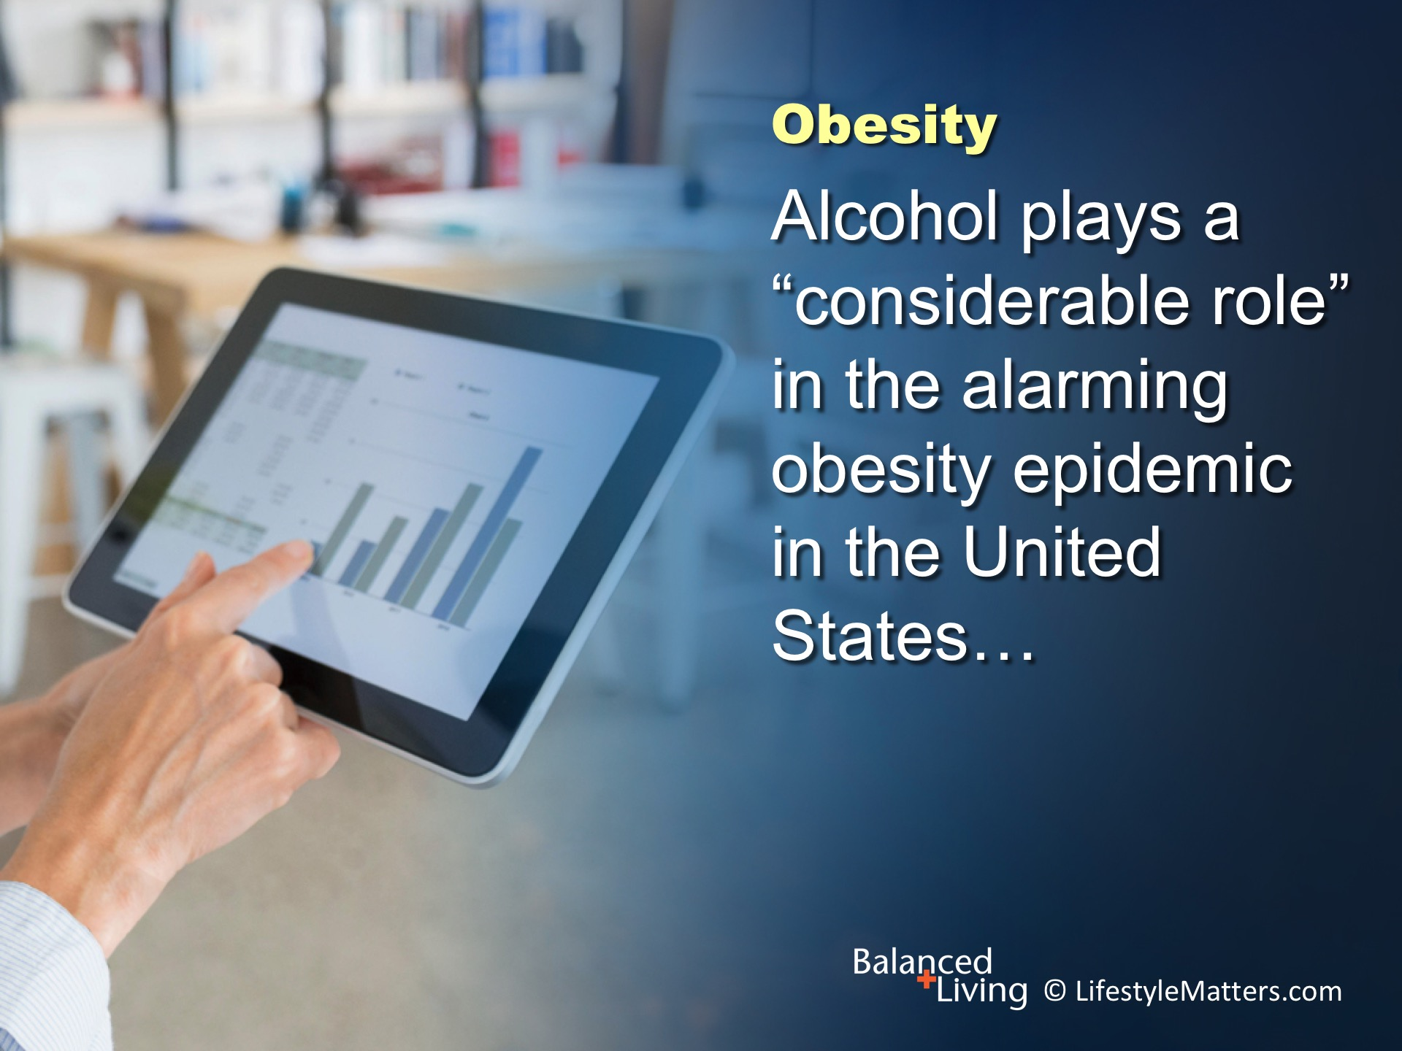
Notes:
Read slide.
Alcohol has twice the calories as sugar per gram.
(Source: International Medical News Group, 2003(36)6.)
(Source: Obesity and Alcohol: an Overview. February 2012. National Obesity Observatory)

Slide 9
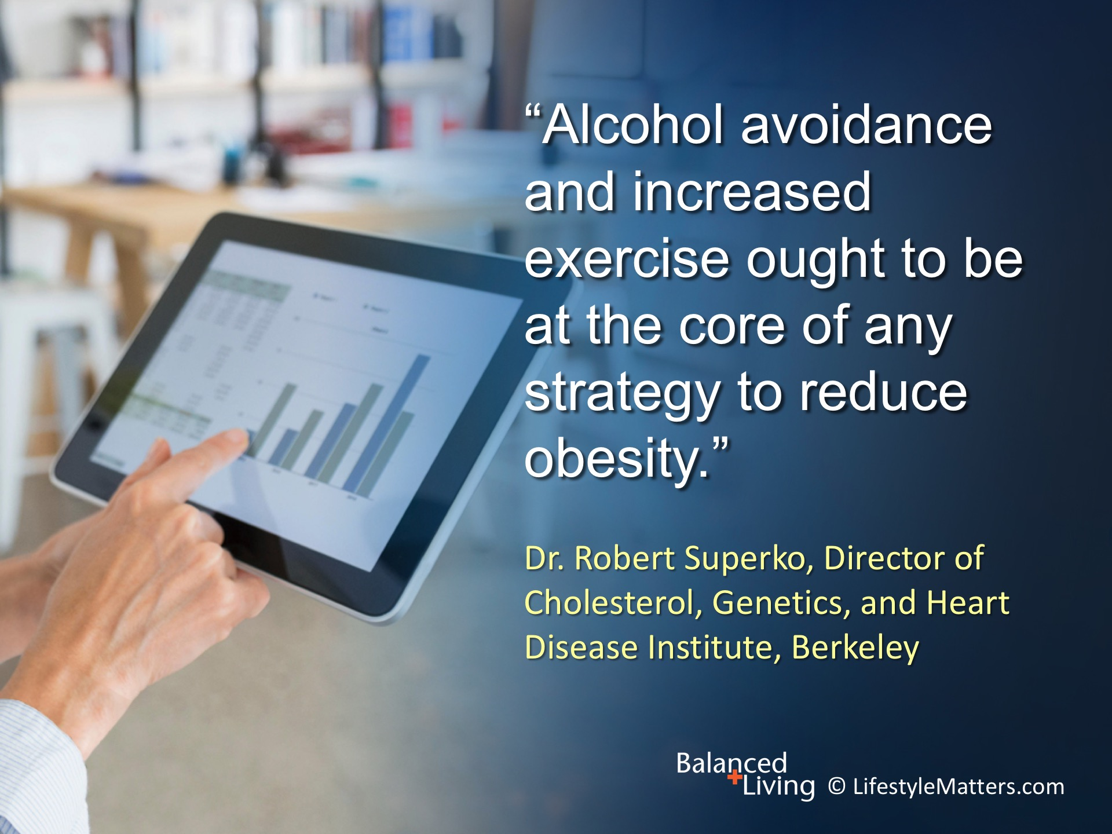
Notes:
Read slide.
Recent research from the UK has found that excess body weight and alcohol consumption act together to increase the incidence of liver cirrhosis.
(Source: Obesity and Alcohol: an Overview. February 2012. National Obesity Observatory)

Slide 10
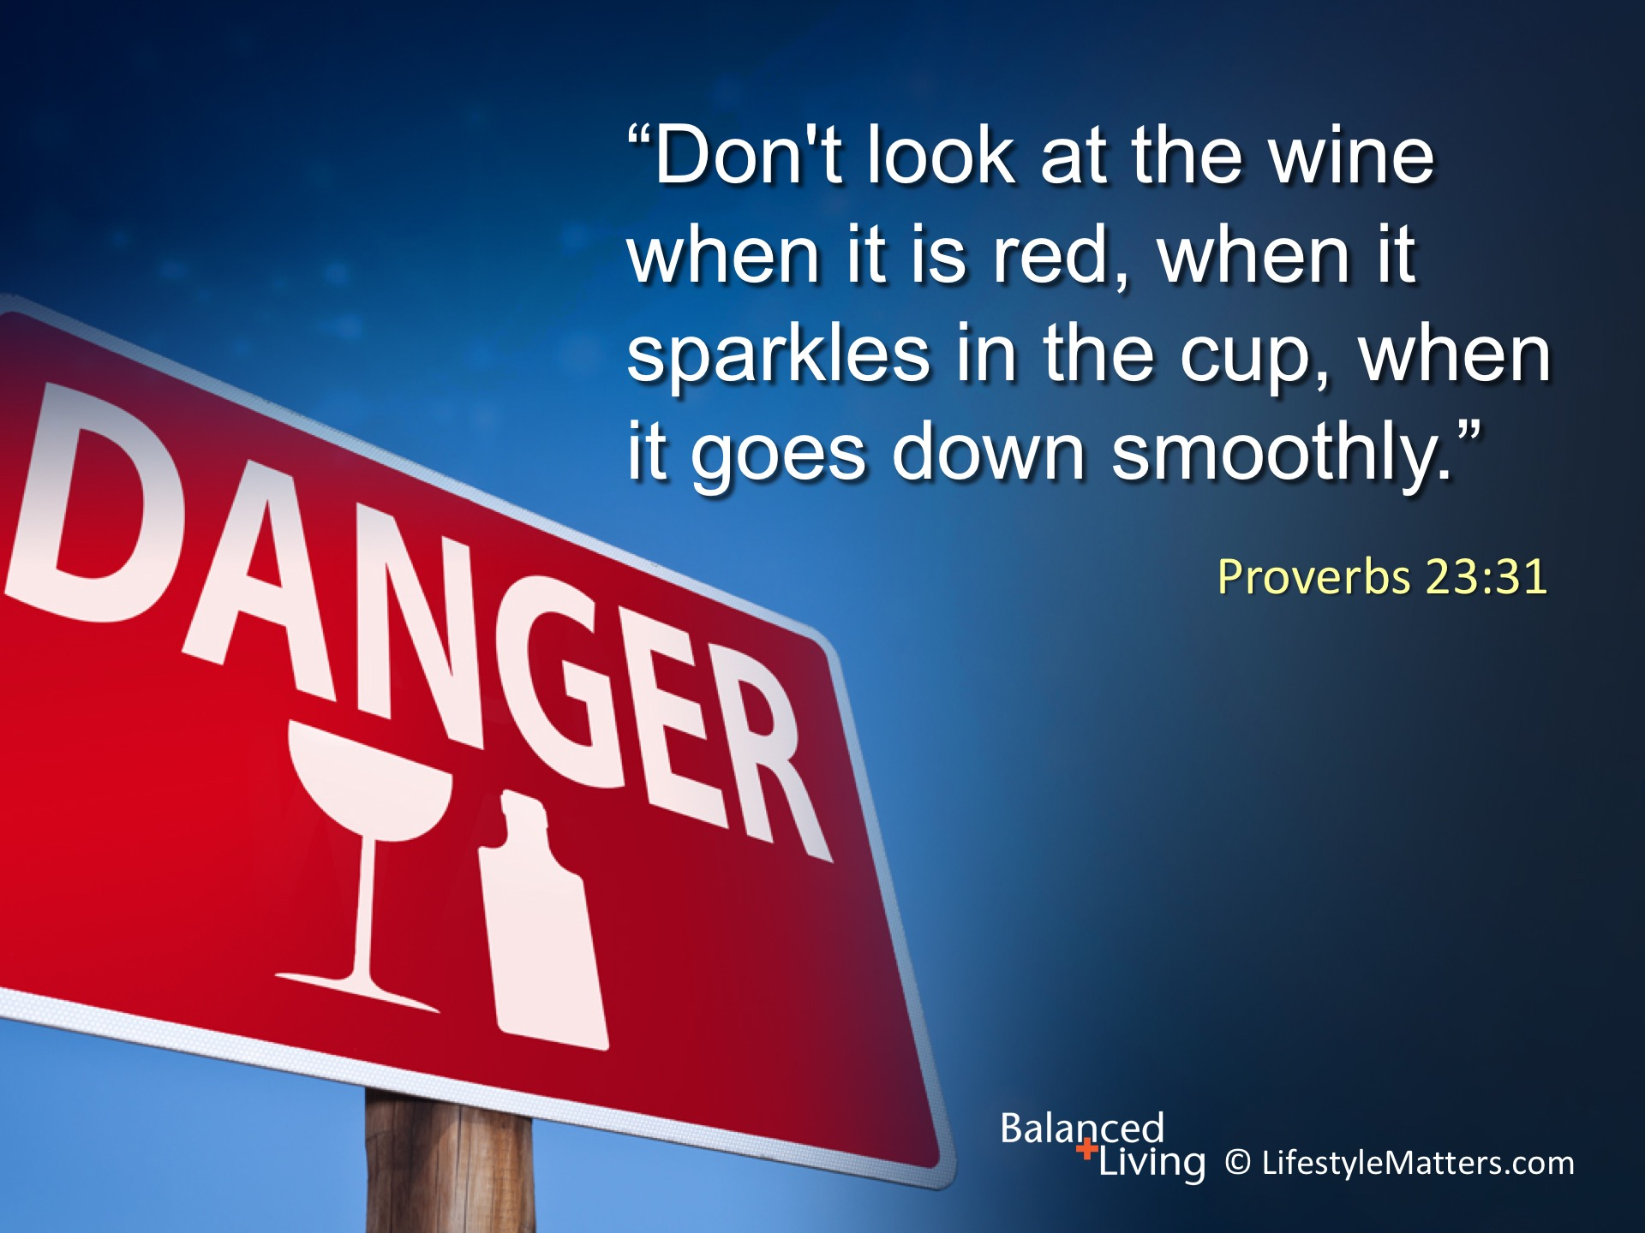
Notes:
The Bible warns against the use of alcohol.
Read slide.

Slide 11
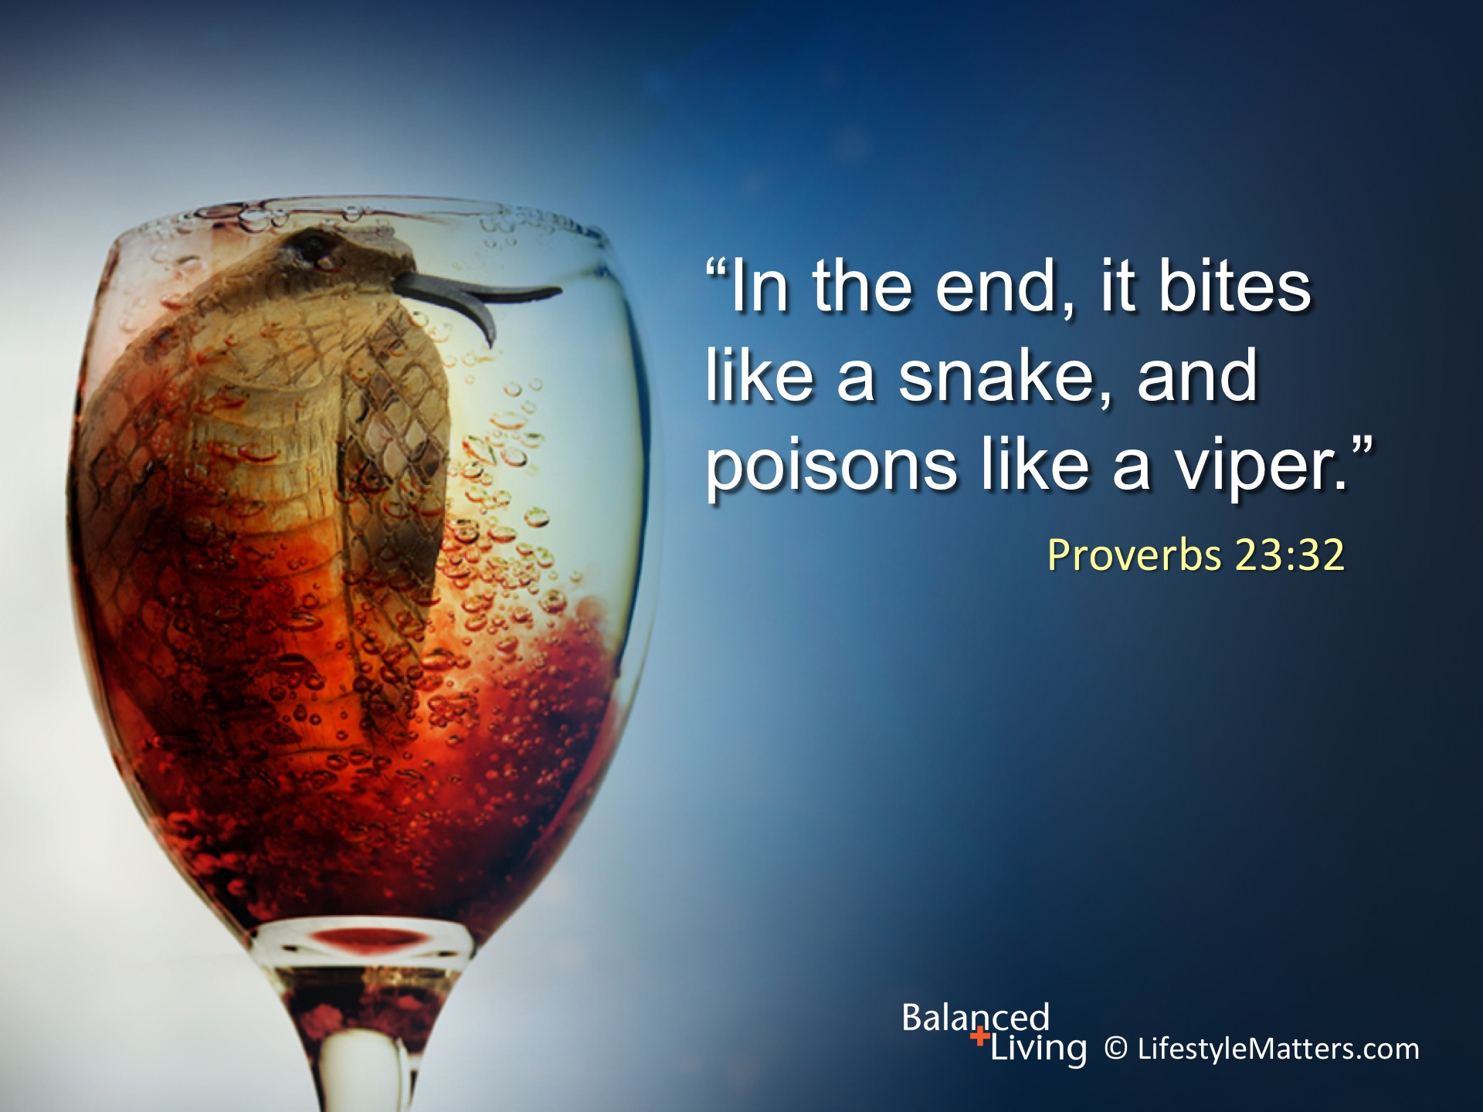
Notes:
Read slide.
At the wedding feast in Cana, Jesus turned multiple gallons of water into sweet, fresh juice.

Slide 12
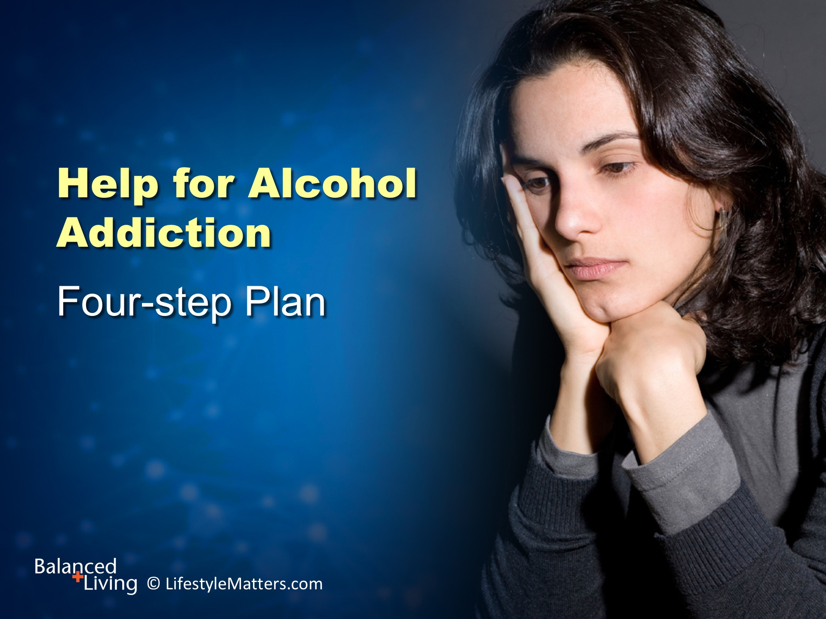
Notes:
Addiction has hijacked the brain and changed it in many ways.
There is: Read slide.

Slide 13
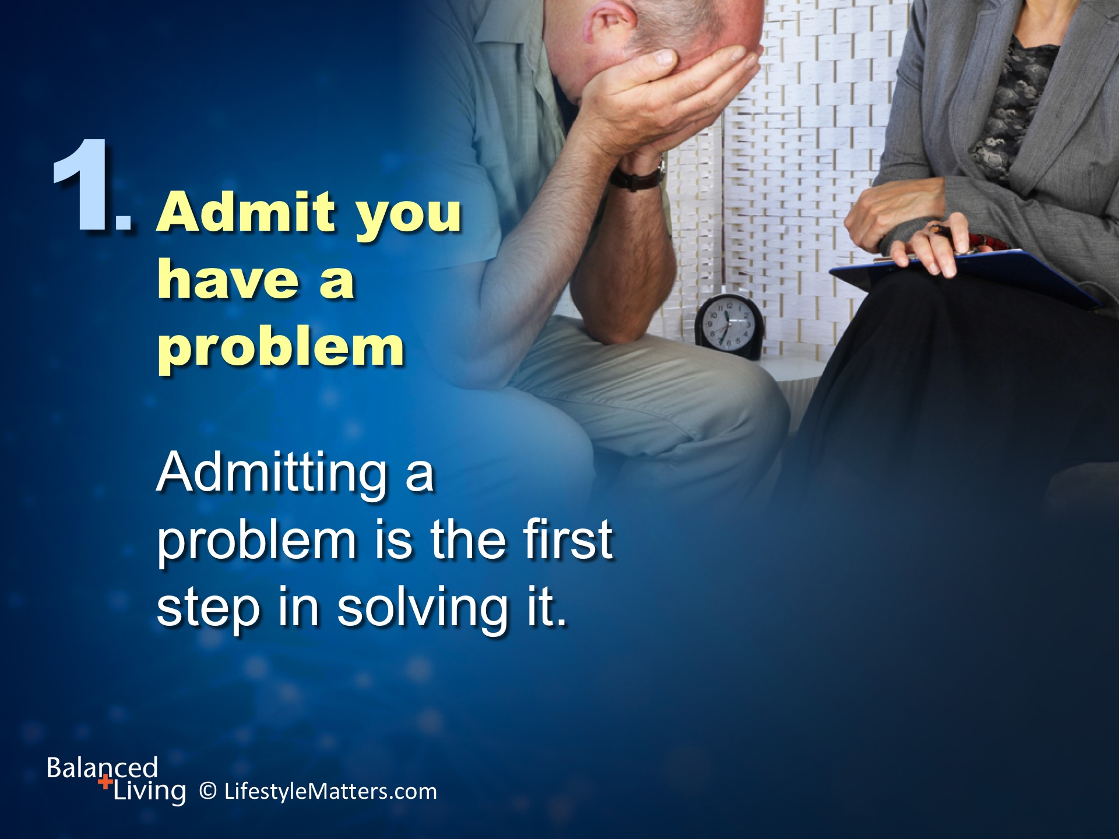
Notes:
Read slide.

Slide 14
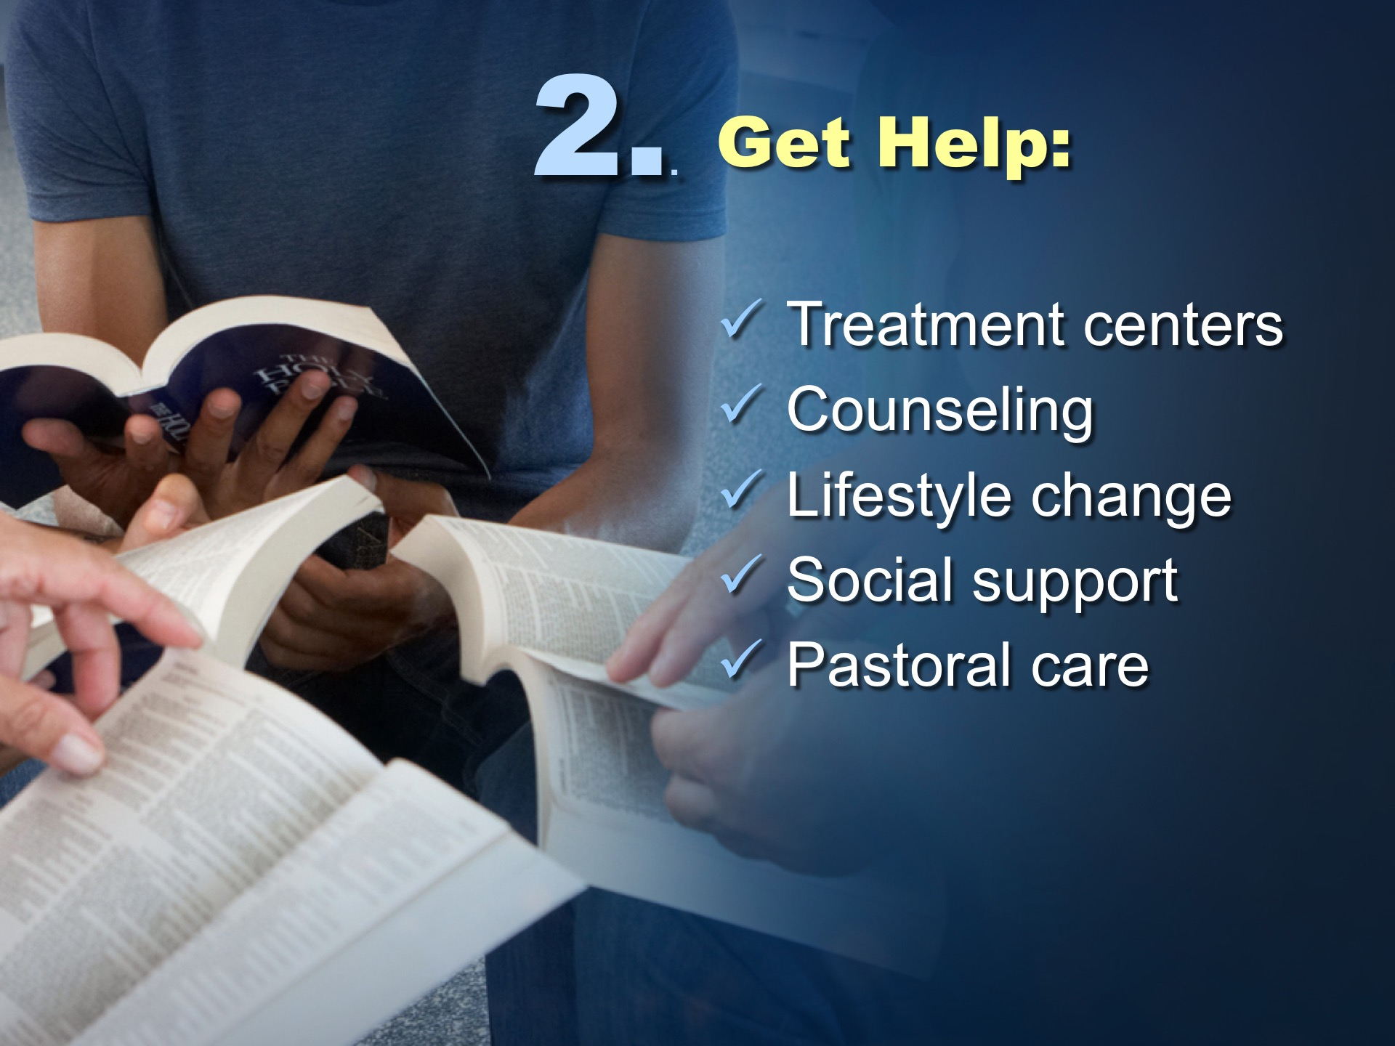
Notes:
Alcohol affects physical and mental health. Seek help to get freedom.
Your likelihood of success is greater when you reach out for help.
Read slide.

Slide 15
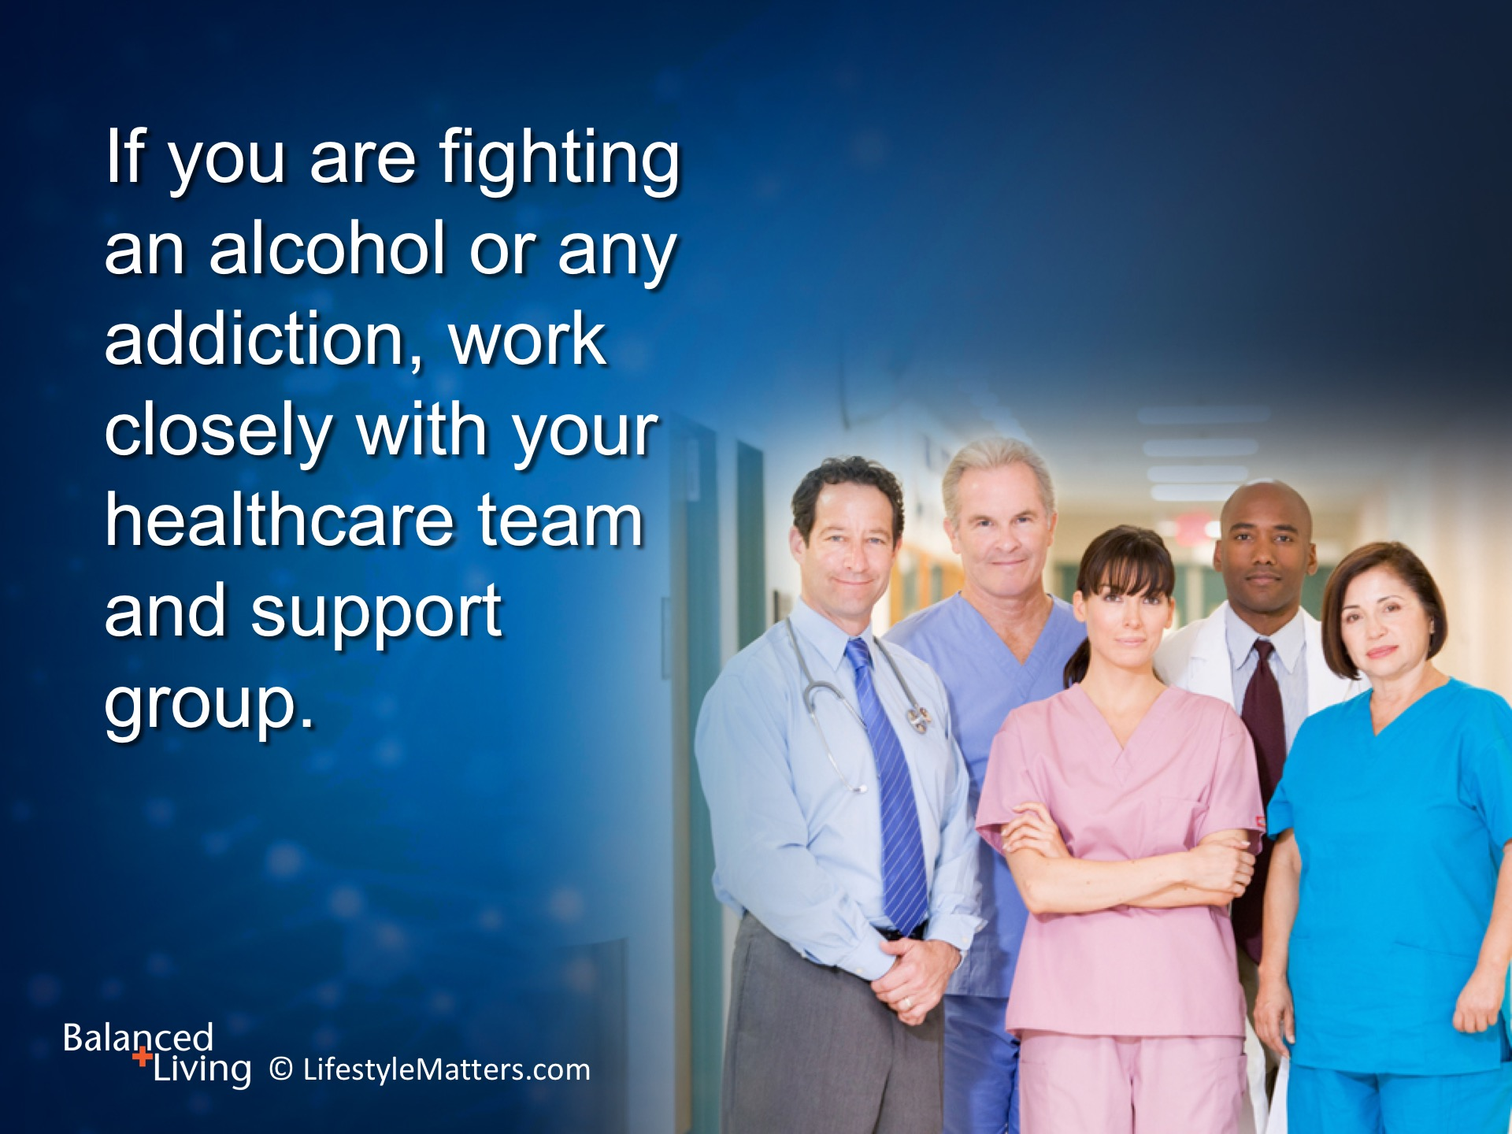
Notes:
Read slide.

Slide 16
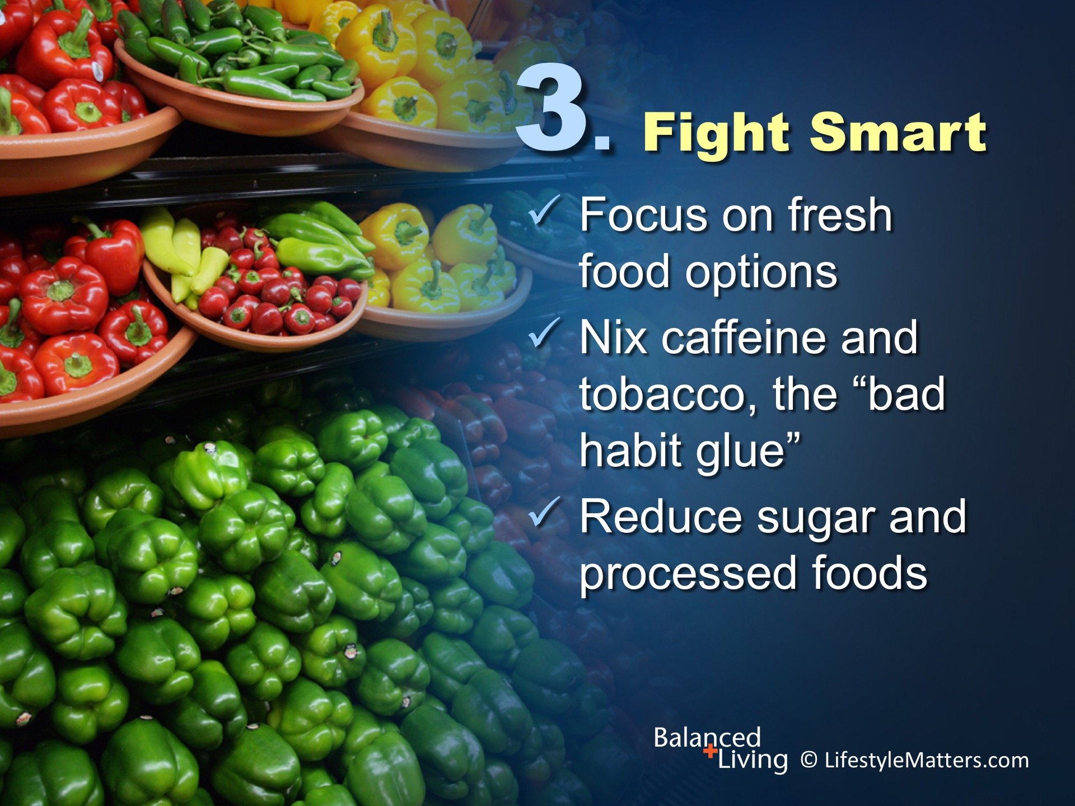
Notes:
Read slide.
The mind, mood, stress levels, and behavior are powerfully influenced by the foods we eat.
Choosing fresh leafy greens; wholesome vegetables and fruit free from grease and added sugar; wholesome whole grains; brain-healthy nuts and healthy fats such as olives and olive oil are going to dial down inflammation, improve thinking and problem-solving, and reduce stress.

Slide 17
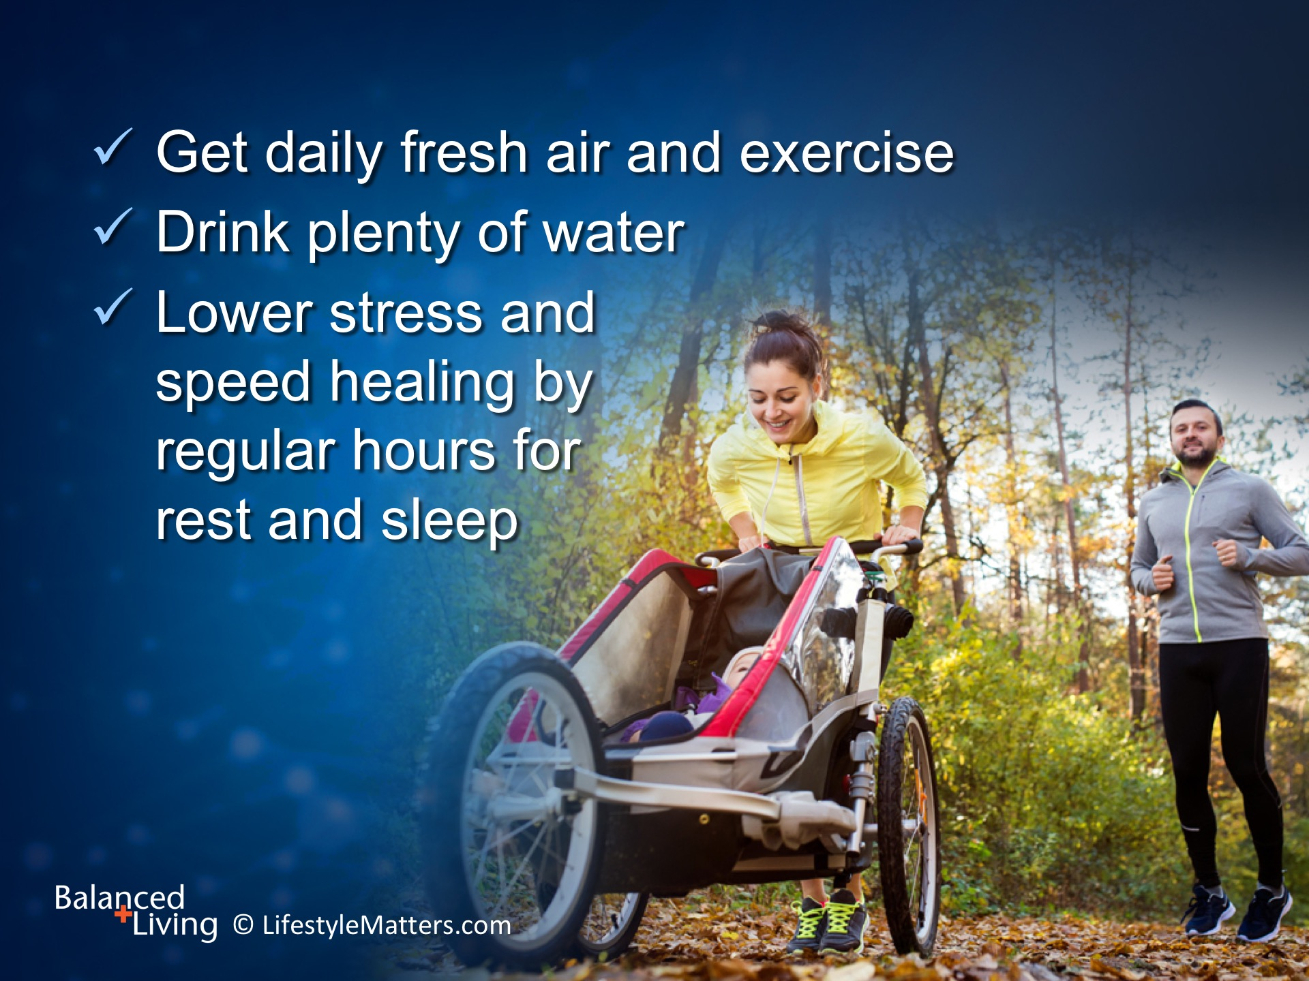
Notes:
Read slide.
Fitness training and aerobic exercise has helped thousands of people overcome addiction by reducing cravings; improving mood and alertness; and lowering risk of relapse! This has proved true for mind-altering drugs as well as alcohol. (Source: John Ratey, MD. Spark)
There are fitness—promotion programs specially designed to battle substance abuse, and they can be very effective.
(Note: RacingforRecovery.org is an example and has inspiring stories)

Slide 18

Notes:
Read slide.
Interact with those who have found freedom.
Find supportive people and activities that are fun and alcohol free.

Slide 19
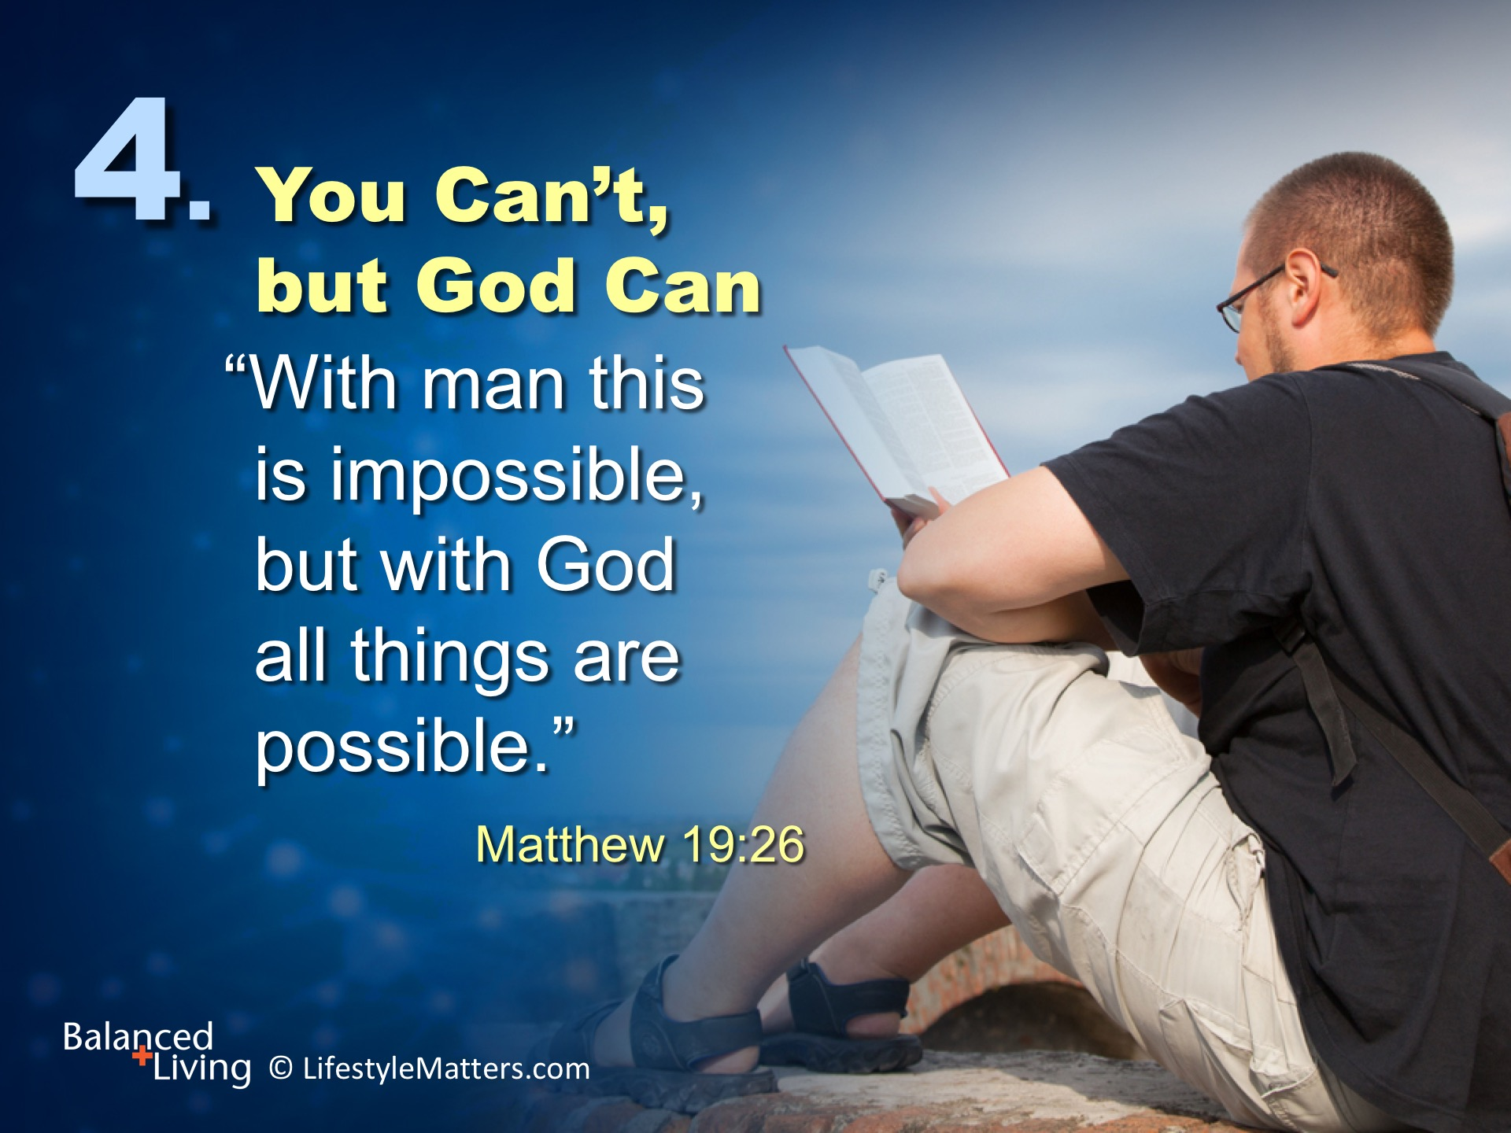
Notes:
Read slide.
Free on the inside. Just imagine. Joy, recovery, healthy relationships.
God is the Healer.
Jesus says, “Come unto Me, you that labor and are heavy laden, and I will give you rest.” Matthew 11:28.
God will create in you a new heart, a new attitude, and a new life.

Slide 20
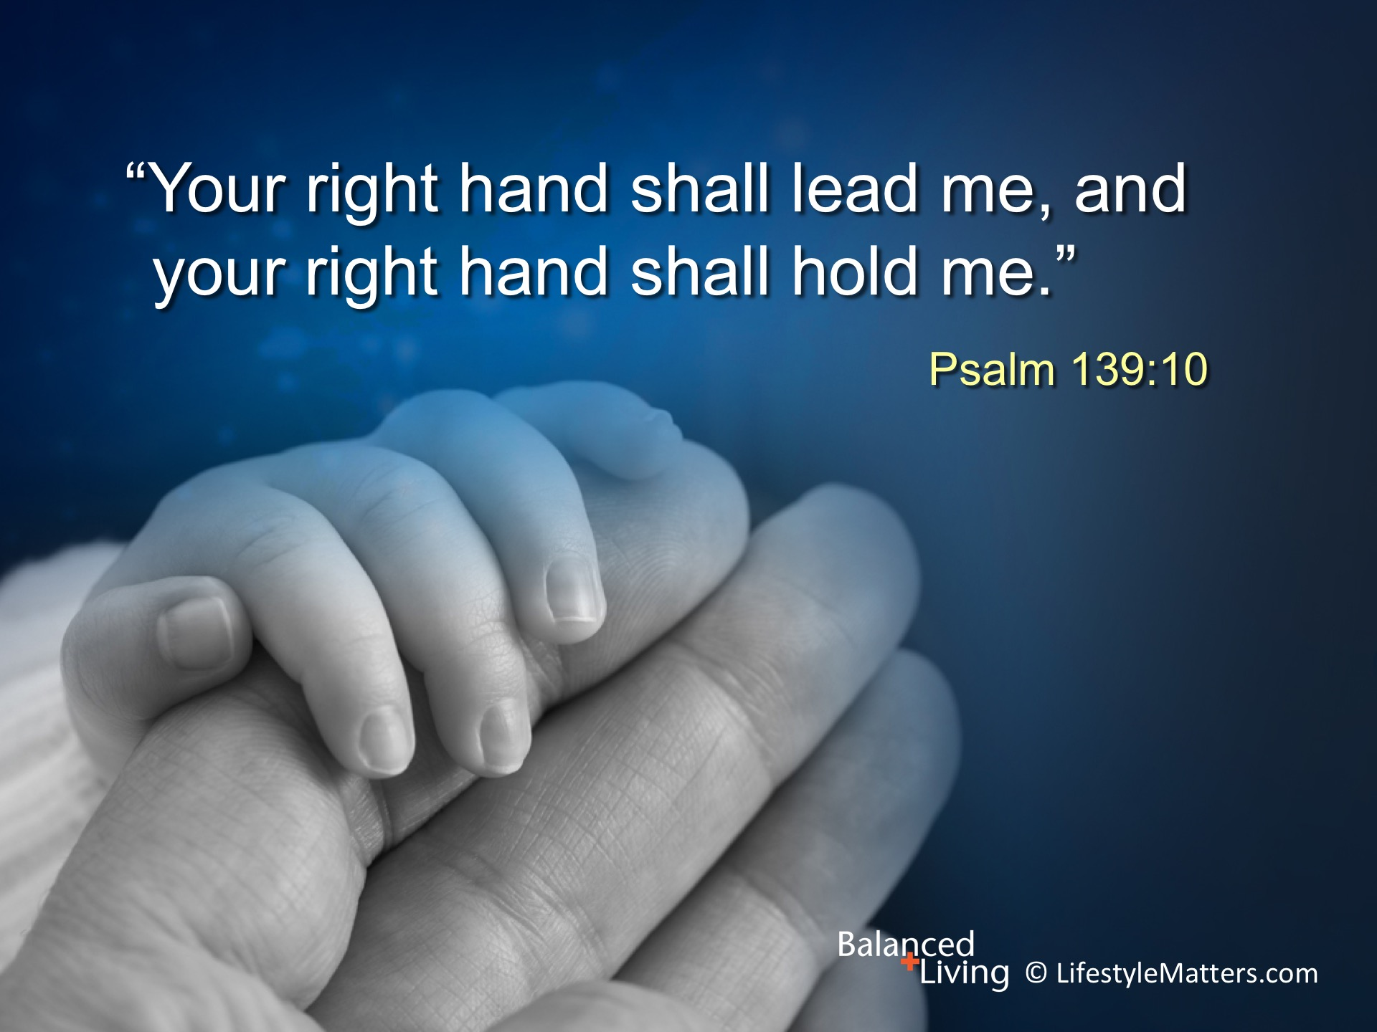
Notes:
Read slide.
With God’s promises, power, and plan, millions have overcome addictions, embarked on a new journey and a new life—and you can too!
God will guide you step-by-step. One day at a time.
The desire you have for freedom and change is an impression from the Holy Spirit.
Say “yes” right now.
Raise your hand high as you say, God please take my hand and create freedom in my life. (Raise your hand and wait for response.)
Those who have raised your hand, please meet me up front for prayer at the end of the meeting.

