Slide 1


Images © Alamy
www.alamy.com
Images used in powerpoint presentation are part of the presentation and not to be used out of context of the presentation, may not be used as stand-alone images unless to promote the presentation/event, and may not be resold in singular form or as part of an image library. Images are © Alamy and presentation templates and content therein are © MISDA, any other usage requires written permission from both parties.

Slide 2
Scripture quotations used in Balanced Living PowerPoints are taken from Bibles in the Public Domain which have no USA copyright restrictions. We have indicated which version each quotation is taken from as follows:
KJV - King James Version
BBE - Bible in Basic English
WEB - World English Bible
DBY - Darby's Translation
Any scriptures not otherwise noted are the author's paraphrase of one of these versions.

Slide 3
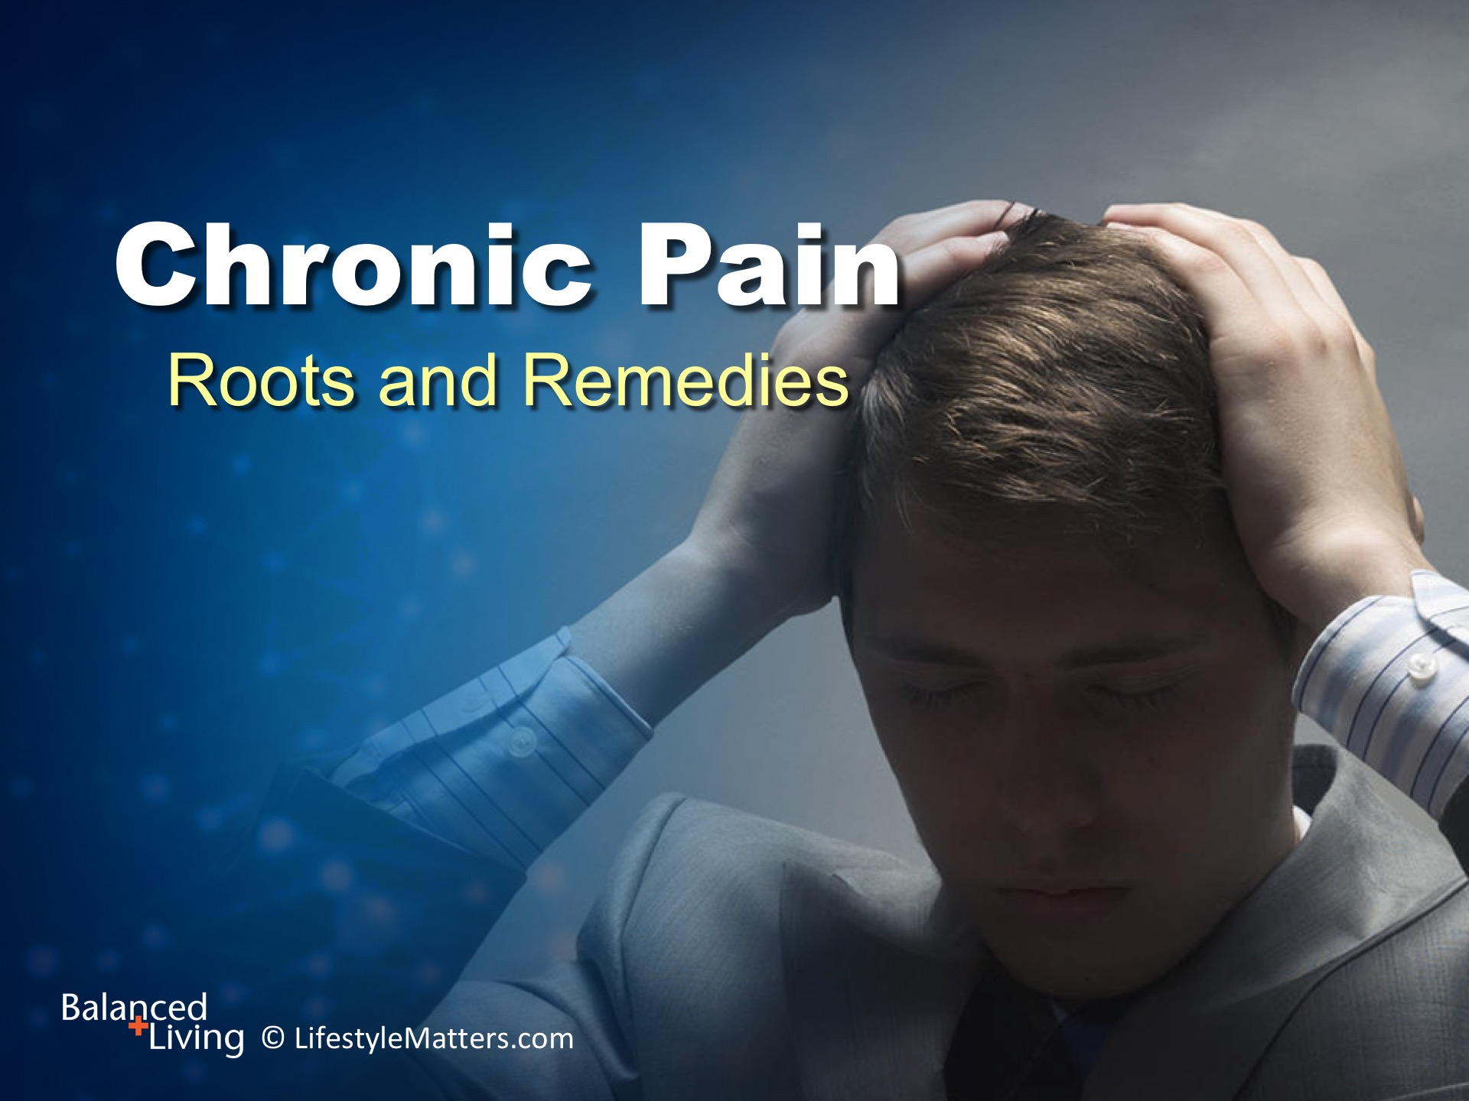
Notes:
Presenter: Please read and study the tract that accompanies this PowerPoint to prepare for this presentation.
Read slide.
Chronic pain is associated with a wide range of injury and disease, and is sometimes the disease itself.
The purpose of this program is to address chronic pain in the big picture, not to address specific pain syndromes.
We will look at helpful lifestyle, emotional, natural, and spiritual tools for addressing chronic pain.

Slide 4

Notes:
Read slide.
Connect with your doctor and other health care practitioners for guidance and available resources.
It’s important to note that these lifestyle tips are not meant to replace the interventions of your health care provider, physical therapist, or other support systems you have in place.
This information is meant to support those systems through applying positive personal wellness principles.

Slide 5
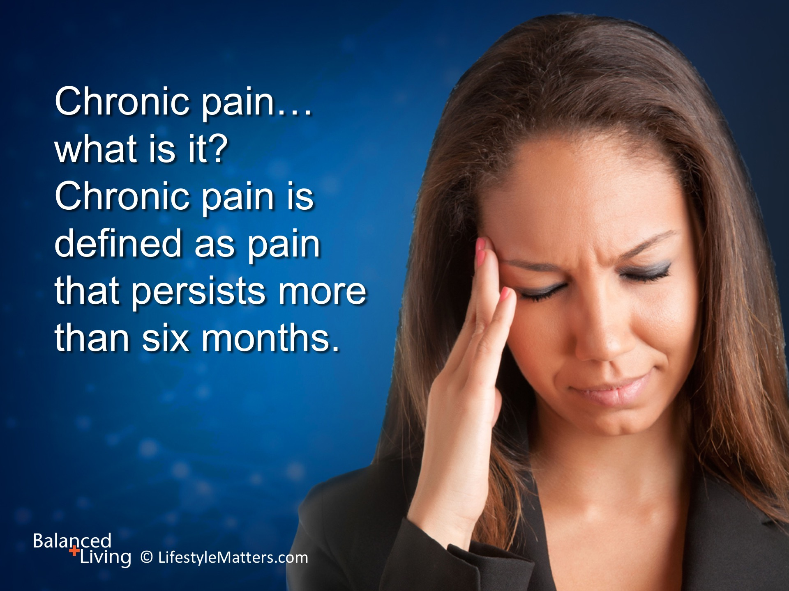
Notes:
Read slide.
Pain can persist long after an injury is healed, so in one sense chronic pain can become its own self-perpetuating condition.
This is particularly true of back, neck, and headache pain.

Slide 6
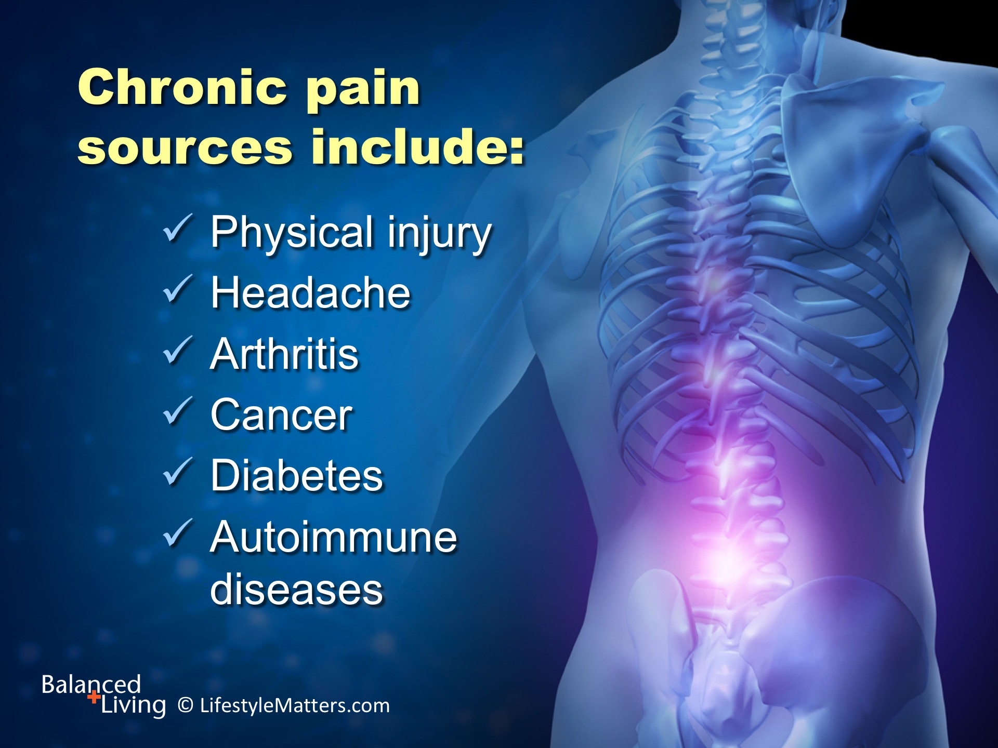
Notes:
Read slide.
We could also include irritable bowel syndrome and other distressing GI disorders that affect millions of Americans.

Slide 7
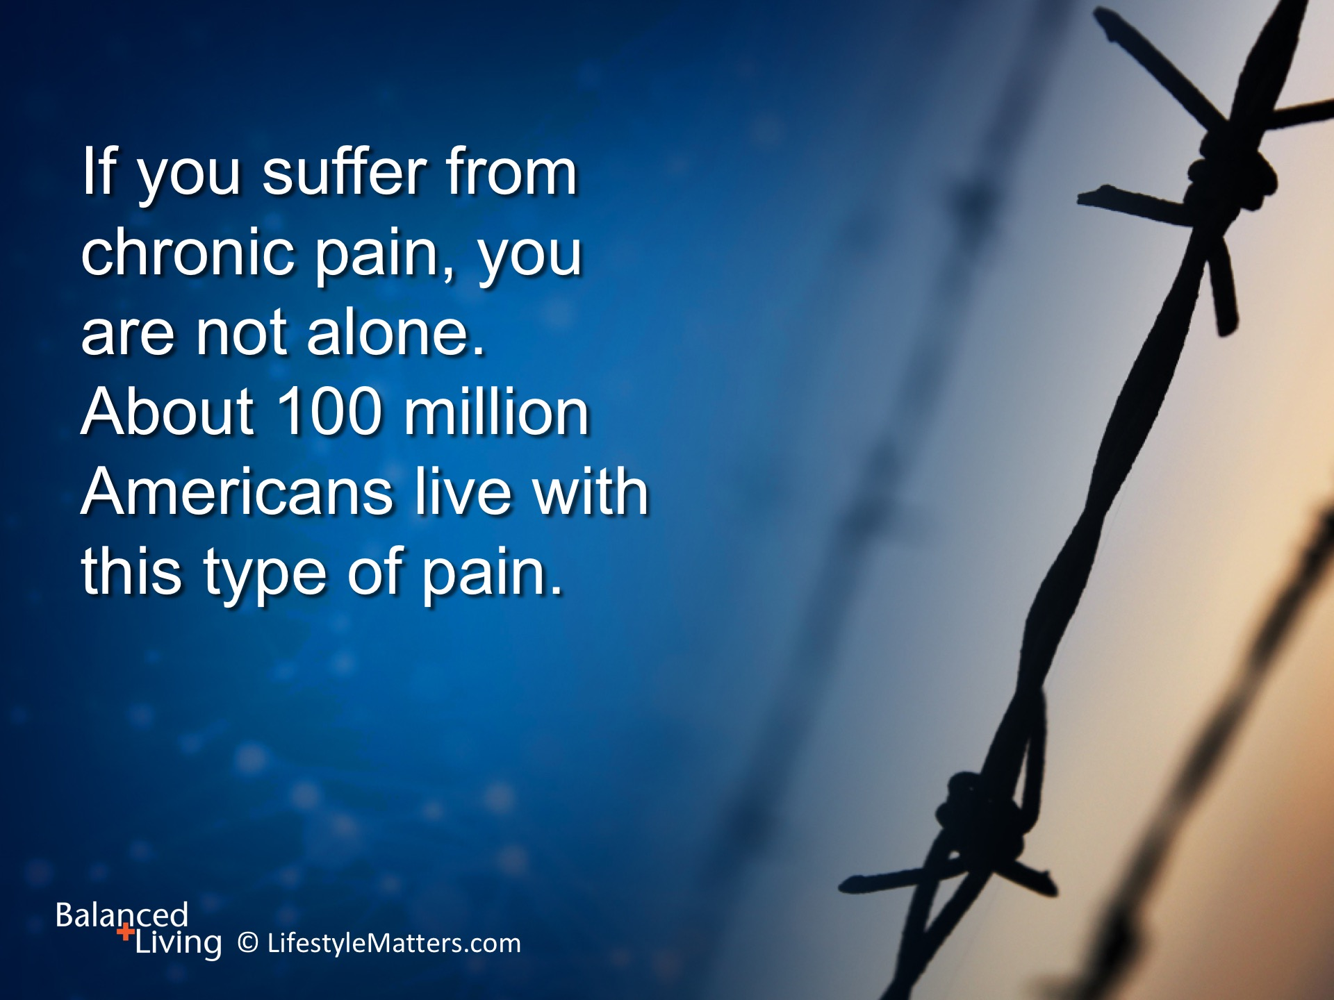
Notes:
Read slide.
Sometimes it is easy to identify the source of pain, such as tumors, lupus, or diabetic nerve pain.
Other times the source of pain is difficult to pin down. This can be frustrating for both the sufferer and the health care provider.
For instance, more than half of chronic back-pain patients have no detectible physical basis for their pain—but if you have back pain, you know it is real.
Then there are those patients who have physical signs of injury by experience little or no pain.
(Source: Deal R. Chronic Pain, 2nd ed. INR, Concord, CA 2009.)

Slide 8
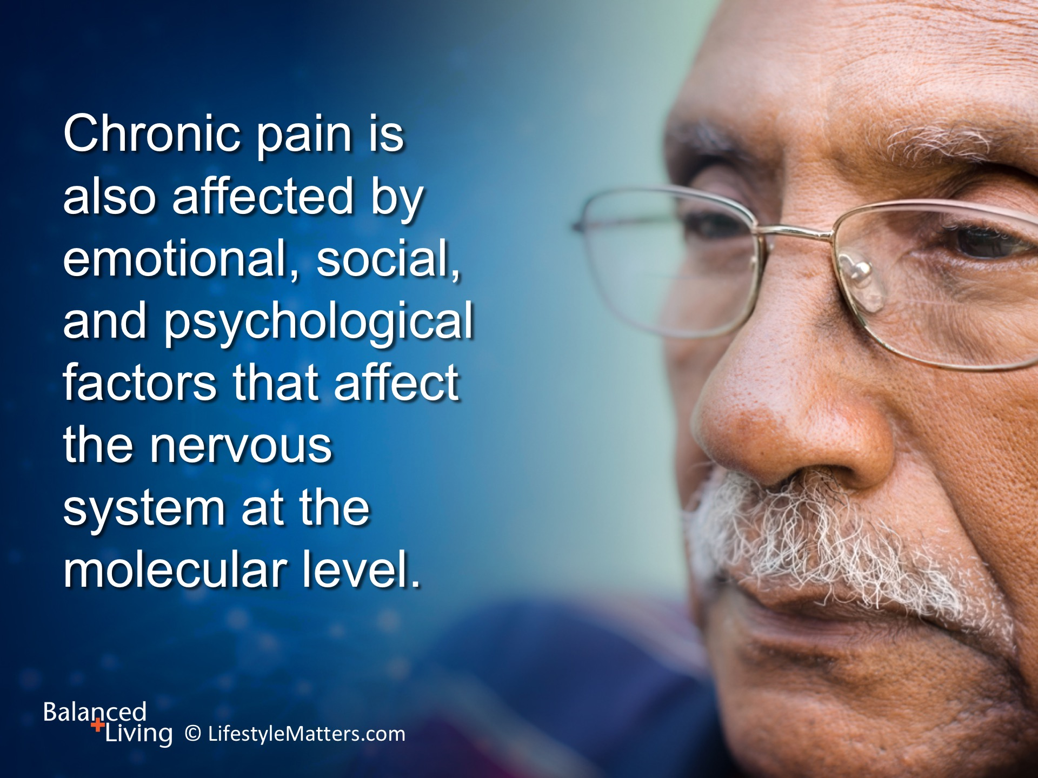
Notes:
Read slide.
The respected physician Sir William Osler stated: “While the good physician treats the disease, the great physician treats the patient.—meaning the whole patient.
Jesus Christ, the Great Physician, knows these connections because He is our Creator.
When on earth, He ministered to the whole person: physical, mental, emotional, and spiritual.
He extended His healing touch to every human need: the sick, the weary, the downcast, the depressed, the anxious, and the guilt-ridden.

Slide 9
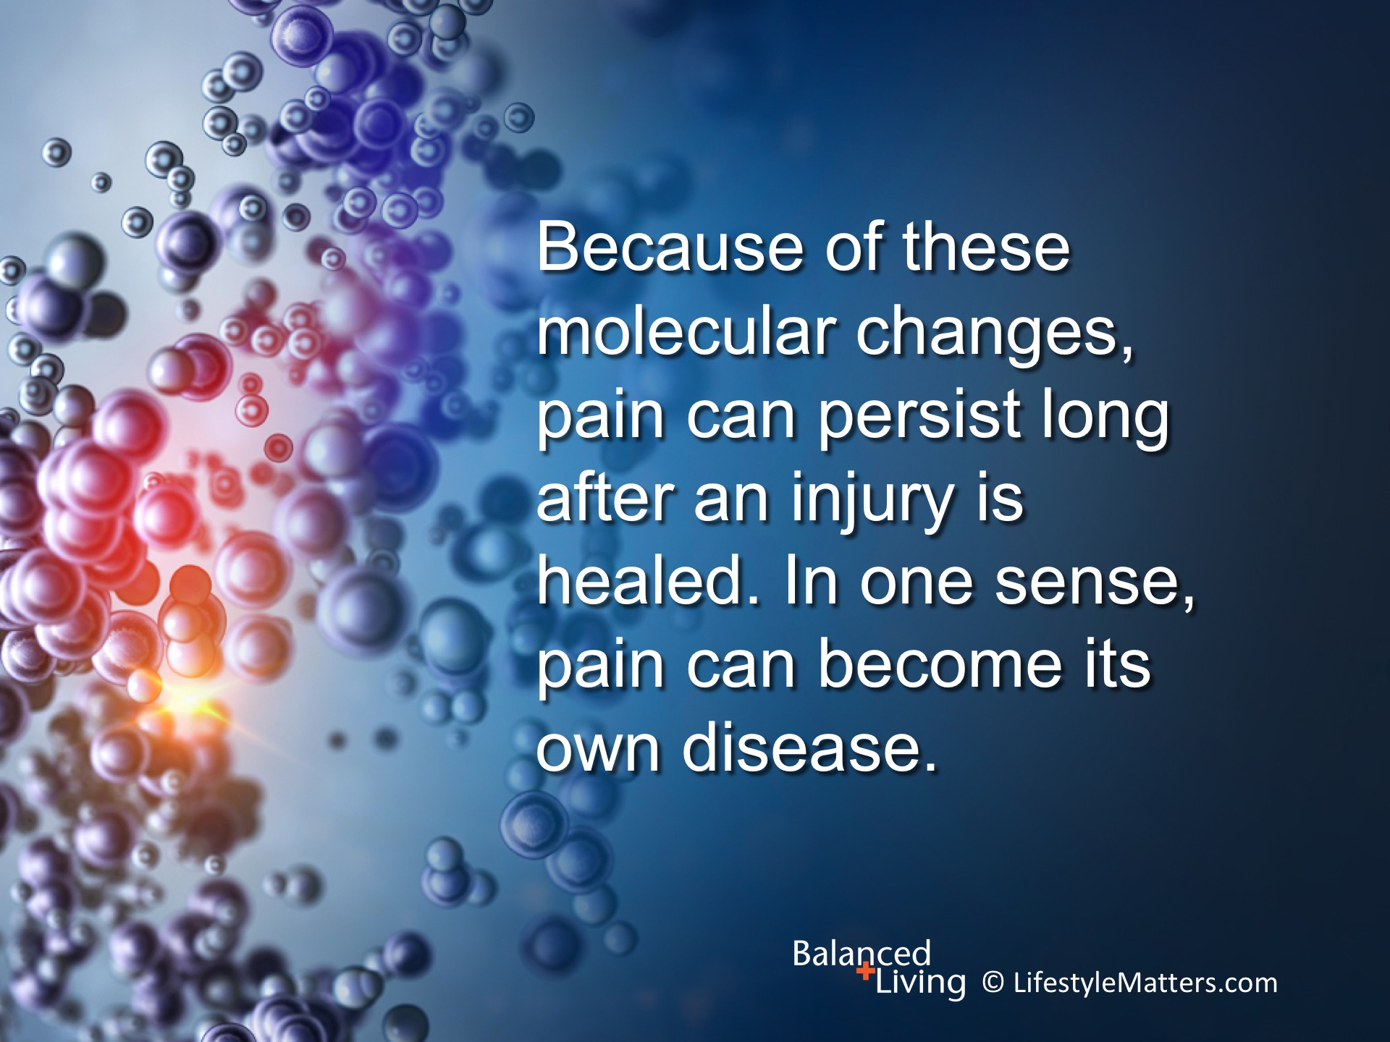
Notes:
Read slide.
As early as 1900 Harvard physician Walter Cannon recognized through his studies that emotional pressure, sadness, and fear could cause changes in stress hormones and neurotransmitters that heightened pain in the sufferer.
(Note to clinicians: Excessive production of stress hormones and neurotransmitters such as epinephrine, norepinephrine, and cortisol can lead to severe pain, cardiovascular disease, weight gain, and fatigue. Source: Scott Brady, MD, Pain free for Life, p. 157)

Slide 10
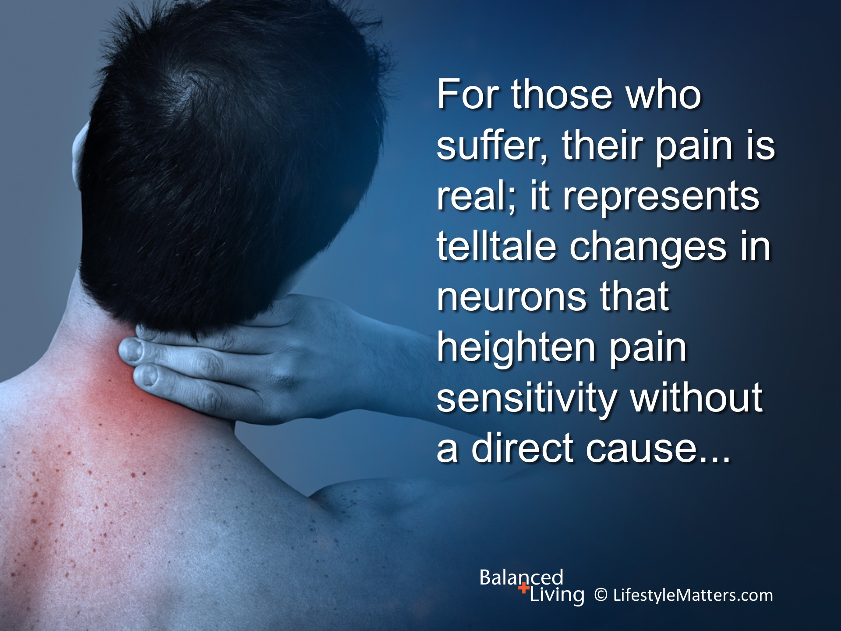
Notes:
Read slide.

Slide 11
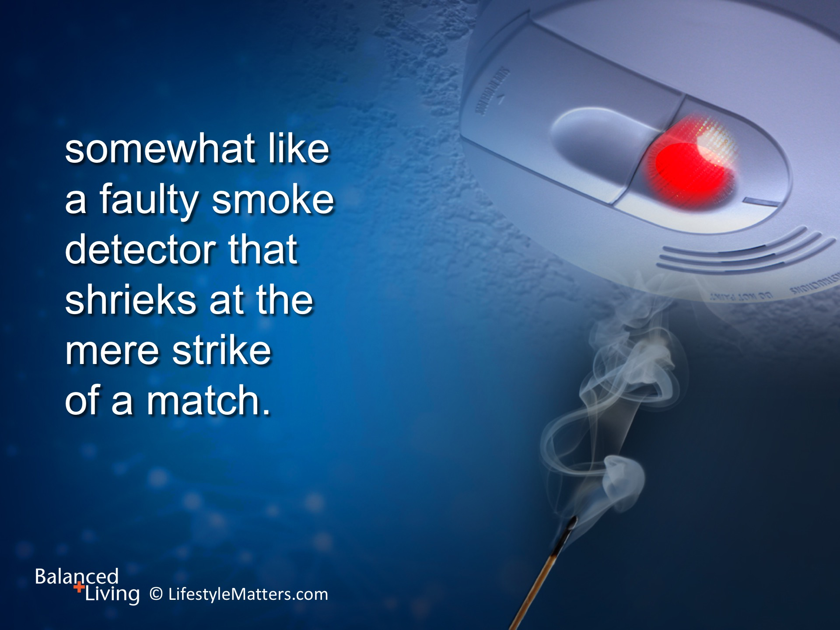
Notes:
Read slide.
Your body produces mood-boosting and pain dampening chemical messengers called endorphins when you exercise or enjoy a pleasant meal. They also dampen pain signals.
The receptors for the body’s pain-soothing endorphins are located in many other organs besides the brain, including the muscles, heart, and intestines.
Your emotions affect more than your brain—they affect many other organs and the sensitivity of the body’s pain systems.
In addition, childhood adversity may influence pain sensitivity later in life. (Source: Neuropsychiatr Dis Treat. 2015; 11: 2109–2116.)

Slide 12
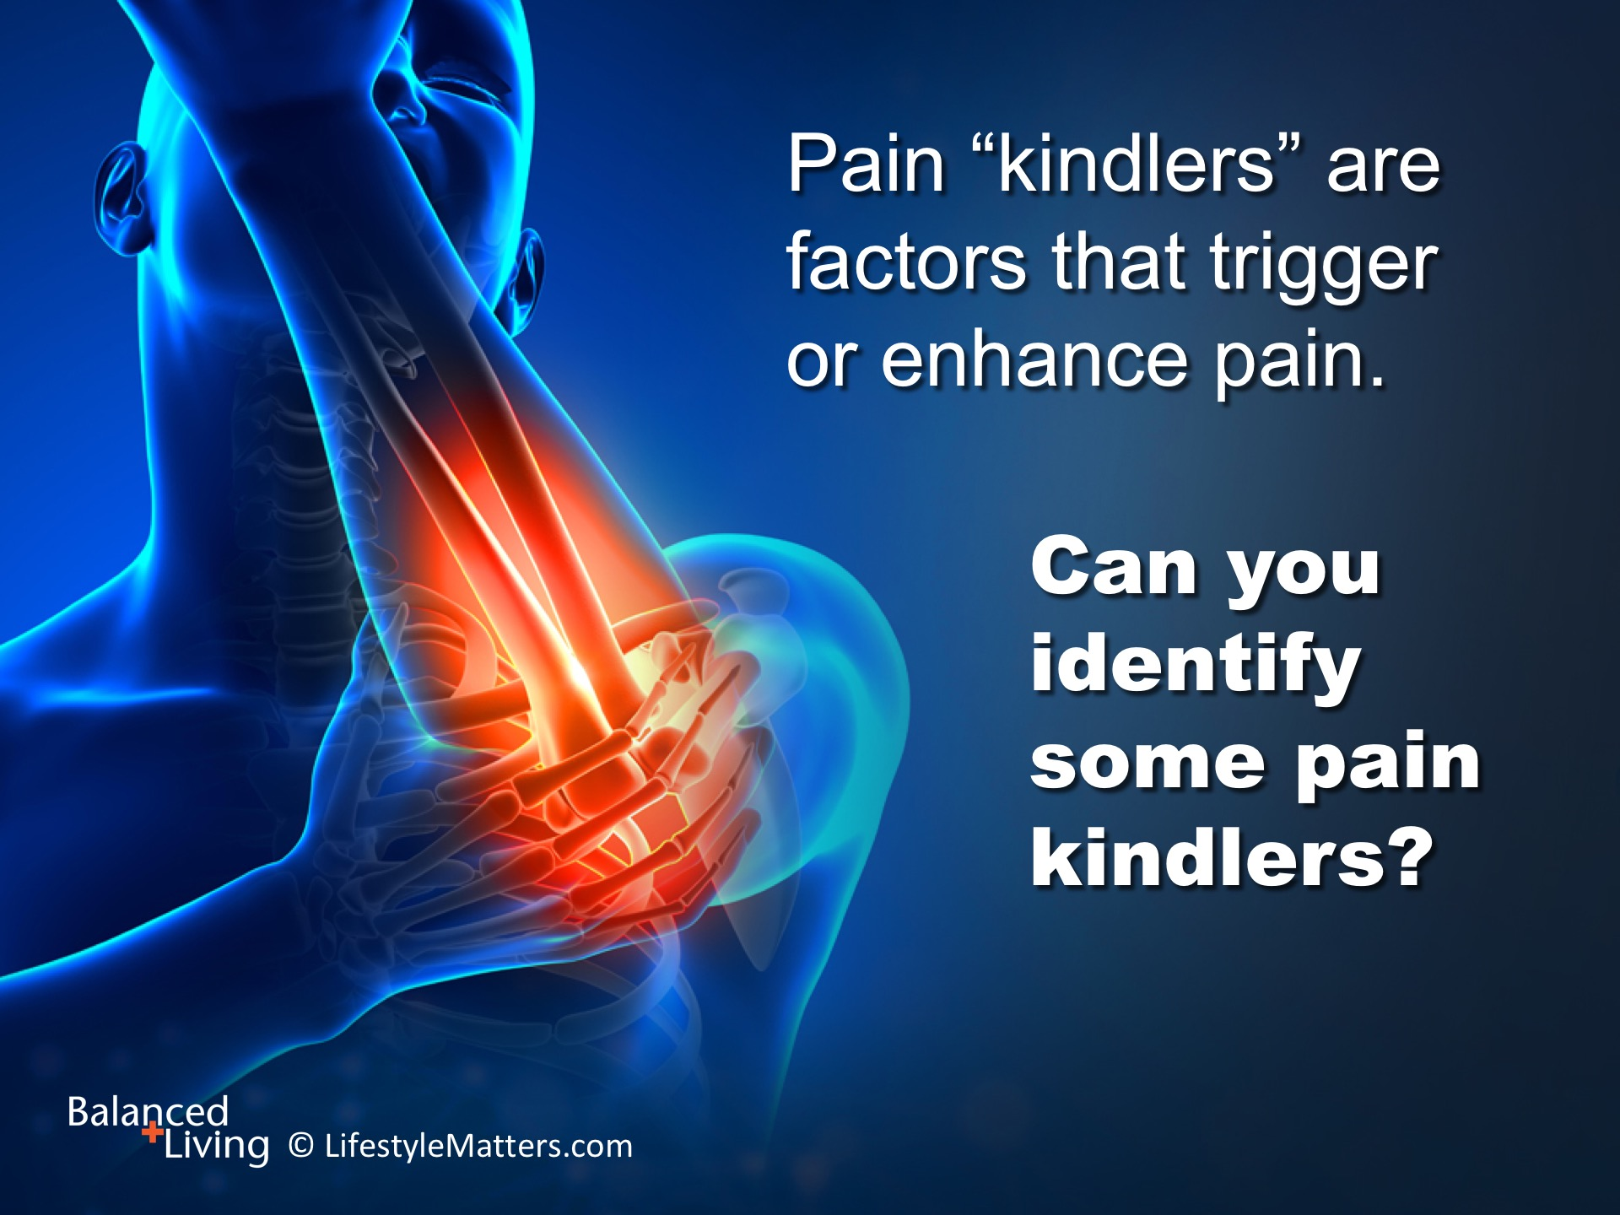
Notes:
Read slide.
(Wait for response)
Examples: Lack of sleep; stress; violent, distressing media; irregular schedule; sugary foods and drinks; high saturated fat diet; smoking; obesity; chronic mood states such as anger; hopelessness; depression.

Slide 13
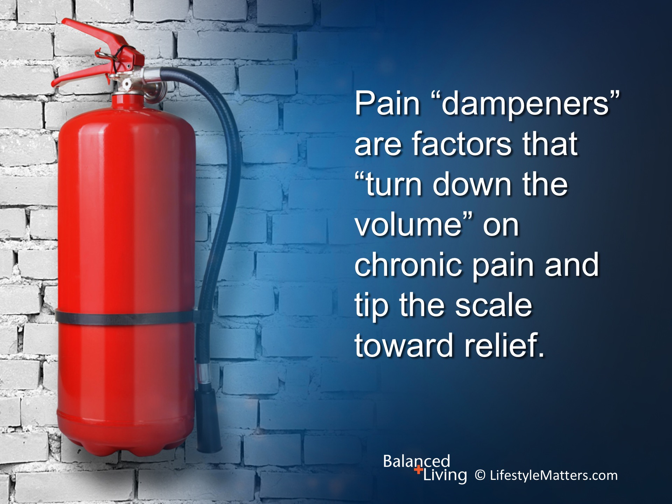
Notes:
Read slide.
Can you identify some possible pain “dampeners”? (Wait for response)
Examples: Plenty of sleep; relaxation; regular schedule; fresh vegetables and fruits; high fiber vegetarian diet; exercise; positive mood states such as forgiveness; gratitude; hope; optimism; faith and trust in God.

Slide 14
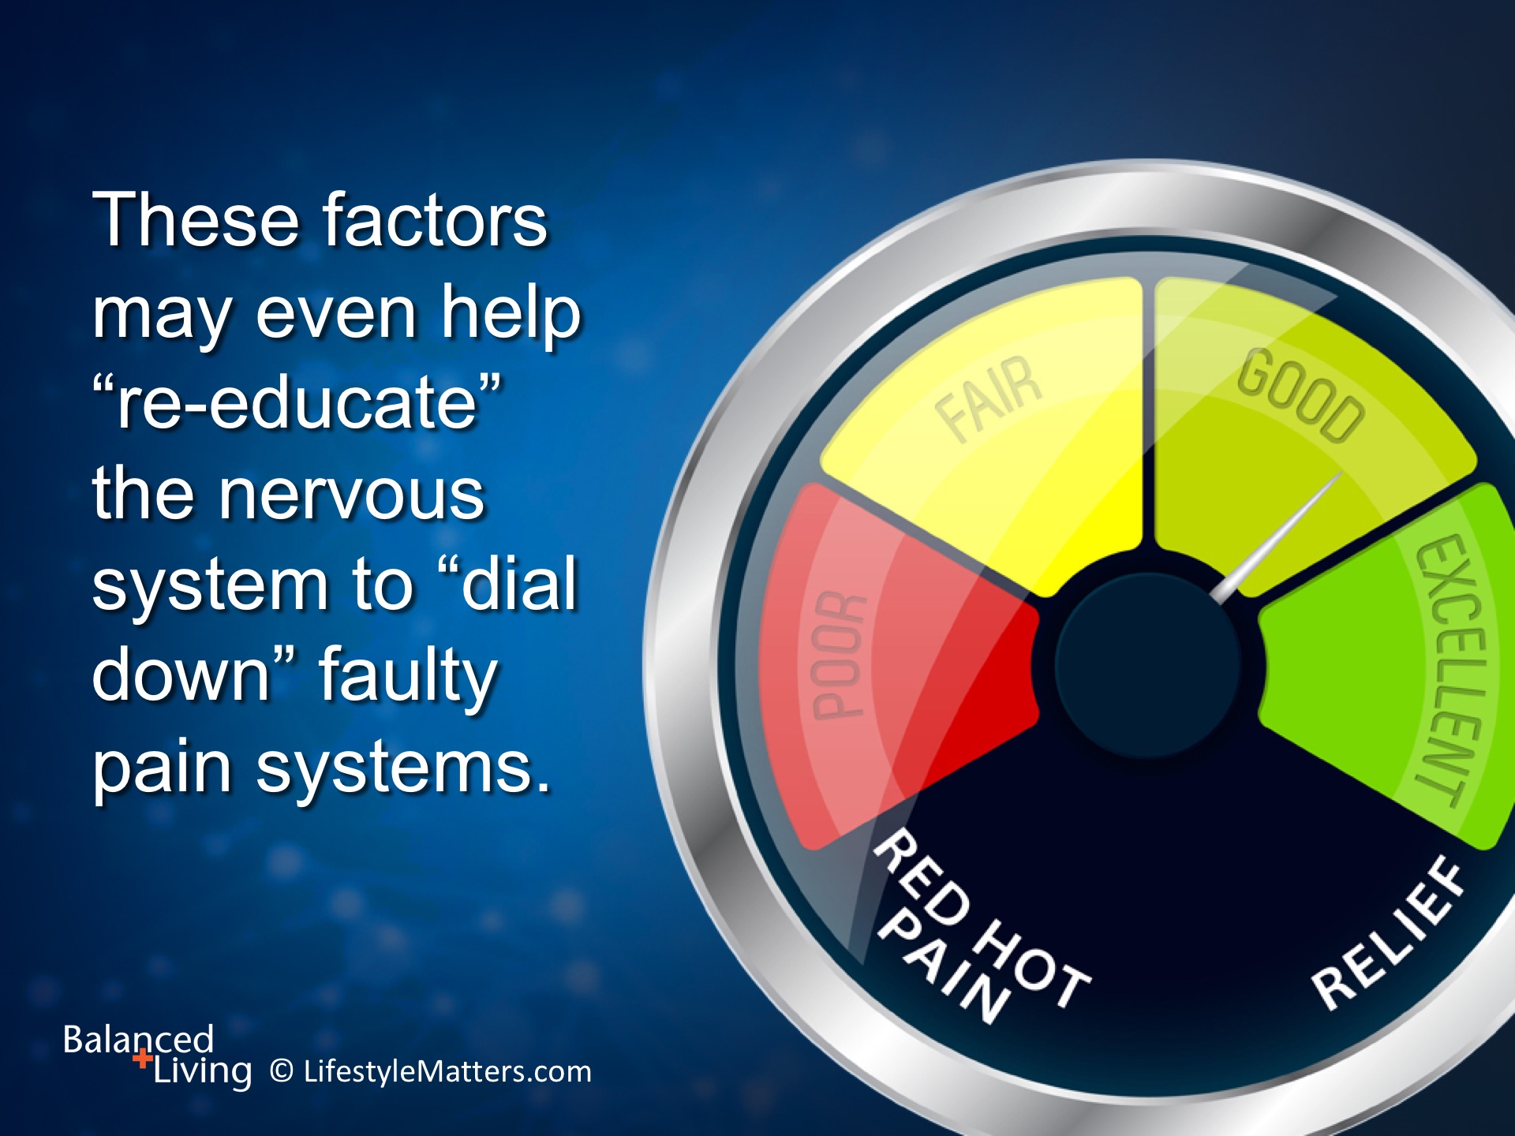
Notes:
The effects may be subtle, but over time: Read slide.

Slide 15
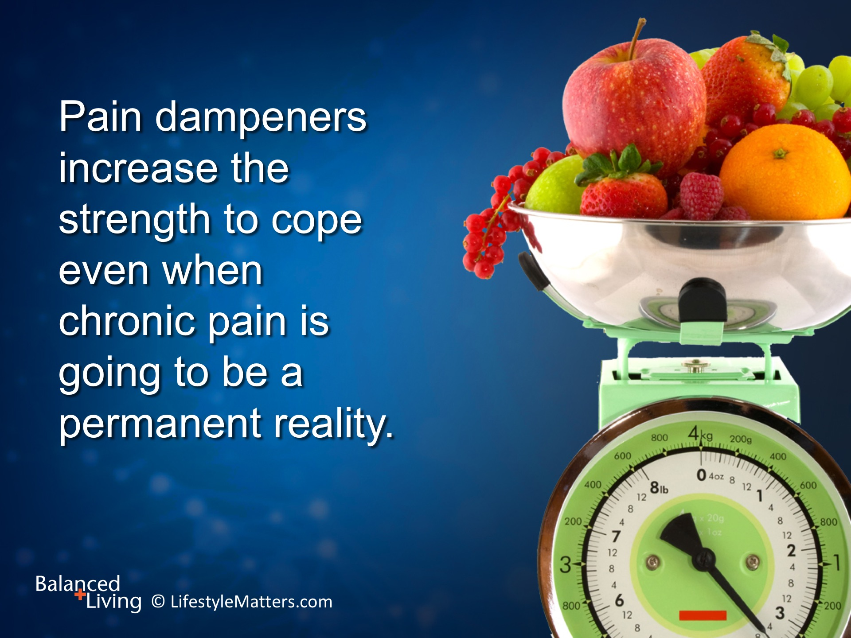
Notes:
Read slide.
Avoiding pain kindlers and increasing pain dampeners increase general health, emotional and mental health.
These healthy habits also increase the ability to adapt to chronic conditions that are here to stay.

Slide 16
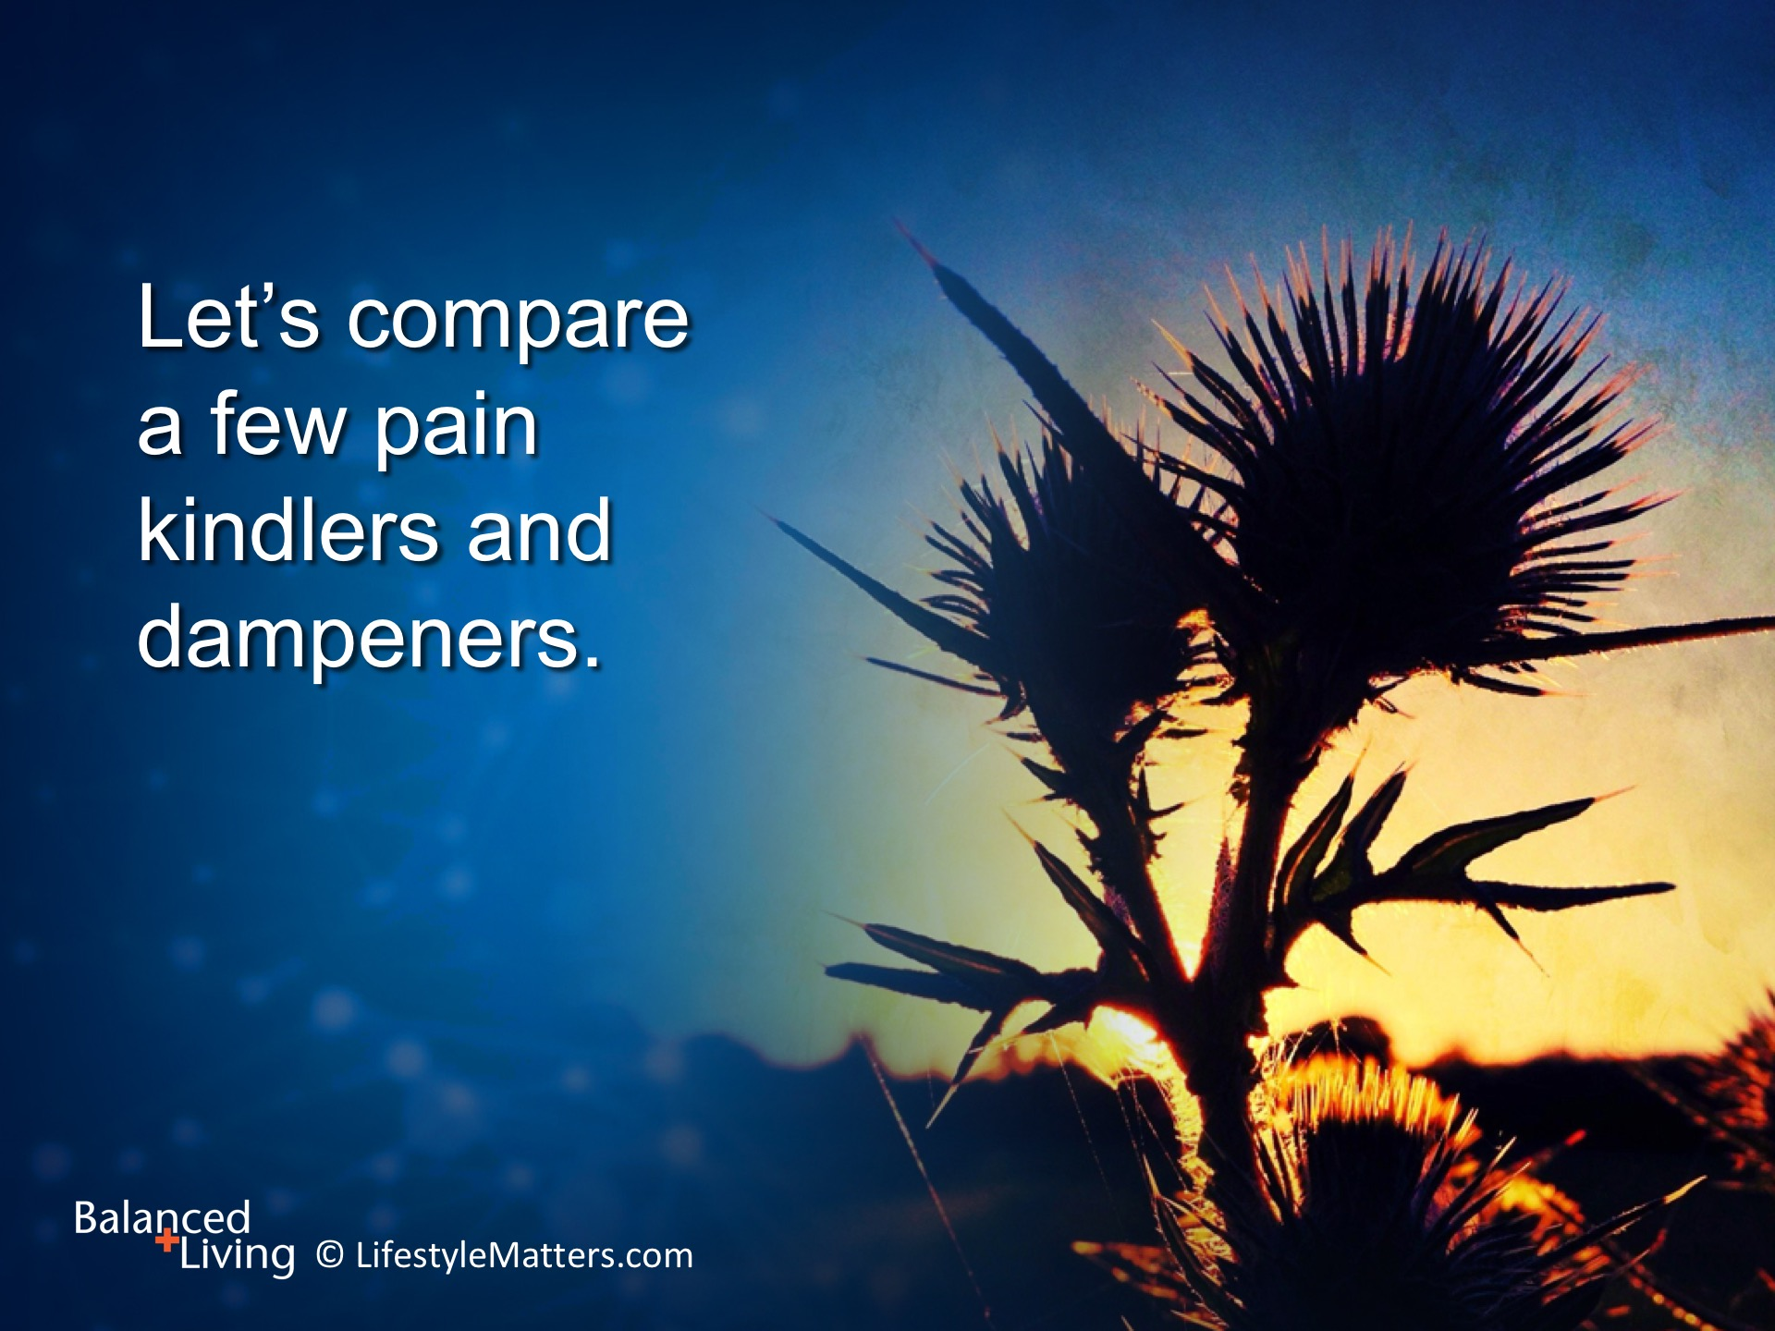
Notes:
Read slide.

Slide 17
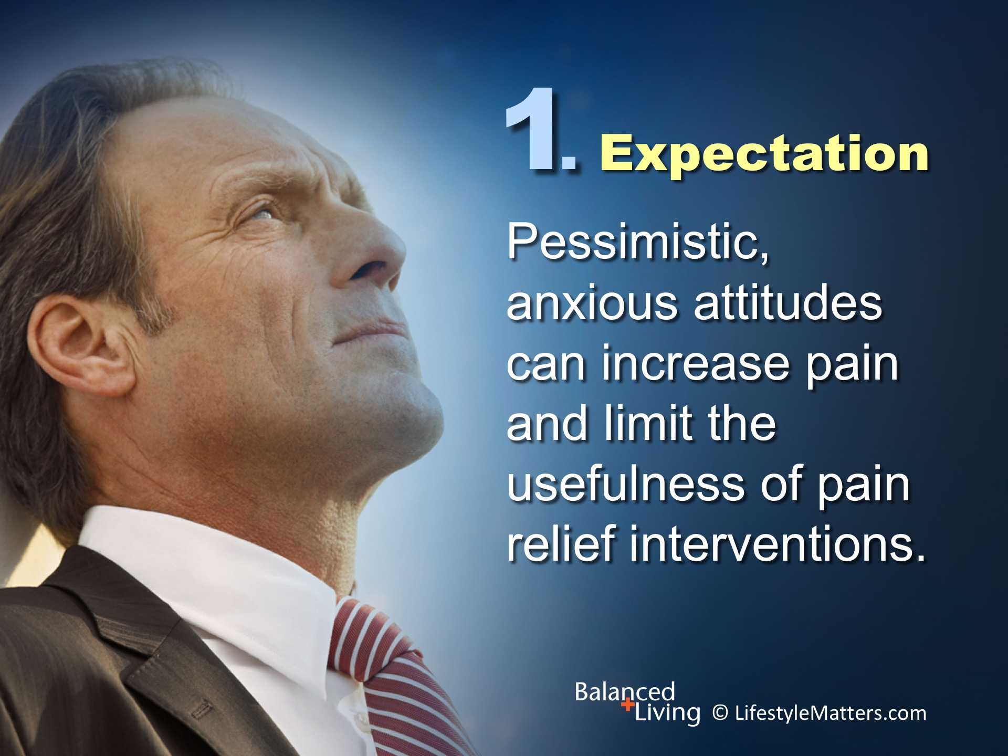
Notes:
Read slide.
Expecting pain can amplify the pain response. Pessimism increases suffering.
(Source: Prog Brain Res 2000;122:245-53.)

Slide 18
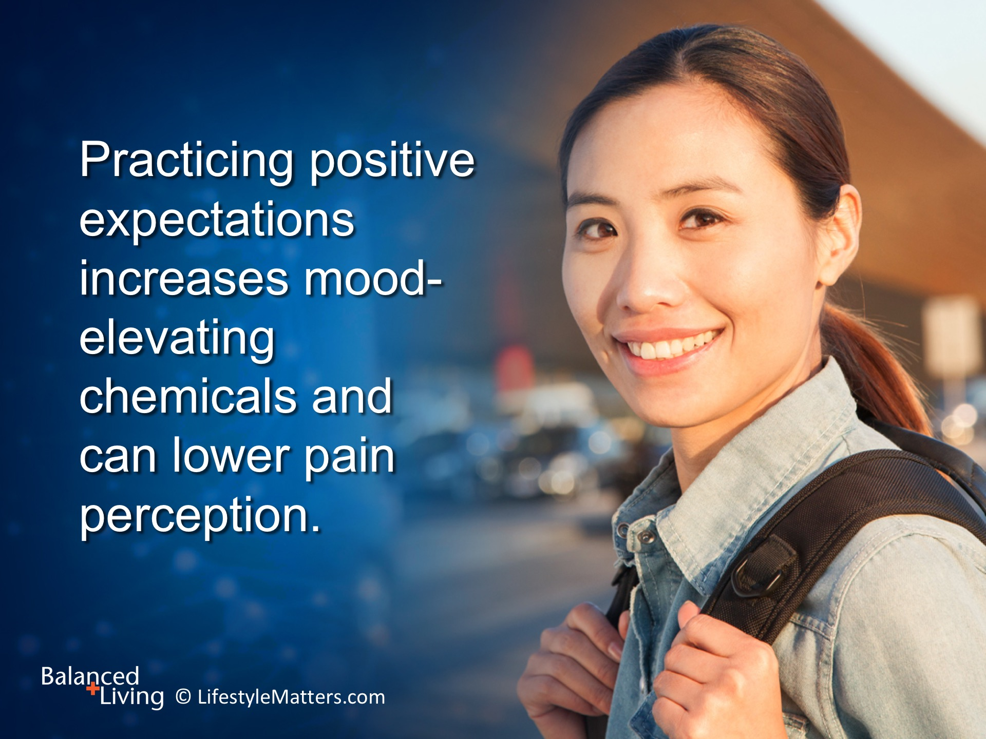
Notes:
Read slide.
Focusing on the positive aspects of life reduce the sense of helplessness that accompanies pain.
This can lead to faster recovery from injuries and better coping abilities.
(Source: Rehab Psychol 2010 Feb;44(1):12-22)

Slide 19
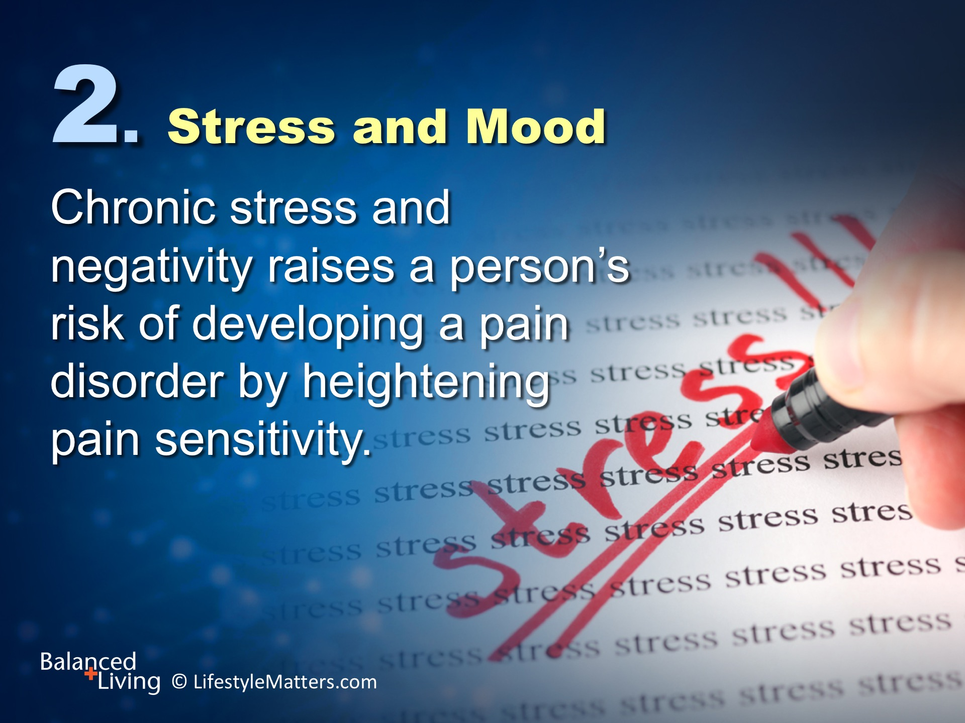
Notes:
Read slide.
Catastrophizing, anxiety, depression, guilt, and negativity all heighten the sensitivity and activity of pain circuits, causing the sufferer to attach negative emotional meaning to his or her pain.
(Source: J Pers April 2004;72:2.)

Slide 20
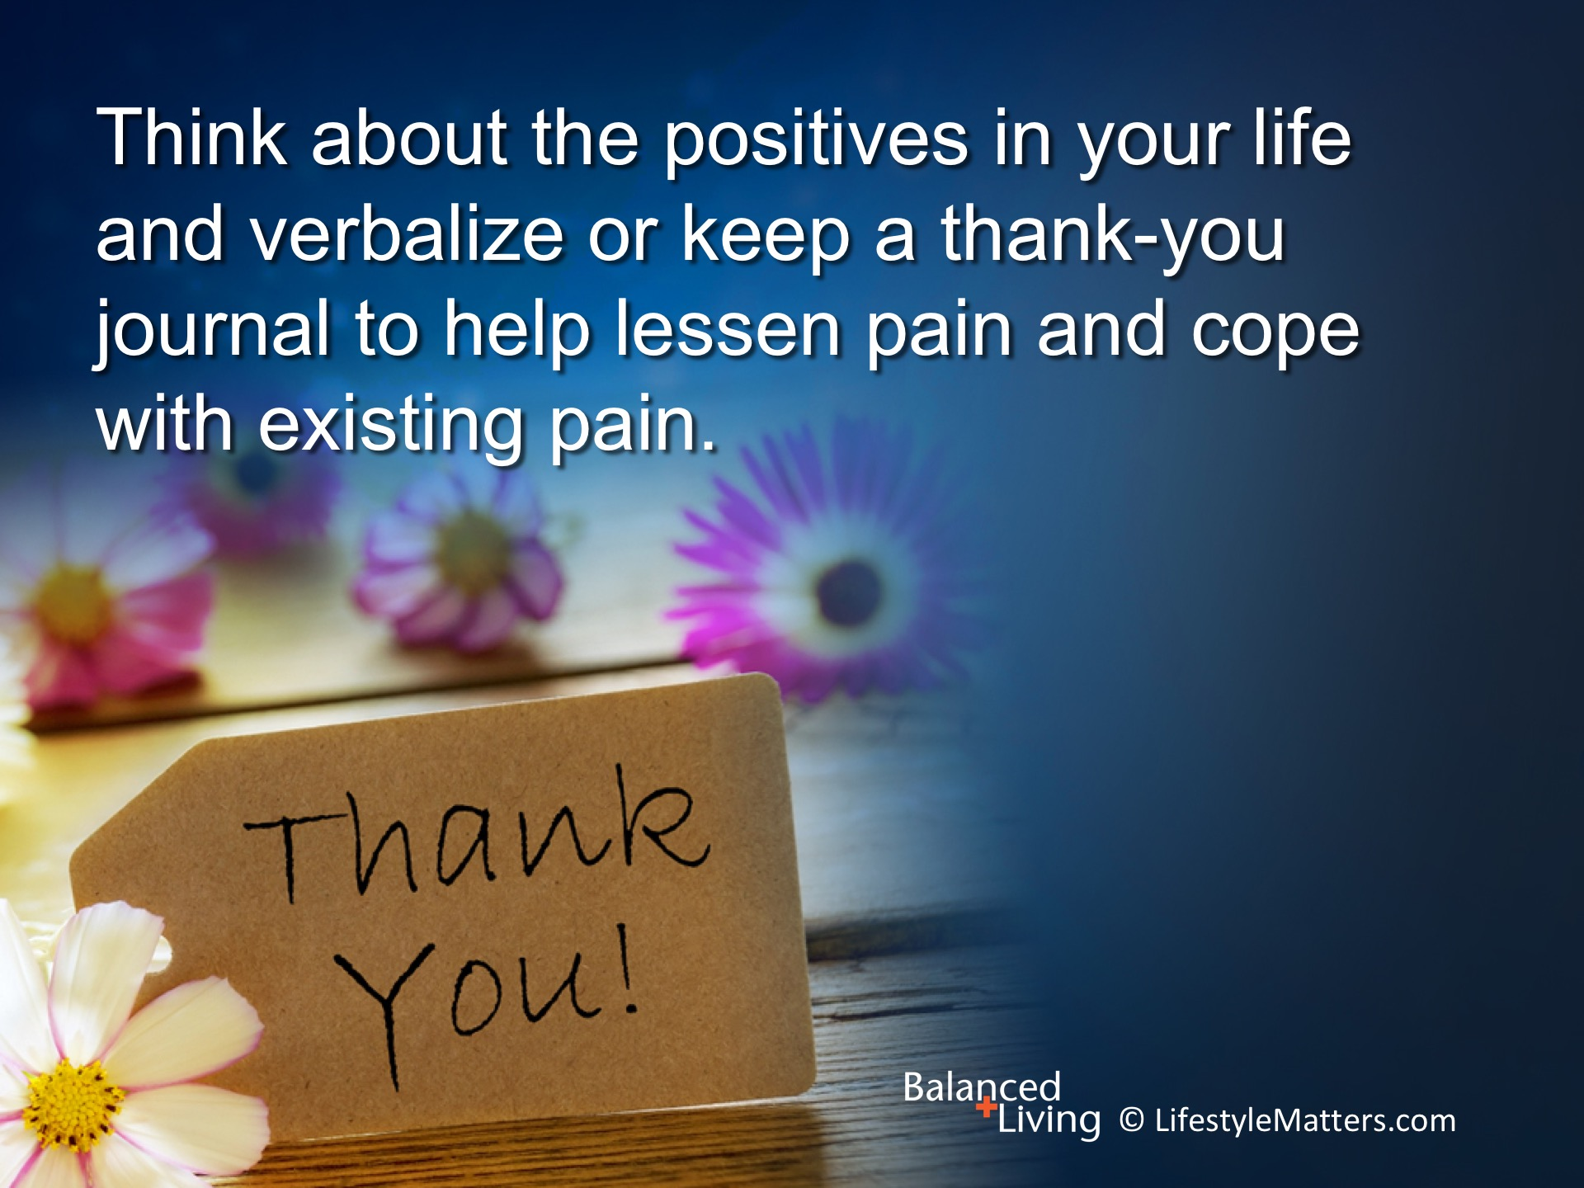
Notes:
Read slide.
Depression is a major factor underlying chronic pain.
Treating depression and expressing gratitude can lessen pain and help you cope with existing pain.
(Source: Biol Psychiatry. 2010 Jun 1;67(11):1083-90.)

Slide 21
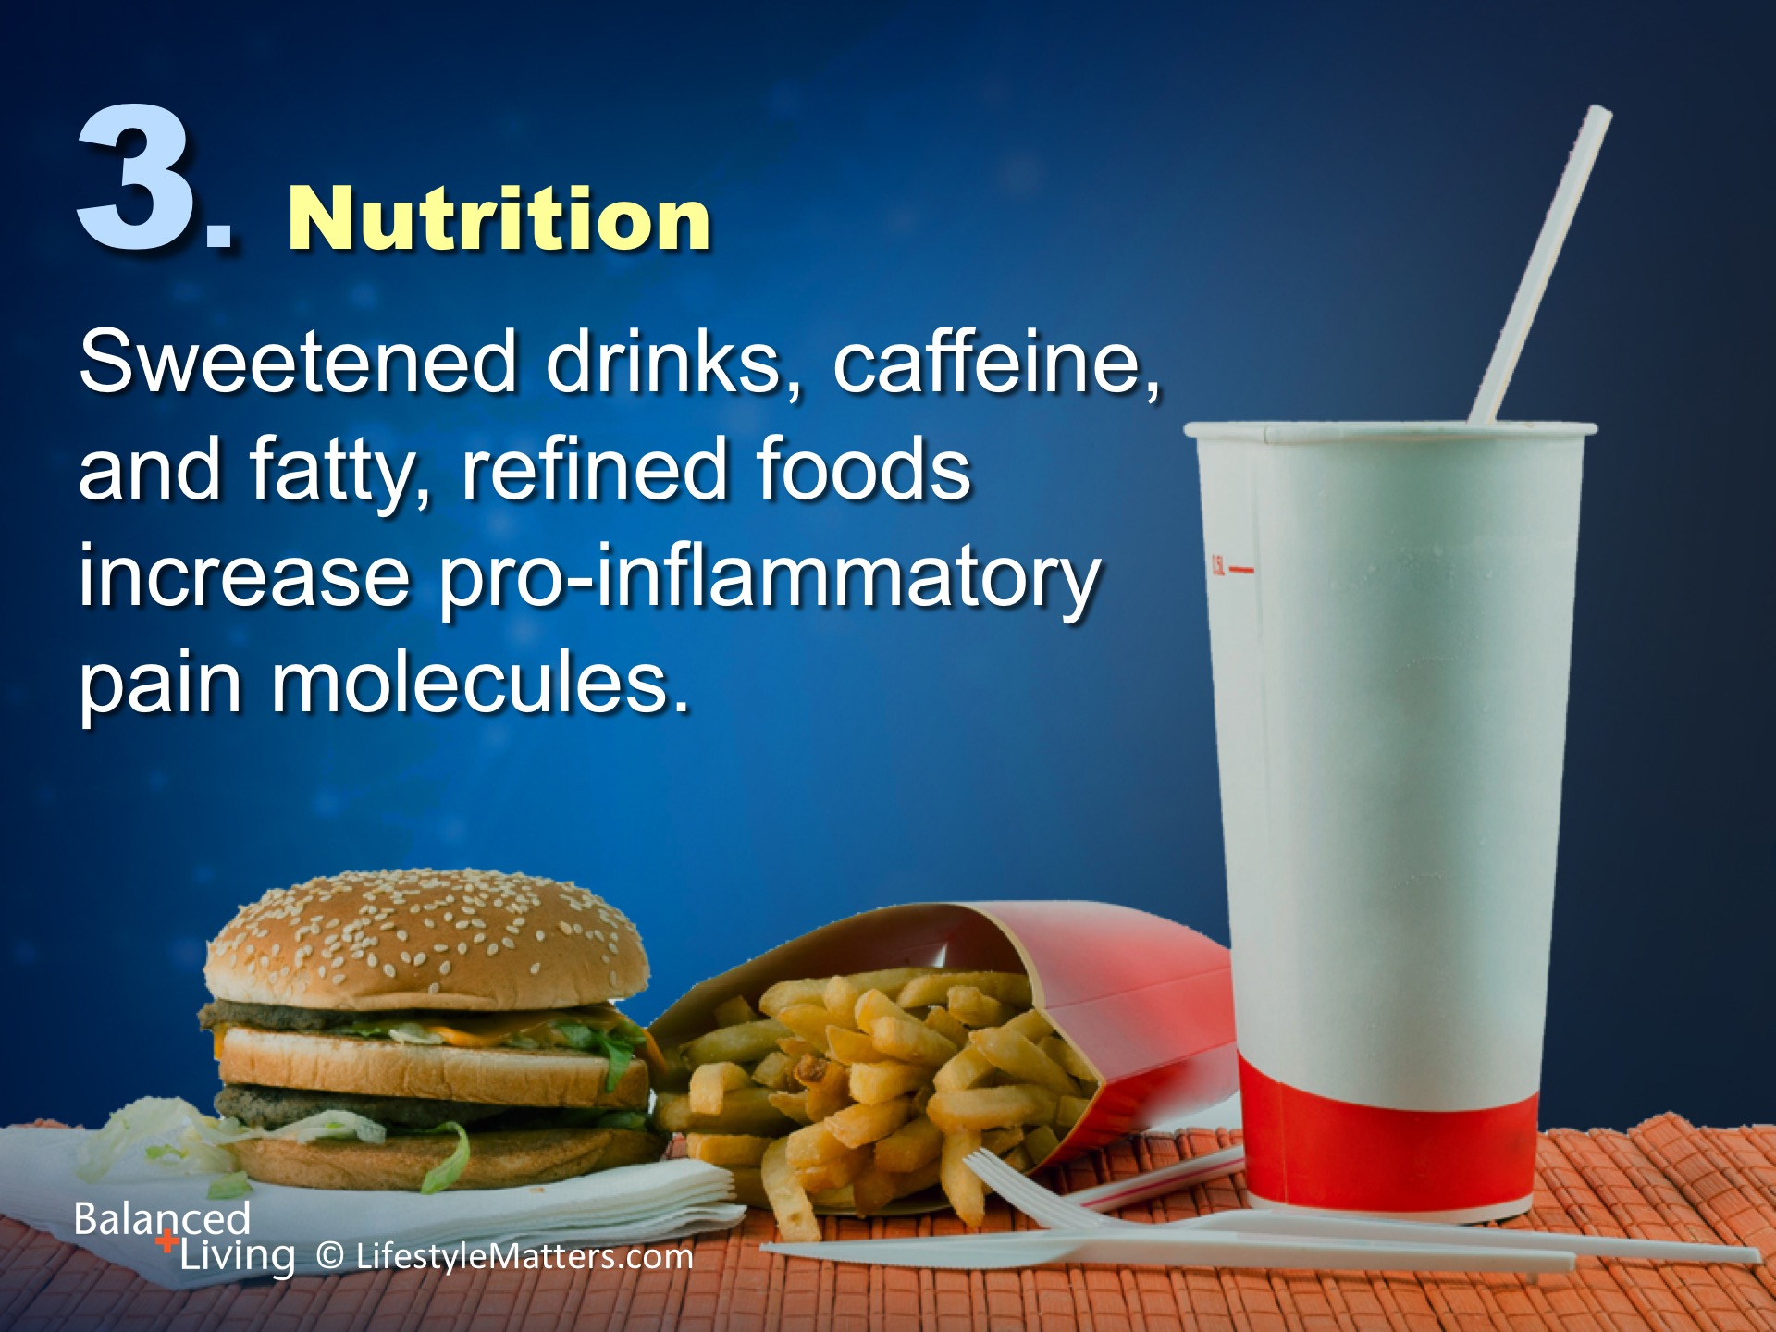
Notes:
Read slide.
Pro-inflammatory molecules increase pain sensitivity.
They also contribute to obesity and other chronic disorders that enhance pain, arthritis, joint stiffness, and slow recovery from injuries.
What would some of these foods be? (Wait for response)

Slide 22
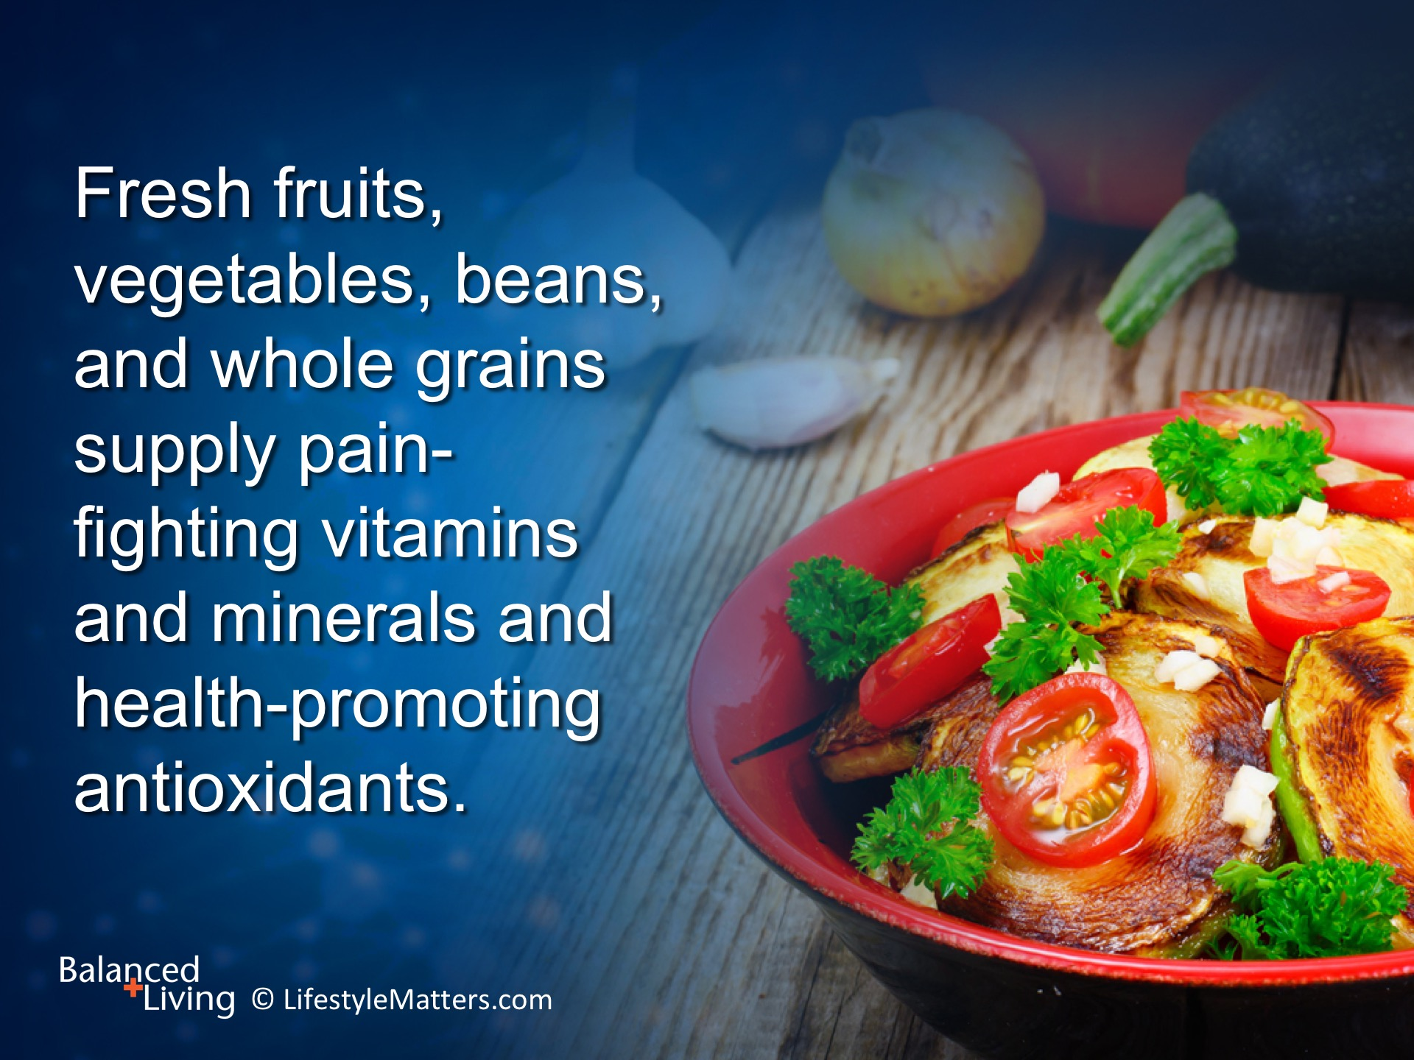
Notes:
Read slide.
Meals rich in fresh fruits, vegetables (especially leafy greens), whole grains, beans, and legumes contain many stress-reducing nutrients, including magnesium.
Describe a meal rich in these colorful foods. (Wait for response)
Can you taste it? Amazing!

Slide 23
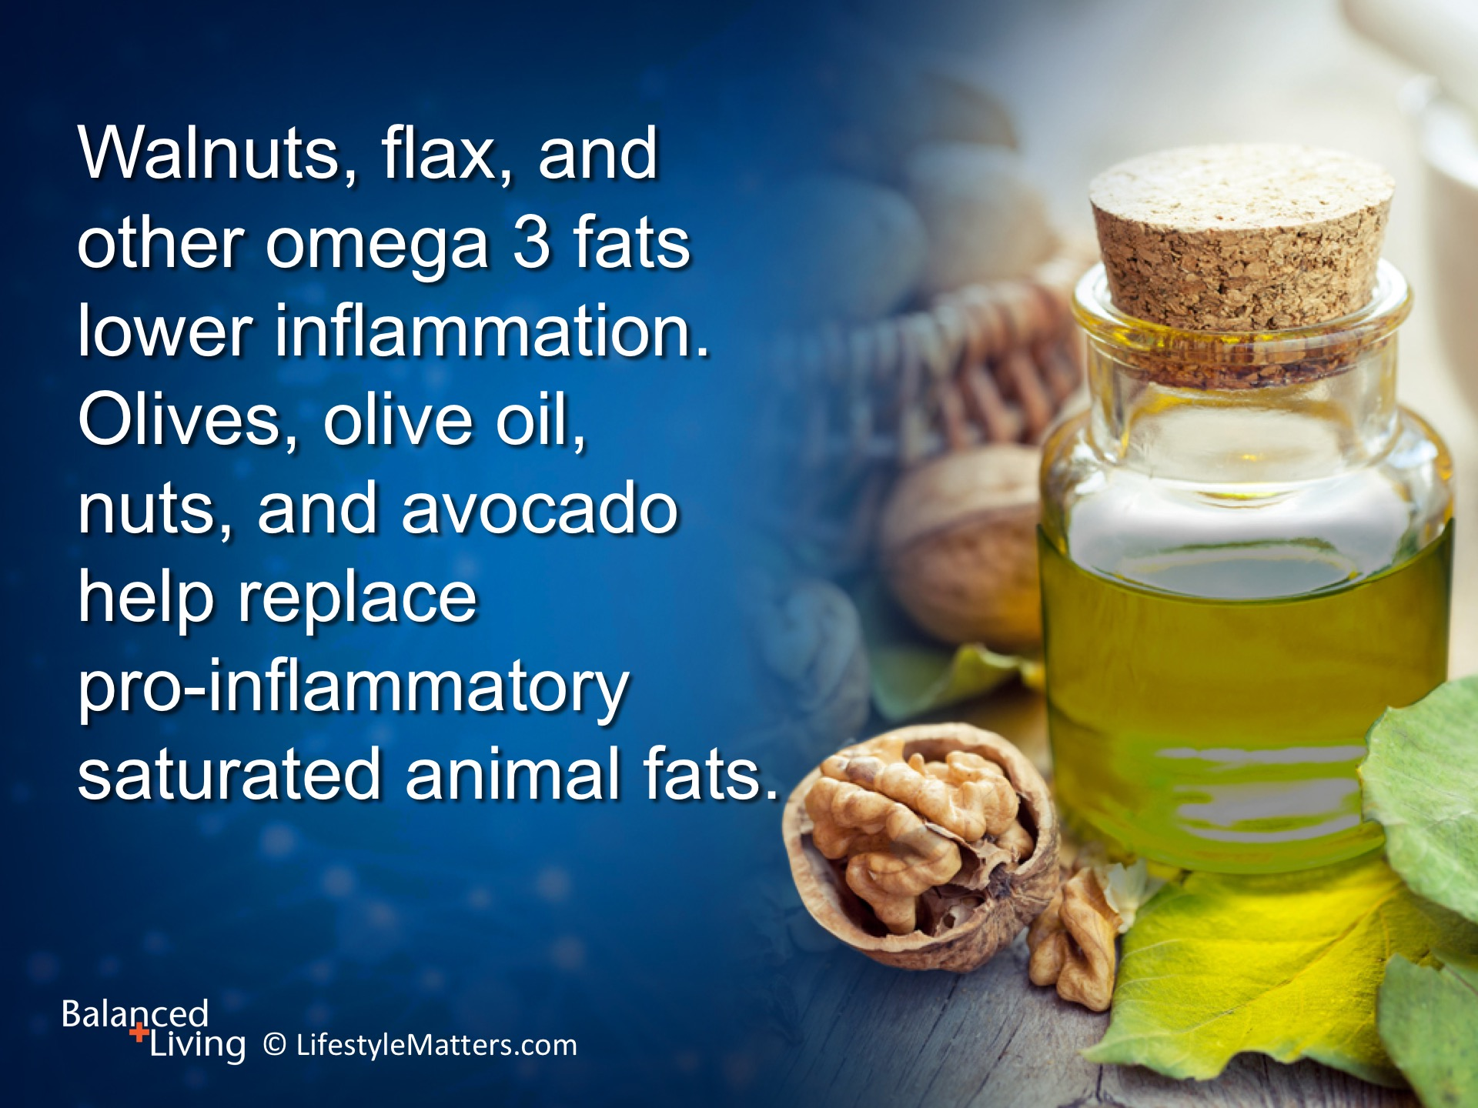
Notes:
Read slide.
What are some ways to include more of these fats into breakfast? Lunch or supper? (Wait for response)

Slide 24
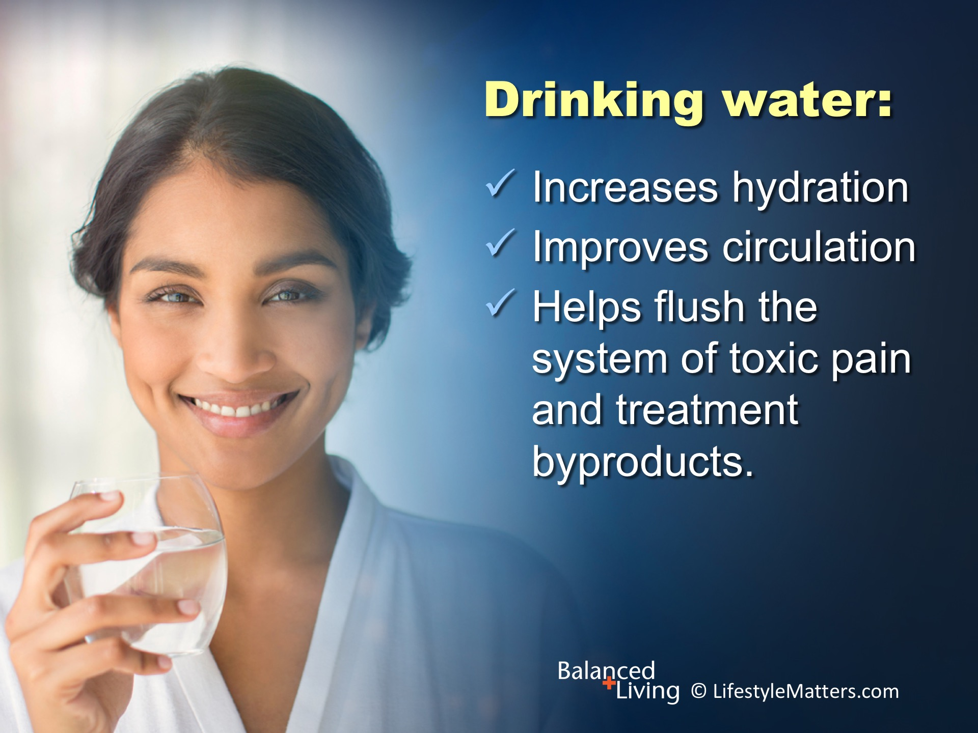
Notes:
Read slide.
Drinking plenty of fresh water between meals instead of with meals promotes healthy digestion and helps prevent indigestion and bloating.
Try adding a sprig of mint or fresh lemon to add zesty flavor.

Slide 25
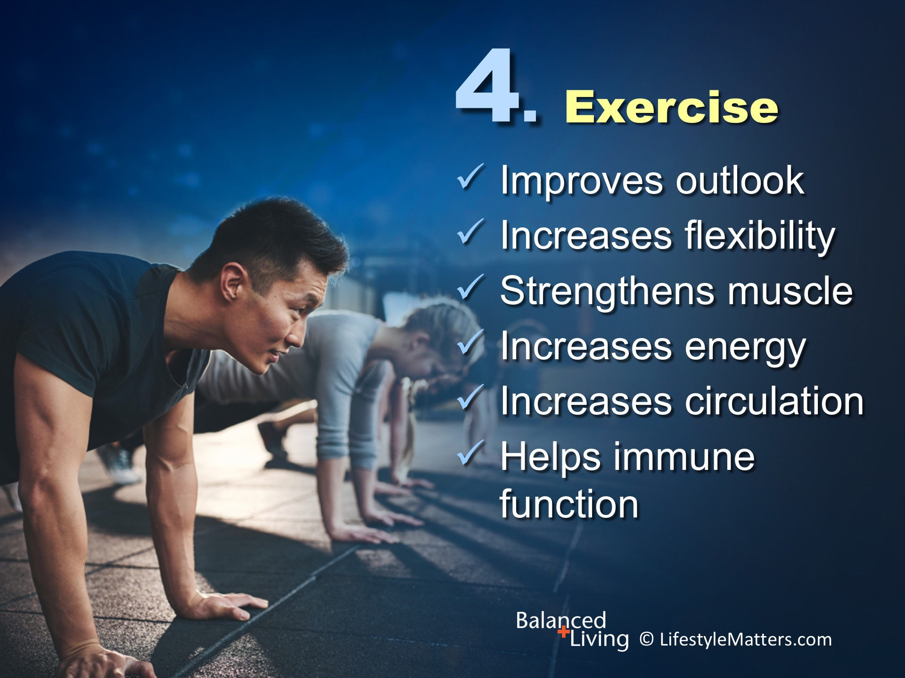
Notes:
Read slide.
Engaging in regular exercise suited to your ability reduces anxiety and increases flexibility, range-of-motion, muscle strength, and circulation.
Gentle exercise can reduce pain and improve energy levels in chronic fatigue and fibromyalgia patients.
Exercise outdoors to get the sunshine advantage.
You may want to consider getting your vitamin D levels checked. Low levels of vitamin D are linked with various types of chronic pain conditions.
(Source: Musculoskeletal Care. 2016 Jul 12: Epub ahead of print)

Slide 26
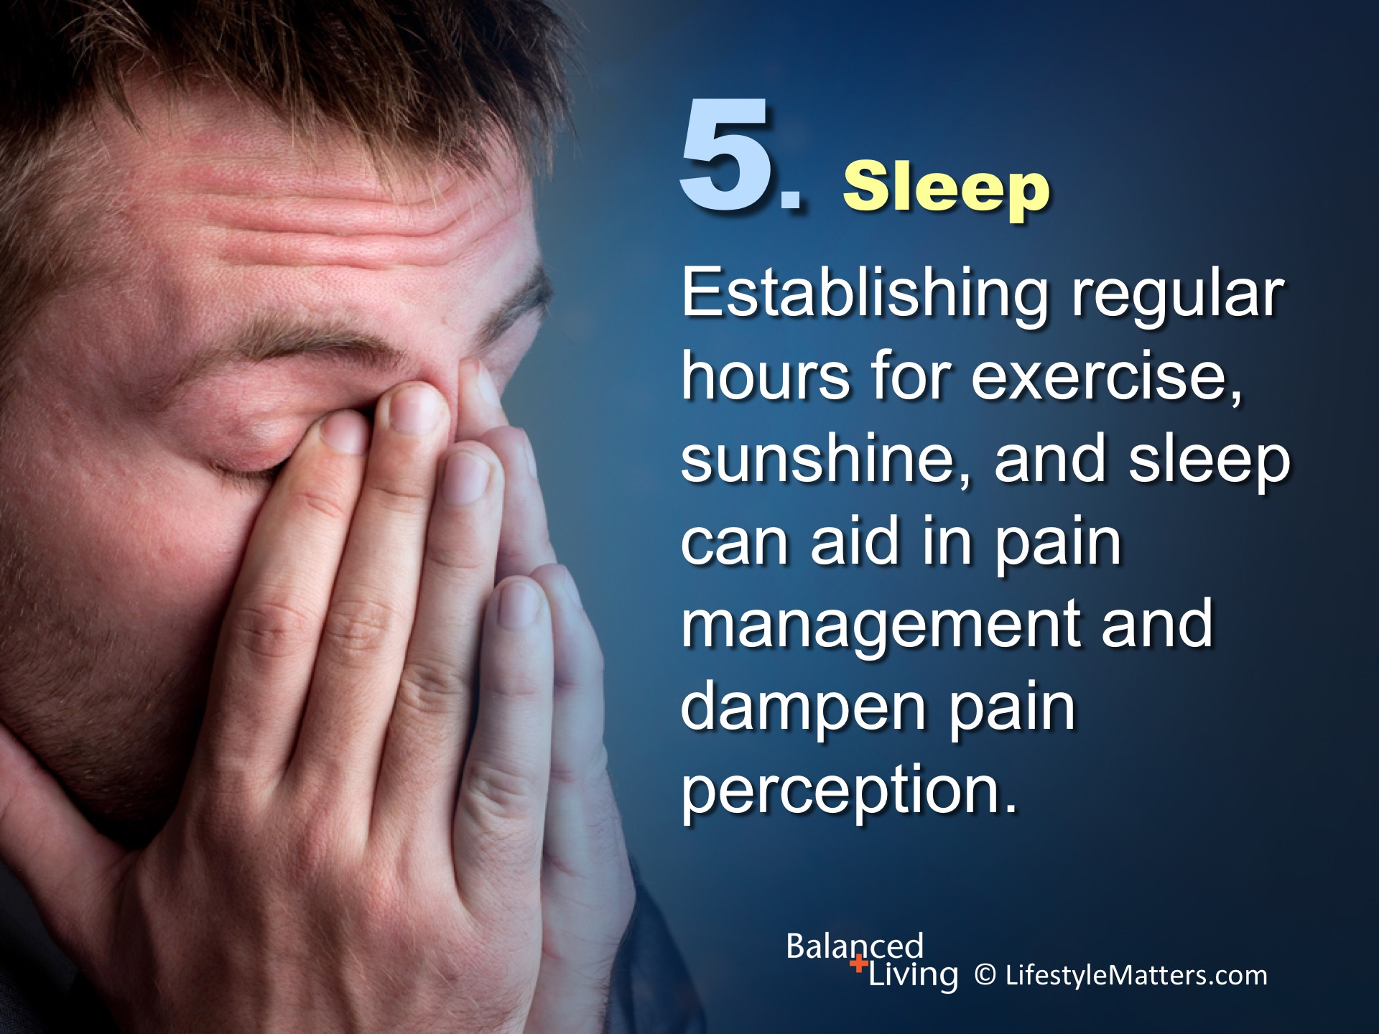
Notes:
Read slide.
Sunshine and exercise aid in developing a sound sleep pattern.
Establishing a regular “sleep routine” signals the brain that it is time to slow down and rest.

Slide 27
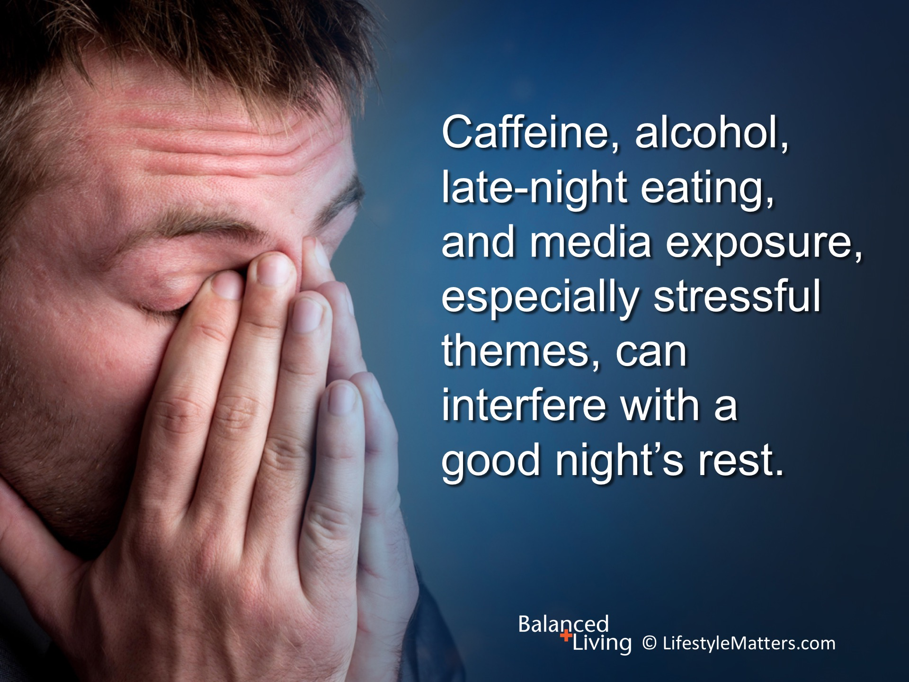
Notes:
Read slide.
What are some positive sleep routines that can facilitate a good night’s rest? (Wait for response)
(Examples: Reading an inspiring book; journaling; a favorite chair or special bathrobe to relax in; an evening bath or shower; walking the dog; a cup of herbal tea)

Slide 28
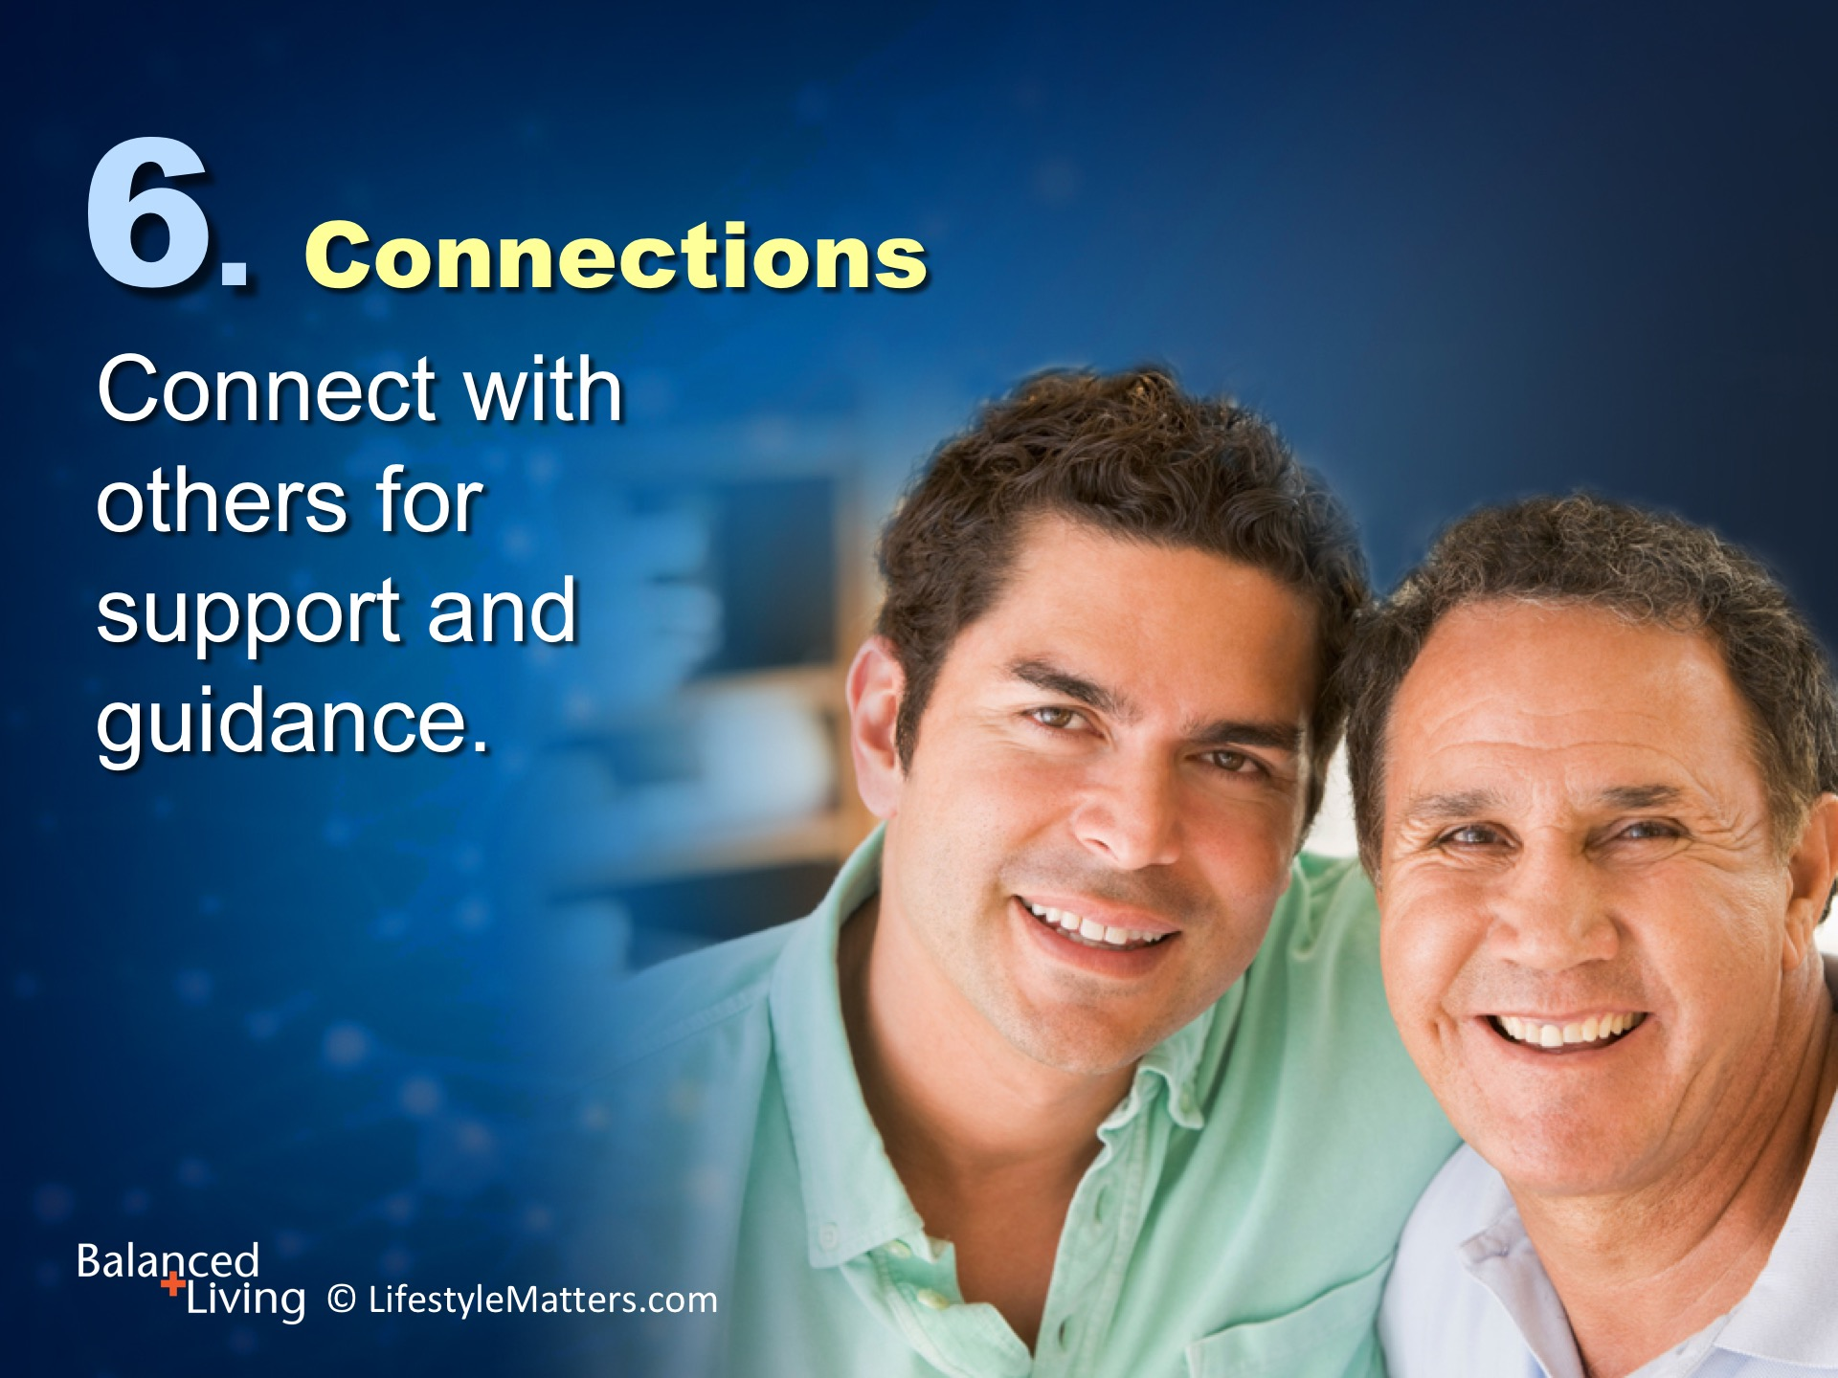
Notes:
Read slide.

Slide 29
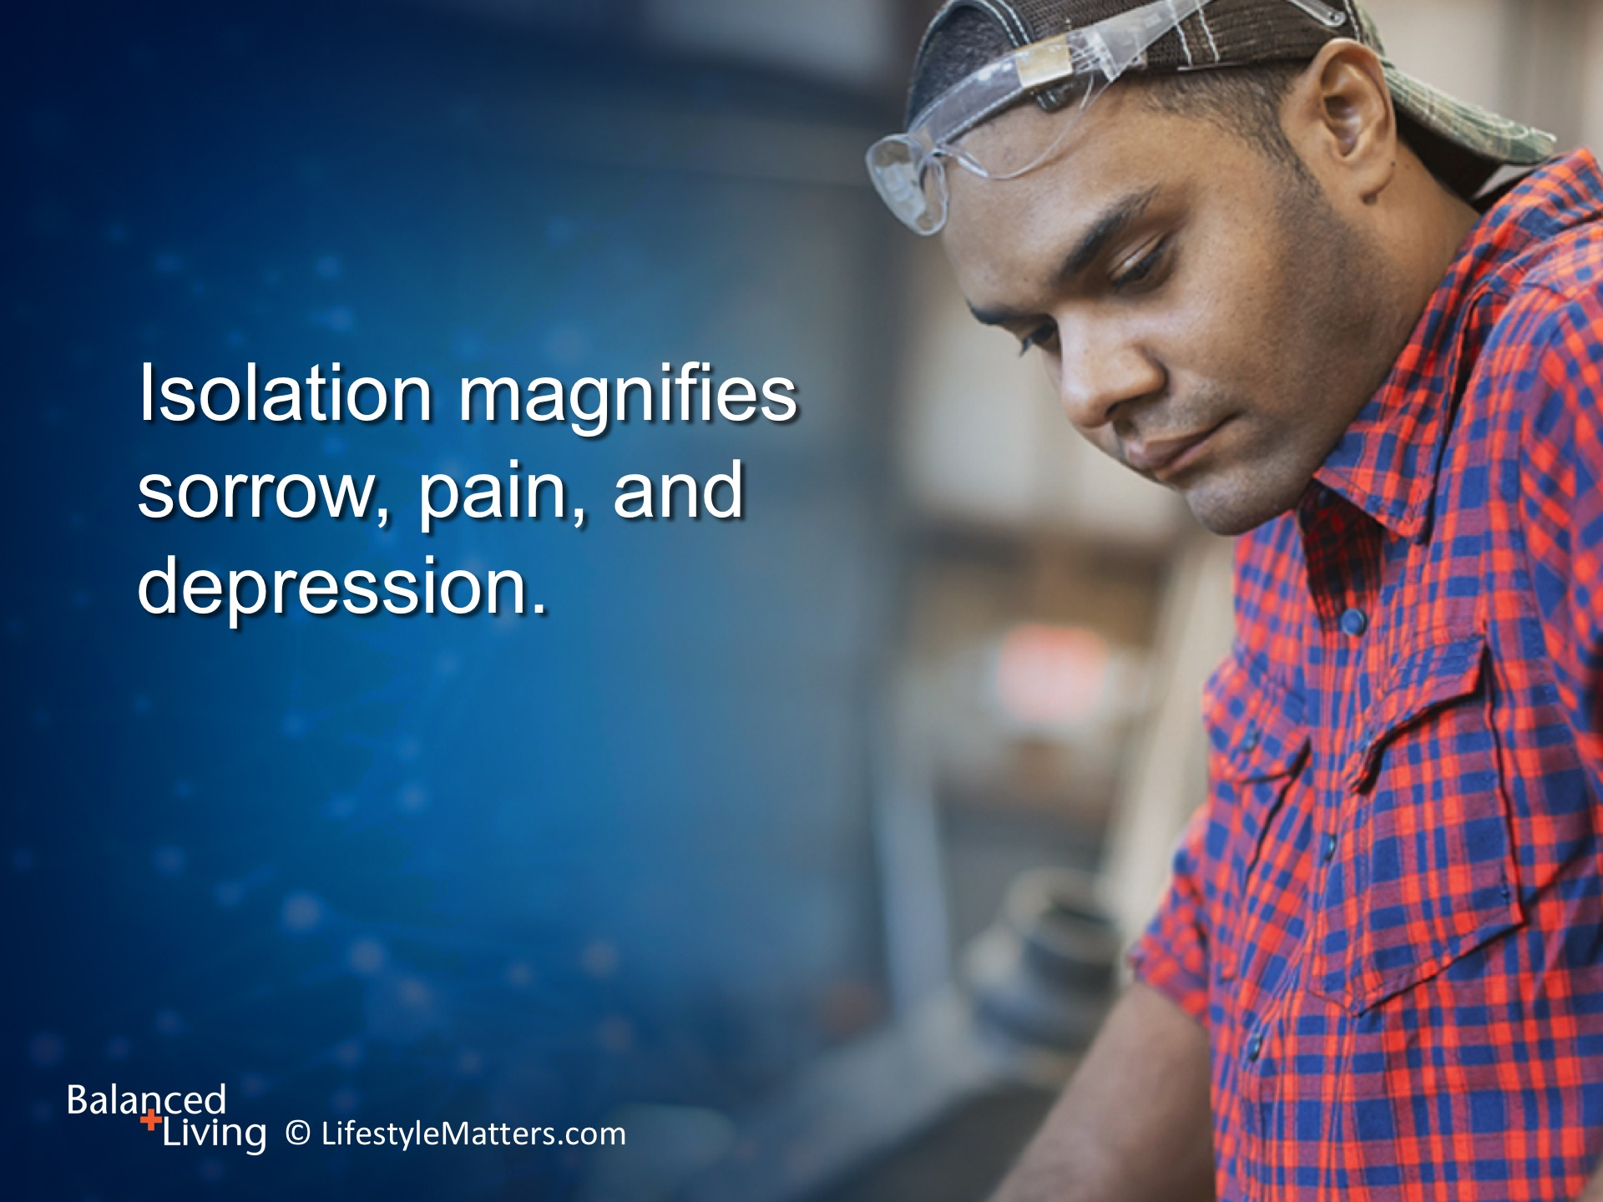
Notes:
Read slide.
Getting involved with a church, hobby, or support group breaks the isolation trap and helps bring creativity and happiness into your experience—and those are real pain dampeners!

Slide 30
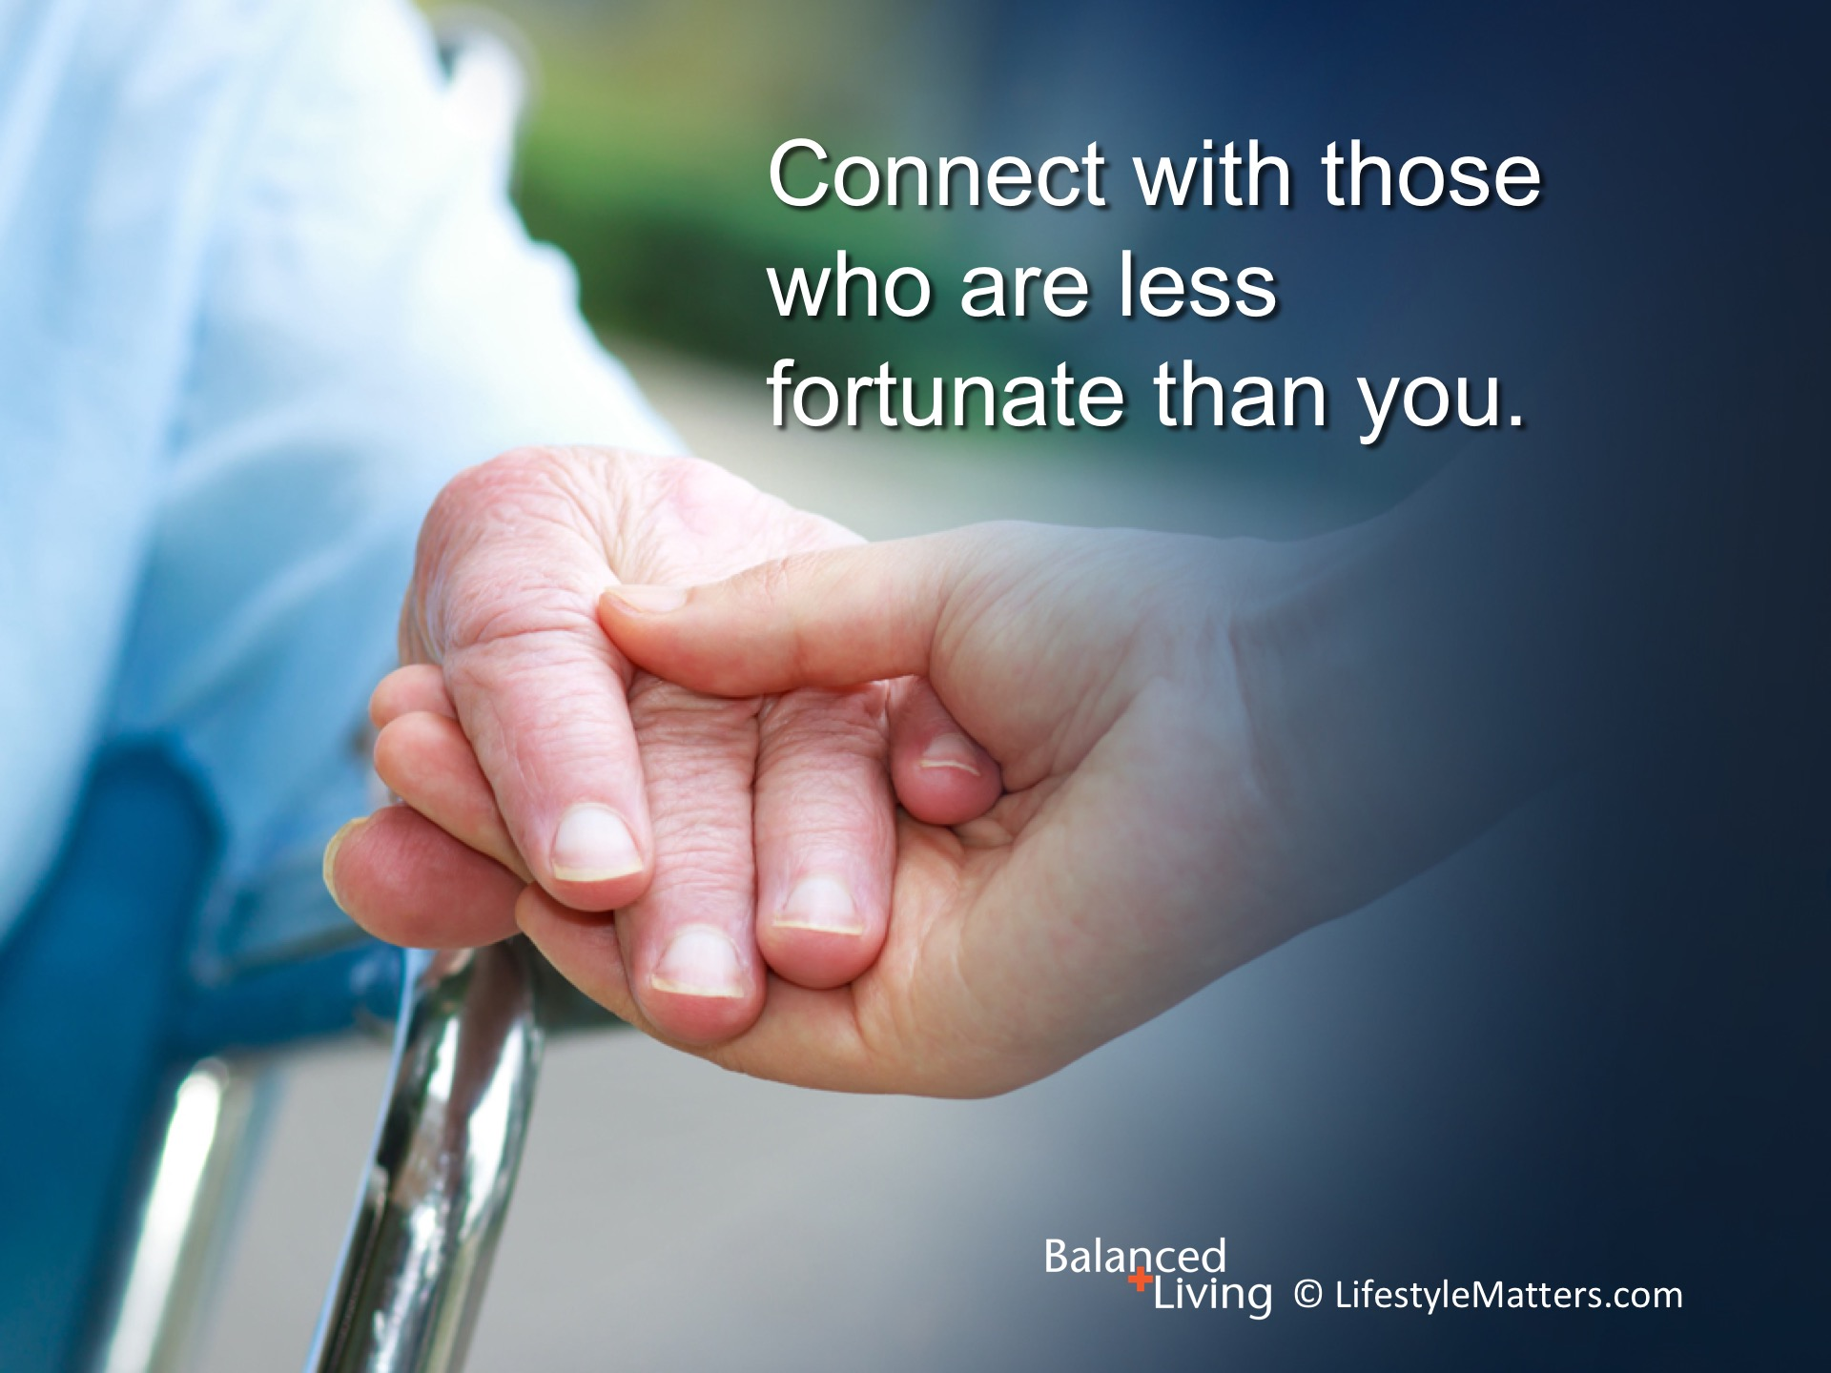
Notes:
Read slide.
Can you remember an experience of connecting with someone who is less fortunate than you?
Did it put your own challenges in perspective?
Connecting with others can turn your attention away from your pain.

Slide 31
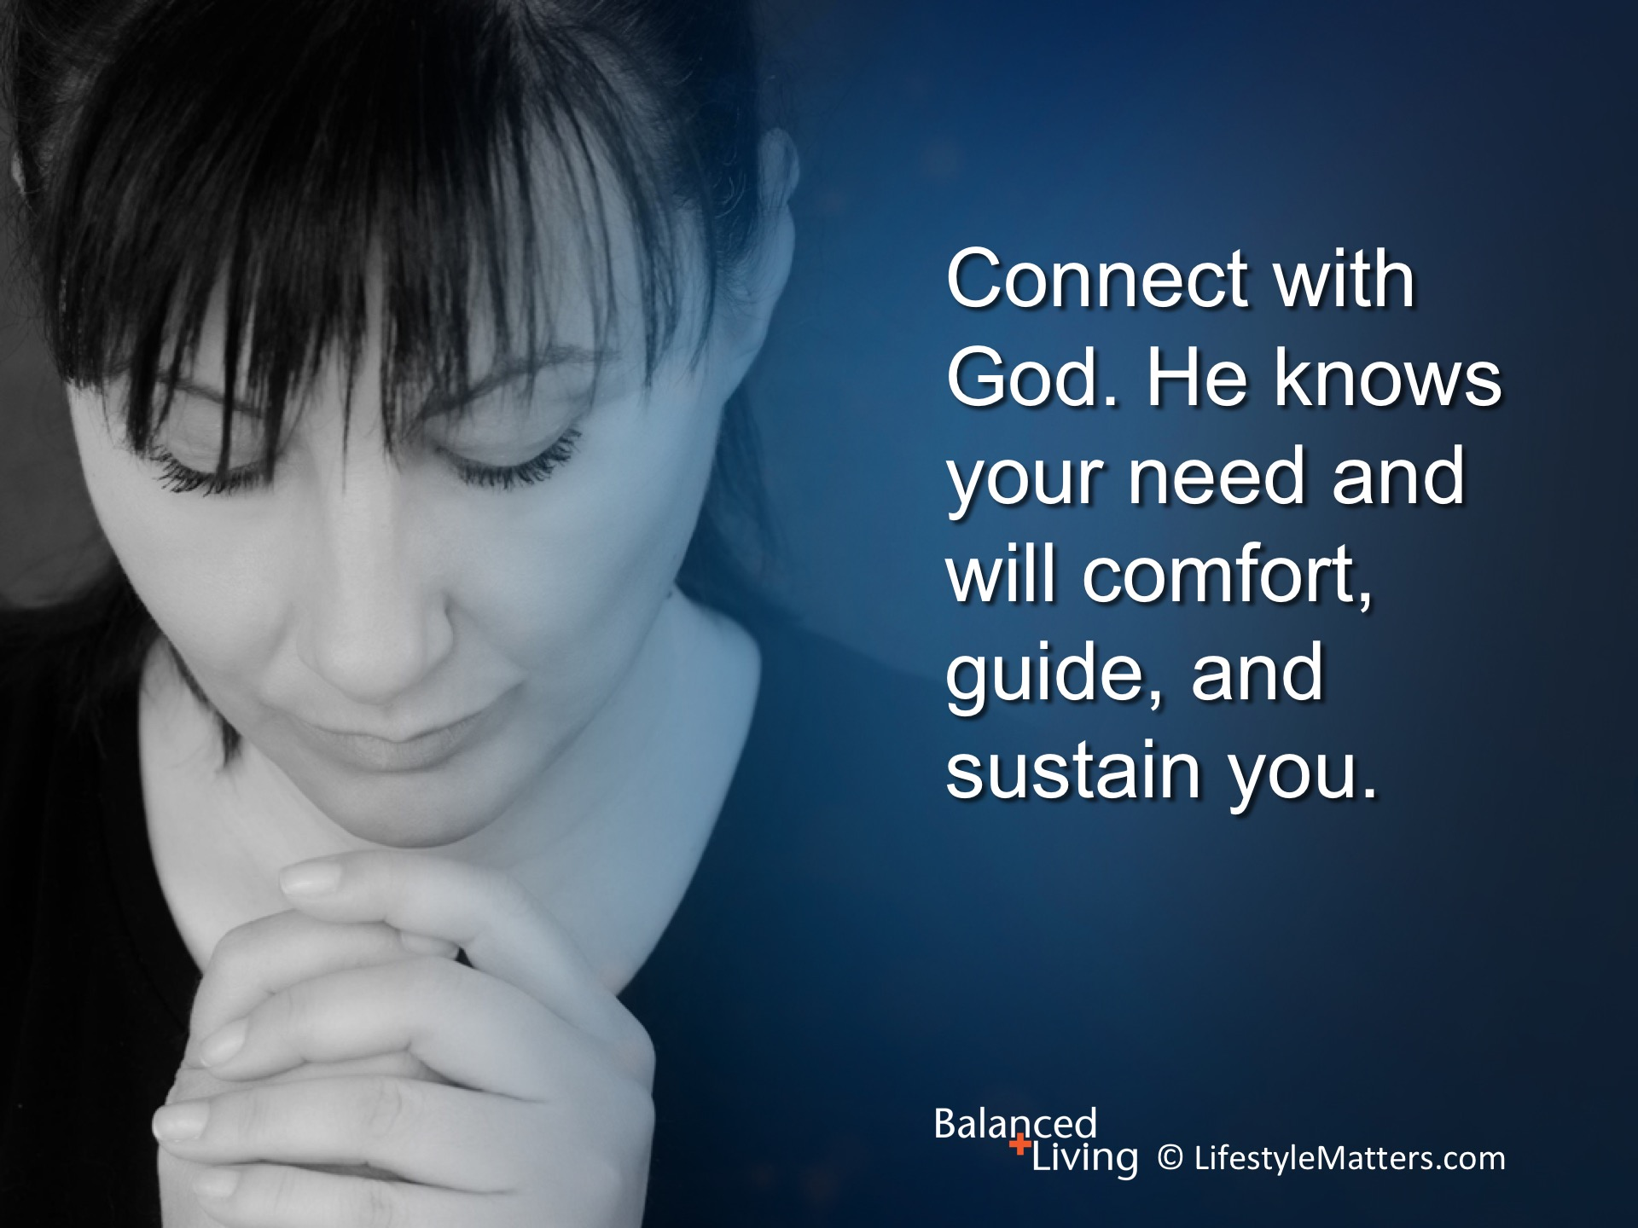
Notes:
Read slide.
One of God’s names is “The Comforter.” John 14:26. He is described as the “lifter up of my head.” Psalm 3:3.

Slide 32
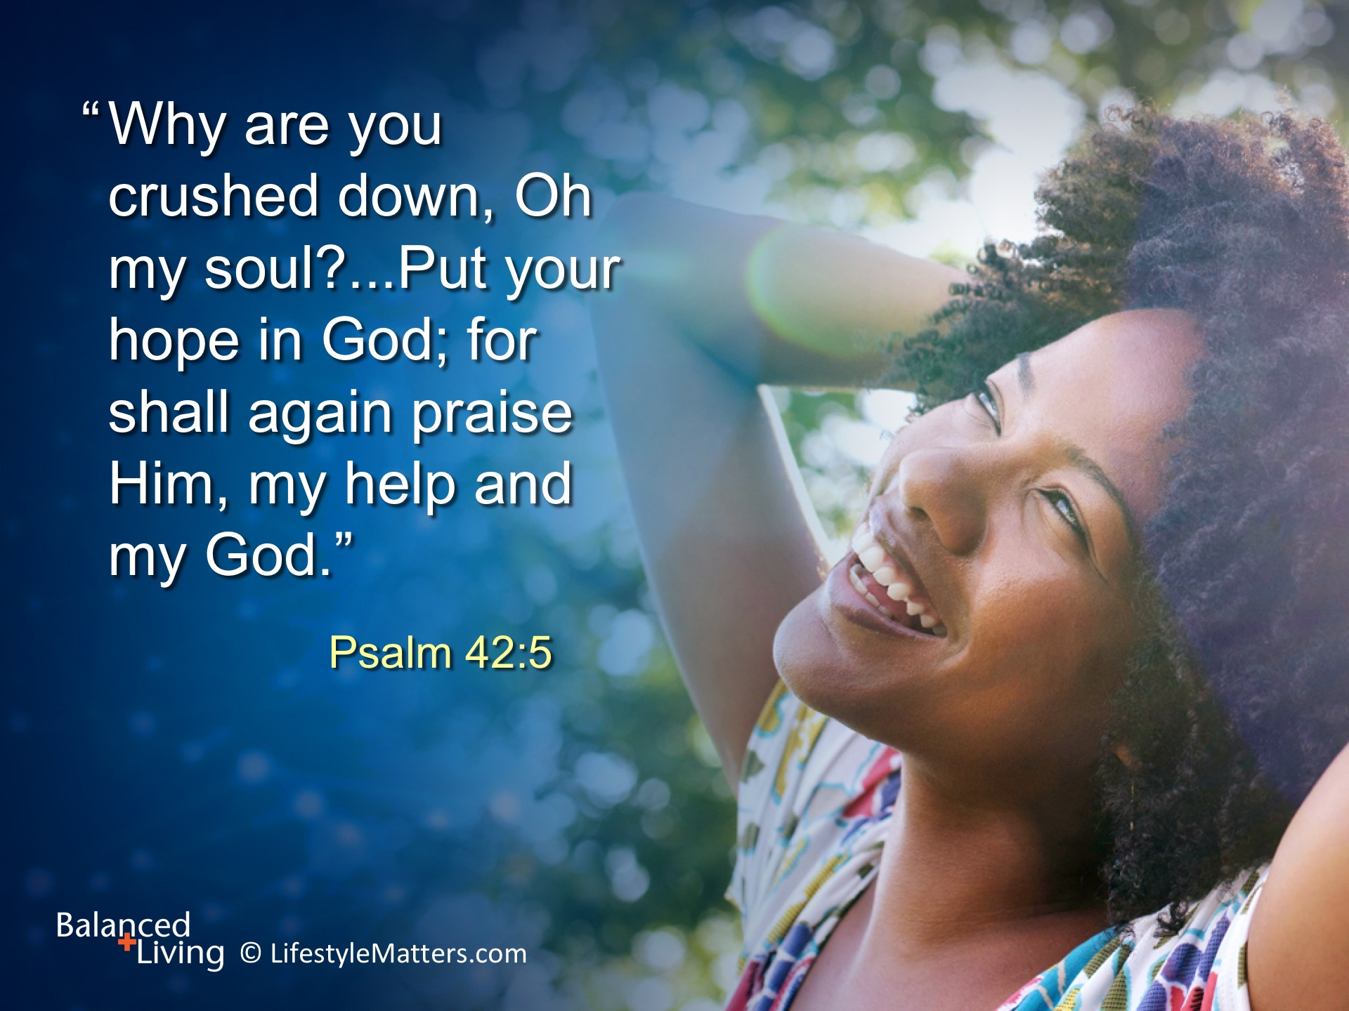
Notes:
Read slide
God promises to strengthen and comfort You.
He has also given us powerful mental, physical, and lifestyle strategies for coping with and reducing pain.

Slide 33
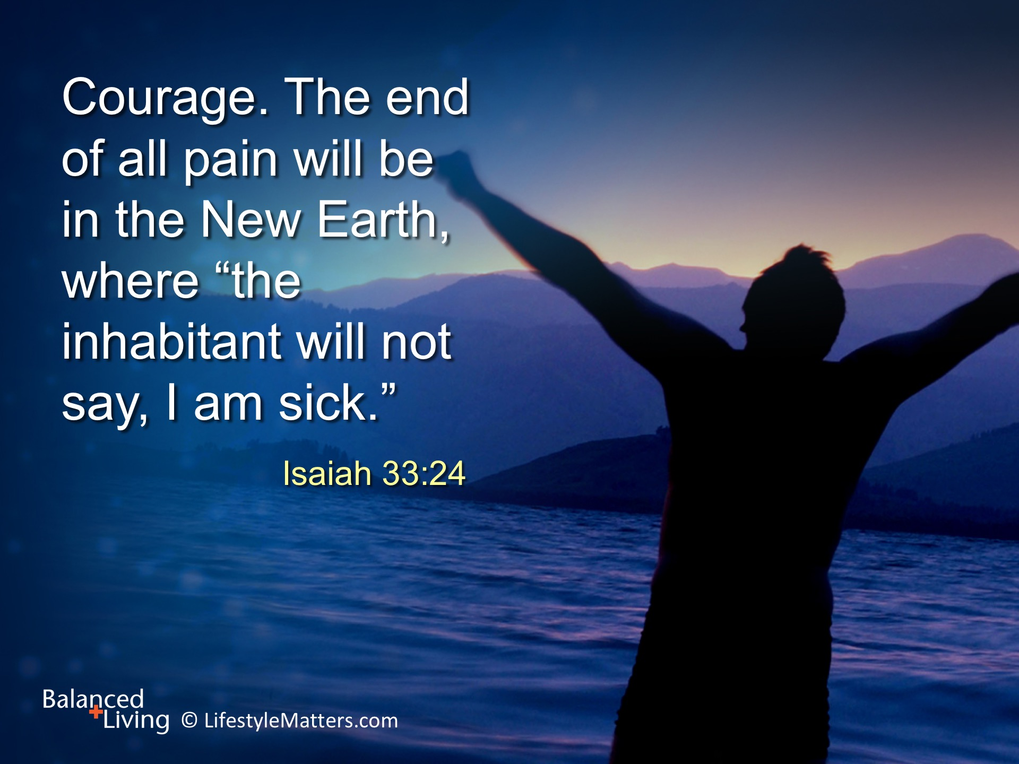
Notes:
So, why do some face a life of chronic pain while others are healed? We don’t have all the answers.
But we do know there’s a better life available after this one—a life free from pain, disease, and sin.
Read slide.
Though your life here may be scarred by suffering, through faith you can look forward to a new life in heaven when Jesus returns.
Would you put your life, your mind, your habits, your future into God’s hands? He knows the way and He will show the way. (Wait for response)

