Slide 1


Images © Alamy www.alamy.com
®
Images used in PowerPoint presentation are part of the presentation and not to be used out of context of the presentation, may not be used as stand-alone images unless to promote the presentation/event, and may not be resold in singular form or as part of an image library. Images are © Alamy and presentation templates and content therein are © MISDA, any other usage requires written permission from both parties.

Slide 2
®
Scripture quotations used in Balanced Living PowerPoints are taken from Bibles in the Public Domain which have no USA copyright restrictions. We have indicated which version each quotation is taken from as follows:
KJV - King James Version
BBE - Bible in Basic English
WEB - World English Bible
DBY - Darby's Translation
Any scriptures not otherwise noted are the author's paraphrase of one of these versions.

Slide 3
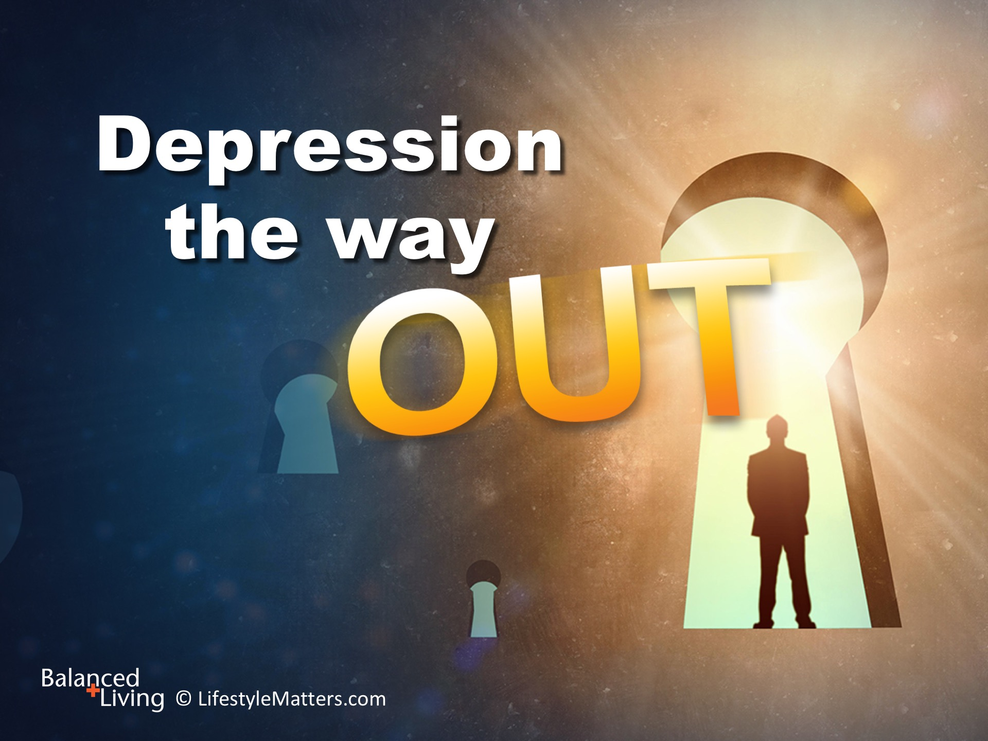
Notes:
Presenter: Please read and study the tract that accompanies this PowerPoint to prepare for this presentation.
Read slide.
Depression is the leading cause of disability in the United States and Canada, ahead of heart disease, any given cancer, and AIDS.
In this session we will look at some practical ways to address and fight depression, and to build hope and healing into your daily life.

Slide 4
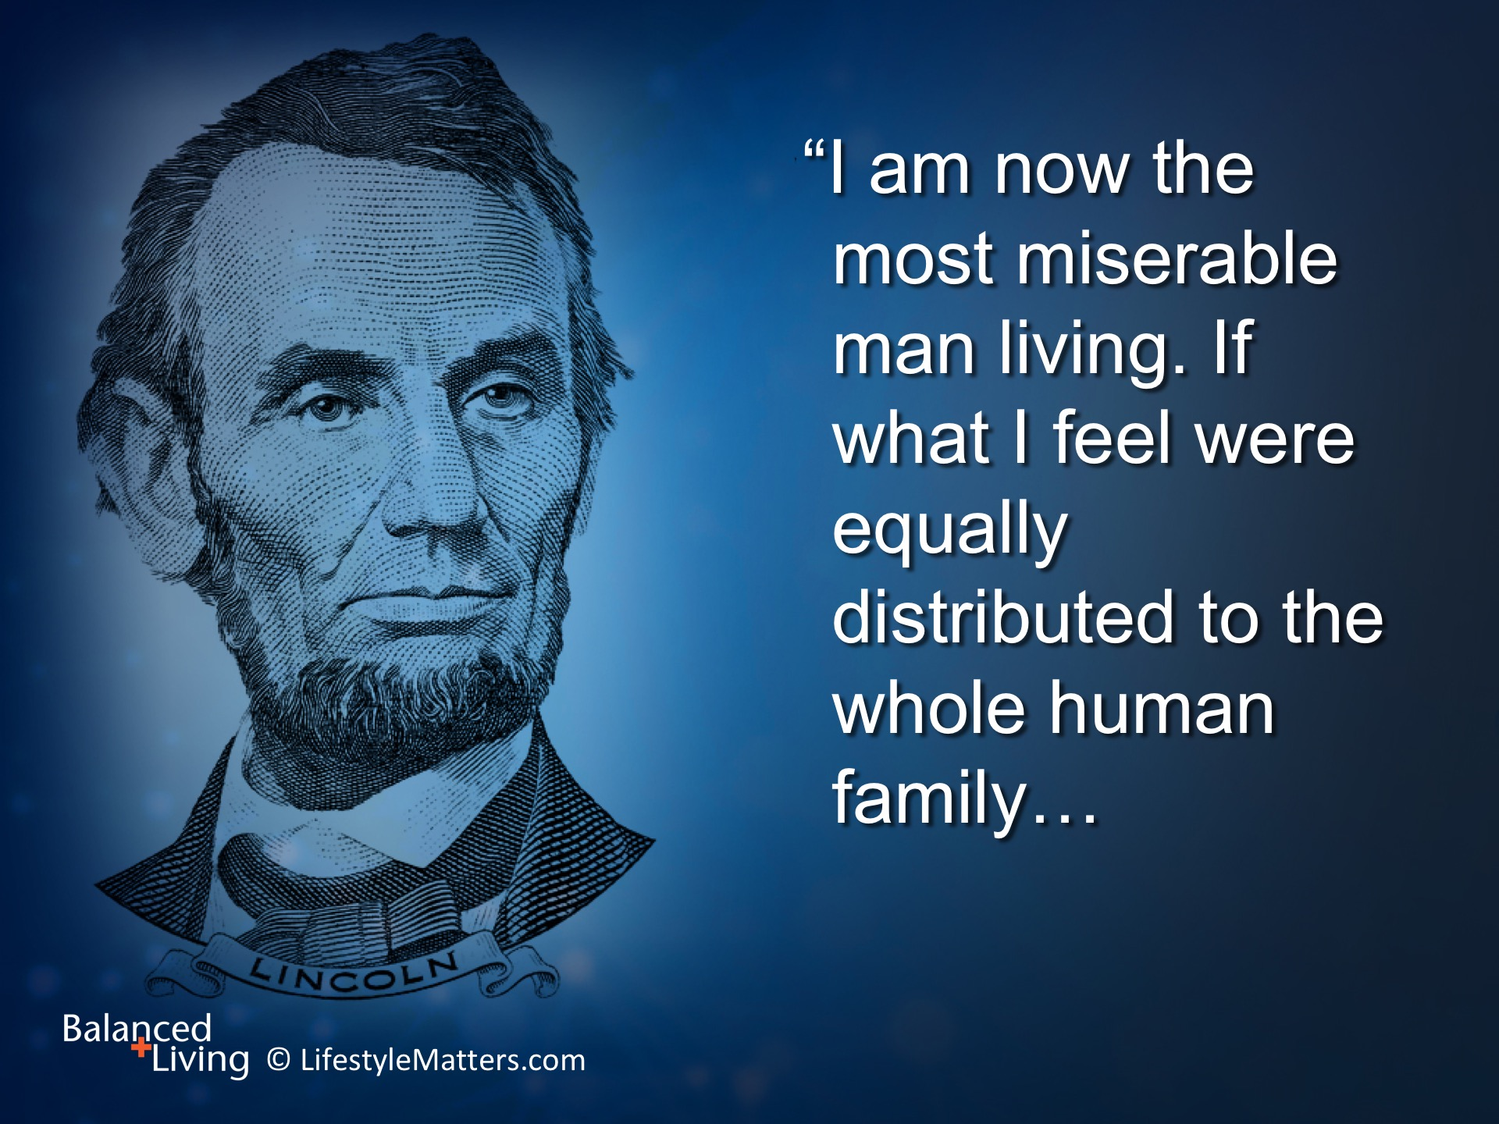
Notes:
Abraham Lincoln suffered from serious bouts of melancholy and depression.
During one of those seasons of sadness he declared: Read slide.

Slide 5
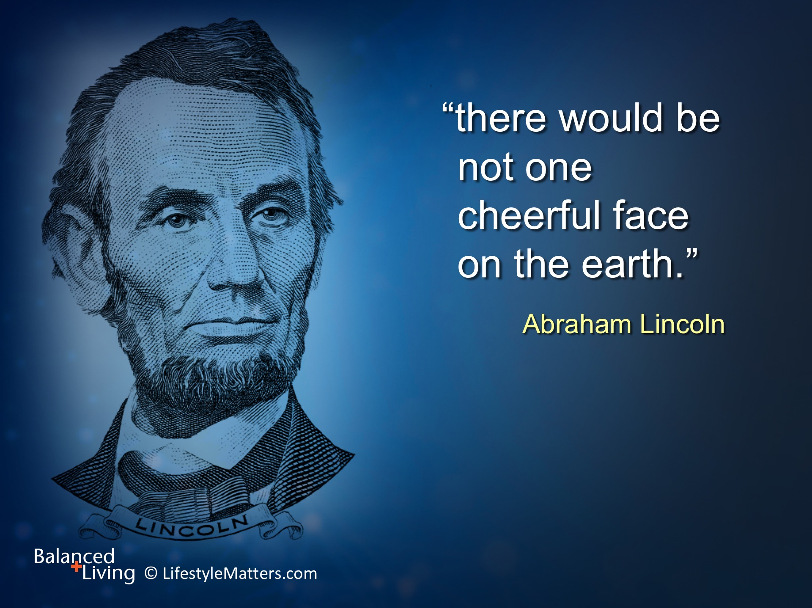
Notes:
Read slide.

Slide 6
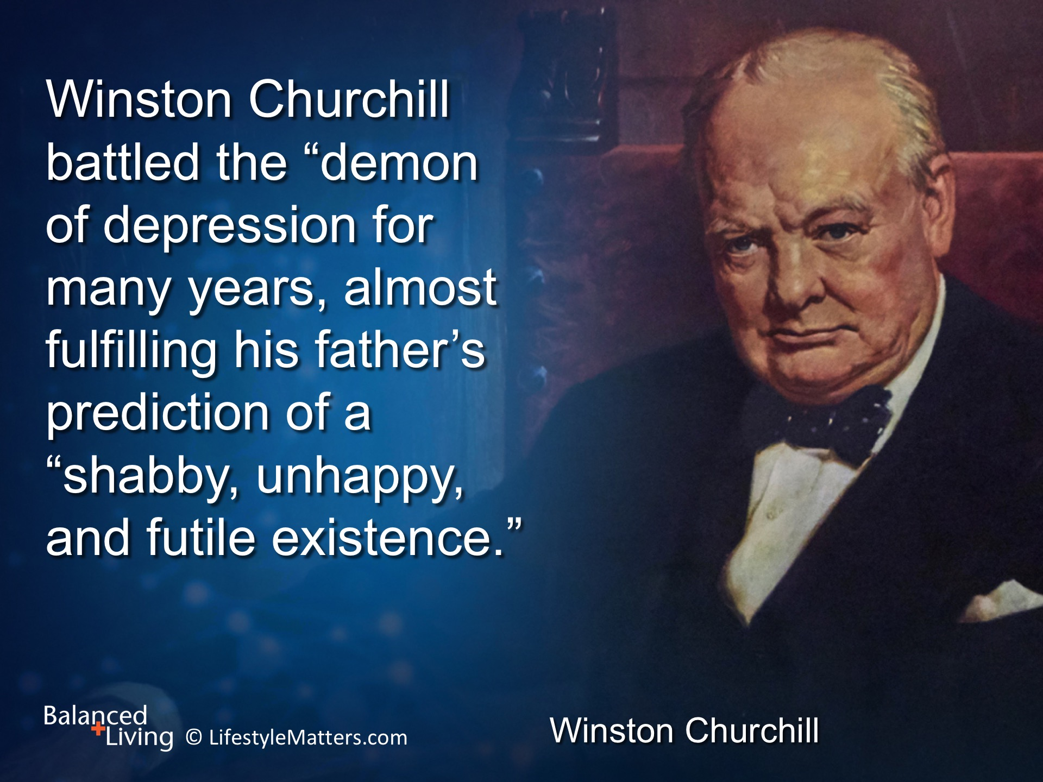
Notes:
Read slide.

Slide 7
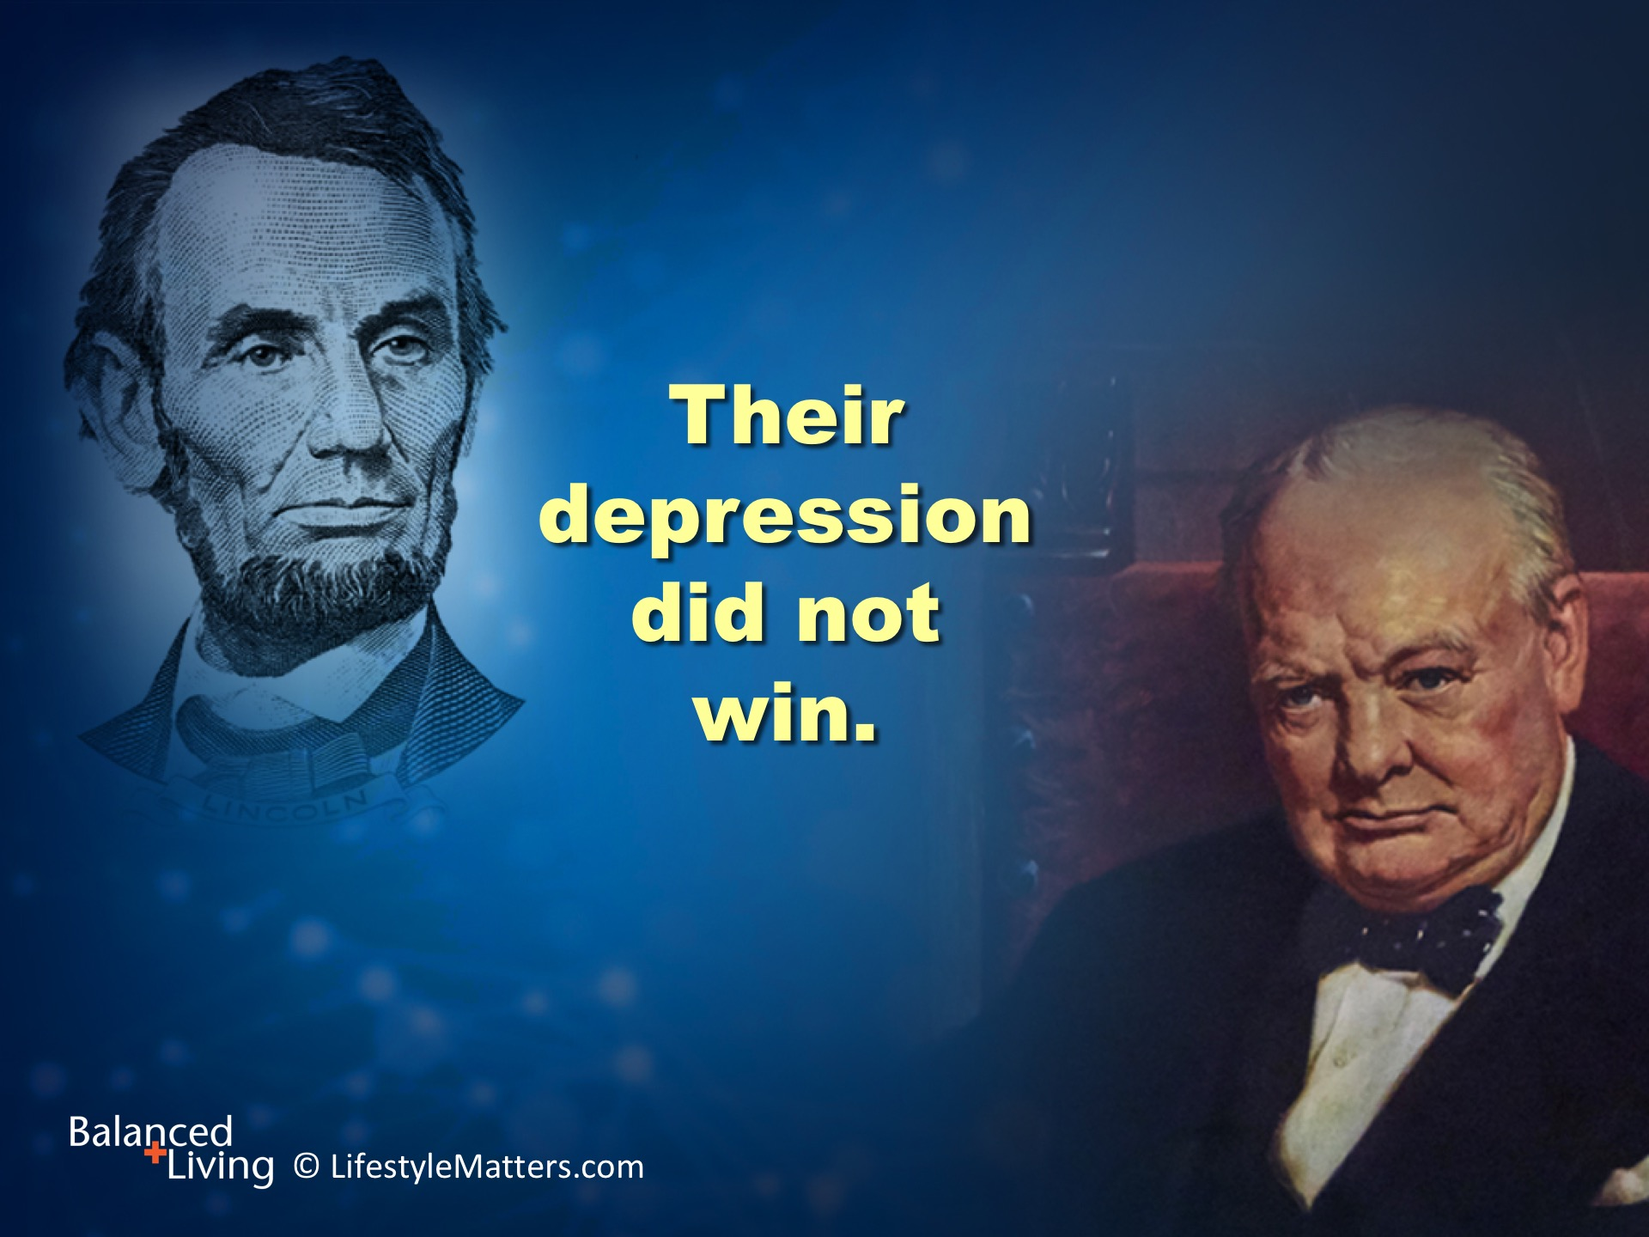
Notes:
Read slide.
These are more than stories about remarkable people who overcame great odds.
These stories are about the awesome power of the human brain to retool and reshape itself in spite of challenges.

Slide 8
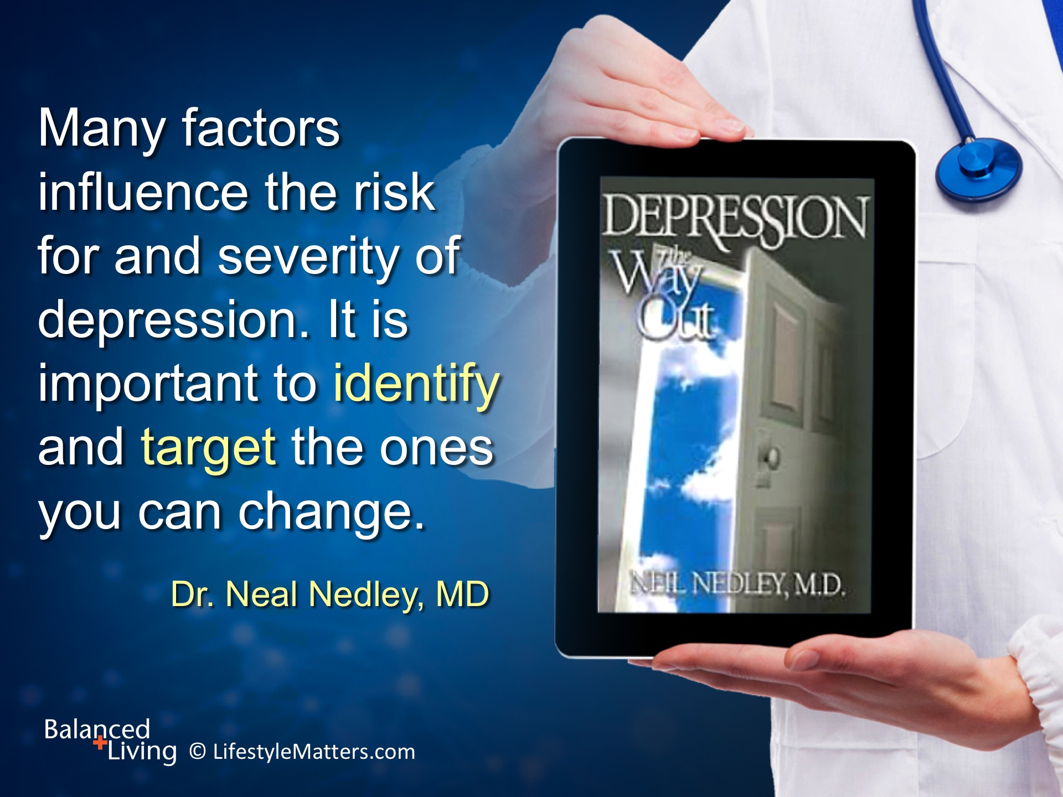
Notes:
Dr. Neal Nedley, MD, in his book Depression: The Way Out has identified 21 “depression hits.”
In his lifestyle approach to treating depression, he states that: Read slide.

Slide 9
Notes:
Read slide.
It is important to work with a healthcare professional in the case of serious depression, as 75% of sufferers have other conditions that need to be addressed.

Slide 10
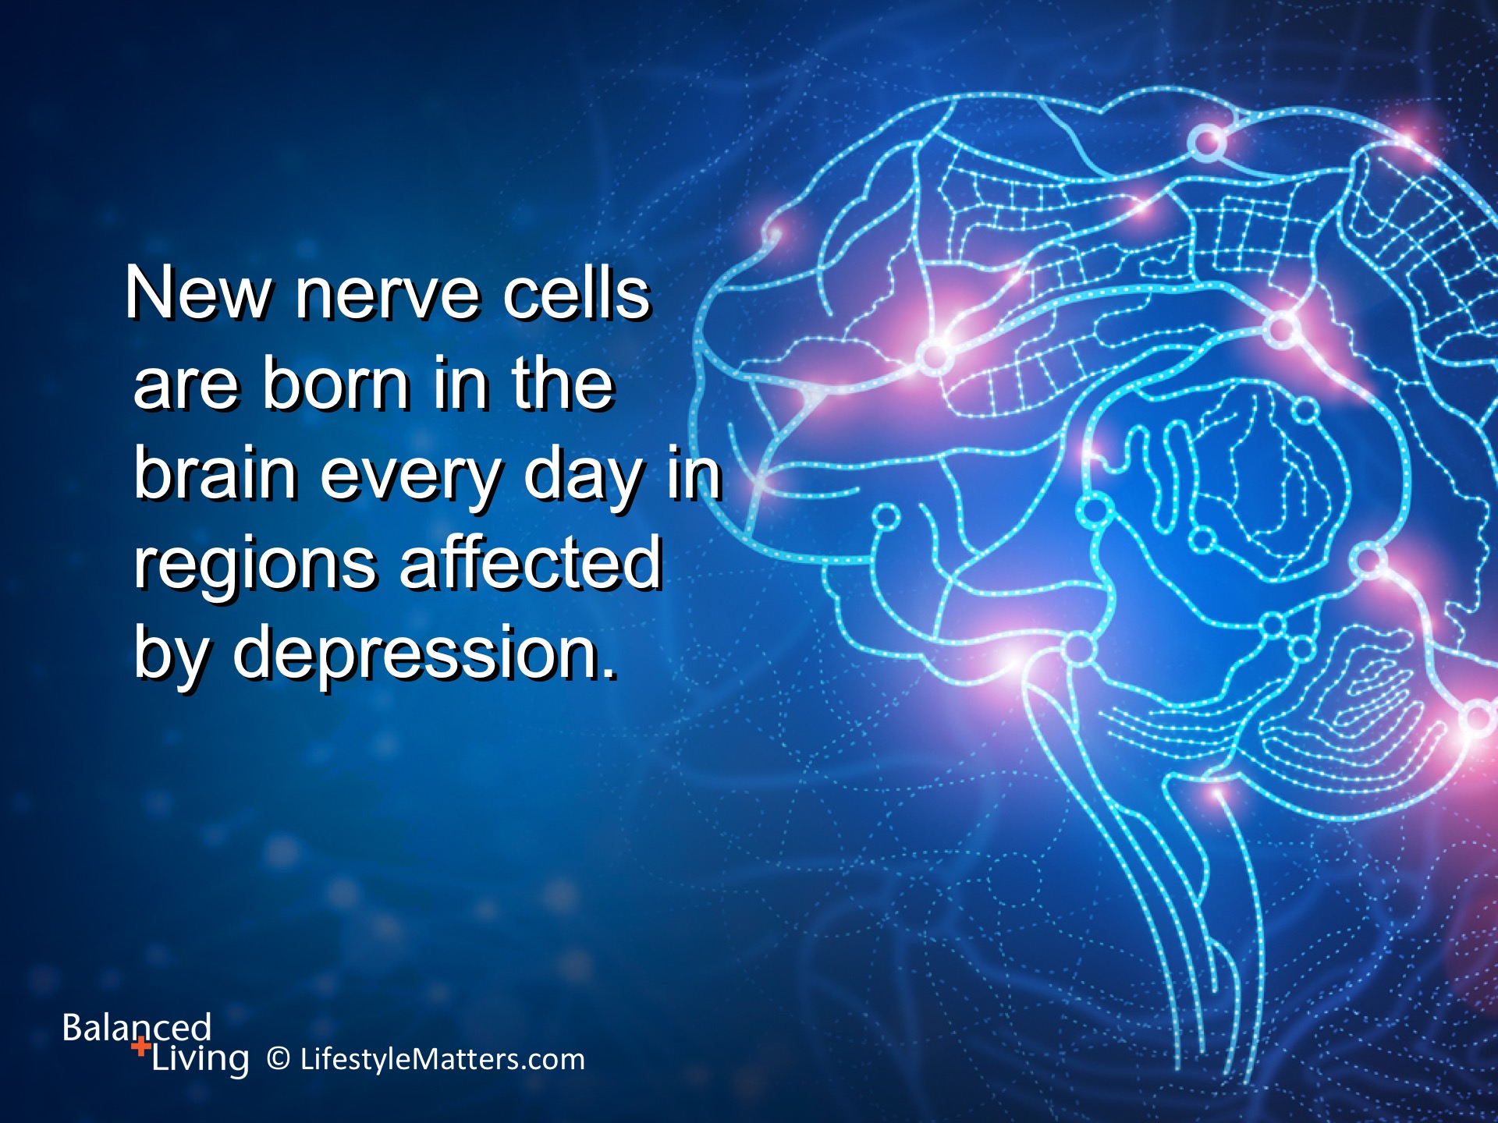
Notes:
The good news is that there is hope!
Read slide.
God has engineered our brains for renewal, recovery, and restoration over time.
The following are some practical ways to find balance in your life.

Slide 11
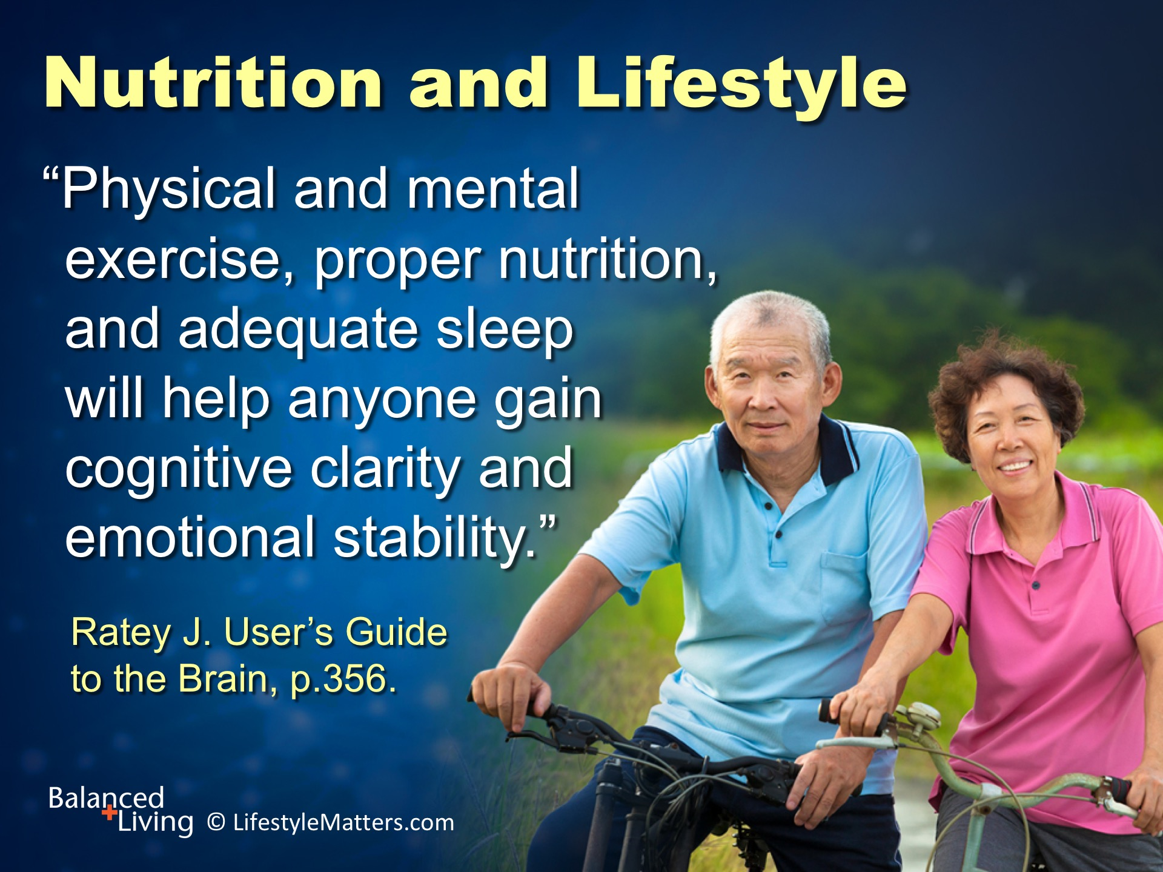
Notes:
Read slide.
Research increasingly underscores the powerful mind/body connection in mental and physical health.
Food is medicine—and good tasting, colorful medicine!
What foods boost brain health and mood? (wait for response)
Which foods work against good brain health? (wait for response)

Slide 12
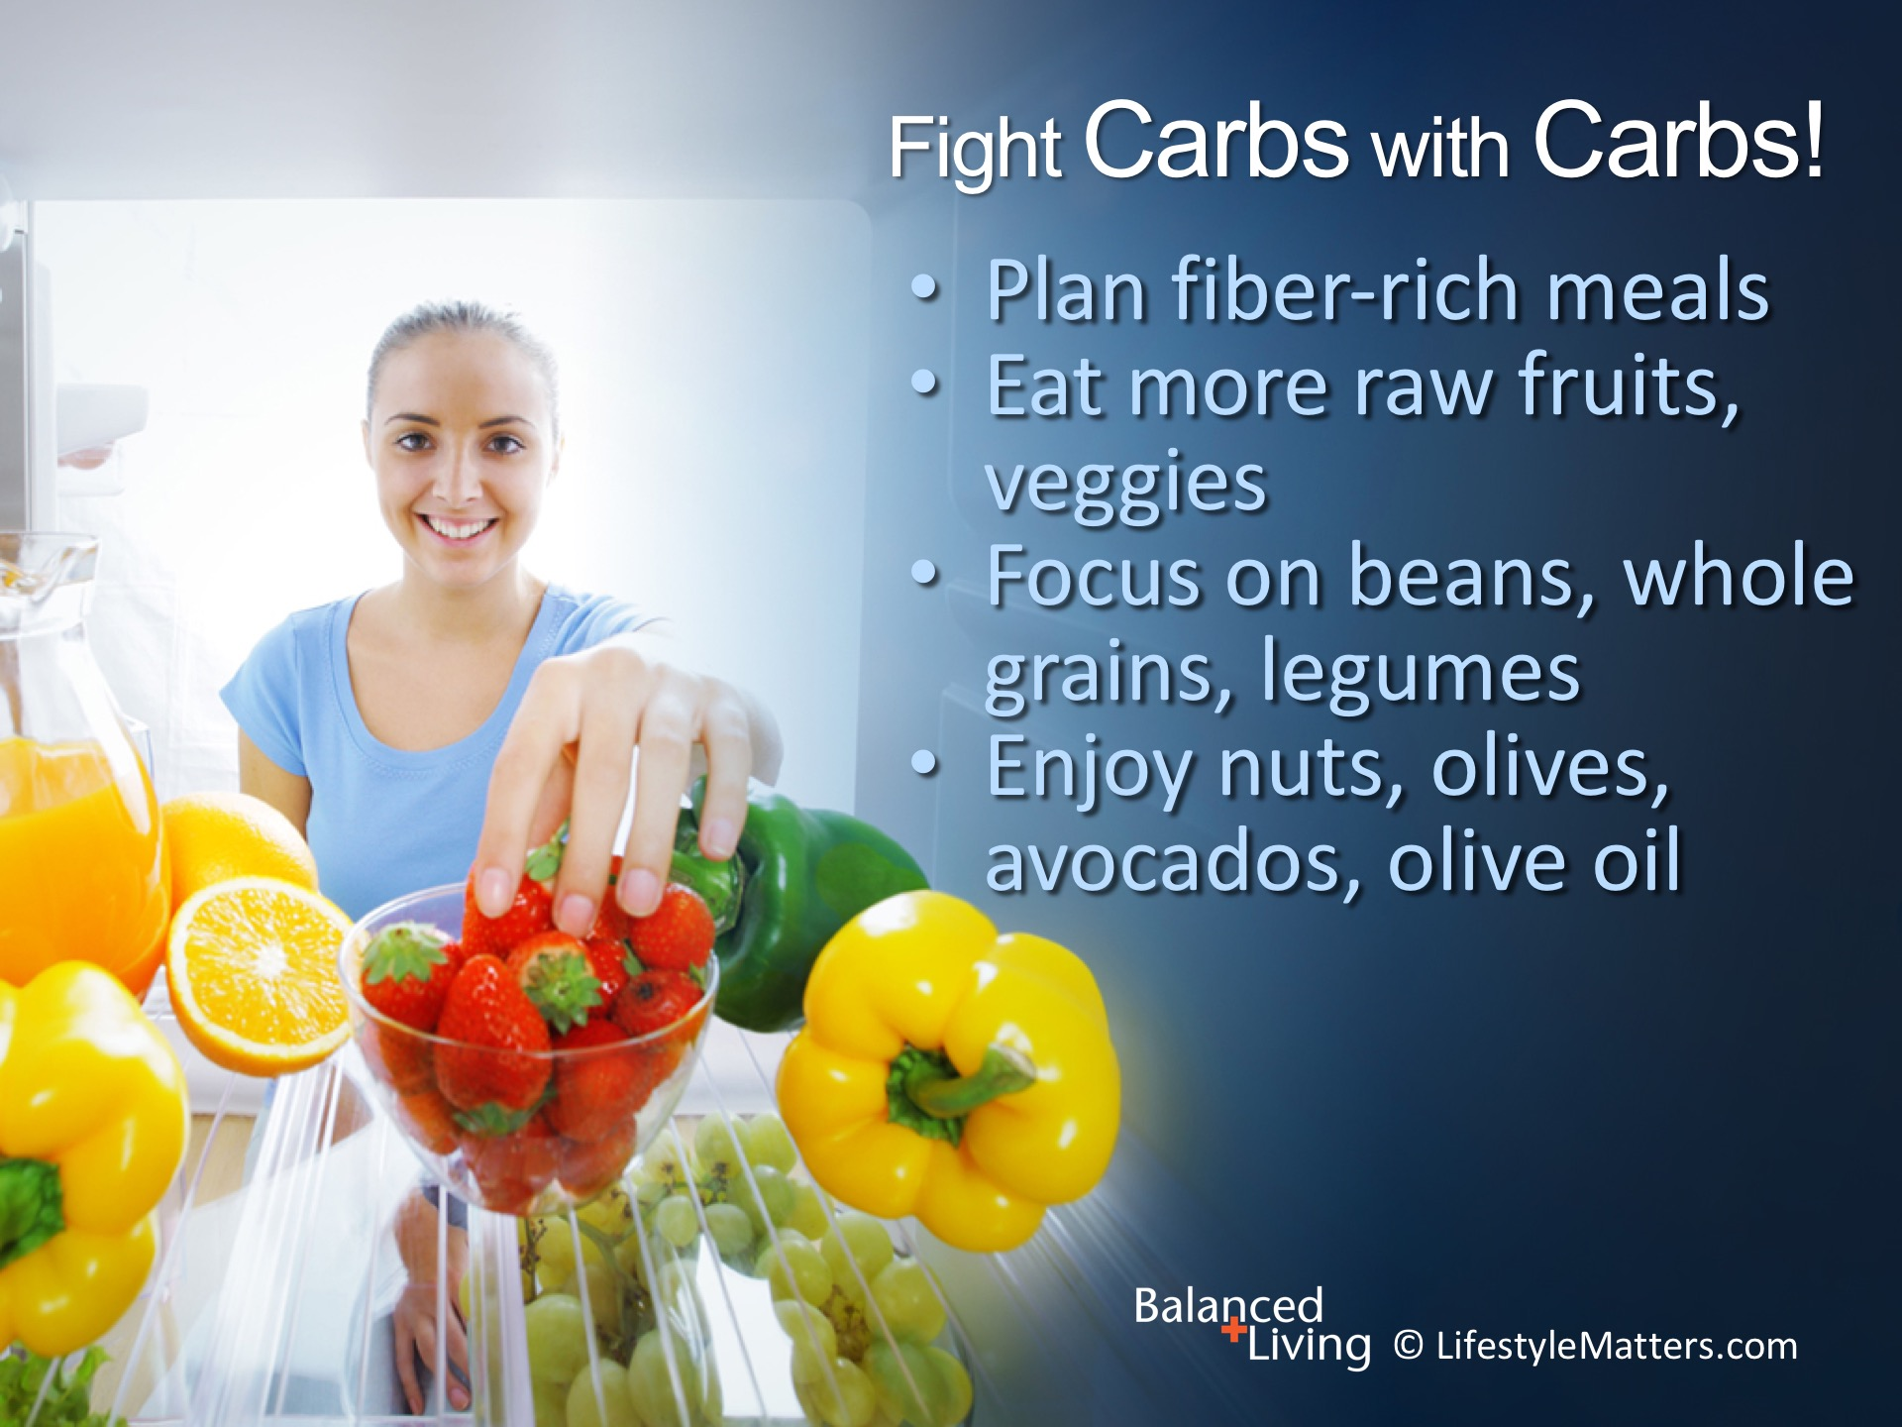
Notes:
Your body wants healthy carbs. Read slide.
Carbohydrates and wholesome plant foods are the major fuel source for cells.
Sugary drinks, sweets, and white flour products promote cravings and addictions.
Whole foods and unrefined carbohydrates satisfy carbohydrate cravings linked to depression.

Slide 13
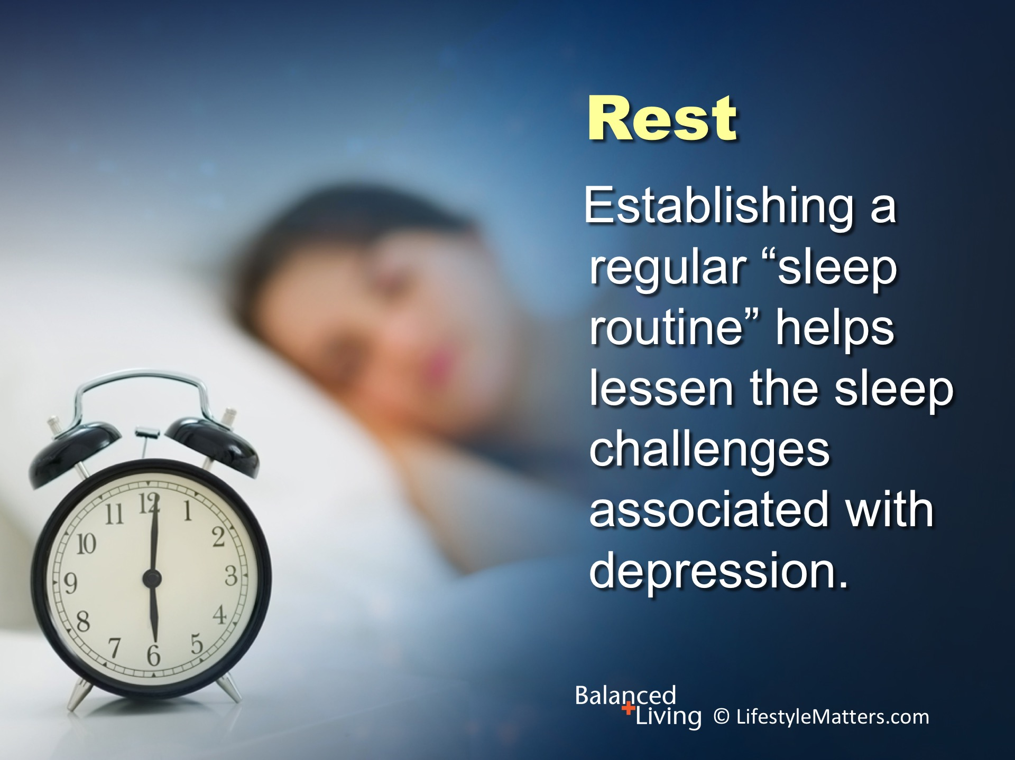
Notes:
Read slide.
Depression affects “sleep architecture,” which is how sleep cycles function throughout the night.

Slide 14
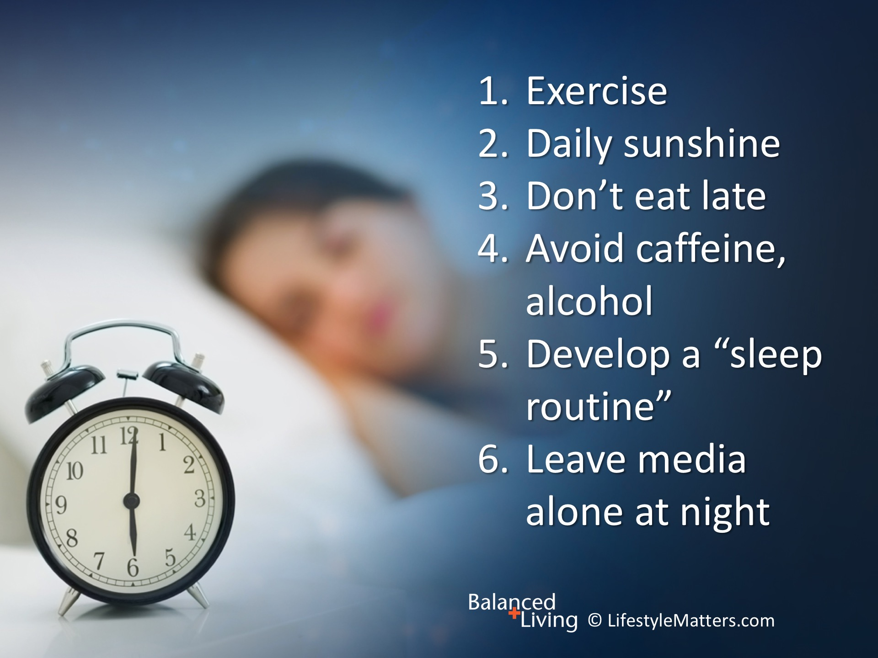
Notes:
Read slide.
A “sleep routine” is a set of habits that remind your brain it’s time to slow down, like a hot bath, cup of herb tea, or a favorite book.
Many factors improve sleep: Can you think of any others? (wait for response)
(Note, psychological and spiritual factors like forgiveness, gratitude, prayer, God’s promises)

Slide 15
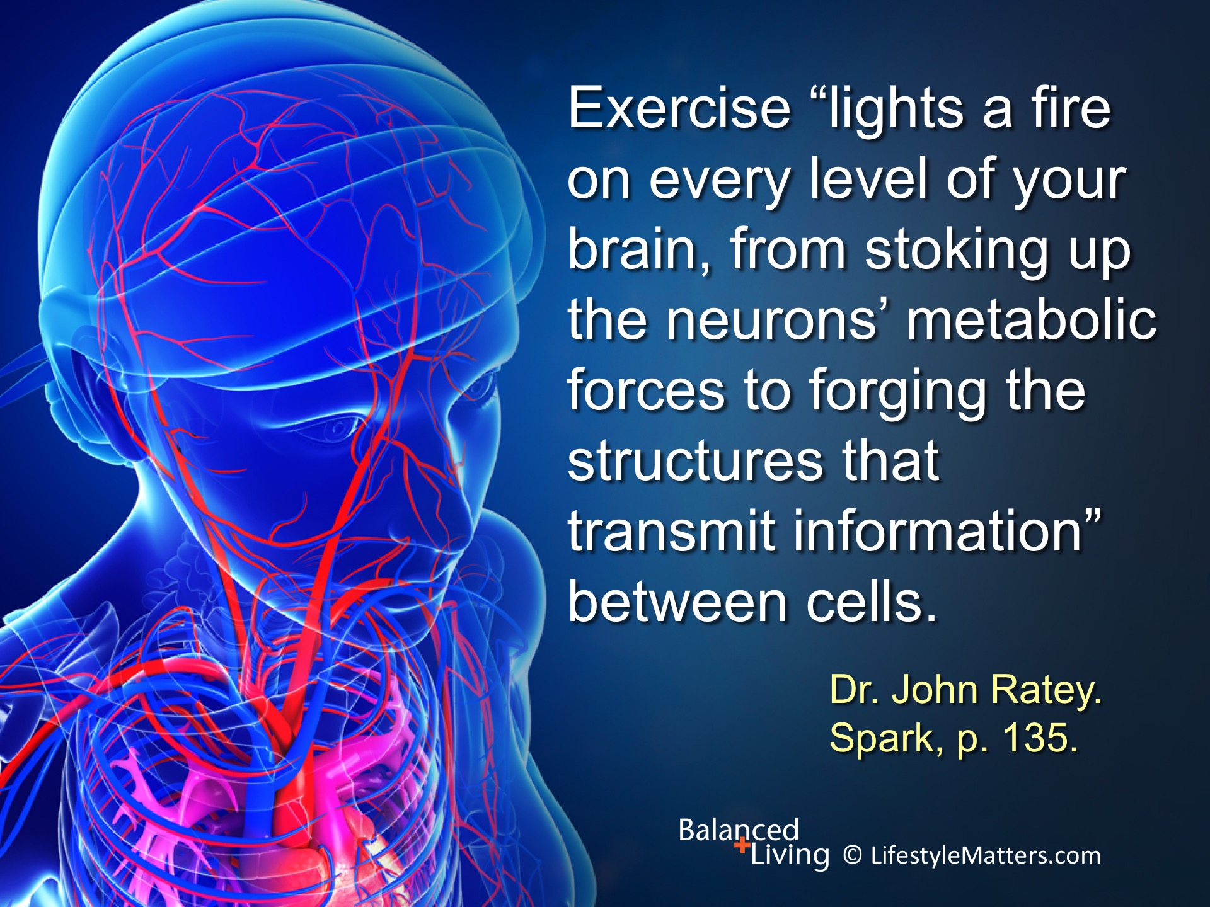
Notes:
Read slide.
Exercise is powerful in creating new neurons for restoring the brain.

Slide 16
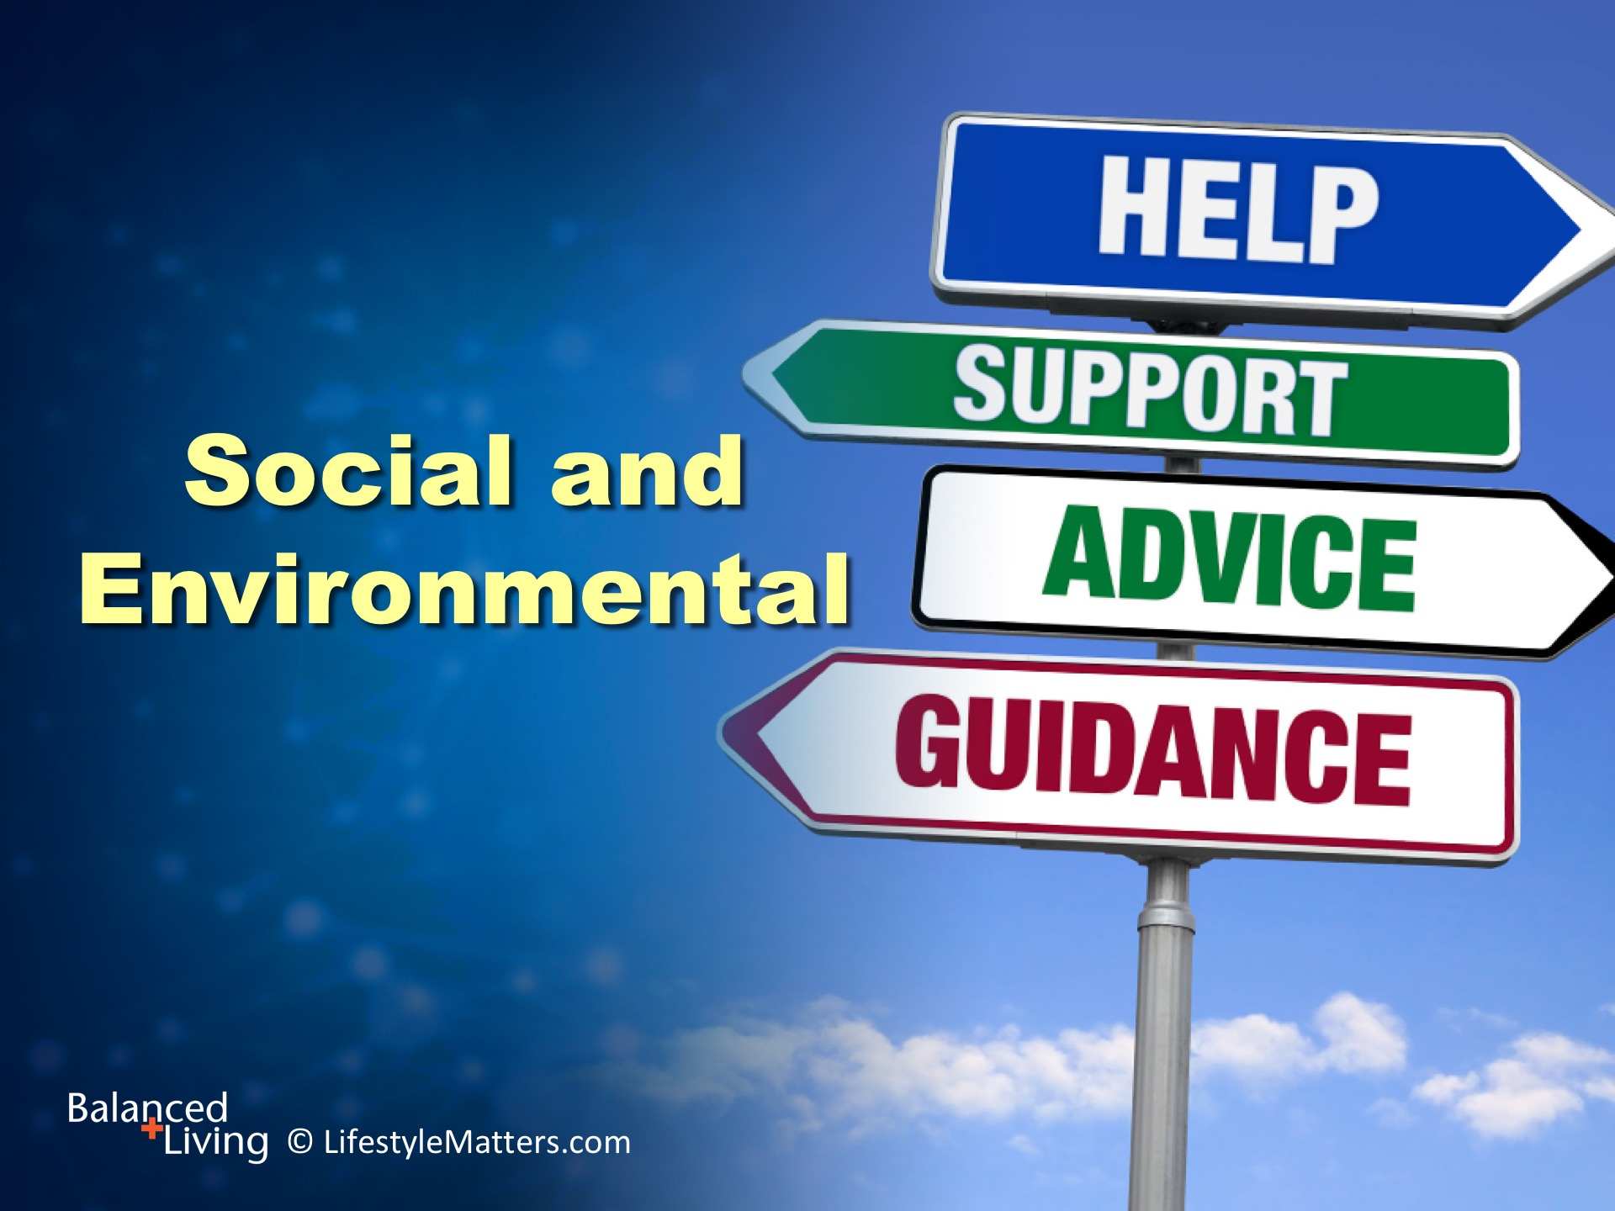
Notes:
Read slide.
Attitude, social networks and a healthy lifestyle are woven together in their importance for physical and mental health.
Healthy relationships make our world bigger and provide support and accountability.

Slide 17
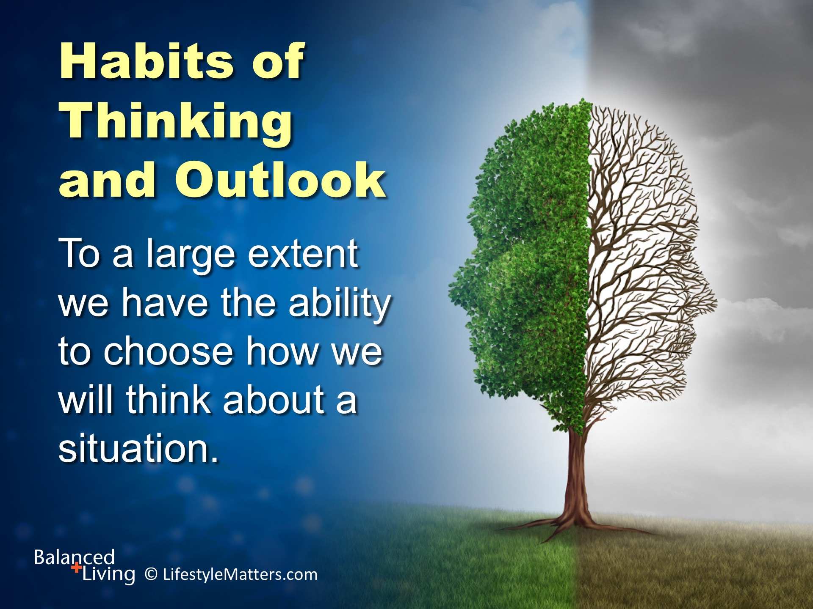
Notes:
Read slide.
A person’s psychological state is a prominent factor in health.
Focus on the positive instead of the negative.
Focus on solutions instead of the problem.

Slide 18
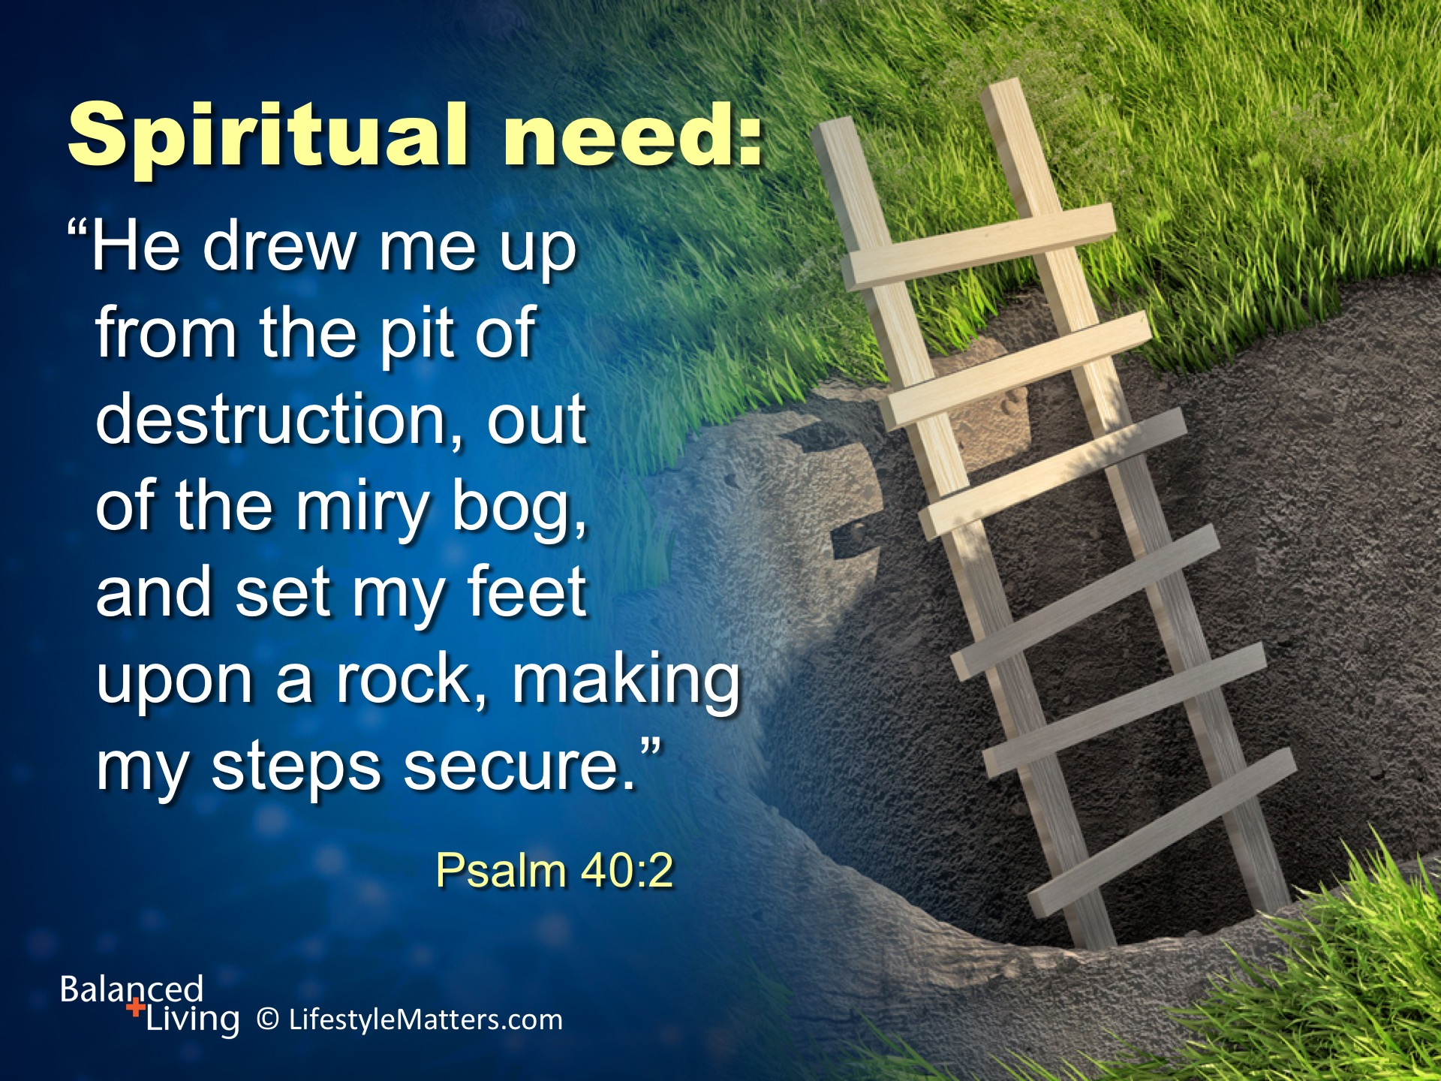
Notes:
Read slide.

Slide 19
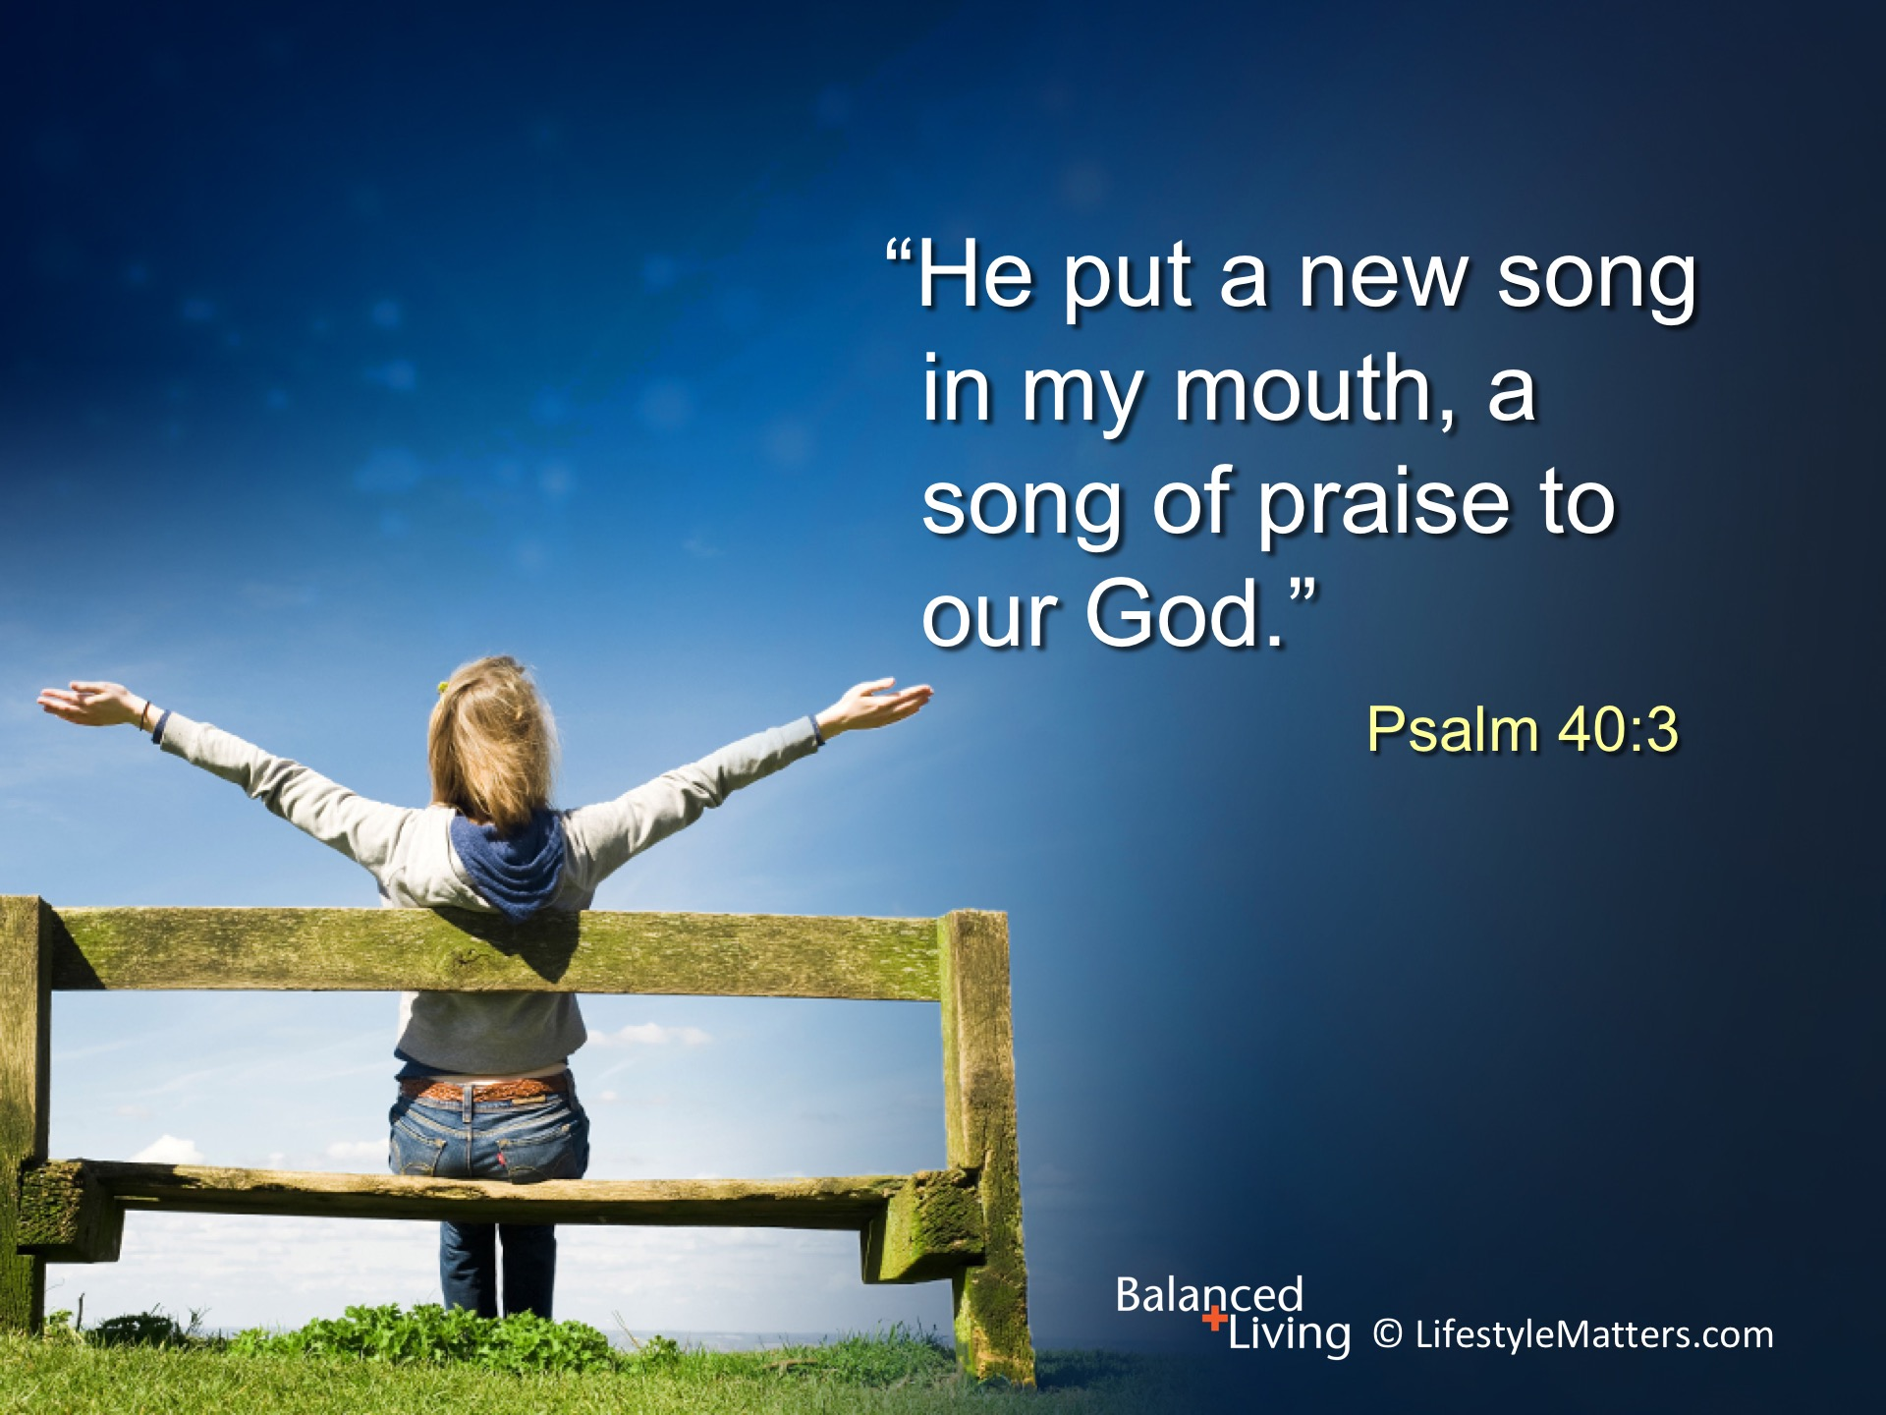
Notes:
Read slide.
Healing takes place with time and perseverance.
There can even be joy in the healing journey.
Choosing God, choosing faith, choosing His plan are all decisions based on choice, not feelings.
His promises are sure.
Will you make that choice today? (Call for raised hands: wait for response)

