Slide 1


Images © Alamy
www.alamy.com
Images used in PowerPoint presentation are part of the presentation and not to be used out of context of the presentation, may not be used as stand-alone images unless to promote the presentation/event, and may not be resold in singular form or as part of an image library. Images are © Alamy and presentation templates and content therein are © MISDA, any other usage requires written permission from both parties.

Slide 2
®
Scripture quotations used in Balanced Living PowerPoints are taken from Bibles in the Public Domain which have no USA copyright restrictions. We have indicated which version each quotation is taken from as follows:
KJV - King James Version
BBE - Bible in Basic English
WEB - World English Bible
DBY - Darby's Translation
Any scriptures not otherwise noted are the author's paraphrase of one of these versions.

Slide 3

Notes:
Read slide.
Digestion—it’s one of those things we don’t think too much about until it goes awry—and then we can’t think about much else.

Slide 4
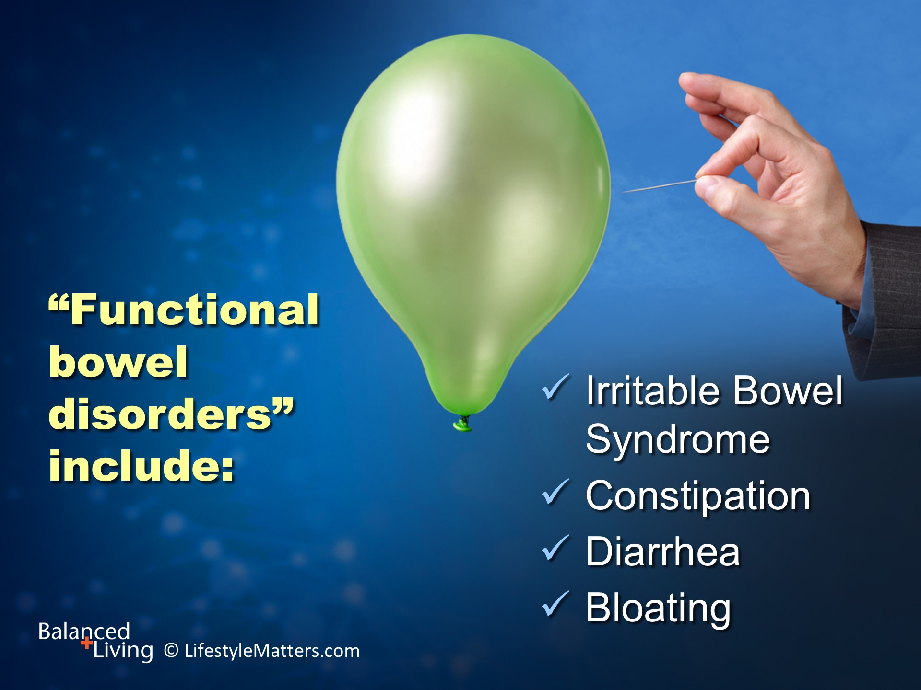
Notes:
Read slide.
Over 10 million Americans suffer from chronic GI problems.

Slide 5

Notes:
Read slide.

Slide 6
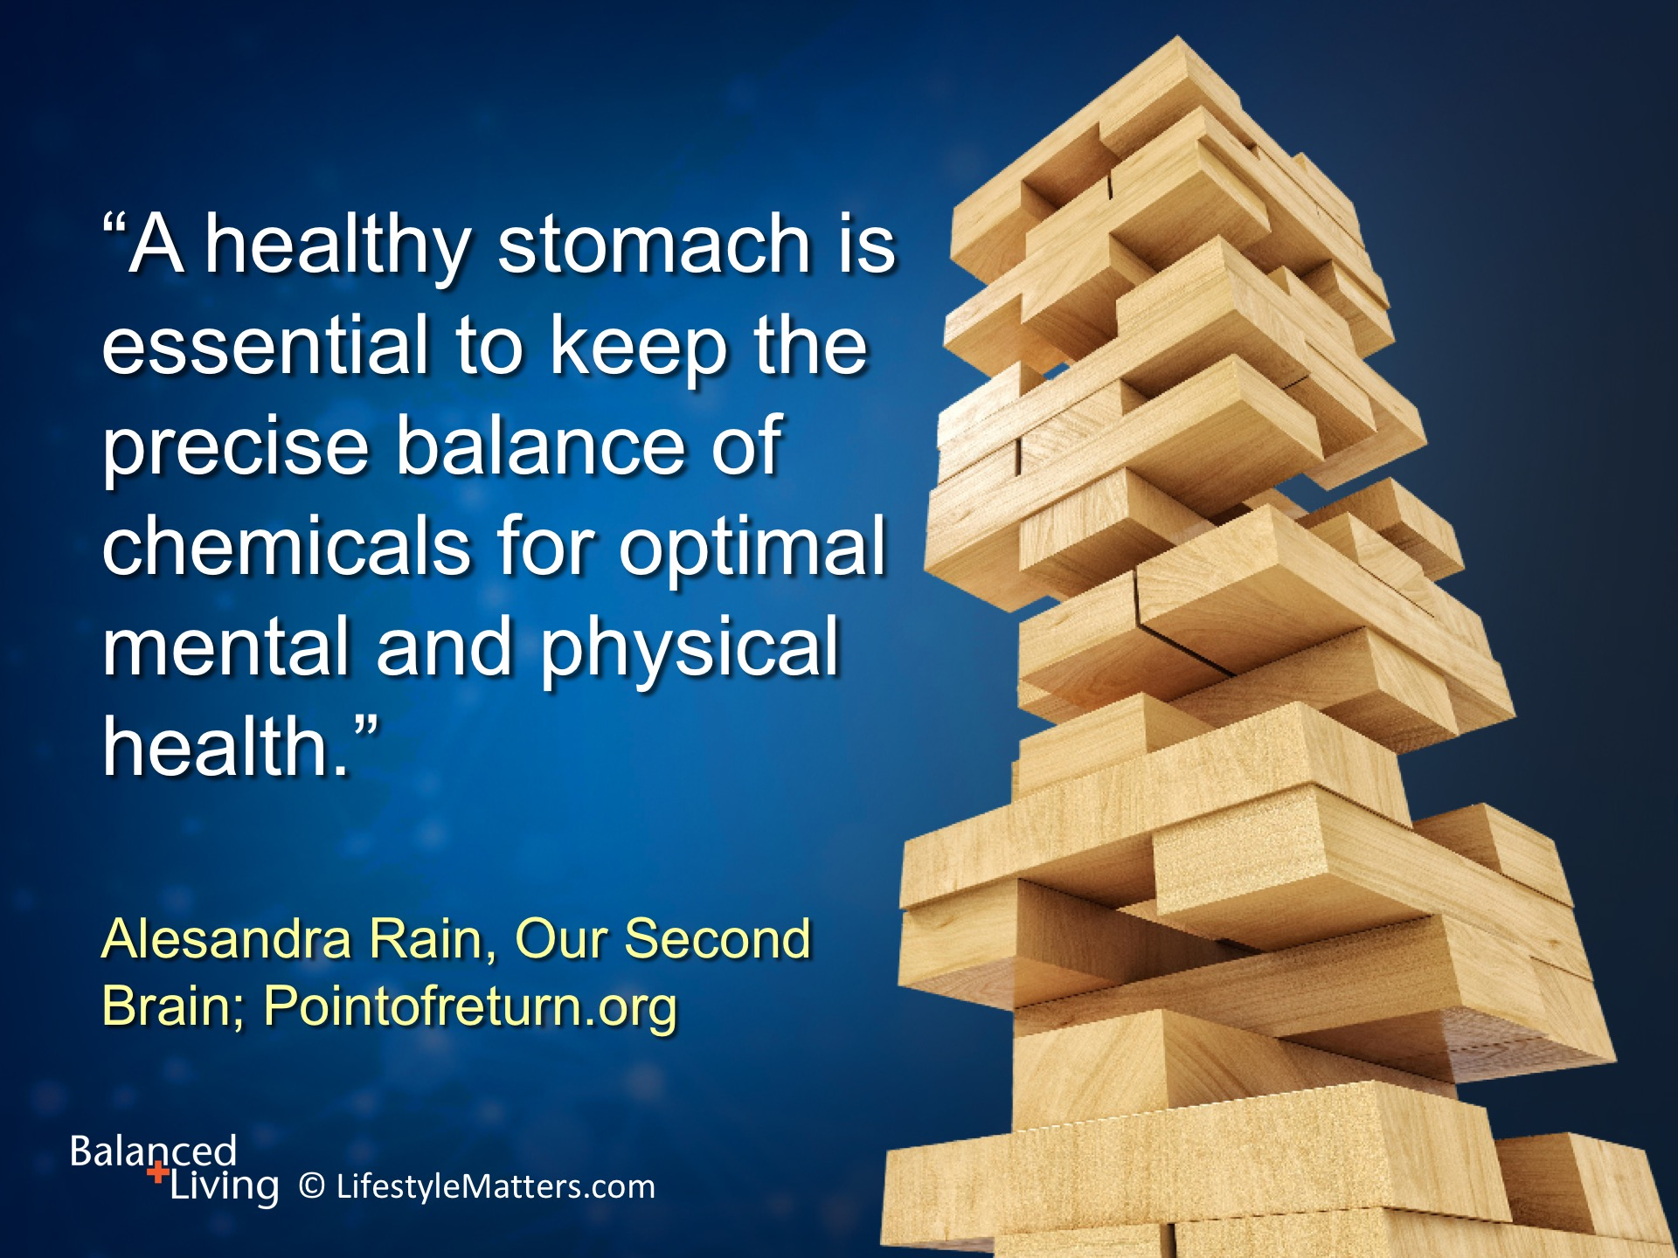
Notes:
Read slide.
Your environment, schedule, activity level, mental state, and diet all affect digestive health.

Slide 7
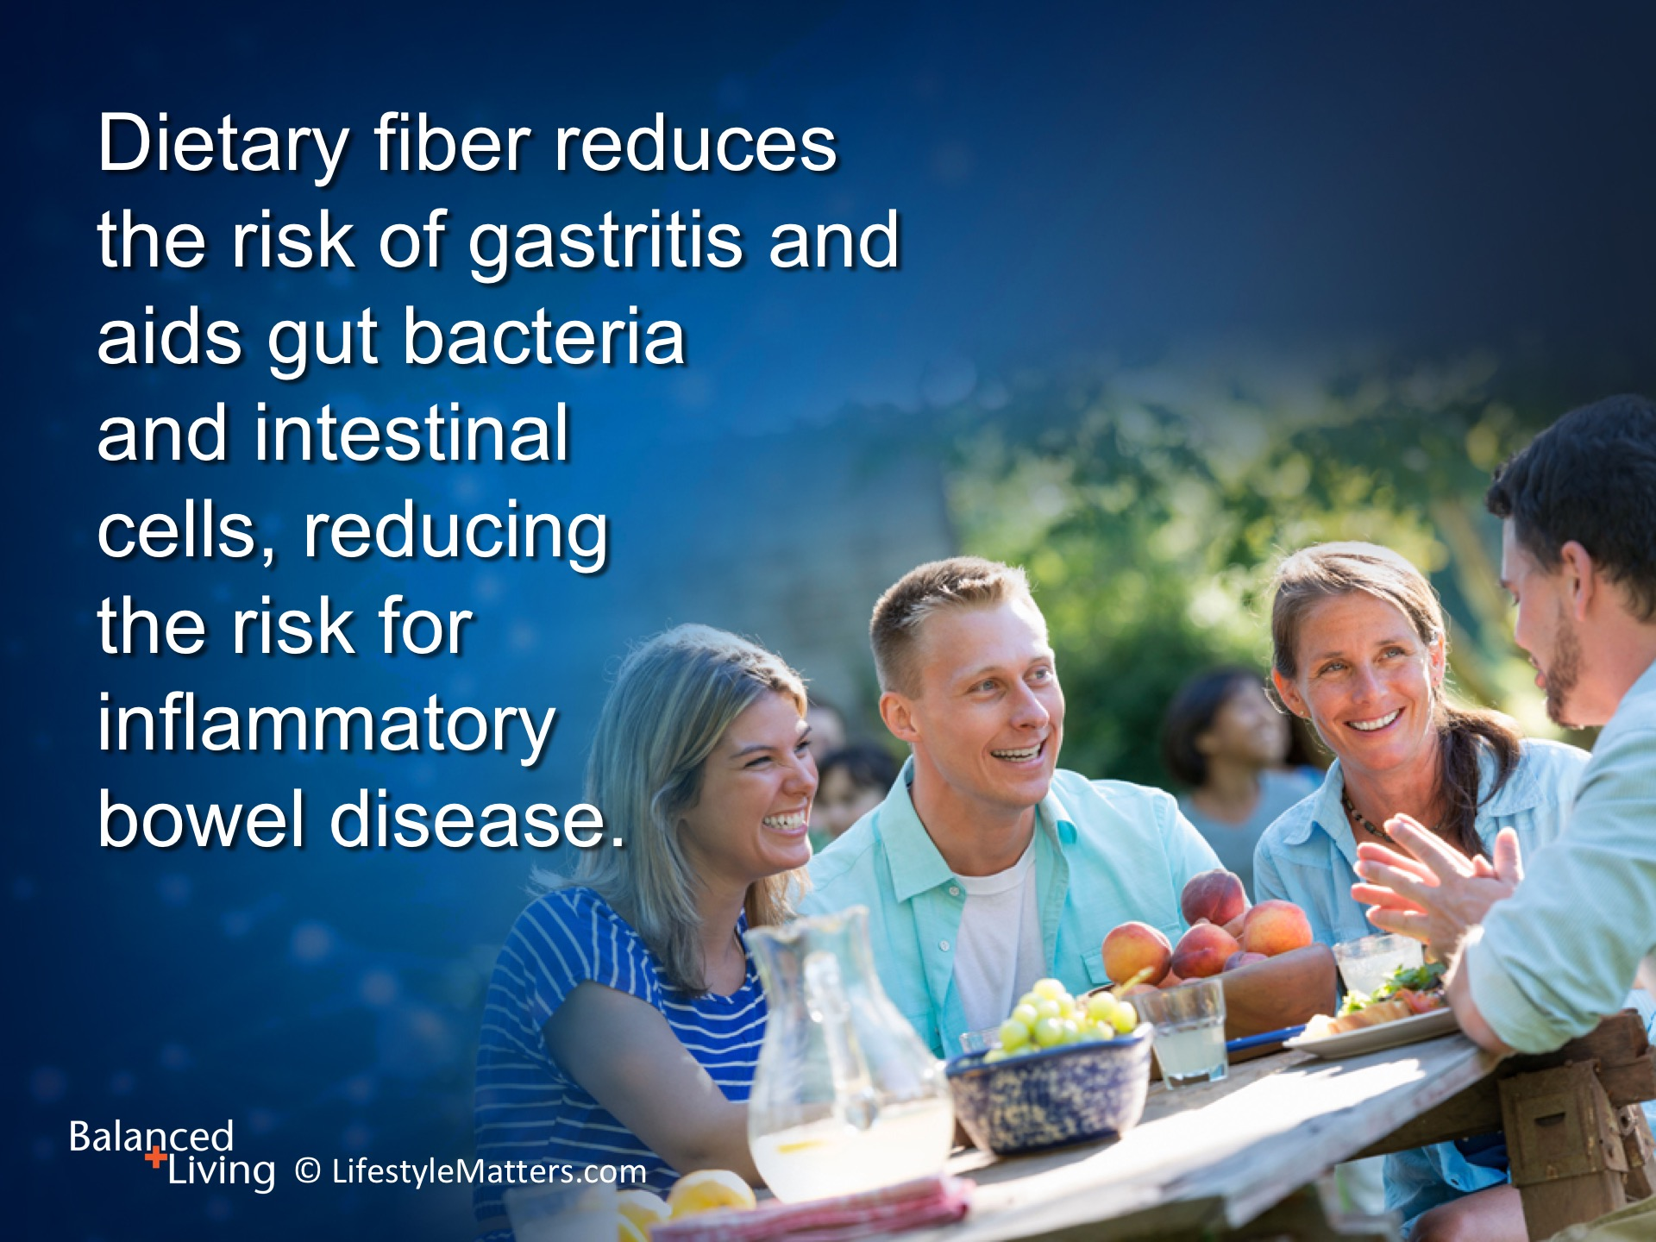
Notes:
Read slide.
The type of food eaten influences the microbiome or gut bacteria.
Good gut microbiome (bacteria) thrive on dietary fiber – vegetables, fruits, whole grains, beans & nuts.
Harmful gut microbiome (bacteria) thrive on sugar and fat – causing inflammation—and increased risk for disease.

Slide 8
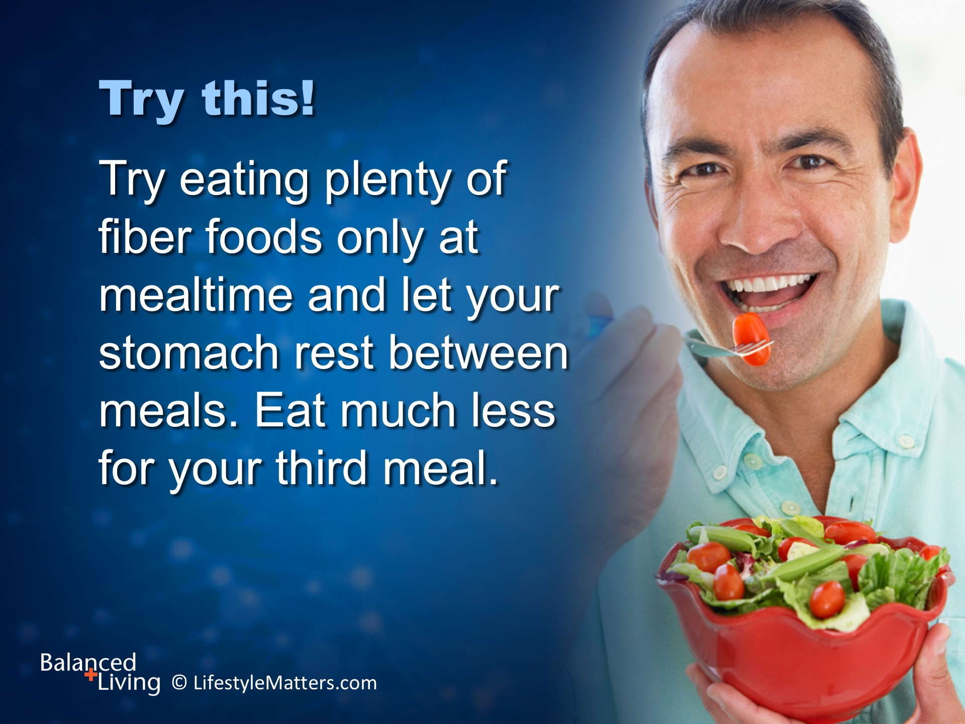
Notes:
Read slide.
“Eat breakfast like a king, lunch like a queen, and supper like a pauper.”

Slide 9
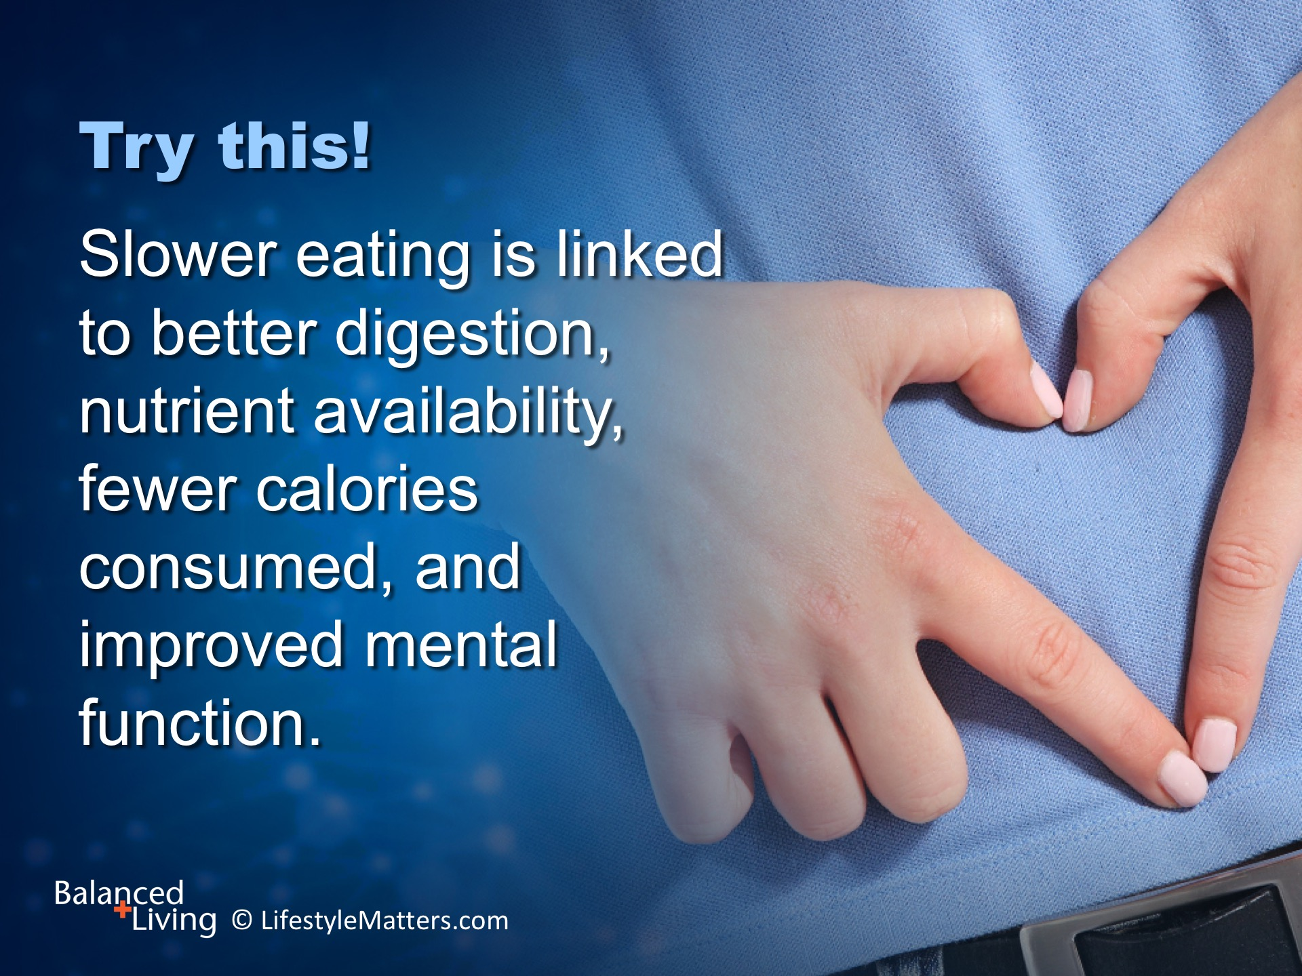
Notes:
Read slide.
Slow down, turn off the media and enjoy your meal with others.

Slide 10
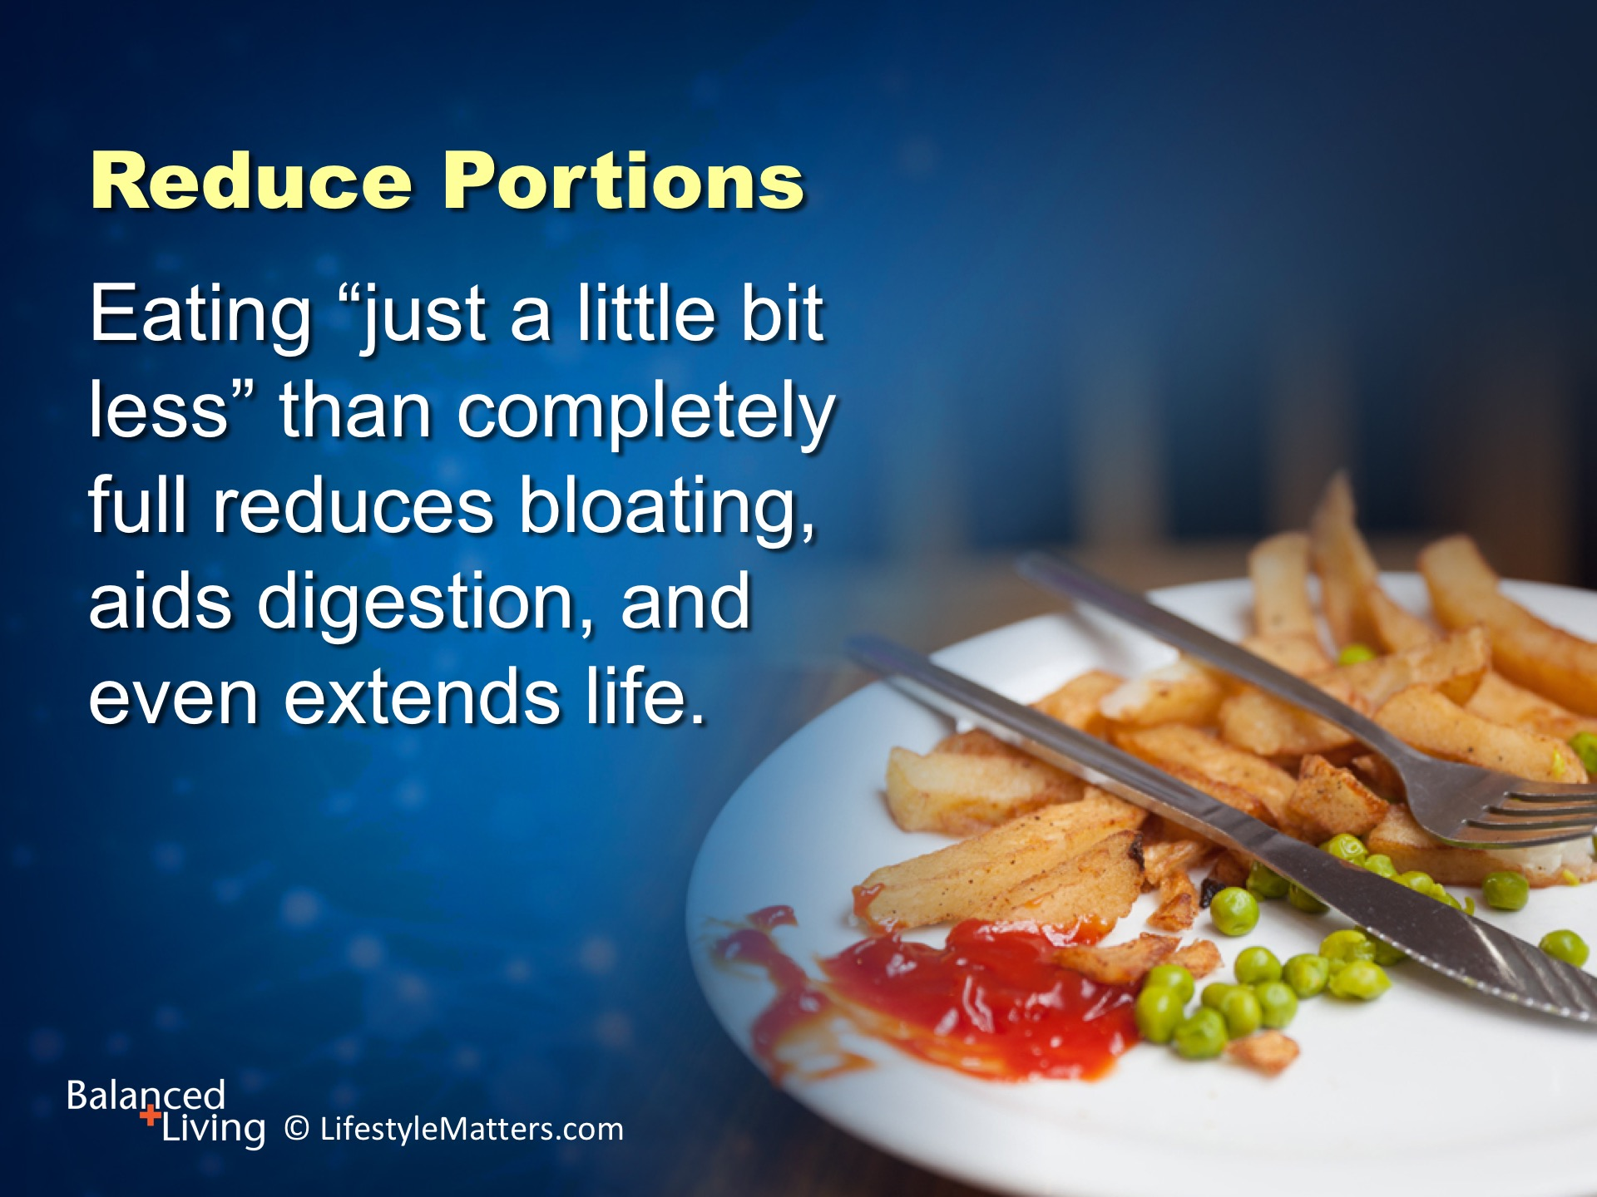
Notes:
Read slide.
Overeating and inactivity creates sluggish circulation, sluggish thinking, indigestion, fatigue, and poor mood.

Slide 11
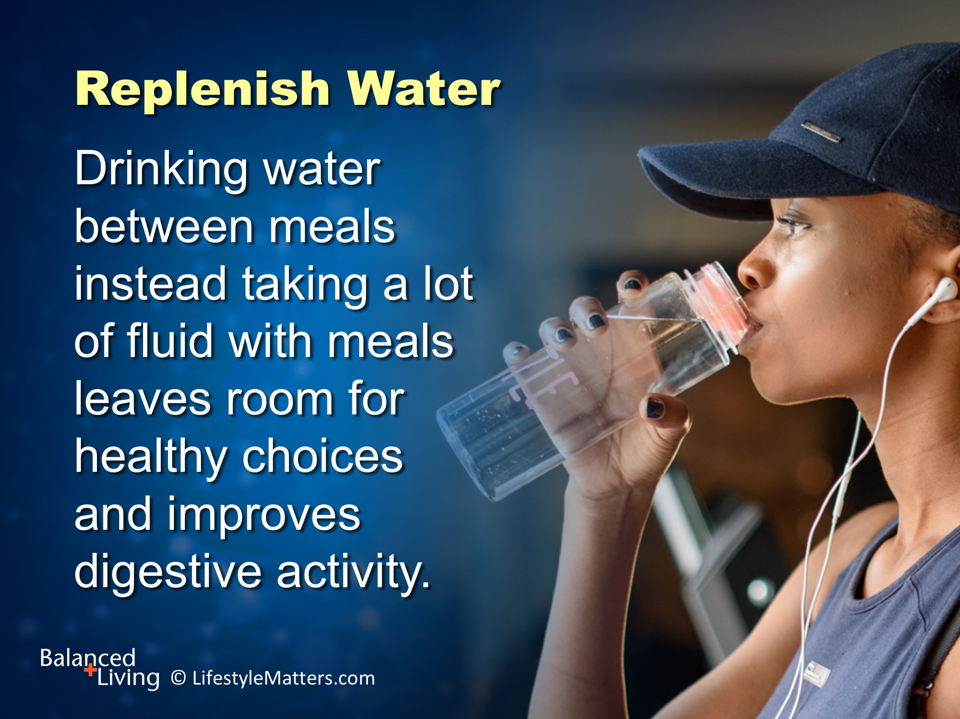
Notes:
Read slide.
Drink a nice big glass of water when you wake up in the morning.

Slide 12
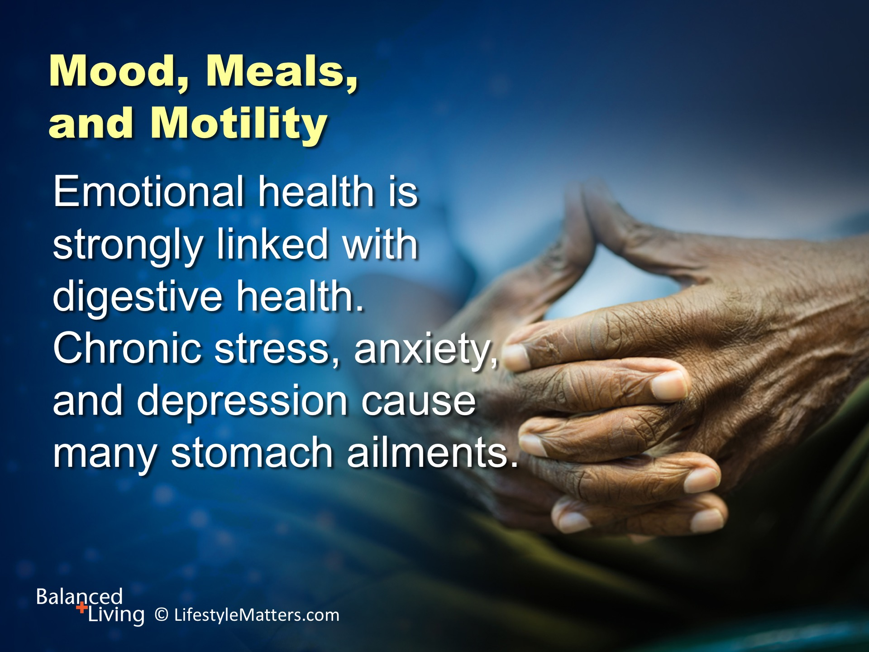
Notes:
Read slide.
“The relation that exists between the mind and body is very intimate. When one is affected, the other is always more or less in sympathy…When the intellect is clouded, the moral powers are enfeebled, and sin does not look sinful.” Ellen White, Our High Calling, p. 266.

Slide 13
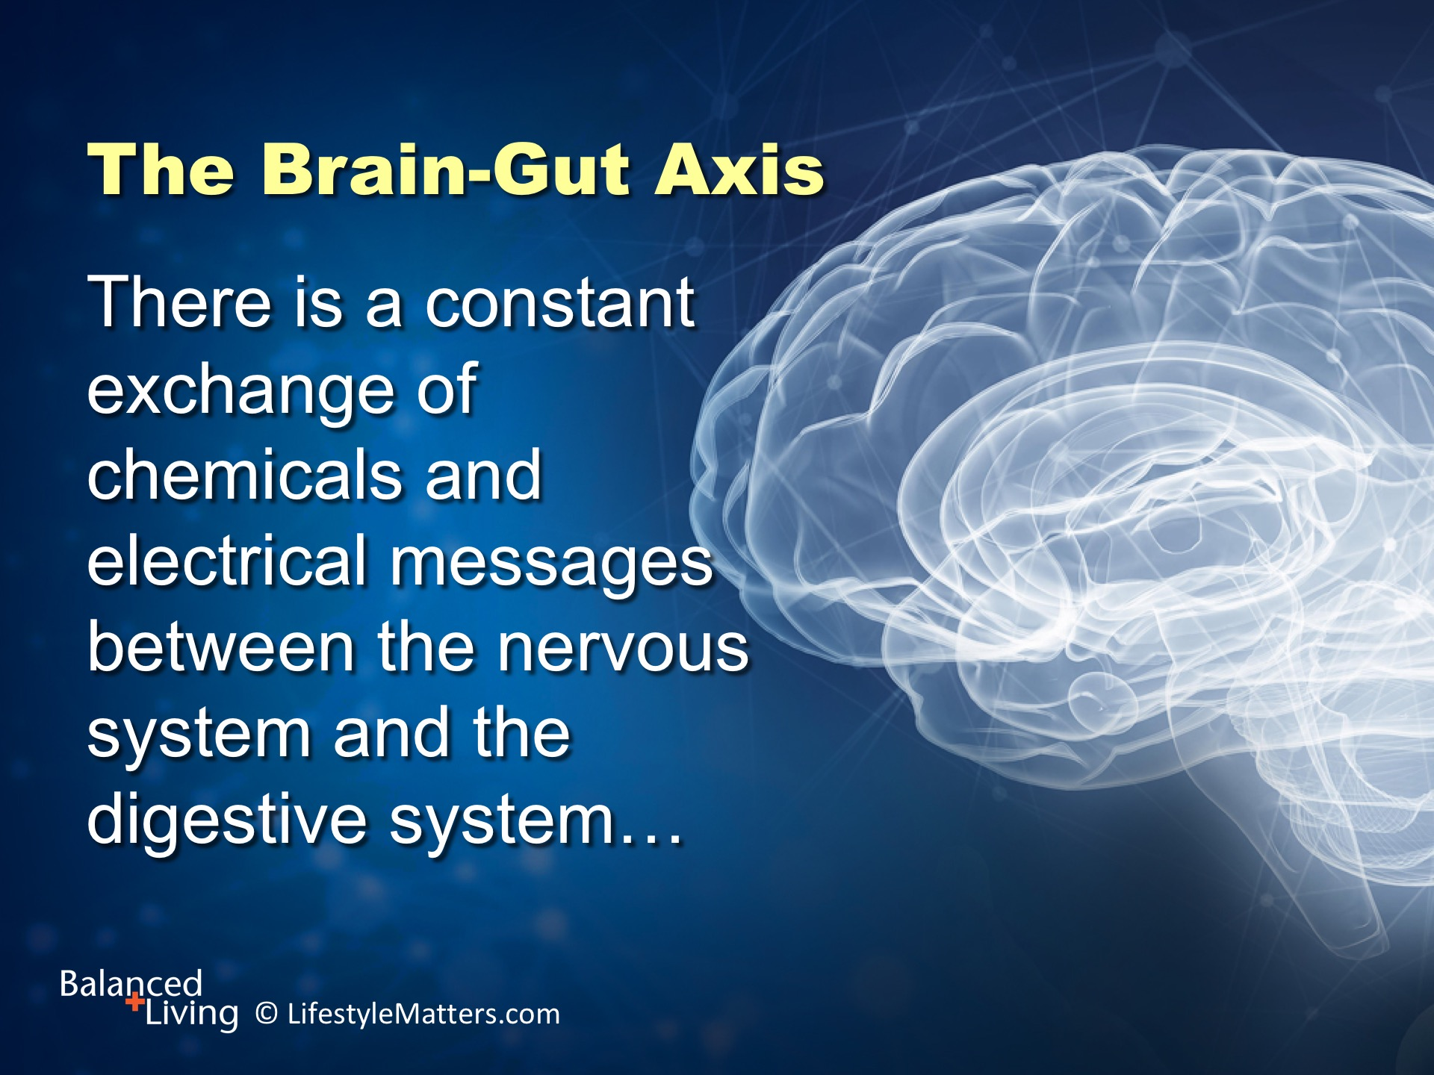
Notes:
Read slide.

Slide 14
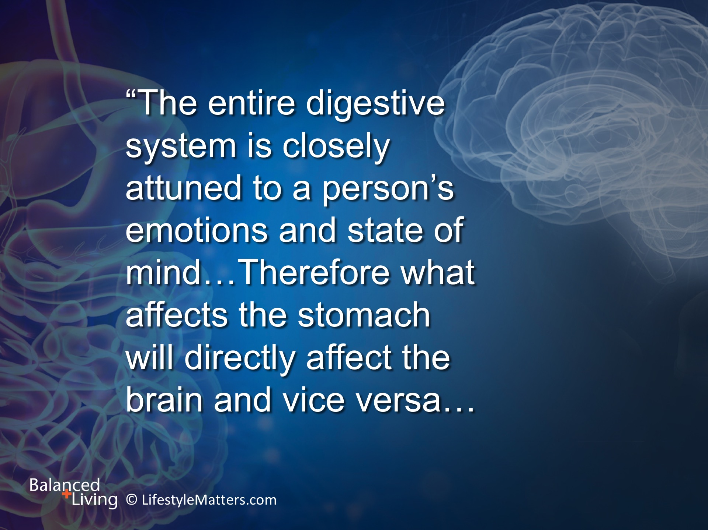
Notes:
Read slide.

Slide 15
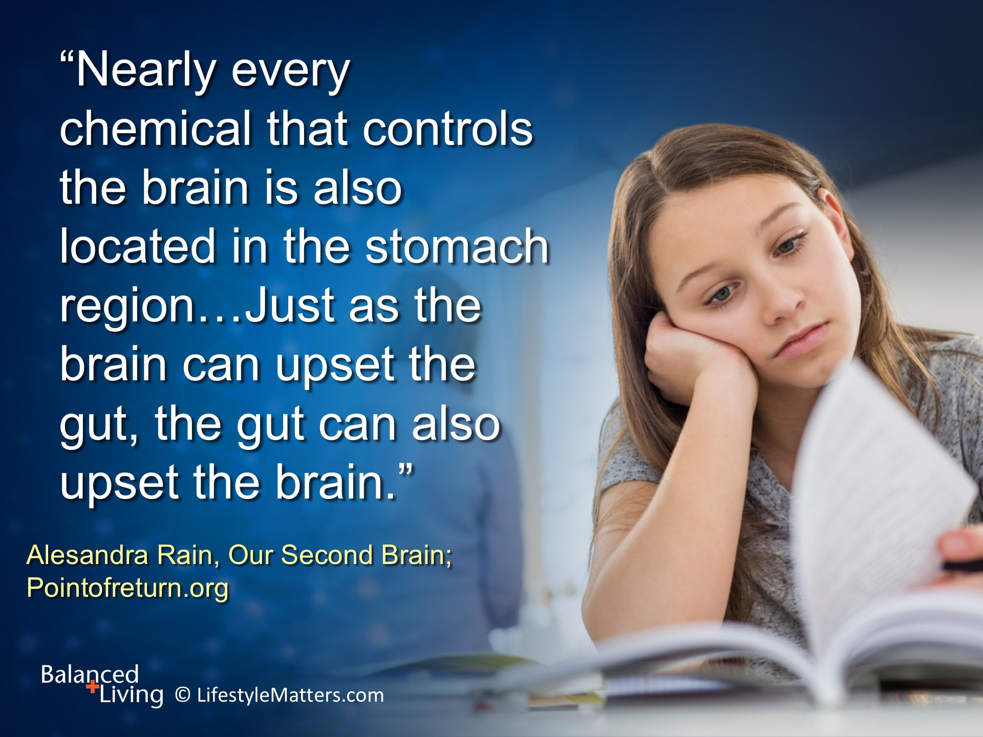
Notes:
Read slide

Slide 16

Notes:
In addition, Read slide.

Slide 17

Notes:
Read slide.
Take time to choose healthful foods, watch portion sizes; slow down eating, enjoy your mealtime with others and have a grateful heart.

Slide 18

Notes:
Jesus is inviting you now: Read slide.

Slide 19
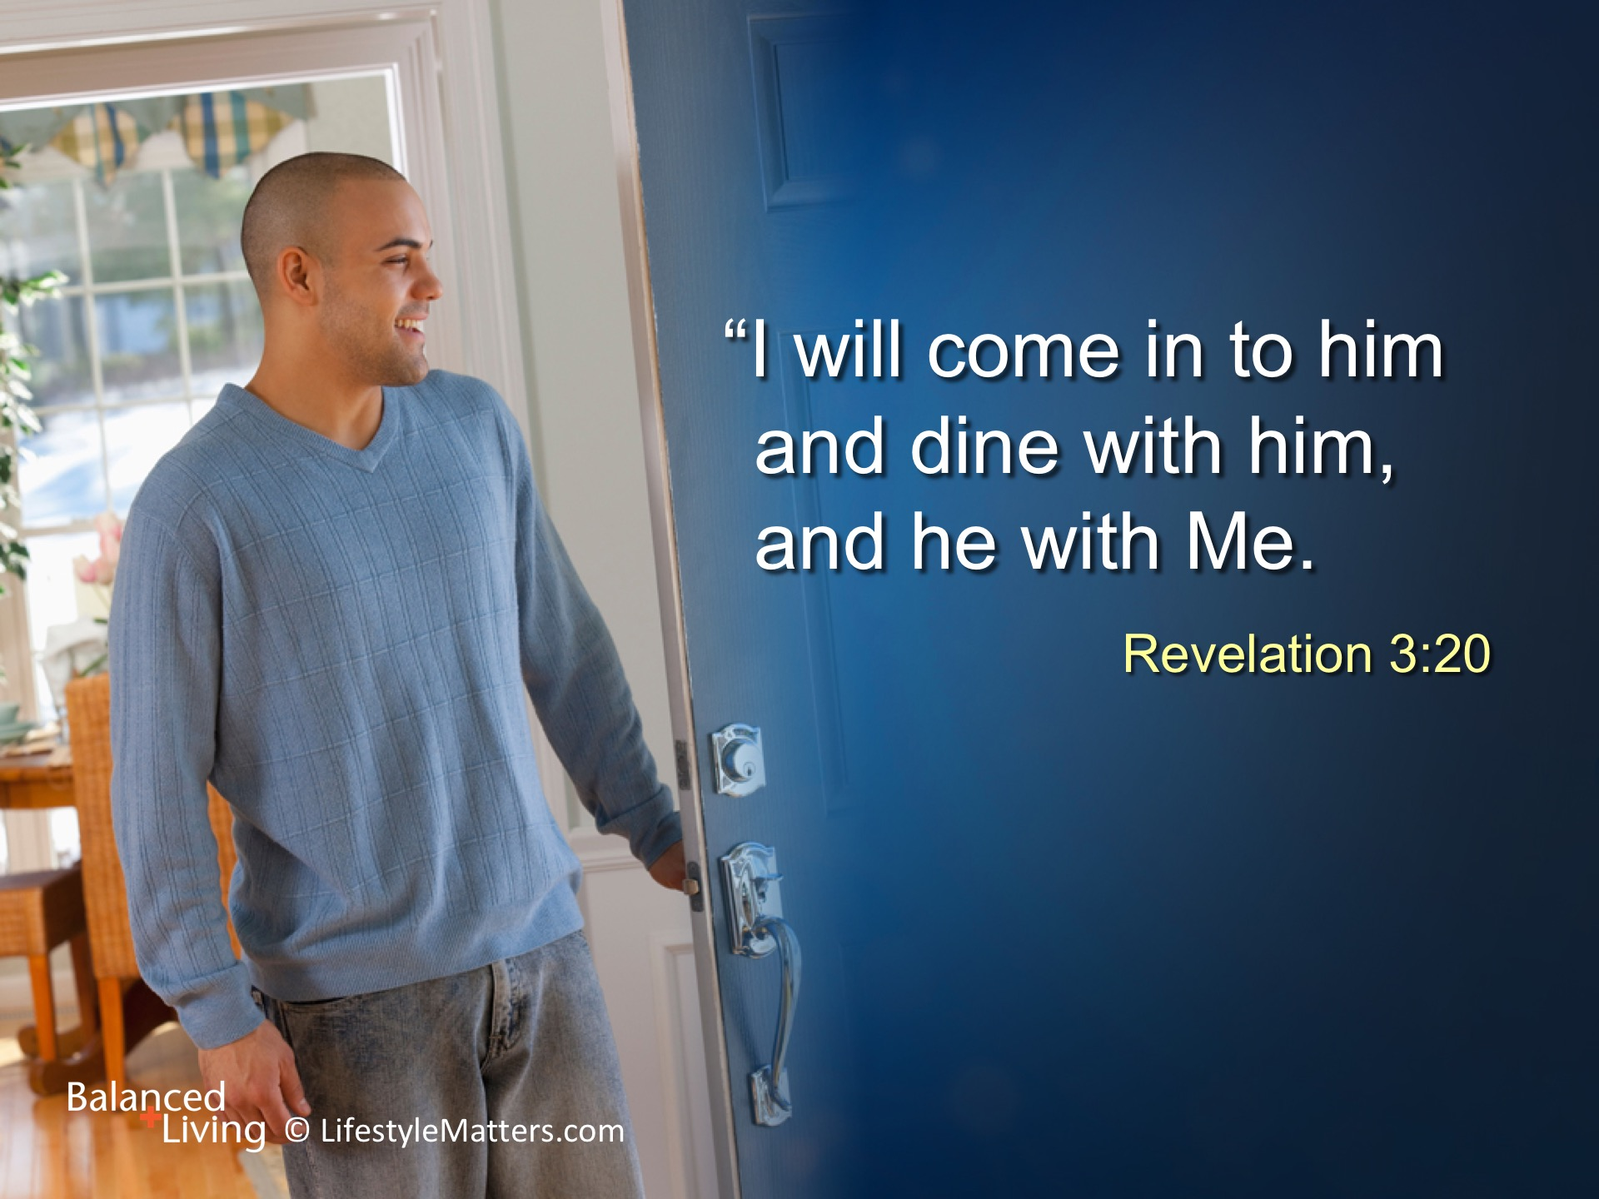
Notes:
Read slide.
Eating good food in regular patterns aids digestive health; feeding on the Word of God eases life’s worries and leads to eternal life.
He wants to calm you in life’s storms—but He will not force an entrance.
The invitation is His, but the decision is yours.
Will you accept His gracious invitation just now?
Will you receive His principles for better digestive and mental health habits; for spiritual health and eternal life? (raise hand and wait for response)

