Slide 1


Images © Alamy www.alamy.com
®
Images used in PowerPoint presentation are part of the presentation and not to be used out of context of the presentation, may not be used as stand-alone images unless to promote the presentation/event, and may not be resold in singular form or as part of an image library. Images are © Alamy and presentation templates and content therein are © MISDA, any other usage requires written permission from both parties.

Slide 2
Scripture quotations used in Balanced Living PowerPoints are taken from Bibles in the Public Domain which have no USA copyright restrictions. We have indicated which version each quotation is taken from as follows:
KJV - King James Version
BBE - Bible in Basic English
WEB - World English Bible
DBY - Darby's Translation
Any scriptures not otherwise noted are the author's paraphrase of one of these versions.

Slide 3
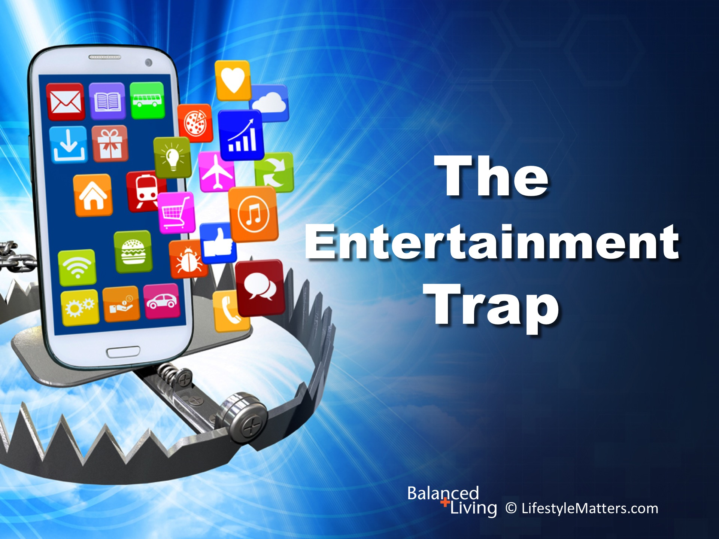
Notes:
Presenter: Please read and study the tract that accompanies this PowerPoint to prepare for this presentation.
In this presentation, we are taking a look at media and: Read slide.

Slide 4
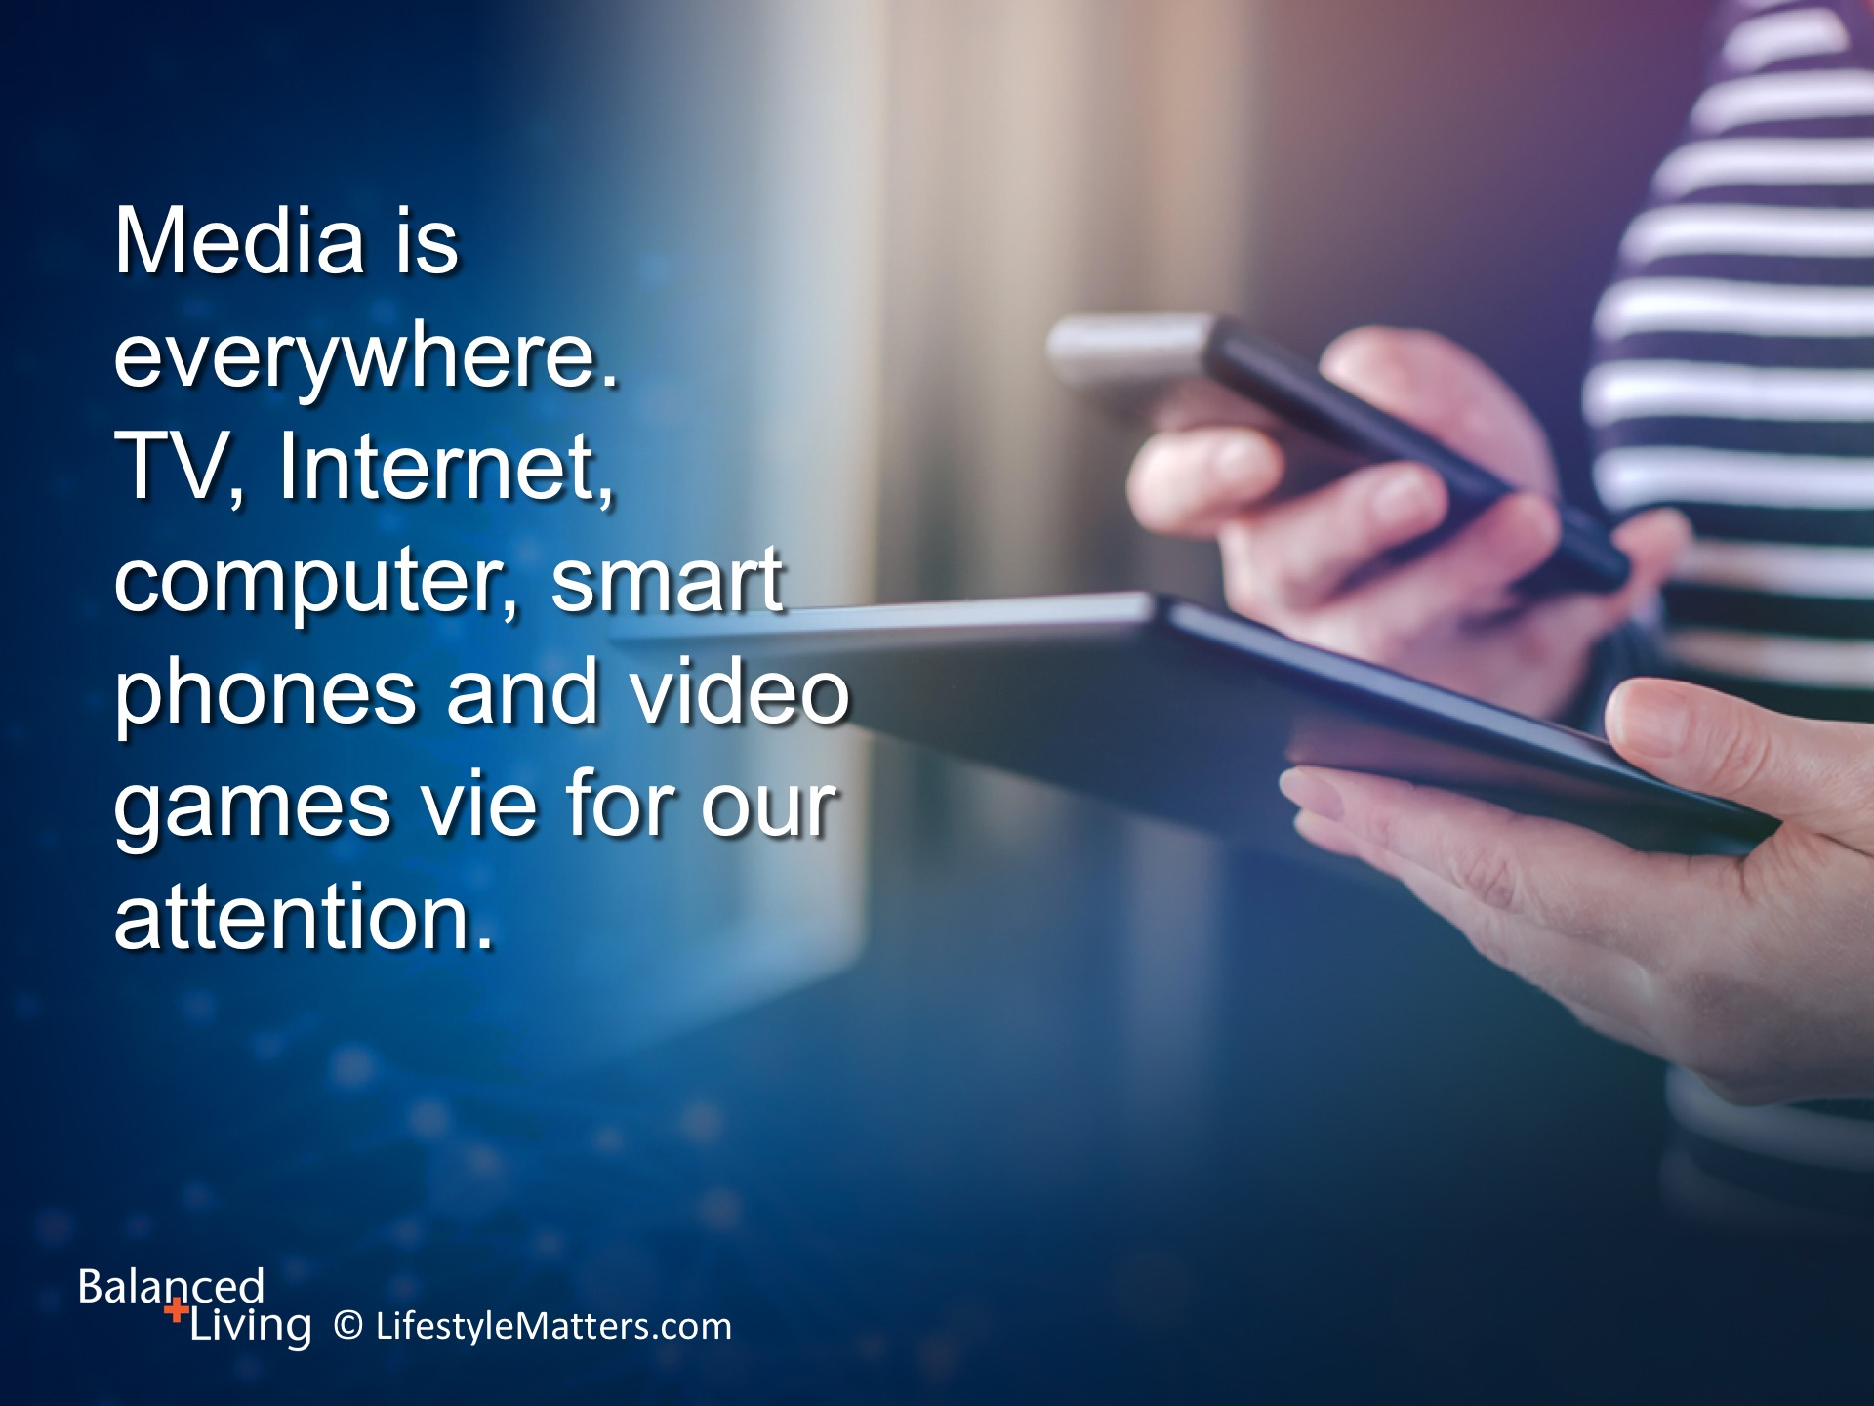
Notes:
Read slide.
Our world has gone digital—at home, work, school, and everywhere in between!
With news coming at us in a flurry of sound bytes and communication reduced to LOLs and emojis (☺), how is this affecting the way we see and interact with our world?
(Note: LOL= laugh out loud; emojis are symbols used when texting;
an emoticon is a digital icon or symbol on a keyboard used for expressing emotion or clarifying intent)

Slide 5
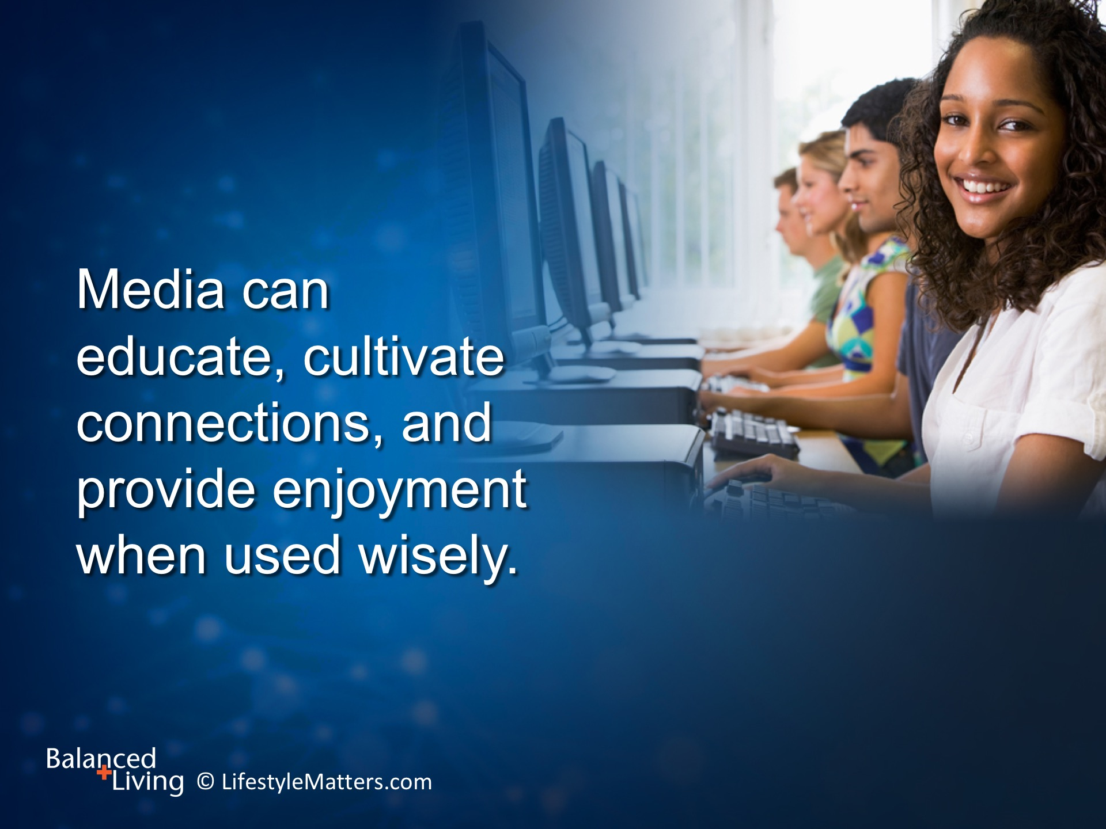
Notes:
Read slide.
1. What are some wise uses and helpful types of media? (Wait for response)
2. When do even these “good things” become tyrants instead of teachers? (Wait for response)
(Notes on questions:
Instructive presentations, nature and educational, news and research, uplifting music or inspirational, shopping options
Too much time, misinformation or information overload, addictive; mood disorders, displacement of real learning and social opportunities, sedentary)

Slide 6
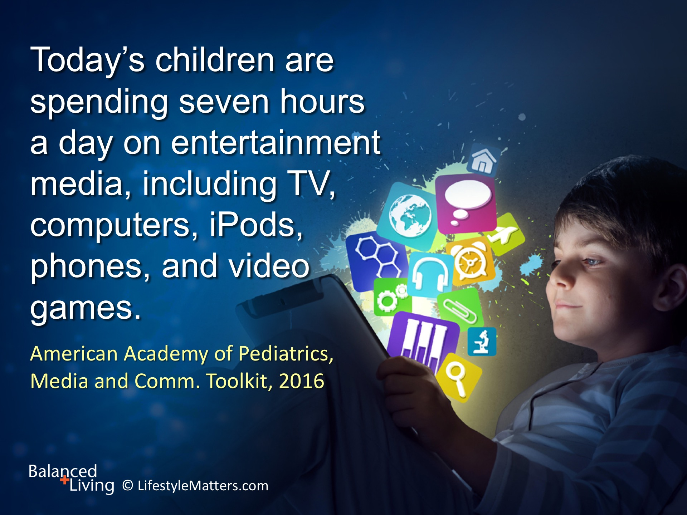
Notes:
Read slide.
Teens are spending an average of nine hours or more.
Many adults and youth of all ages now spend more time with multiple media devices than any other activity but sleeping.

Slide 7
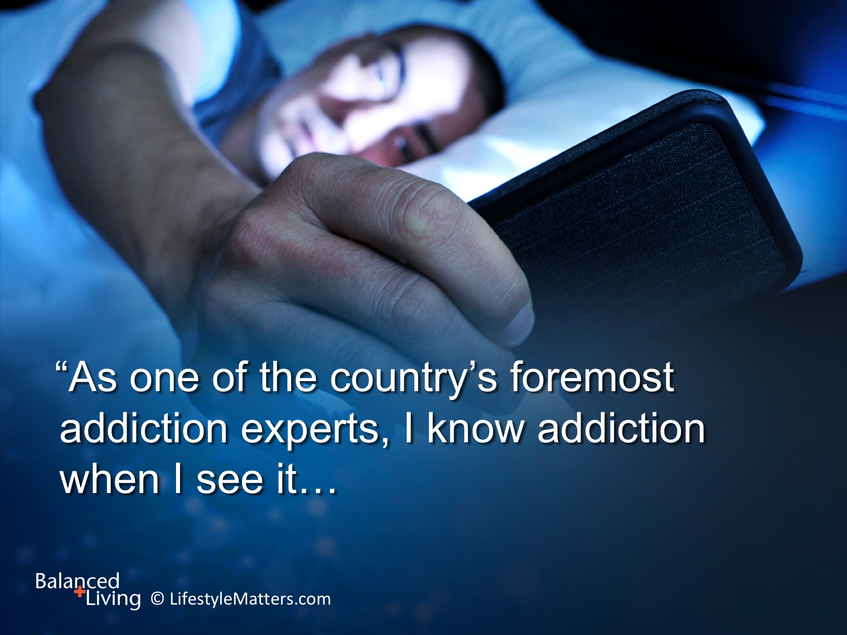
Notes:
Leading authority on addictions, Dr. Nicholas Kardaras, states: Read slide.
Yes, we appreciate the ability of technology to keep us up-to-date on what’s happening in our world.
But consider this: Are we consuming information or is information is consuming us?

Slide 8
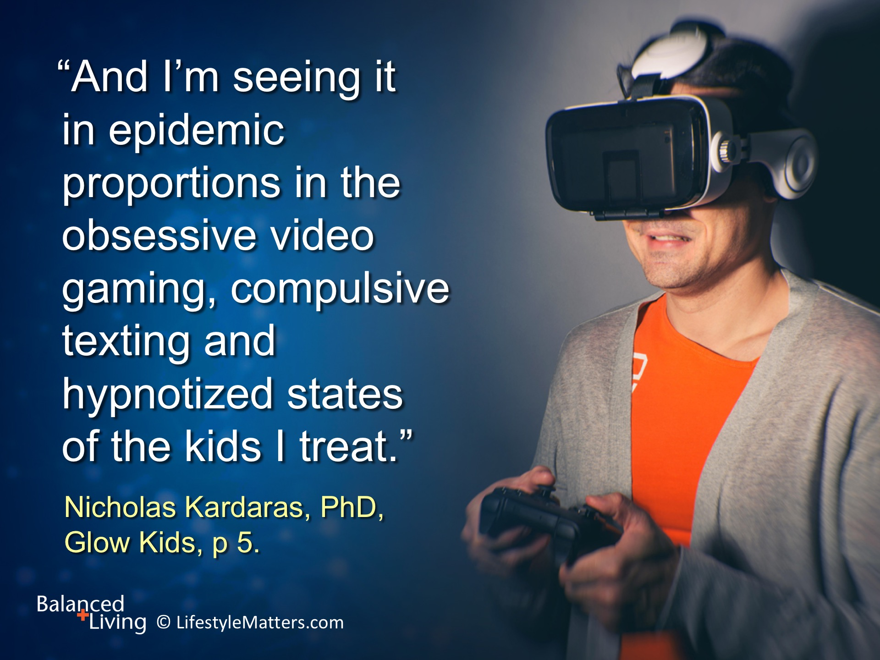
Notes:
Read slide.

Slide 9
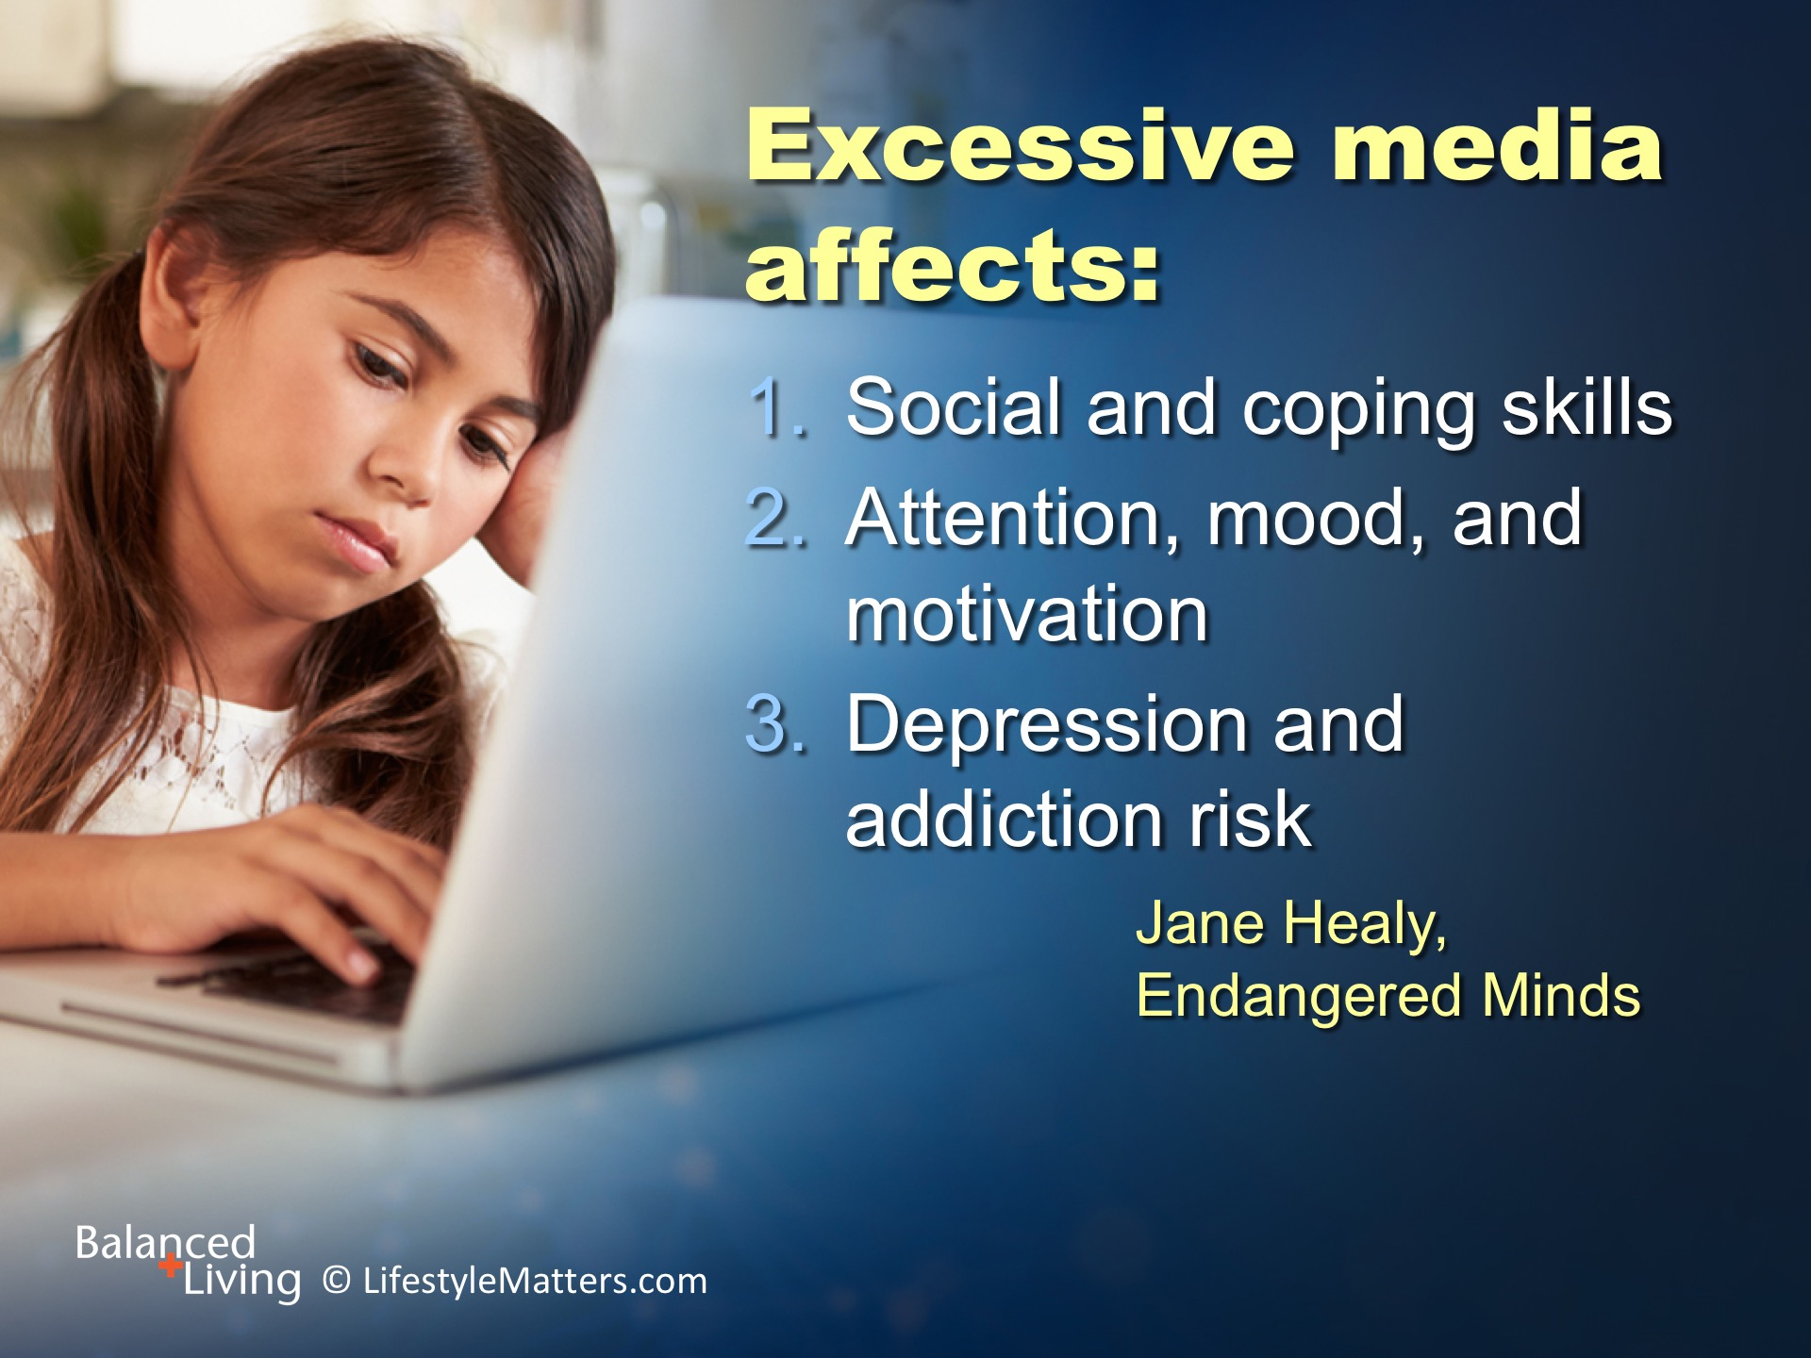
Notes:
Read slide.
Social and coping skills require time, focus, and practice. Social media does not develop these skills and may diminish them.
Excessive media increases short bursts of attention, but staying focused on non-media tasks is more difficult.
The addictive nature of media promotes depression and mood disorders.
(Reference: Microsoft Insights: Attention span report, Spring 2015.)

Slide 10
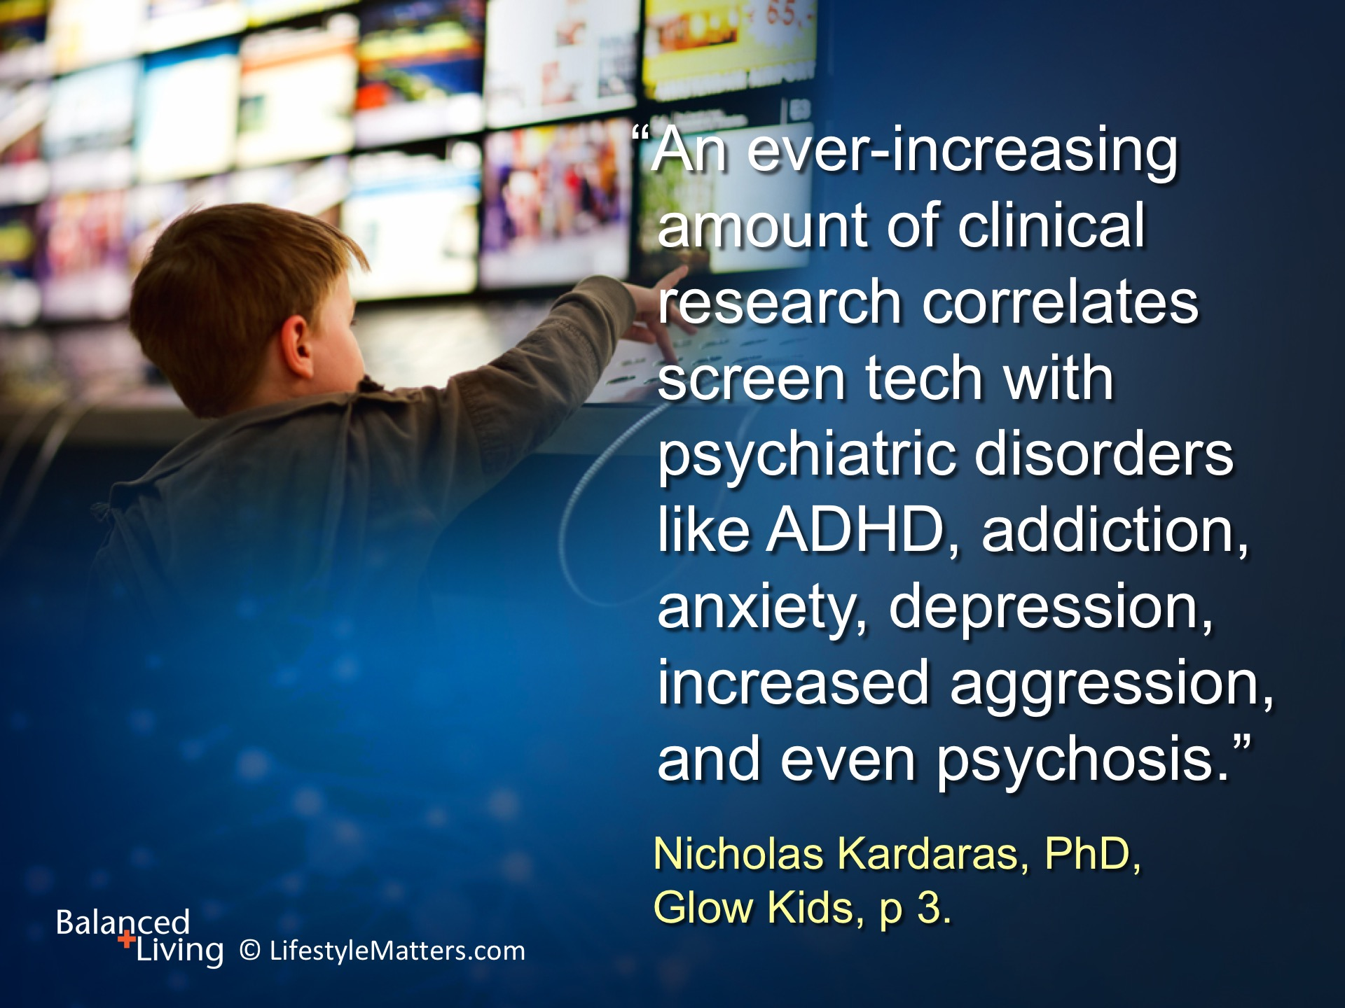
Notes:
It’s important to remember that these brain and mood-altering effects are seen in adults as well as children and teens. Dr. Kardaras states: Read slide.
It’s time to ask ourselves:
1. How many times a day am I checking news? Facebook? Instagram? Tweets? Texts?
2. How many hours am I spending in front of the TV or computer watching back-to-back programs?
3. How many hours a day am I spending playing games? Or surfing the Internet with no aim in view?
4. How long can I pay attention to a task such as reading a book without being distracted?

Slide 11
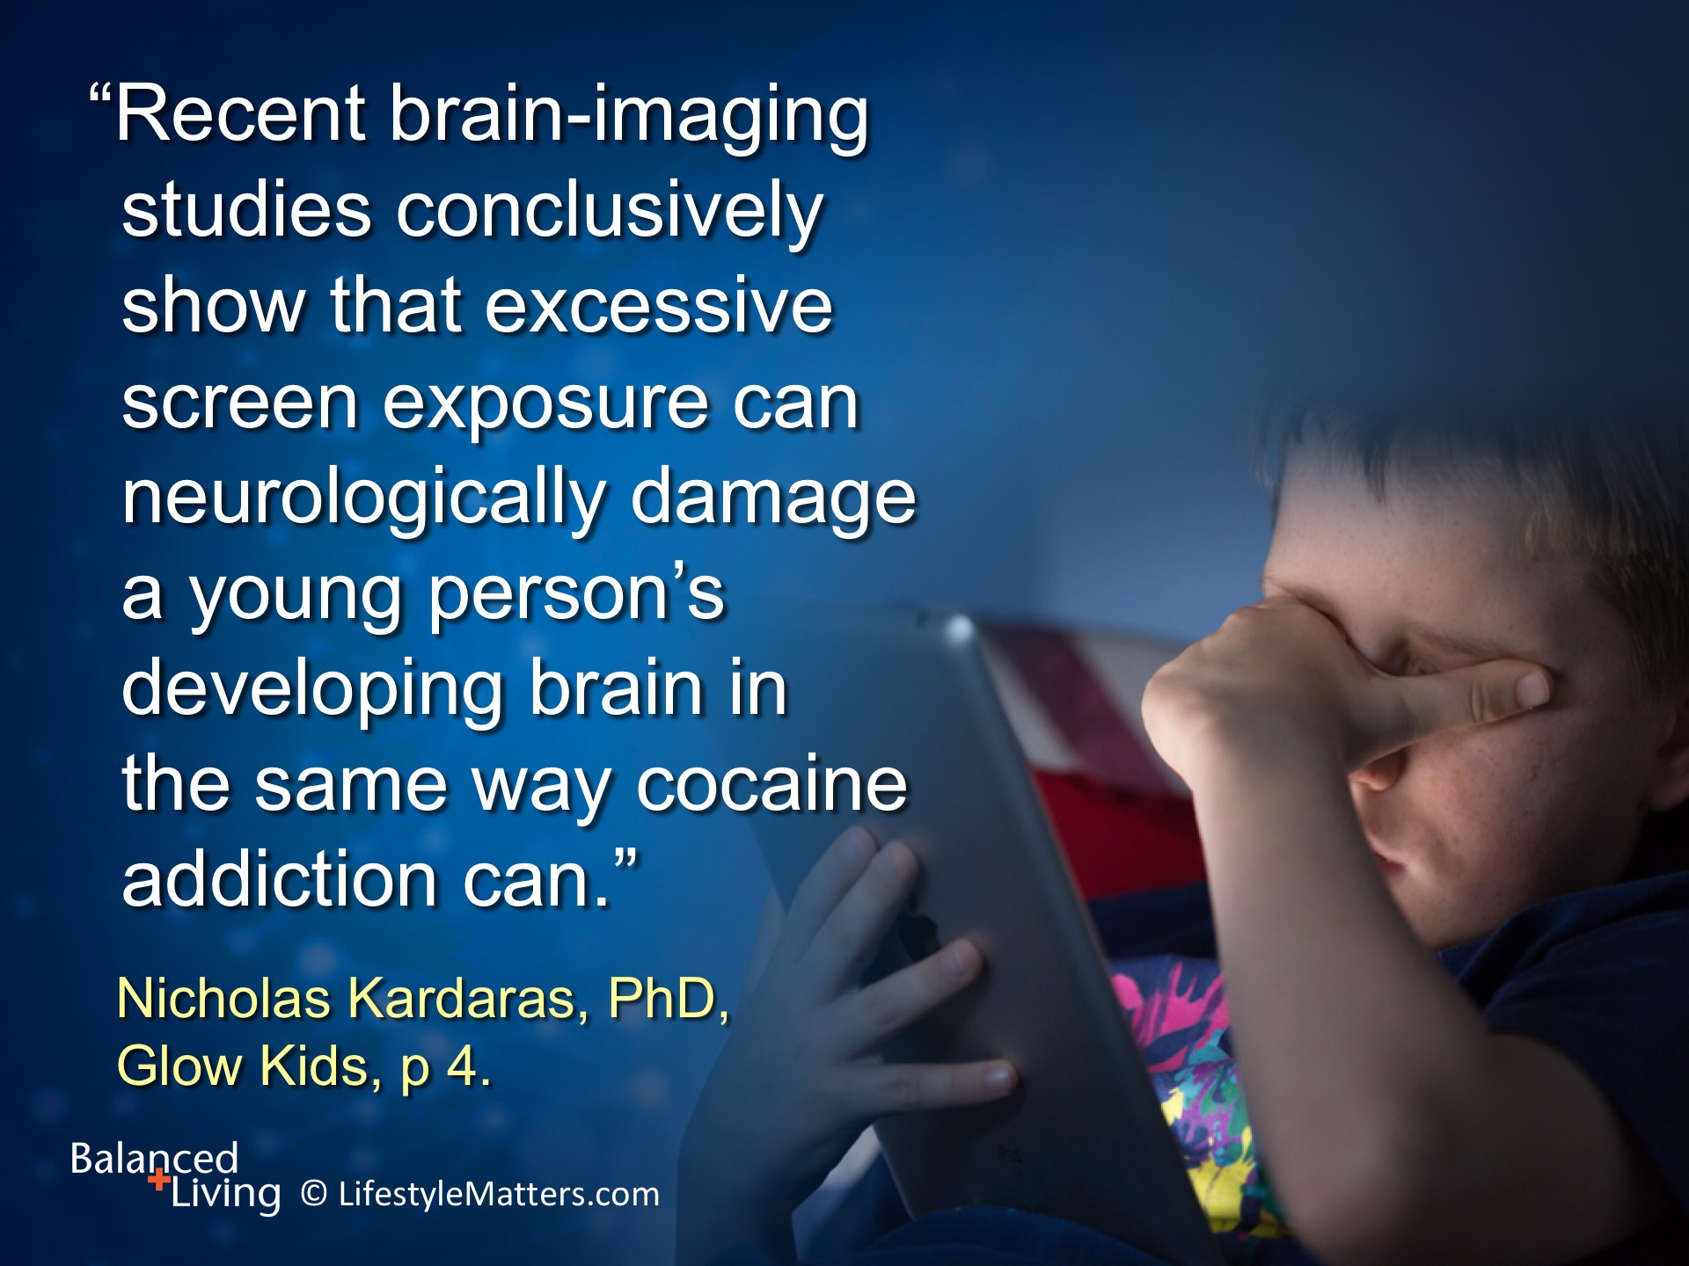
Notes:
Read slide.
The American Academy of Pediatrics recommends that parents develop a balanced, personalized family media plan and follow it together, such as:
No screen media (other than video chatting) for children younger than 18 months, and no more than 1 hour per day for children aged 2 to 5 years.
Set limits on adult media and phone devices during time with their children and each other.
Set media use limits that prioritize health-promoting activities such as physical activity, sleep, family time, meals, and friends.
Implement media-free times and zones such as the dinner table.
(Source: American Academy of Pediatrics Media and Children Communication Tool Kit. October 2016; https://www.aap.org/en-us/advocacy-and-policy/aap-health-initiatives/pages/media-and-children.aspx)

Slide 12
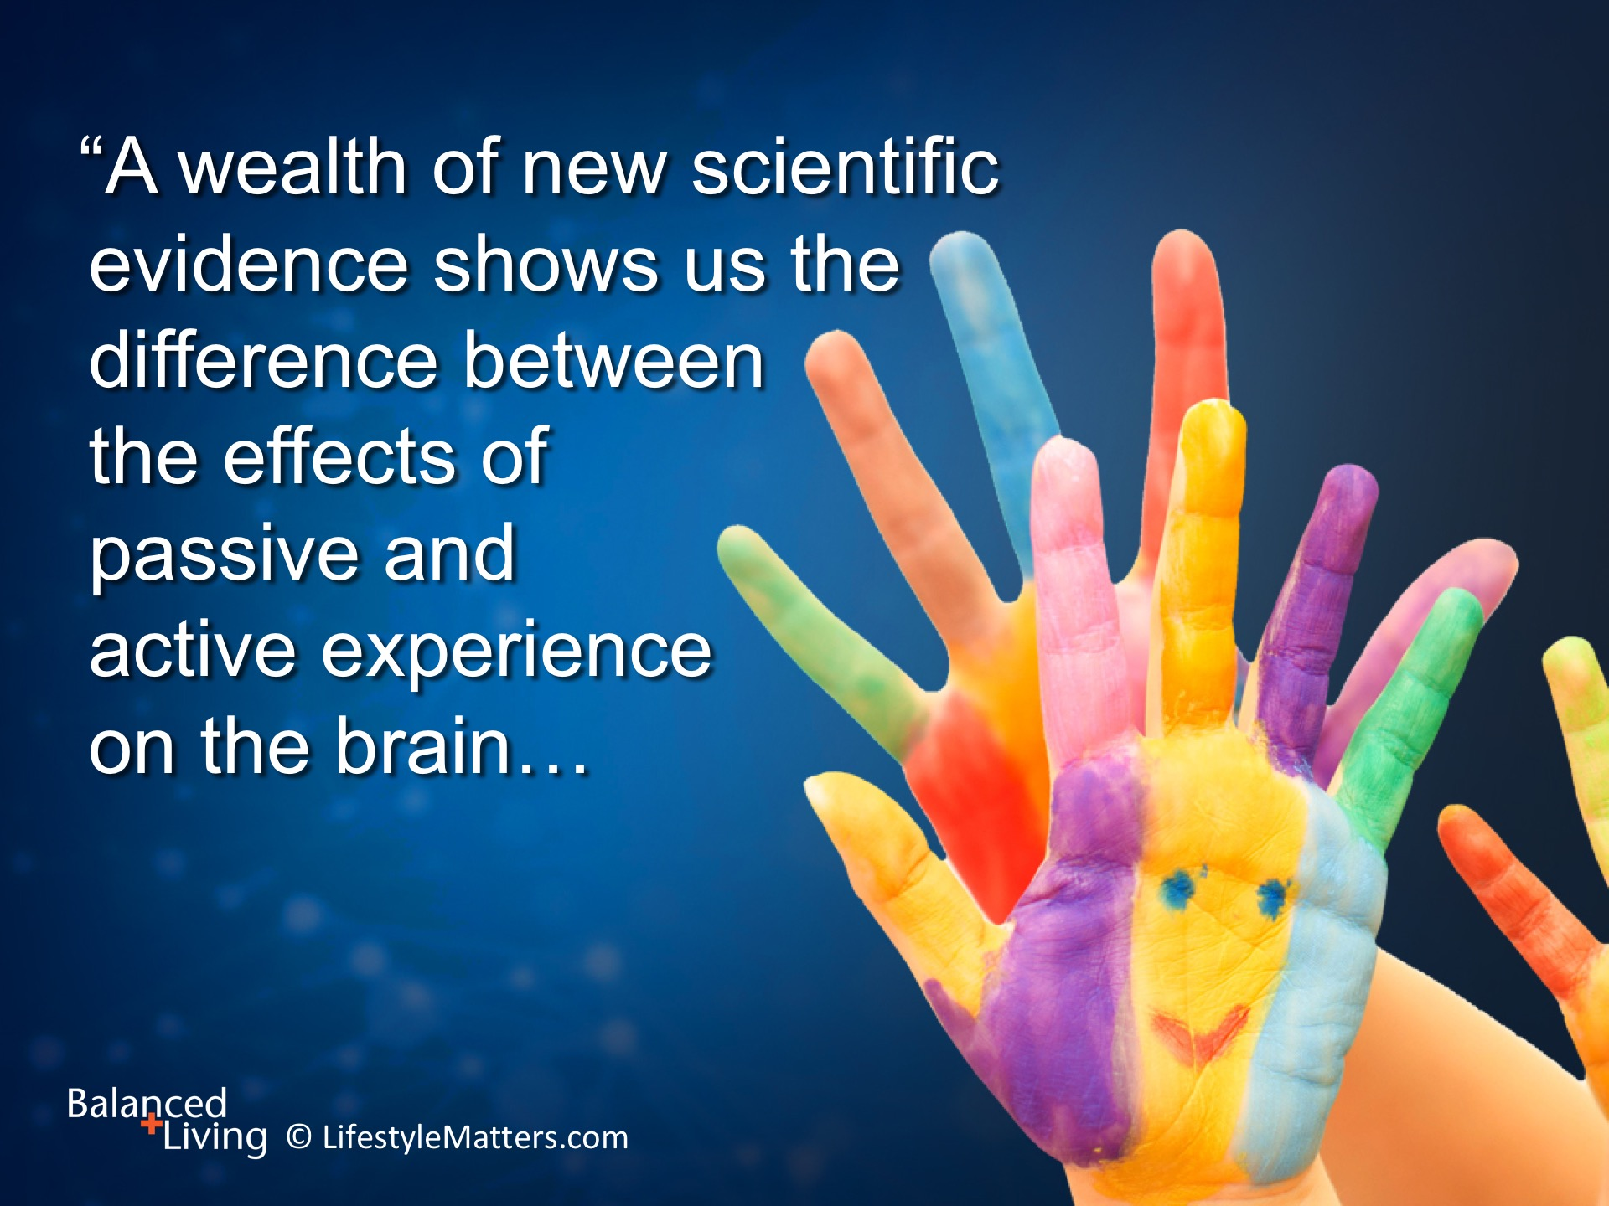
Notes:
Read slide.

Slide 13
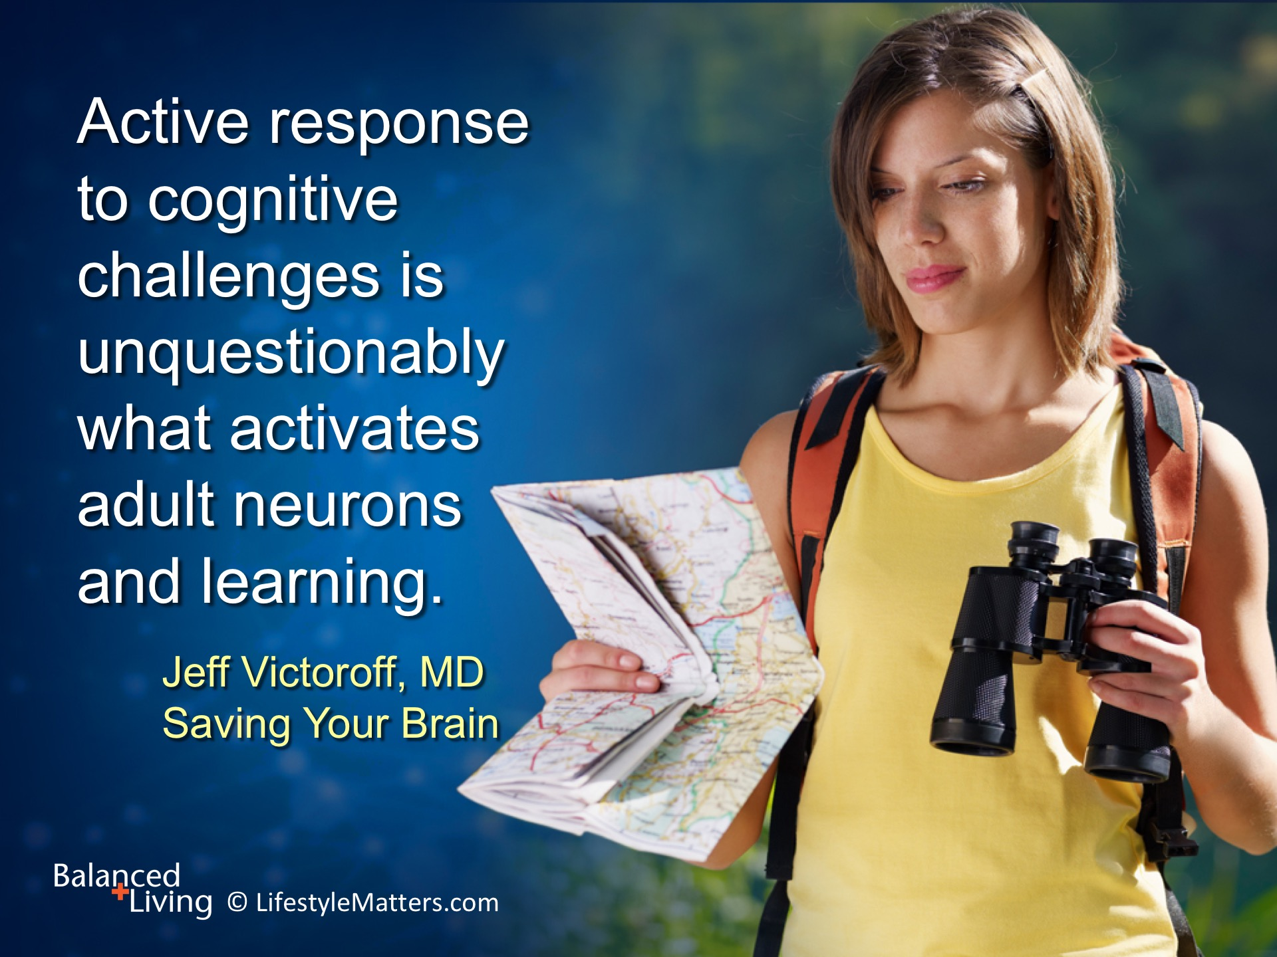
Notes:
Read slide.
What are some reasons it is important to avoid too much media exposure, even good programming? (Wait for response)
(Note: It is a passive experience; it displaces other more meaningful activities; it is sedentary and is linked to obesity and poor eating habits; it encourages spending; it promotes depression; it is isolating)

Slide 14
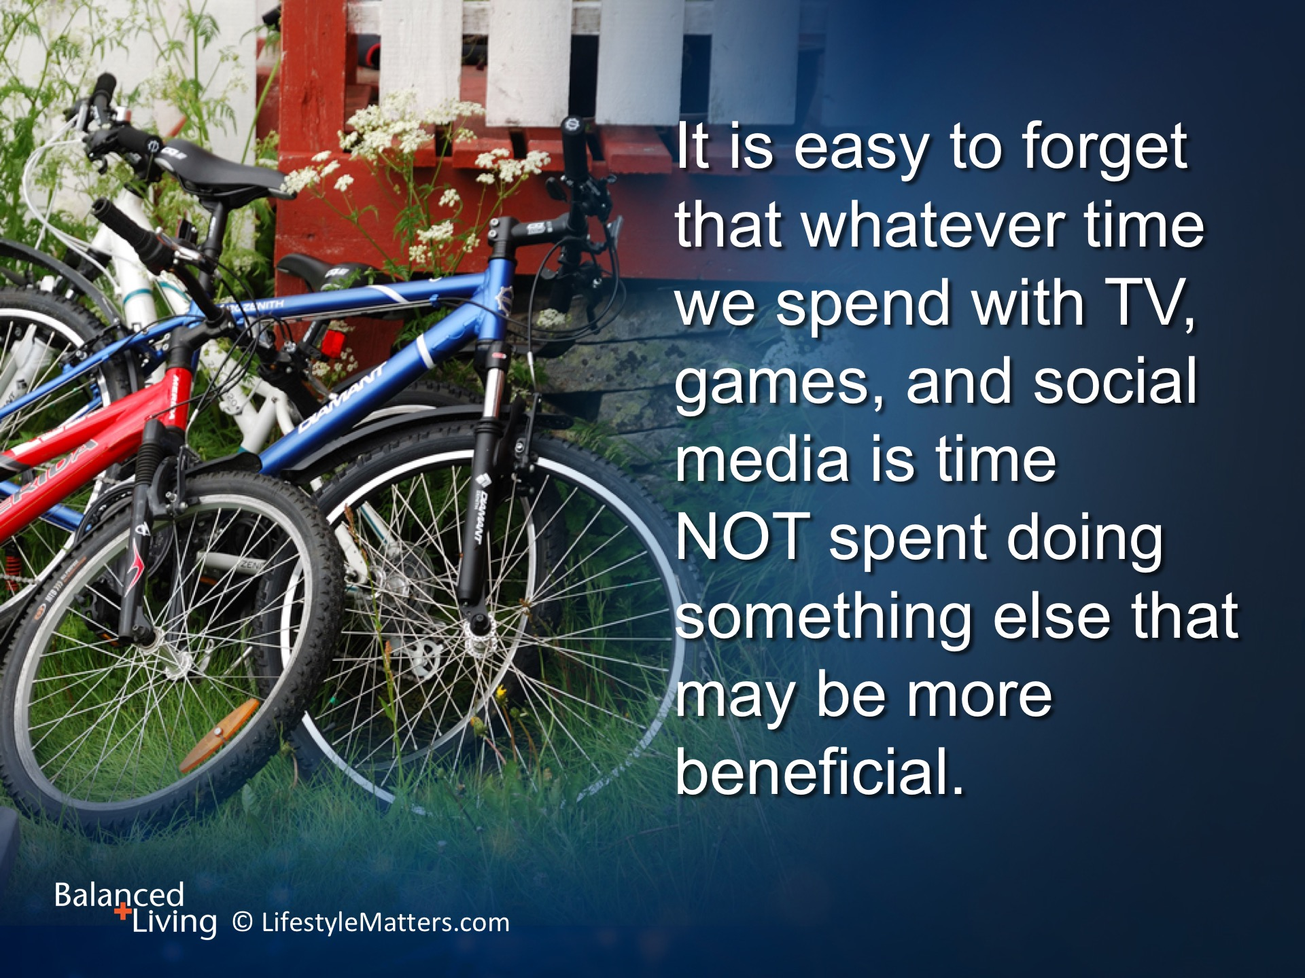
Notes:
Importantly, Read slide.
This has an impact on learning, socialization, and health.
What are some beneficial activities that need to be re-prioritized? (Wait for answer)
(i.e. Exercise, outdoor play, personal contact with others, chores, fixing things, hobbies, reading books, cooking, caring for a pet)

Slide 15
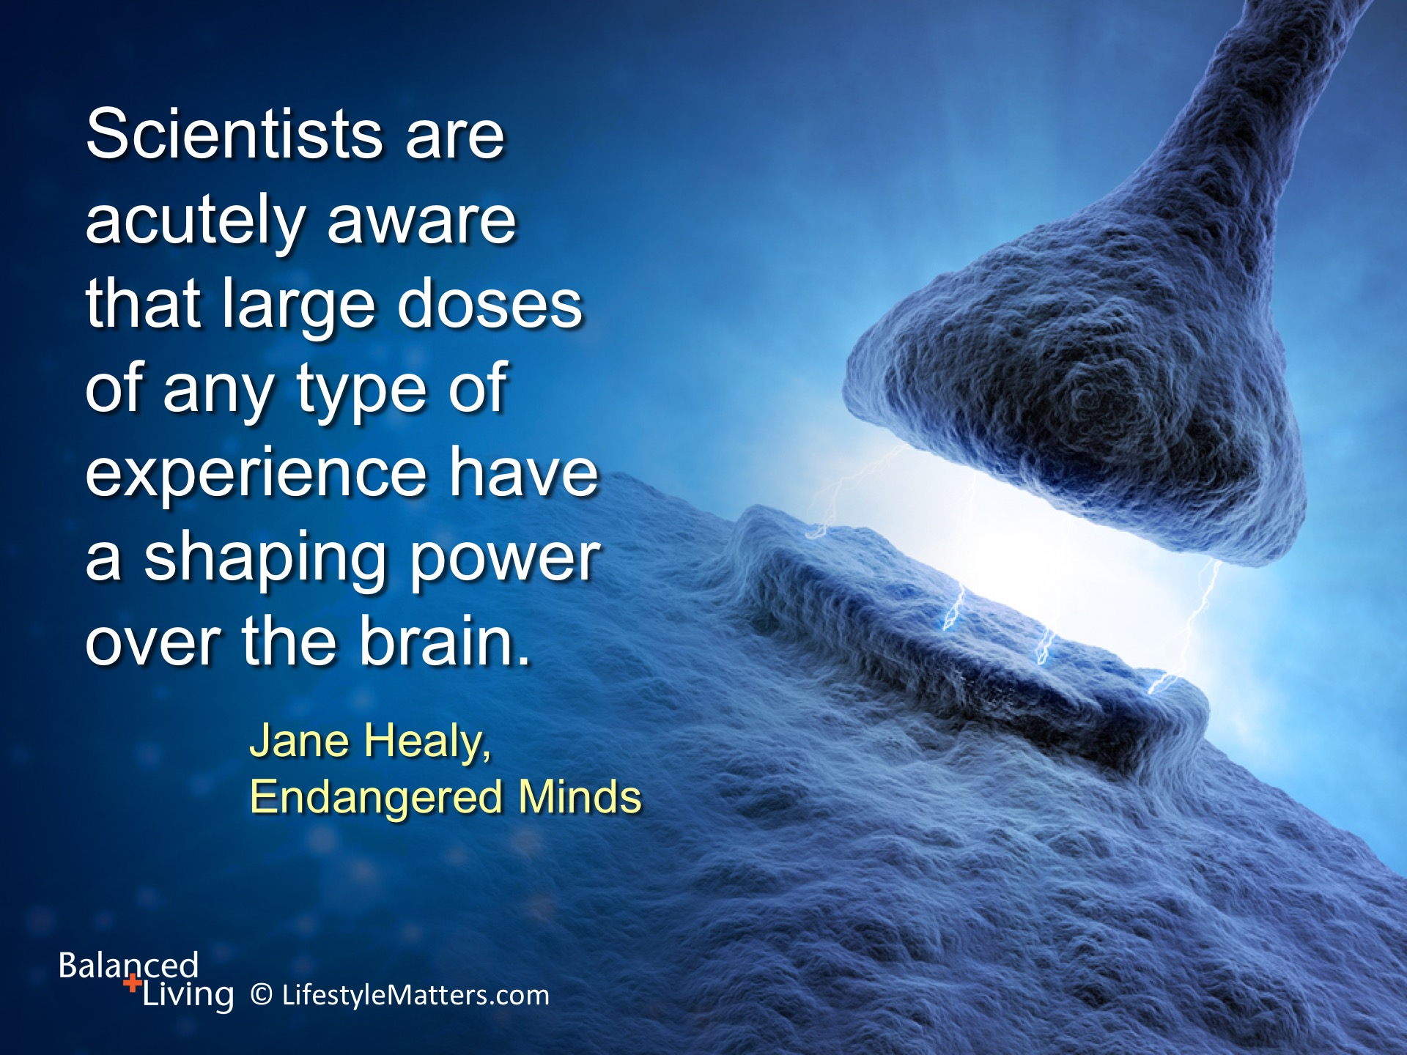
Notes:
Read slide.

Slide 16
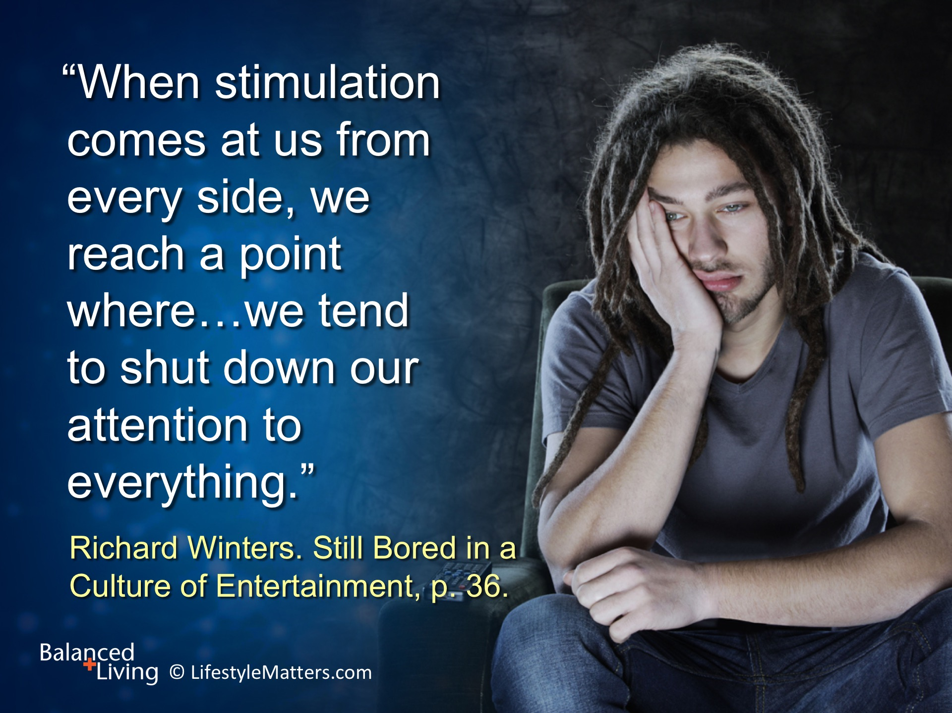
Notes:
Dr. Richard Winters, a noted Christian psychiatrist and author states it this way: Read slide.
Ironically, the side-effect of overstimulation is boredom—which often drives increased media consumption.

Slide 17
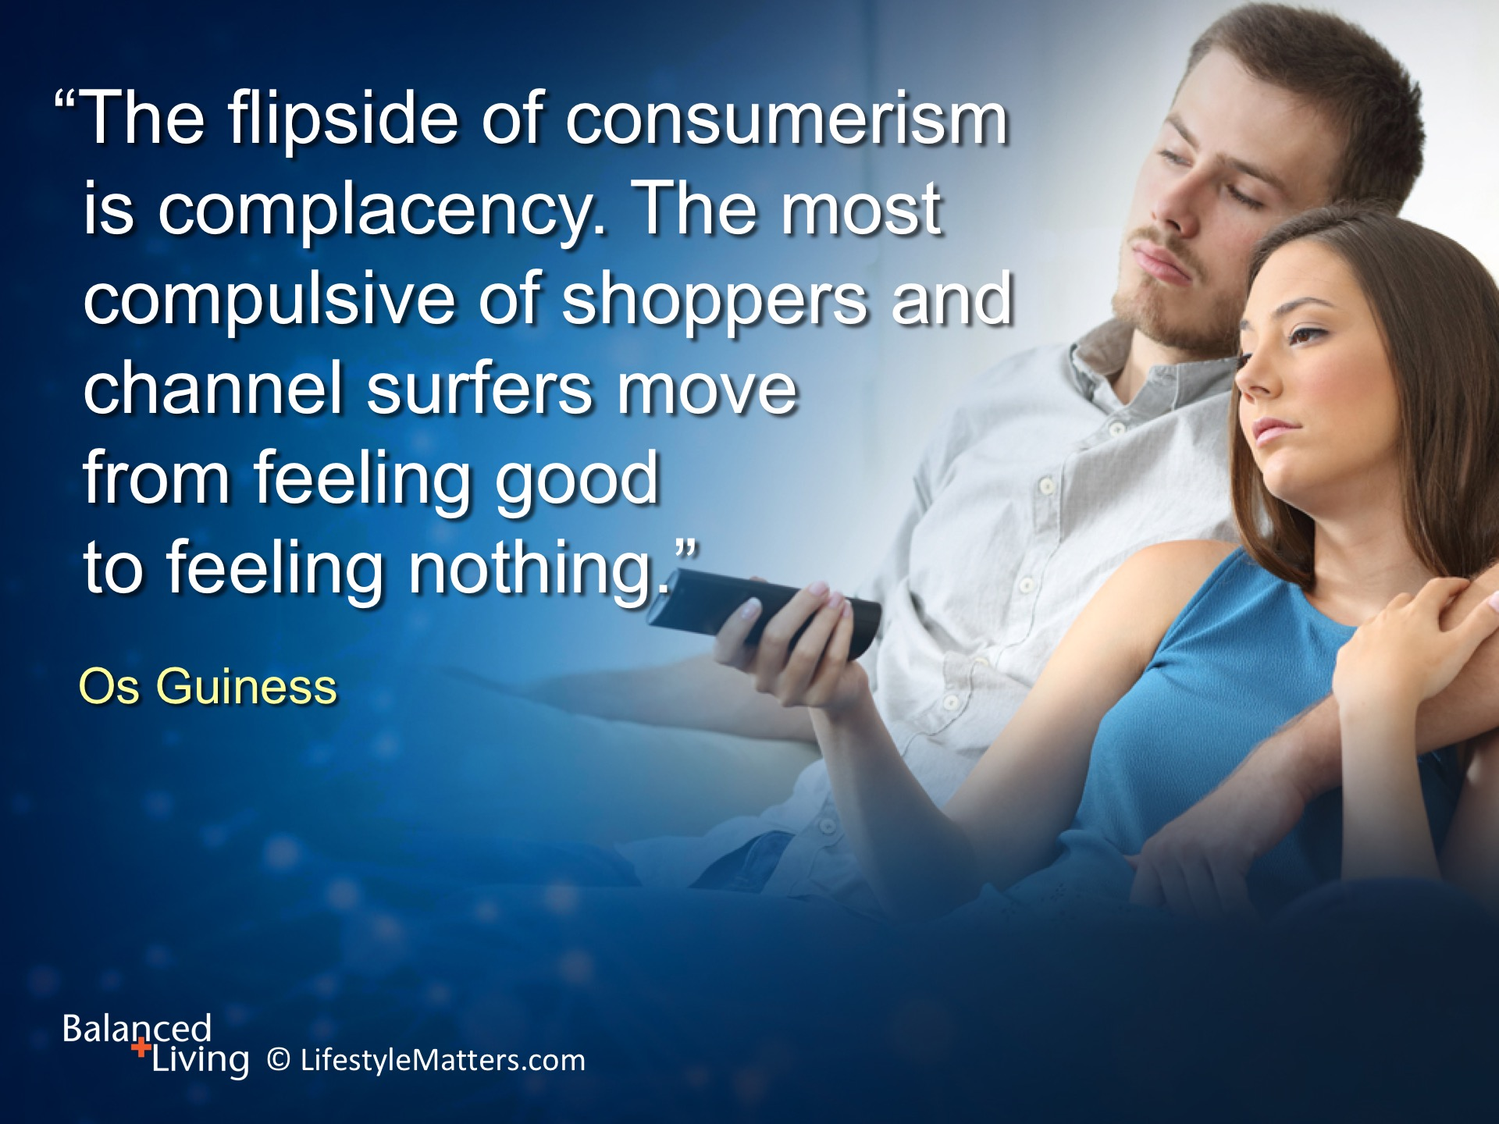
Notes:
Read slide.

Slide 18
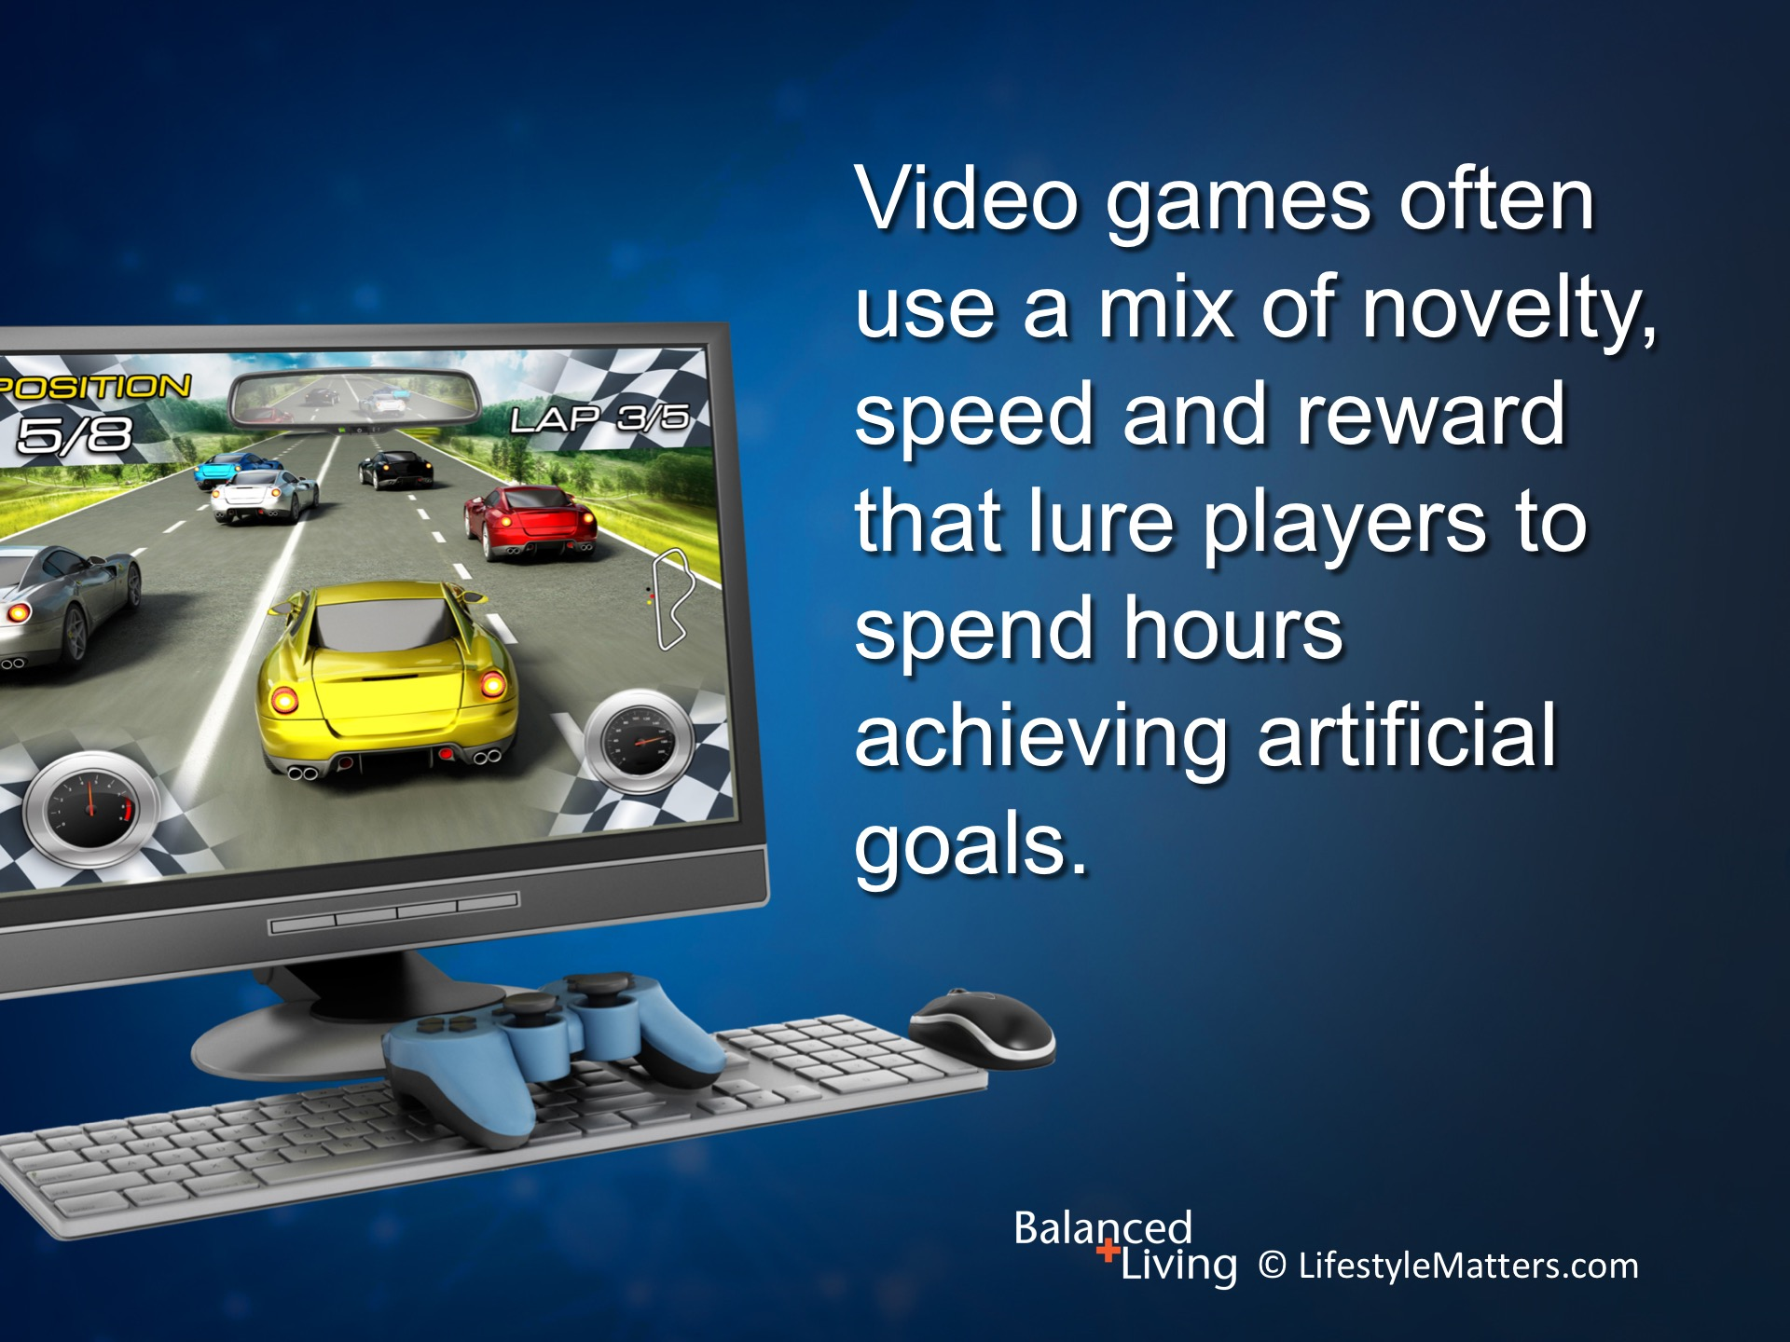
Notes:
Read slide.
Users get “swallowed” in a timeless, anonymous, “boundary-less” world of artificial rewards.

Slide 19
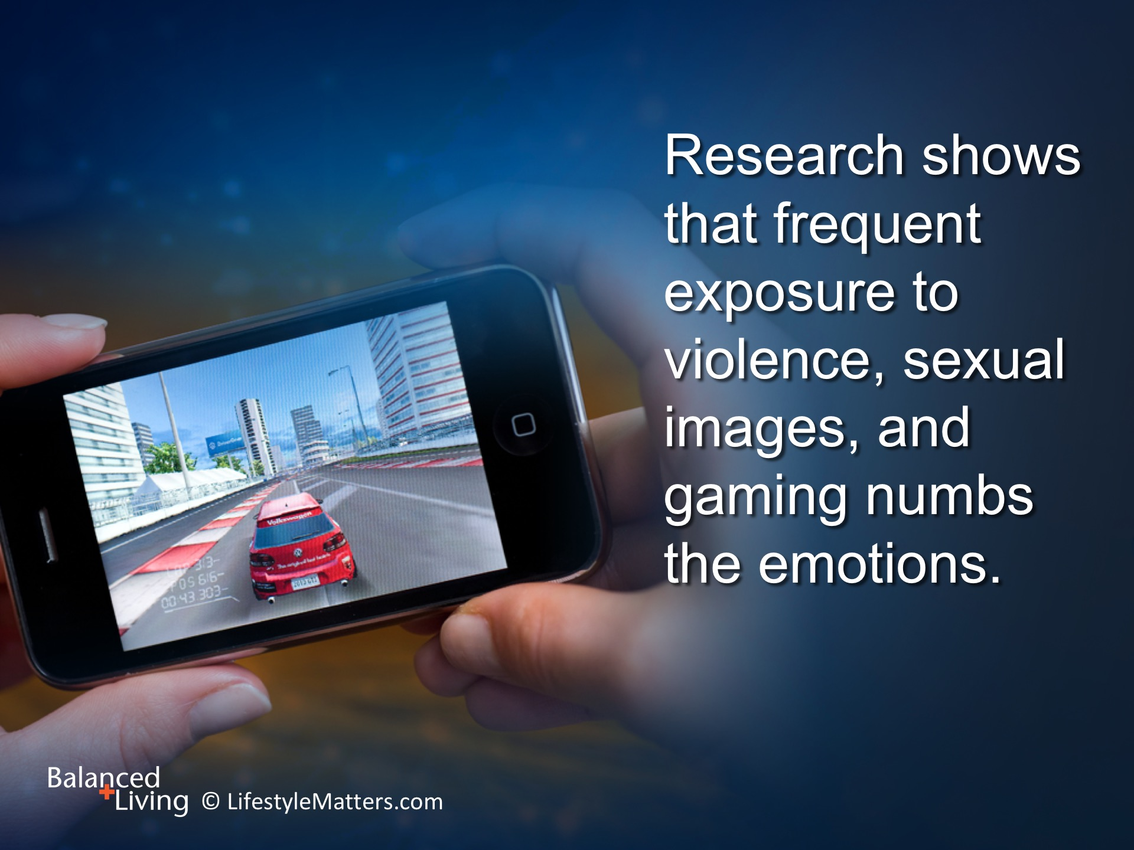
Notes:
Read slide.
This “numb” mental state—is a hallmark of addiction—that empty feeling after a high that often drives addictive behavior and depression.
(Reference: Os Guiness is quoted in Still Bored in a Culture of Entertainment, p. 52)

Slide 20
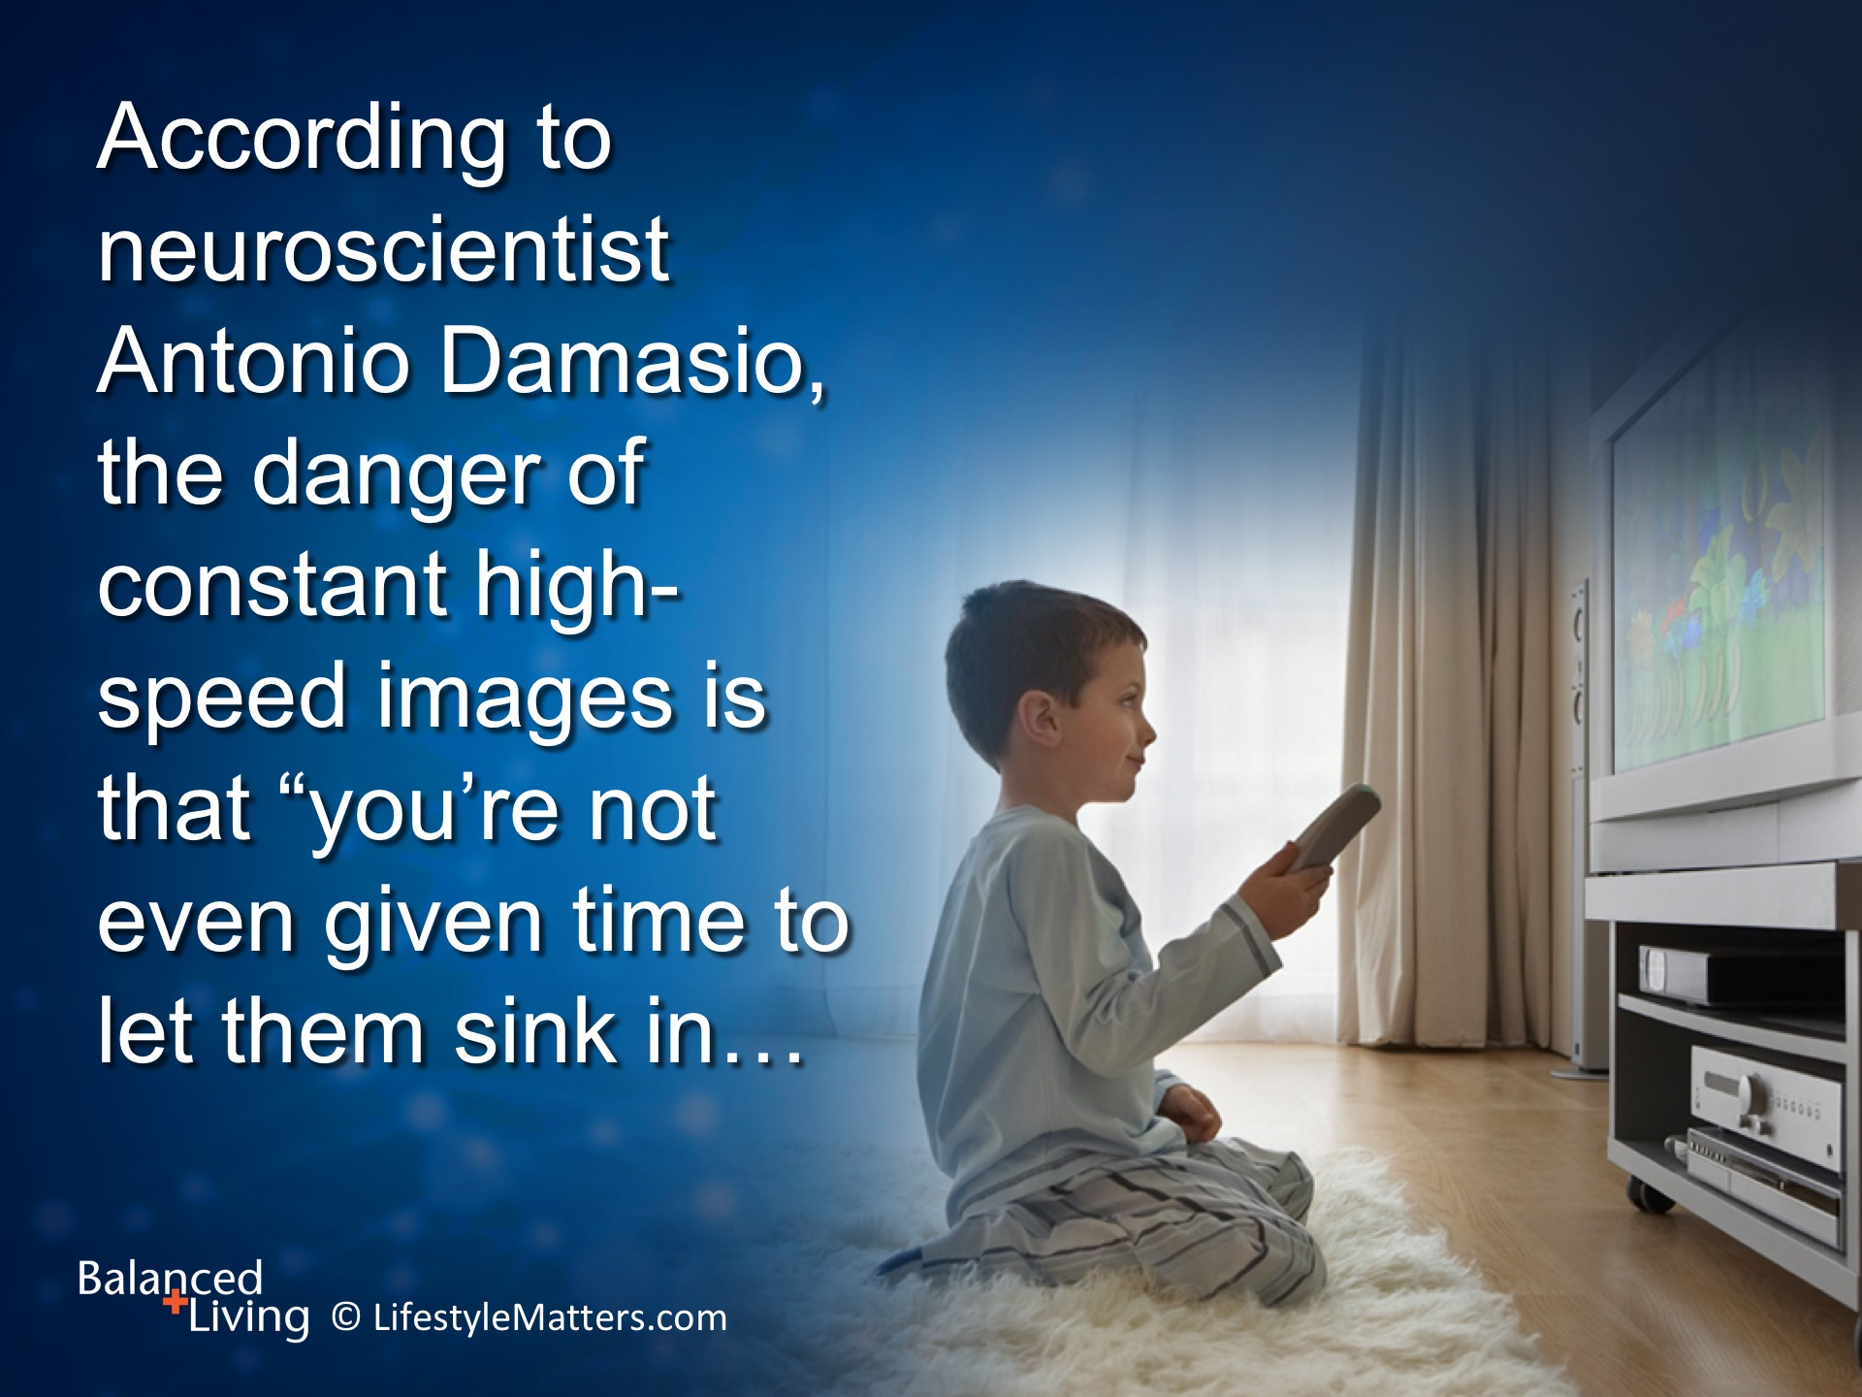
Notes:
Read slide.

Slide 21
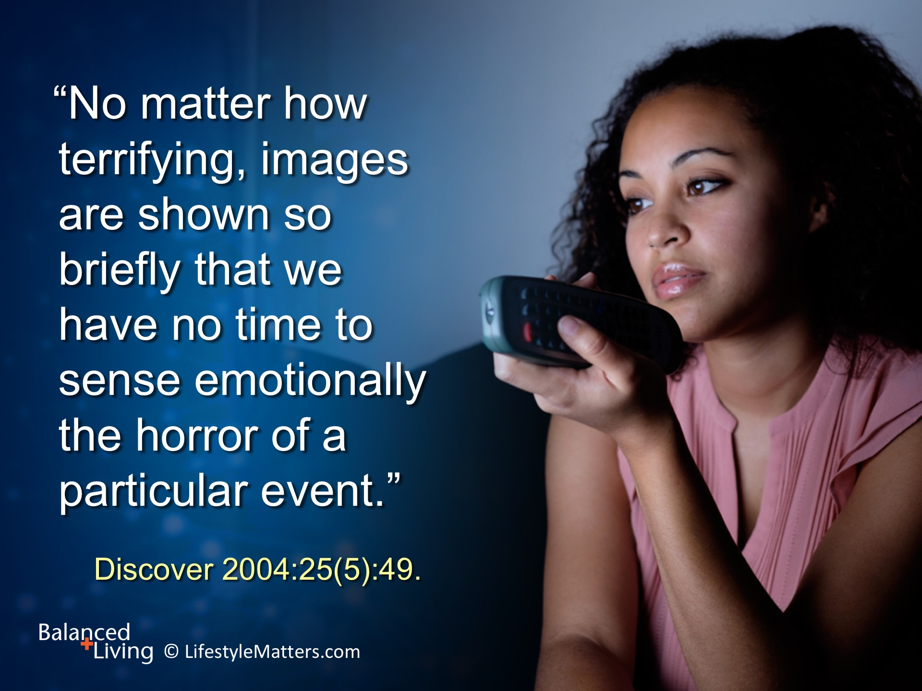
Notes:
Read slide.
According to Dr. Domasio, the intellect absorbs the information but the emotions do not “tag” the event with meaning.
A viewer might “know” an act is wrong but is “emotionally rudderless” with regards to its magnitude.

Slide 22
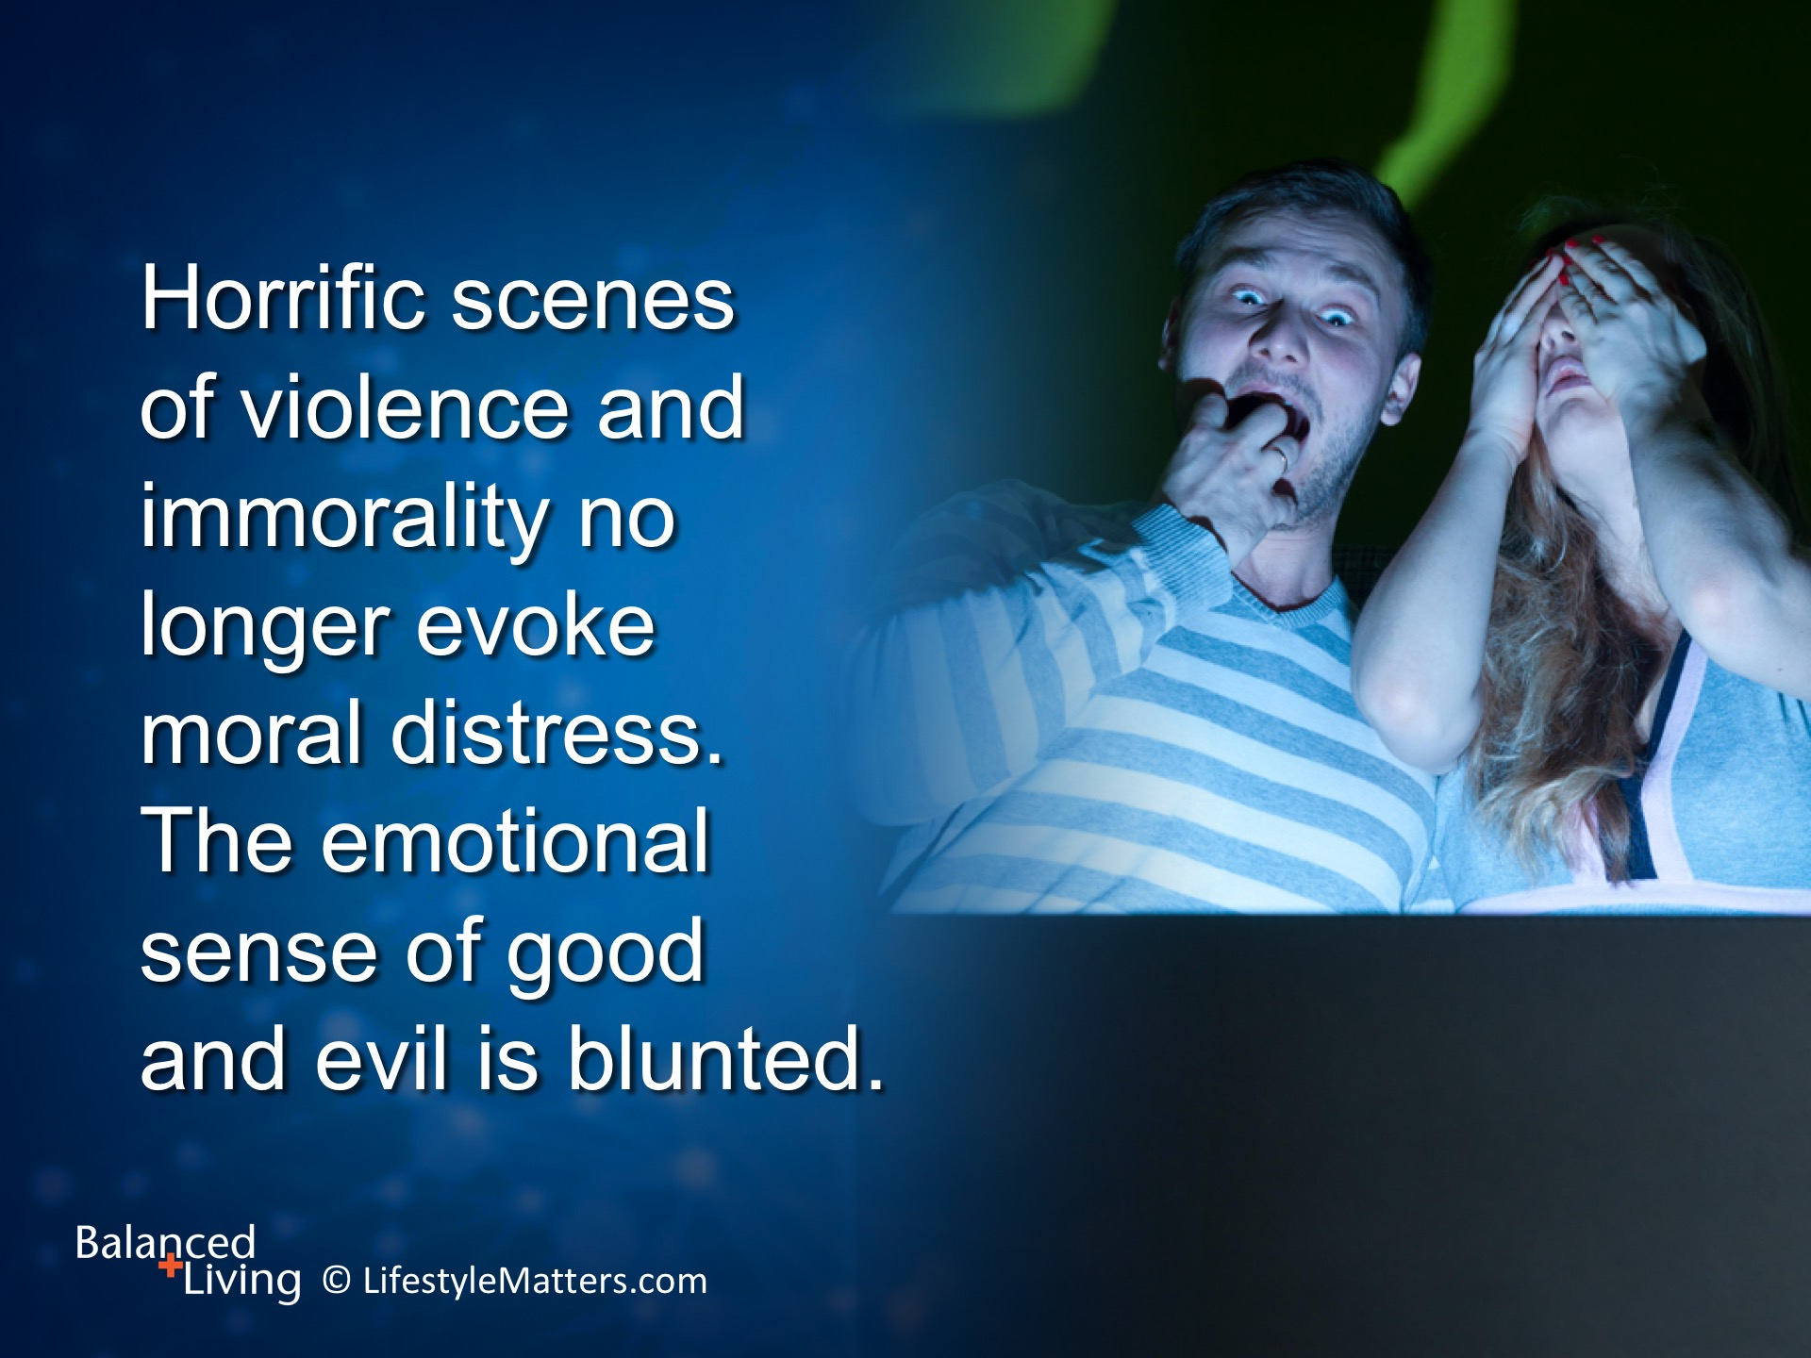
Notes:
Read slide.
A viewer may be eating popcorn and enjoying a drink while watching a murder for entertainment.
The brain thus creates a powerful link feelings of pleasure with pain, suffering, violence, and immorality.

Slide 23
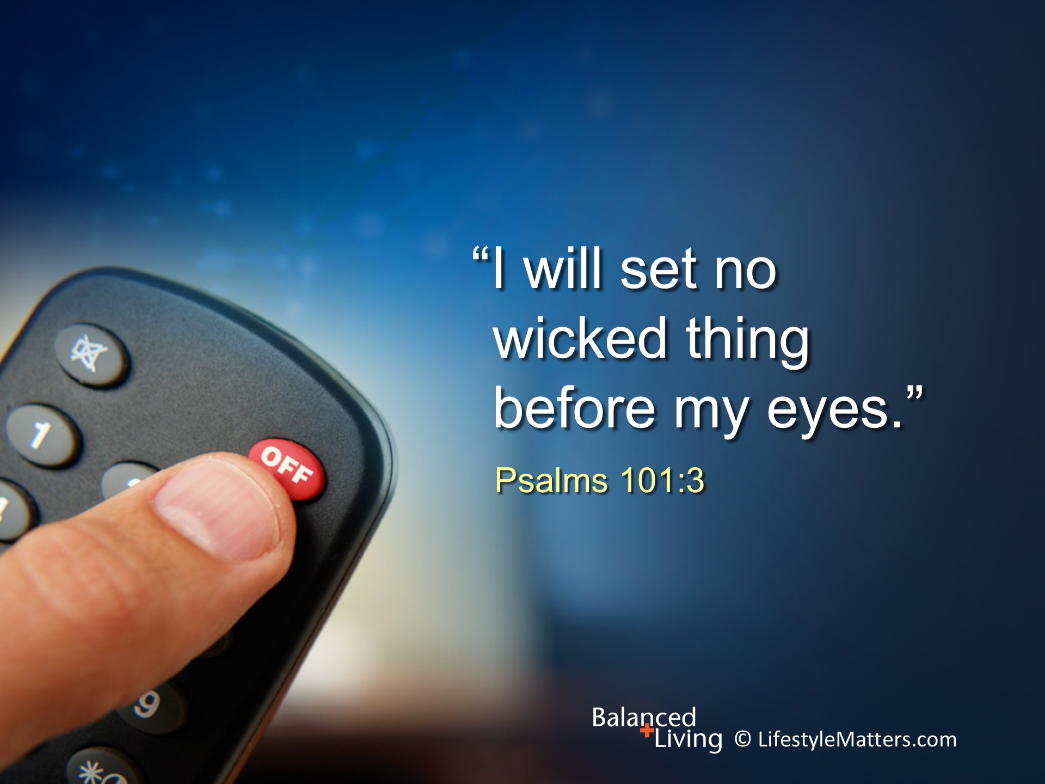
Notes:
Read slide.
This timely counsel prompts important questions for our reflection:
Am I playing games or viewing programs for entertainment that are violent, immoral, occult, or foolish?
God is calling you and me to choose. He says: “Cease to do evil, and learn to do well.” Isaiah 1:16-17.
It is impossible to accomplish this on our own—but with the power of God we can navigate through the maze of media and develop healthy habits that do not bring pollution, addiction, and sorrow to our own souls.

Slide 24
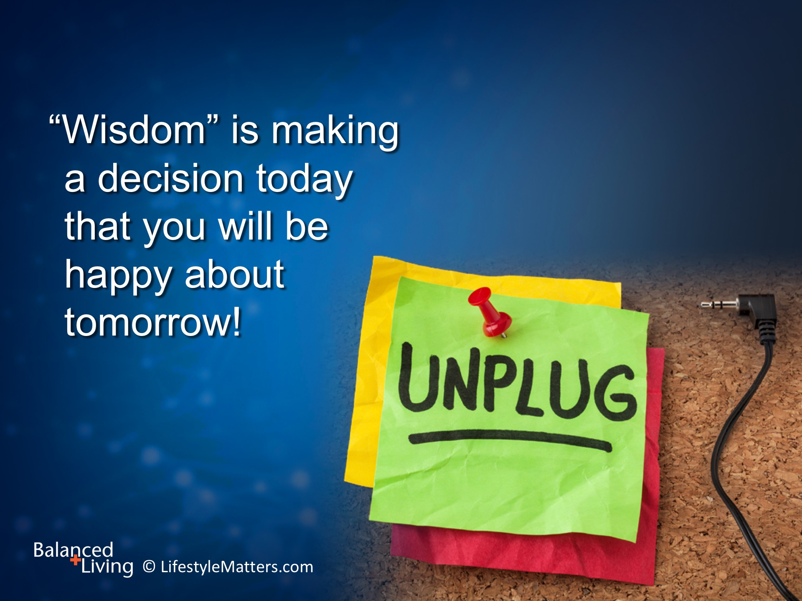
Notes:
Read slide.
We must learn to say “NO” to inclinations and impulses that pull us away from what is right.
And behind that “NO” declare a stronger “YES” to each decision you make for life, health, and well-being.
With practice and repetition, good decisions become our inclinations!
1. Set boundaries around your media use—how often, what kind, and when you use media.
2. Monitor yourself on a daily basis.

Slide 25
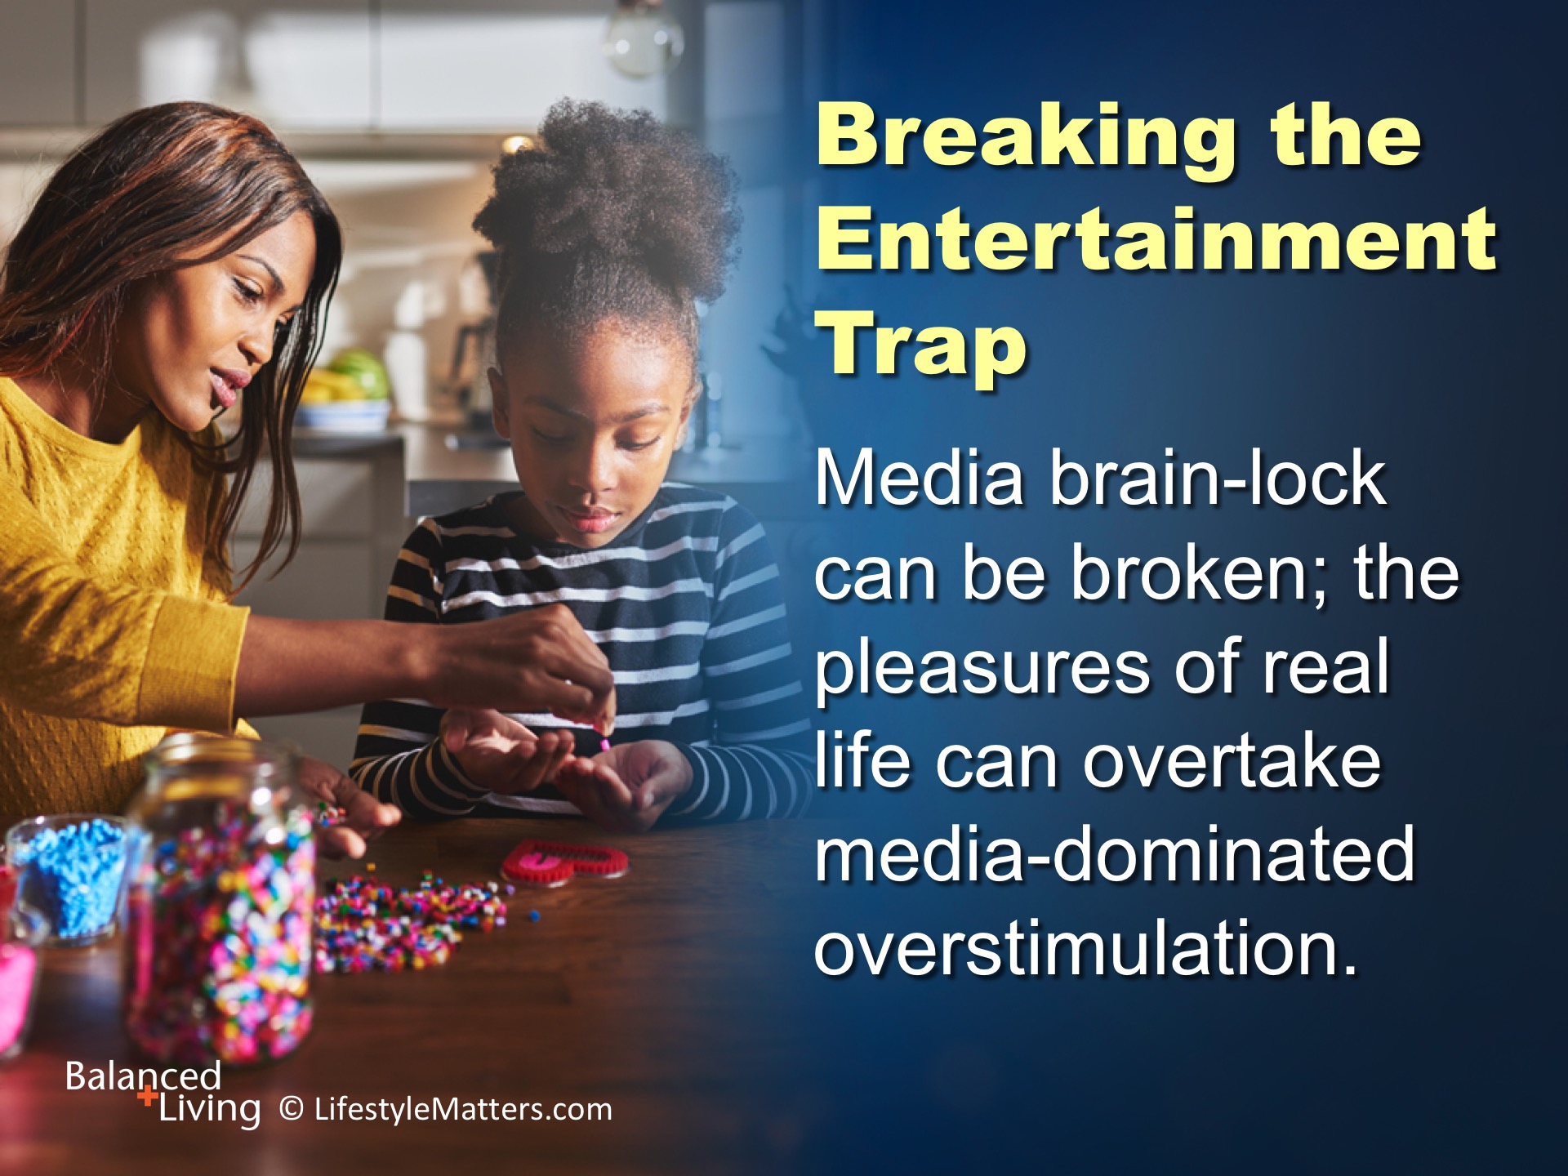
Notes:
Read slide.
With prayer, watchfulness, intentionality, and dependence on God, a balanced, healthy use of media is possible.

Slide 26
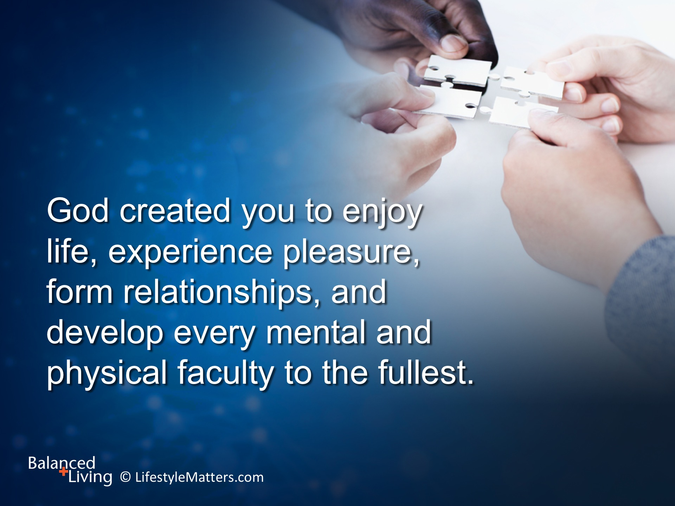
Notes:
Read slide.
We were designed for pleasure. Too much time digitally can take away the real pleasures in life.
You have a choice to have true freedom and joy.
With God’s help, you will be empowered to break free.
God wants to engage your mind, increase your capacities, cleanse you from sin, and improve your ability to participate in life.

Slide 27
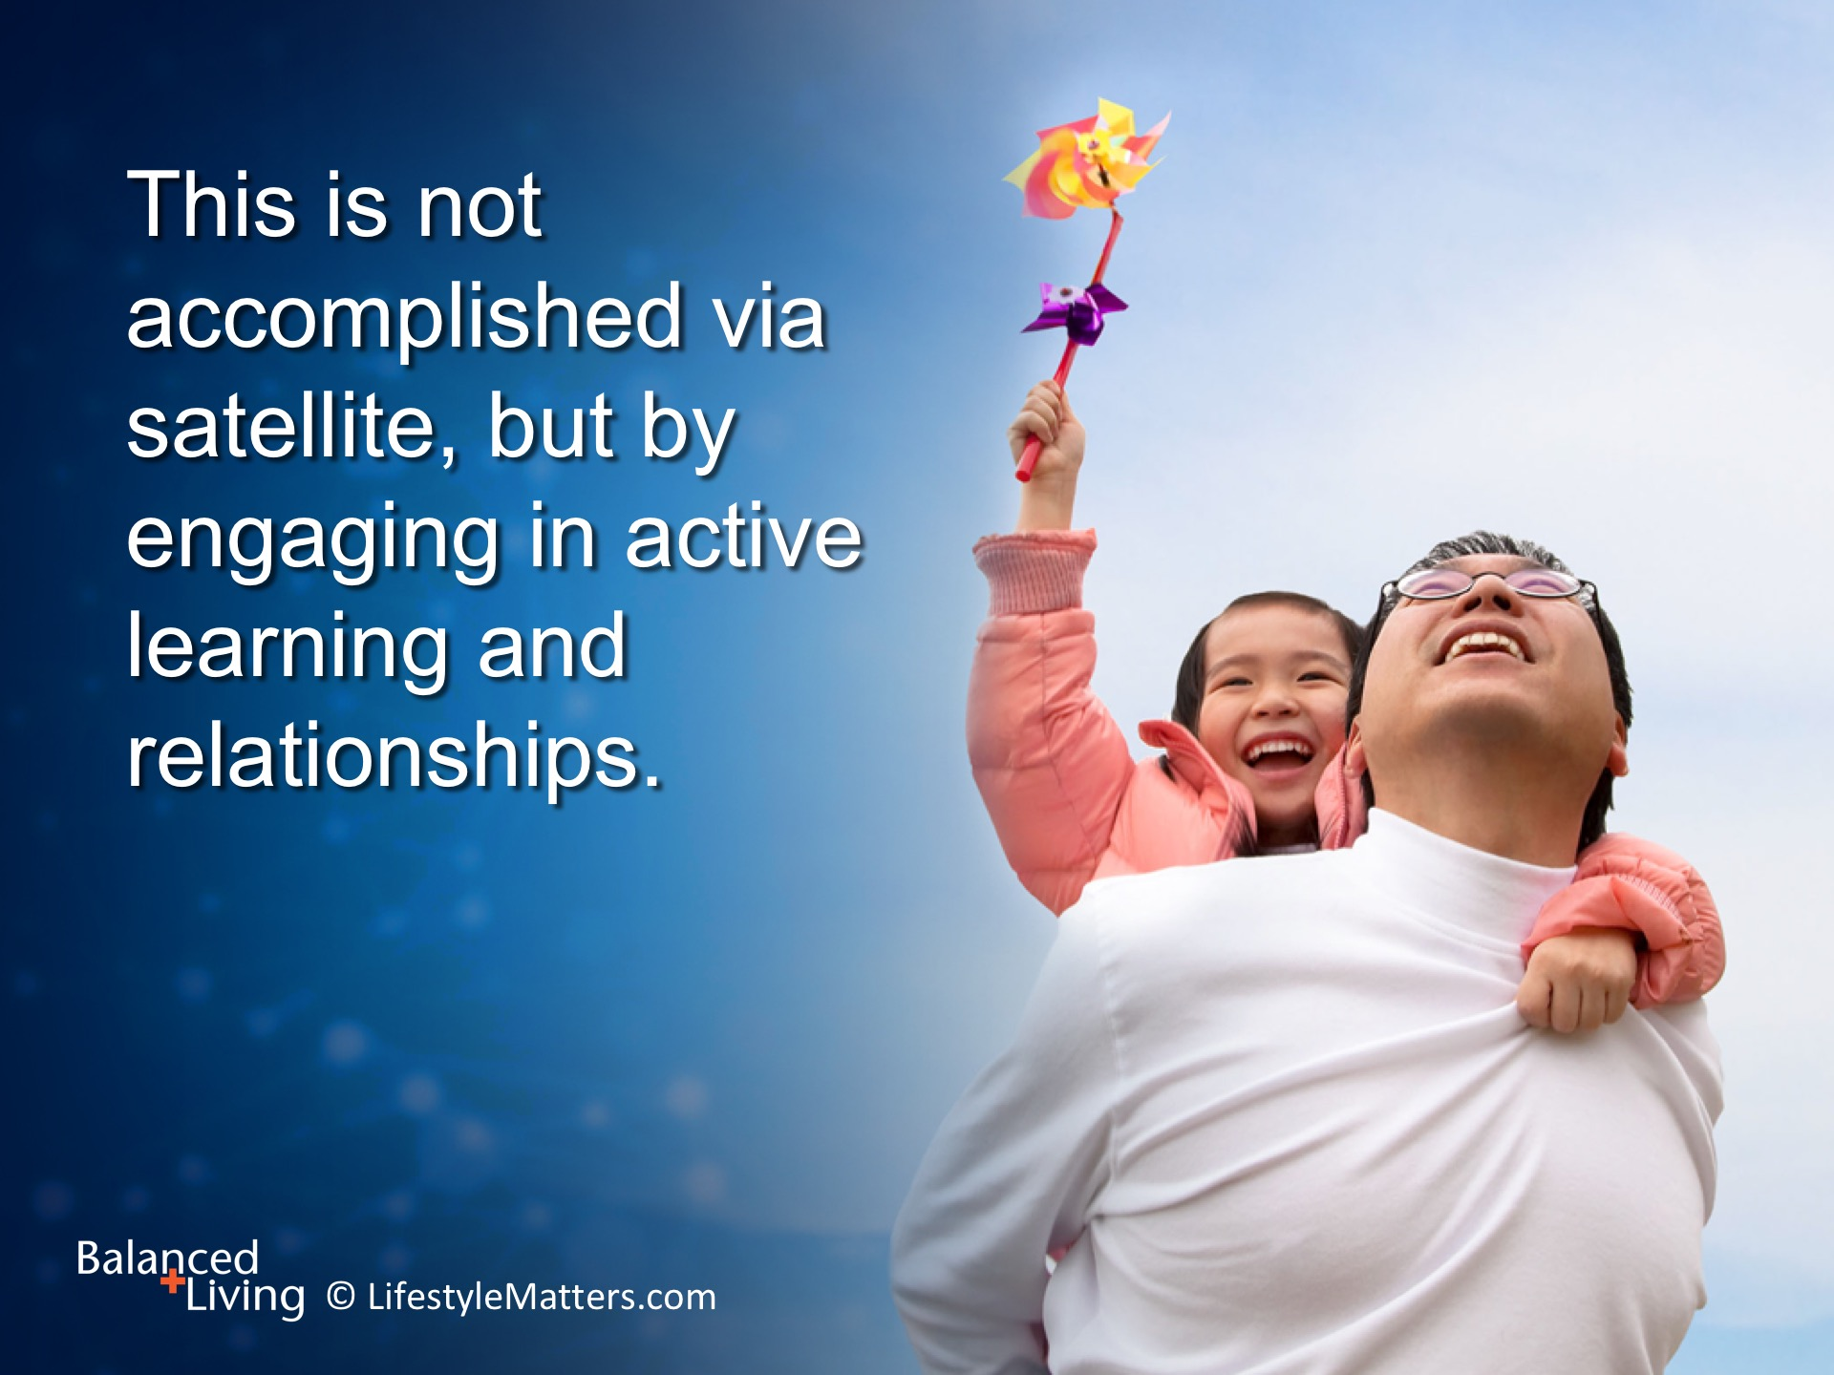
Notes:
Read slide.
Time spend creating meaningful relationships with others and a connection with God will change your life for good.
The path of growth and freedom that God offers fills the empty longings for meaning and purpose that media and games cannot satisfy.

Slide 28
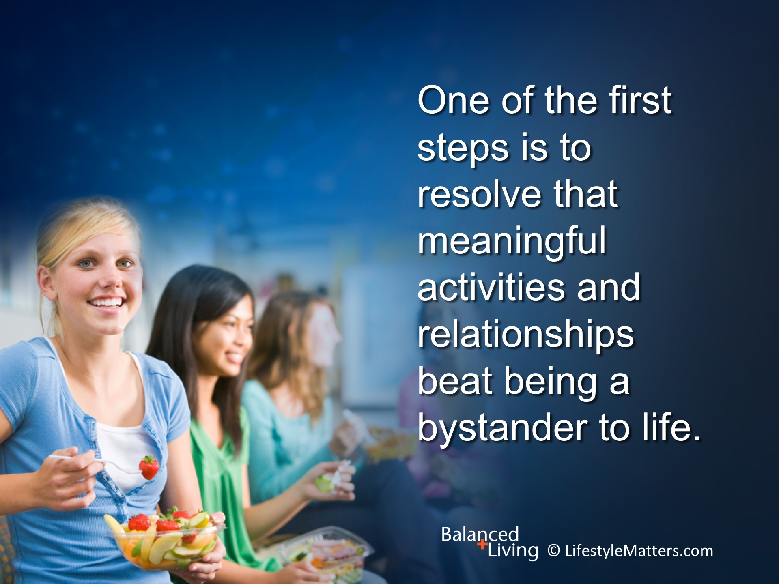
Notes:
Read slide.
Awareness of a need and a decision to change are the first steps in forming better habits.
Choose to use your time to your greatest advantage.

Slide 29

Notes:
Read slide.
Focus on the task at hand—do not allow media to distract you. Turn off distracting and noisy media alerts.
Focus on the people, circumstances, and beauty around you. Learn to find the blessings in each day.
Stay focused: Limit how many times you check media or surf the net for information.

Slide 30
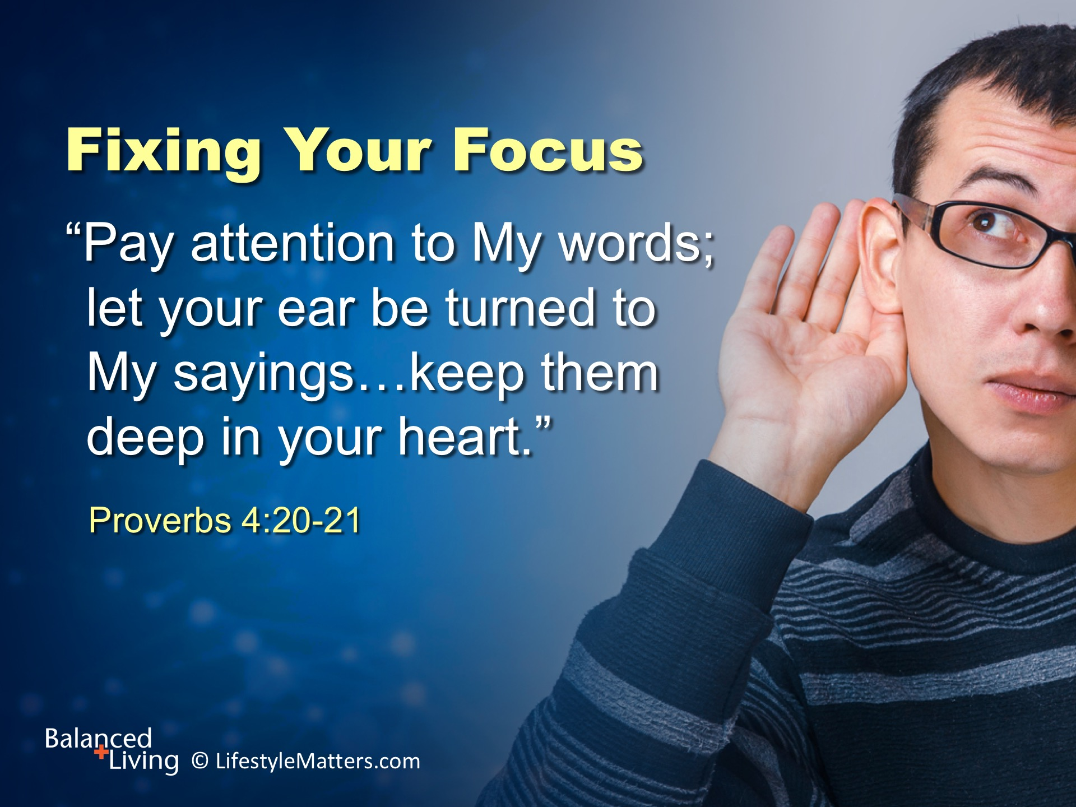
Notes:
Read slide.
God wants your attention.
He is calling you and me to spend time reading the Bible and conversing with Him in prayer.
He is never distracted or too busy to pay attention to you. And you will never leave empty-handed when you pay attention to Him.
Spiritual growth is not instant—it takes place over time. But it is the source of true life satisfaction, real joy, and the power to live a balanced, healthy life.

Slide 31

Notes:
Why is it so important to filter out any practice that lessens our ability to pay attention to God’s Word? Read slide.
The reward of this decision is life—not just a better quality of life here, but eternal life.

Slide 32
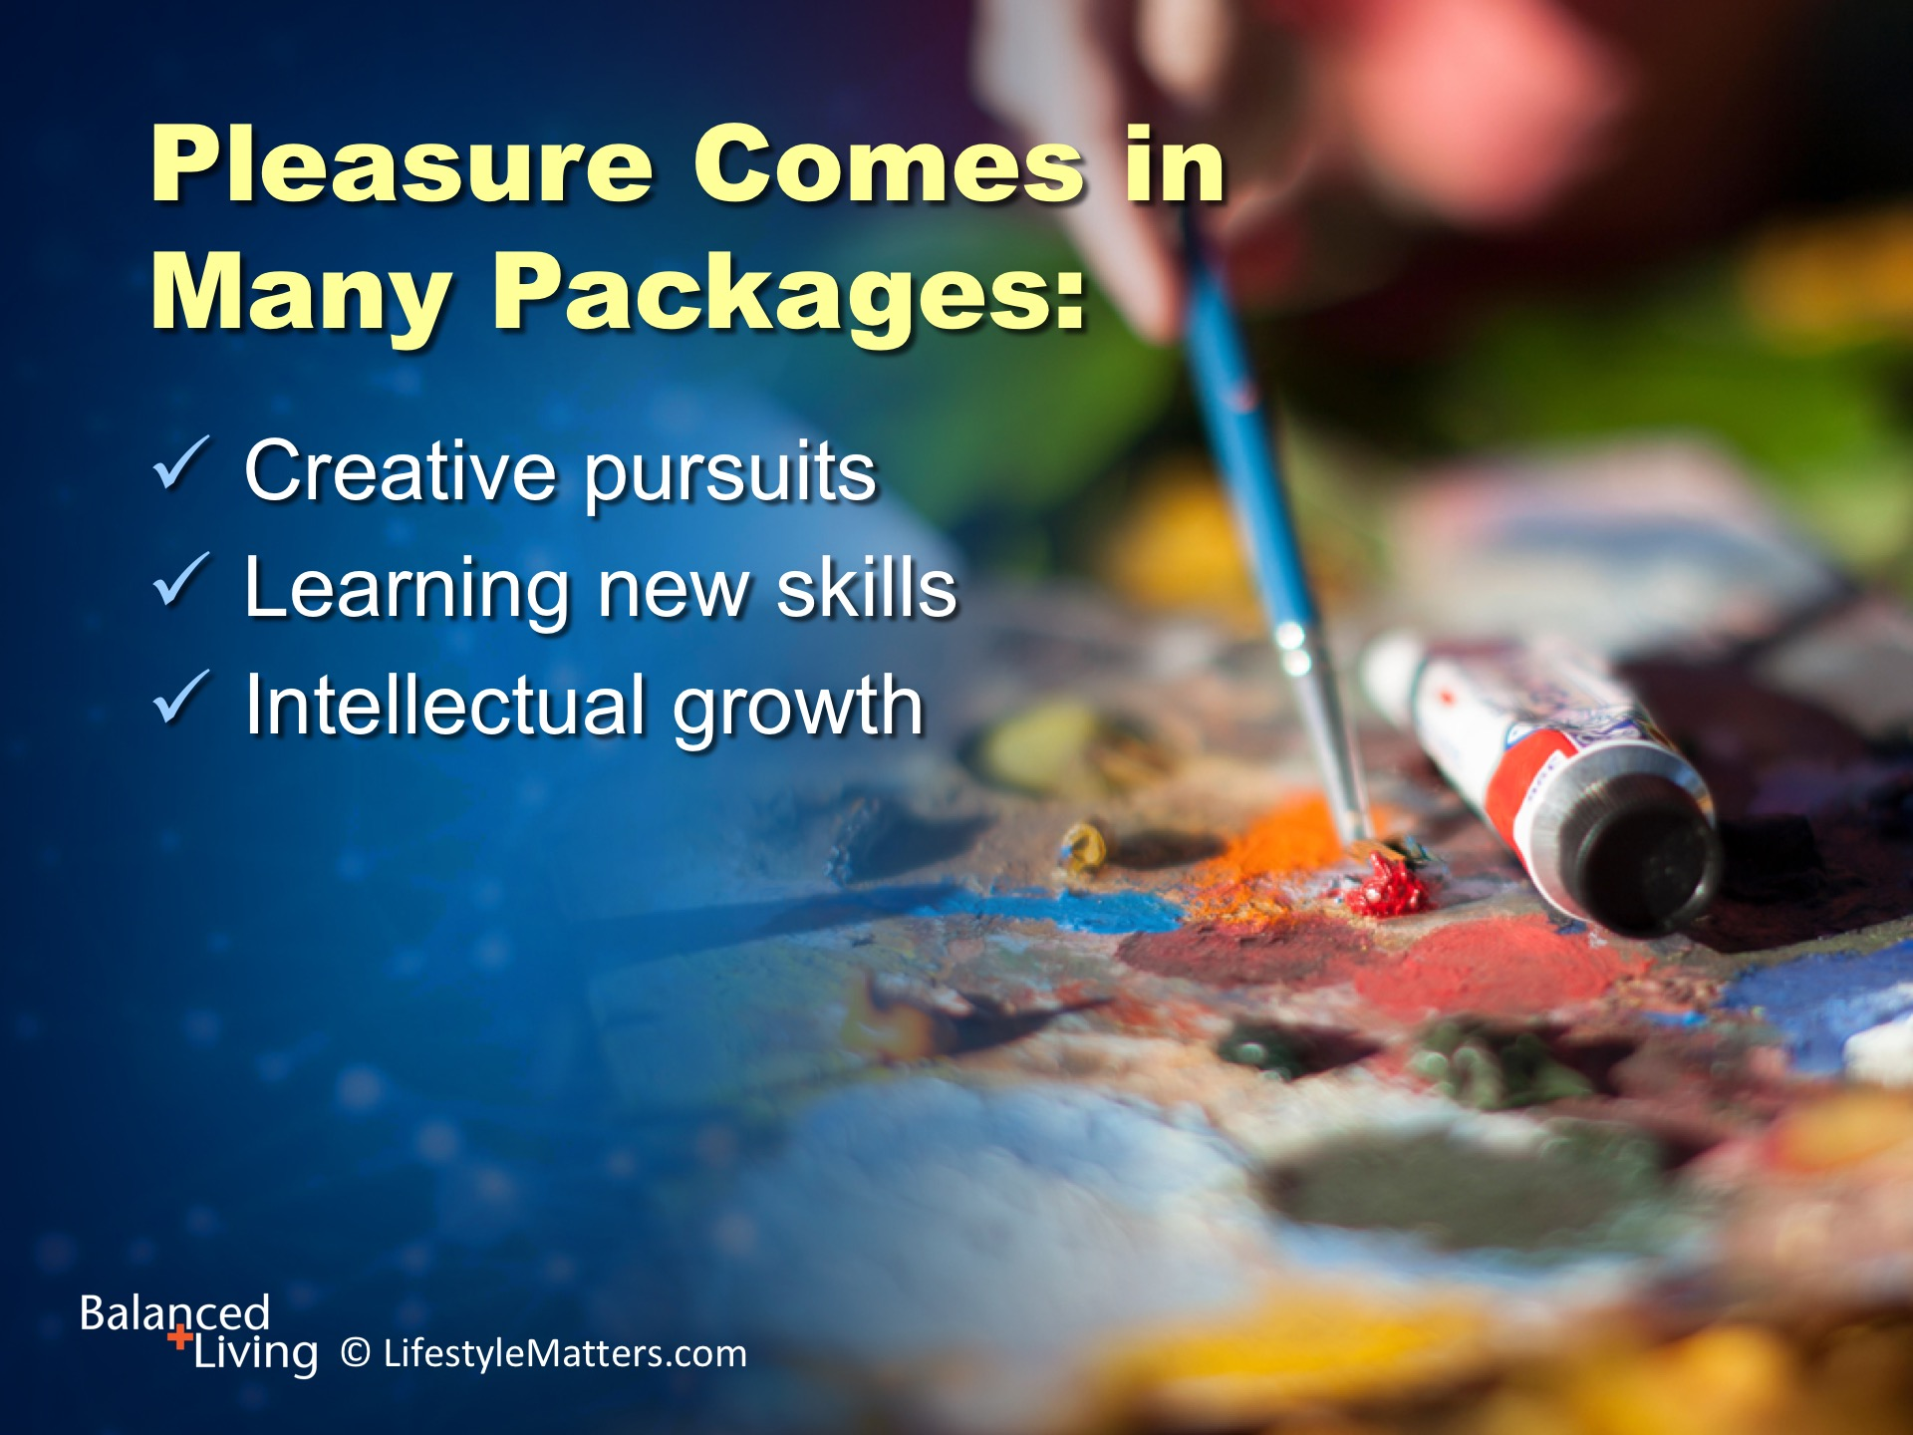
Notes:
God created you to have pleasure in life. Read slide.
What are some great ways to increase:
Creative pursuits (Wait for response)
New skills? (Wait for response)
Intellectual growth? (Wait for response)

Slide 33
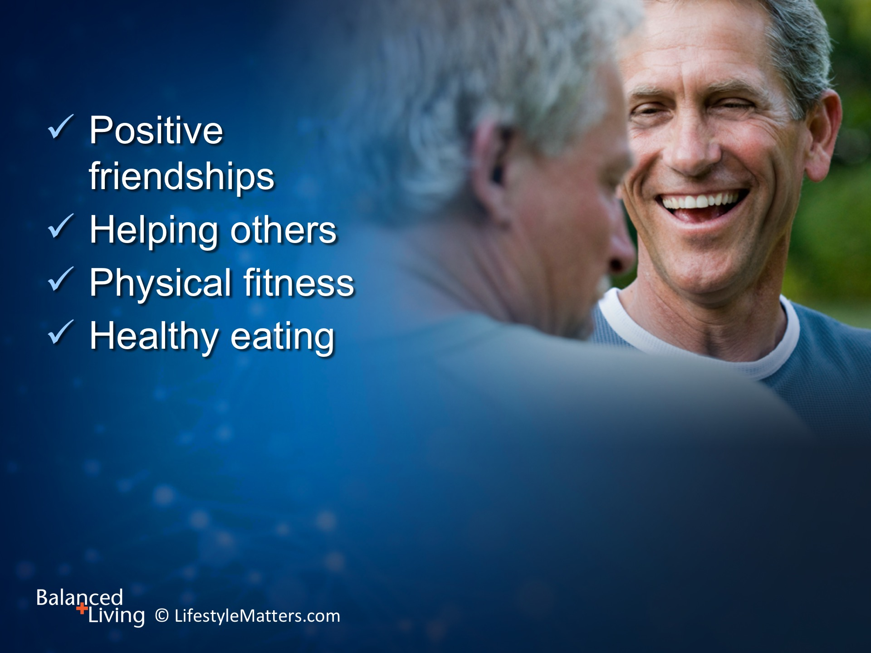
Notes:
Pleasure also comes by way of: Read slide.
Face-to-face interaction increases social and coping skills.
Healthy lifestyle choices improve brain health, including mood, attention, and focus.

Slide 34
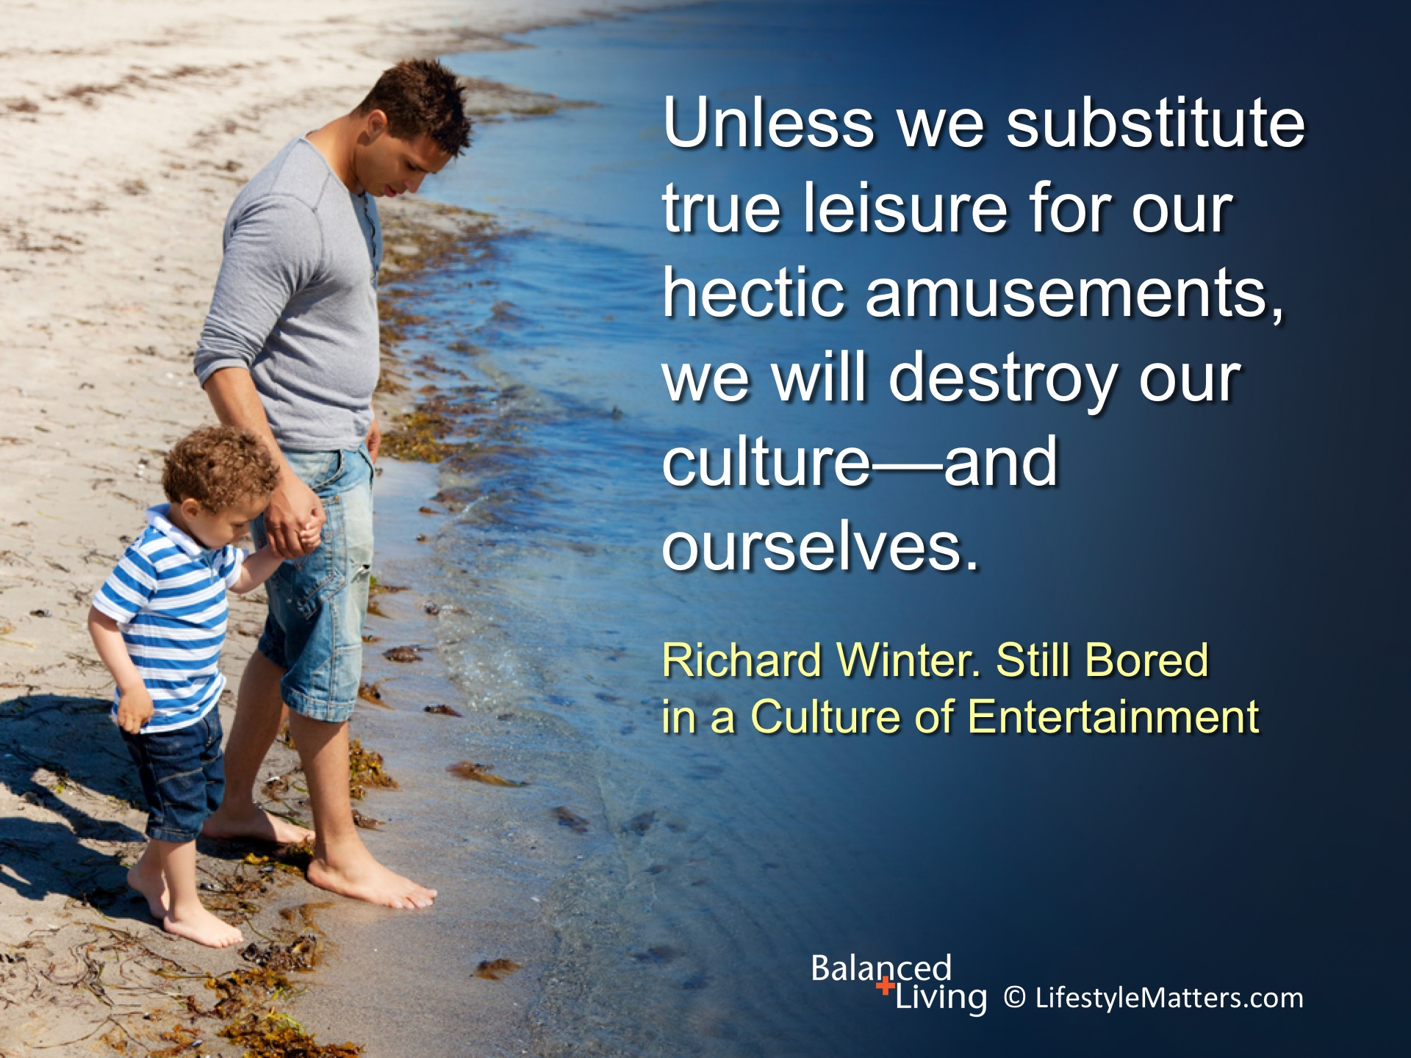
Notes:
Read slide.
How can you improve the quality of leisure time in your life? (Wait for response)

Slide 35
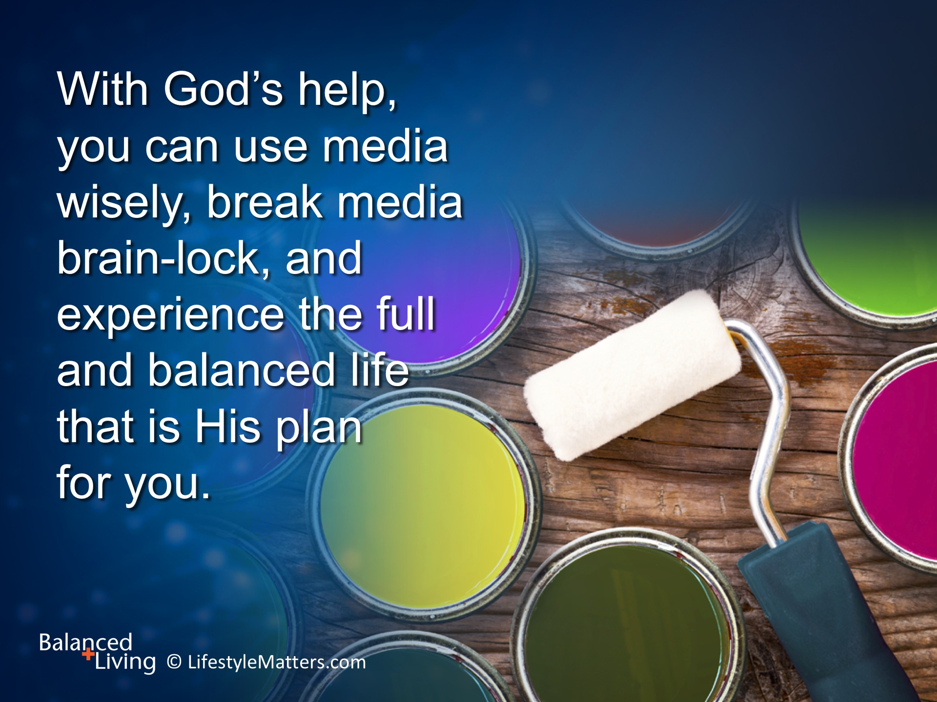
Notes:
Read slide.
Will you make a decision for a more full and balanced life?
What is your first step in balancing media with other priorities?

Slide 36
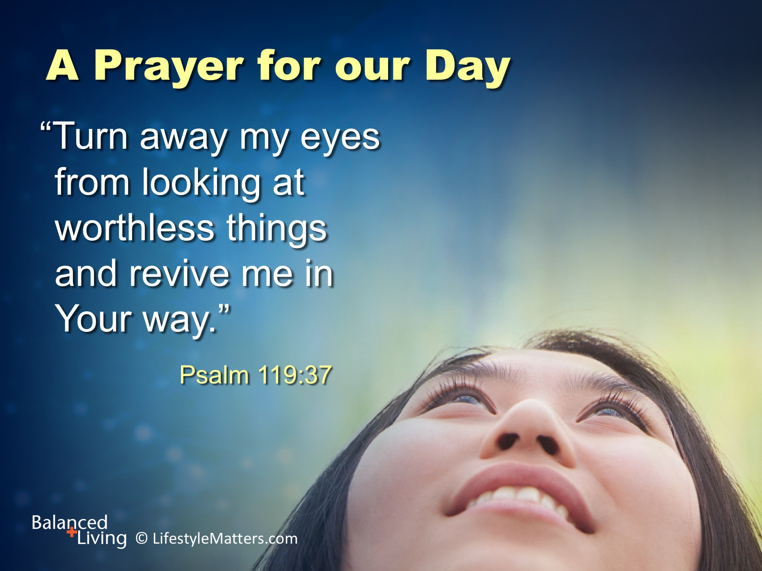
Notes:
Read slide.
The Word of God is the path that changes our focus. We begin to love what God loves and hate what God hates.
We move from time with worthless things to time that gives life and joy.
Our thoughts and emotions are changed.
We receive power to make positive choices that guard against moral, physical, and spiritual pollution.
Will you decide now to unplug from what is robbing you and plug into the life-changing power of God?
If this is your prayer, please raise your hand in agreement as I pray. (Raise hand and wait for responses)
“Please God, revive my heart, my understanding, my determination to love what you love and hate what you hate.”

